Slide 1

0301 Trick
Peter H. Chen

Slide 2
0201 Function
https://www.ucsc-extension.edu/certificate-program/offering/python-programmers
Topics:
Module: sys
Important Trick: __name__ and ‘__main__’
Valid identifier

Slide 3
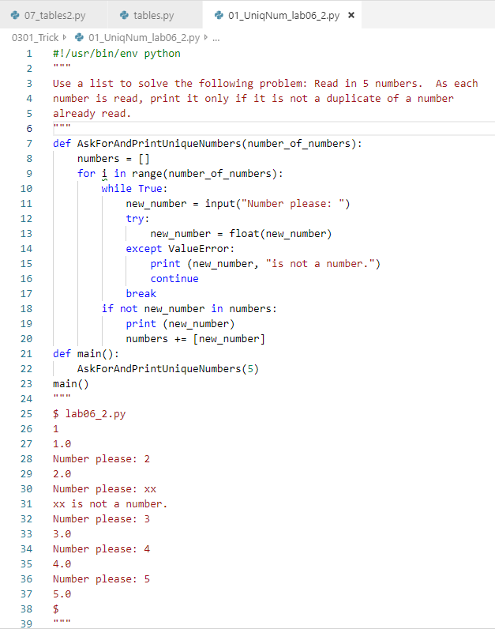
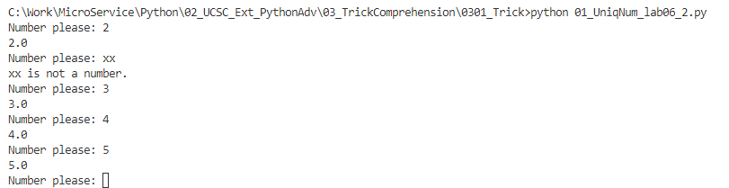
0201 Function
https://www.ucsc-extension.edu/certificate-program/offering/python-programmers
Unique Number:

Slide 4
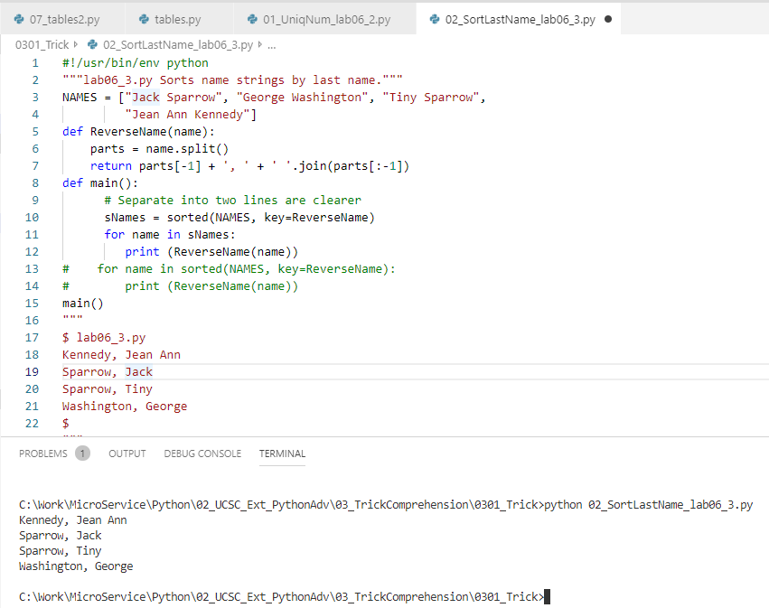
0201 Function
https://www.ucsc-extension.edu/certificate-program/offering/python-programmers
Sort Last Name:

Slide 5
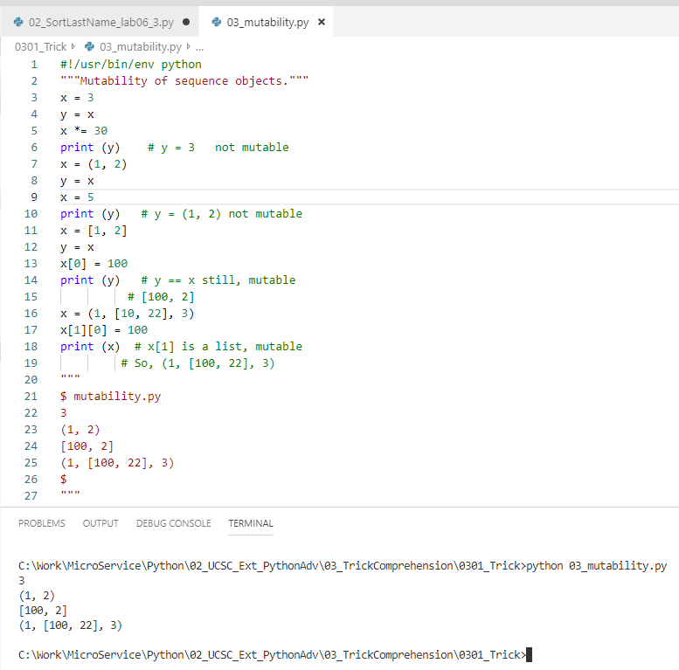
0201 Function
https://www.ucsc-extension.edu/certificate-program/offering/python-programmers
Mutability:

Slide 6
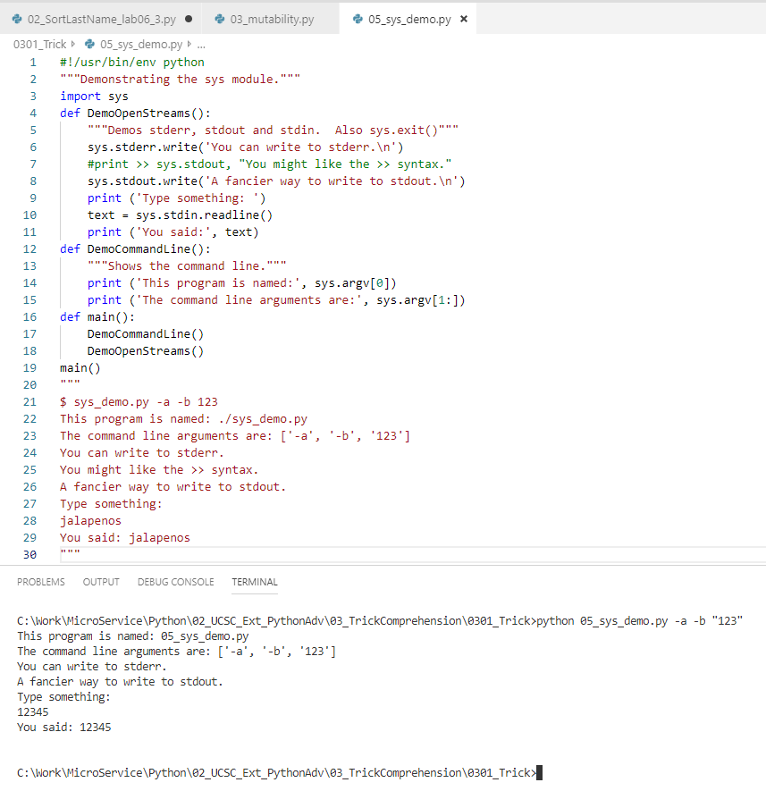
0201 Function
https://www.ucsc-extension.edu/certificate-program/offering/python-programmers
sys demo:

Slide 7
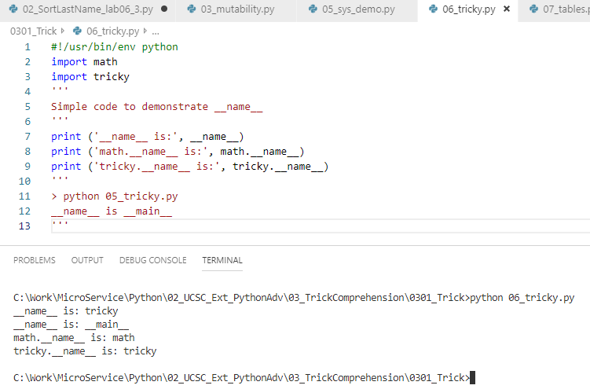
0201 Function
https://www.ucsc-extension.edu/certificate-program/offering/python-programmers
tricky:

Slide 8
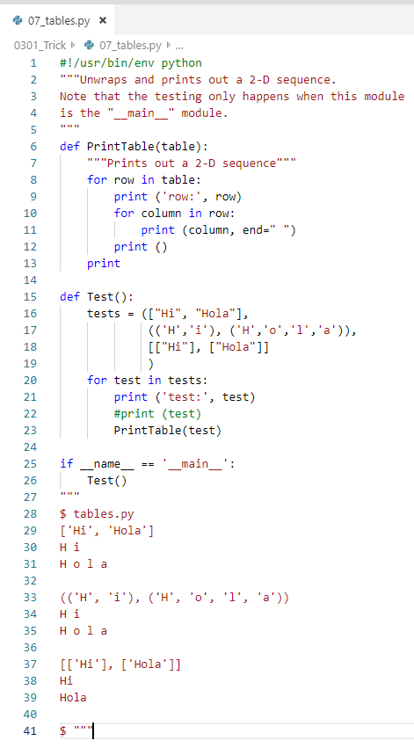
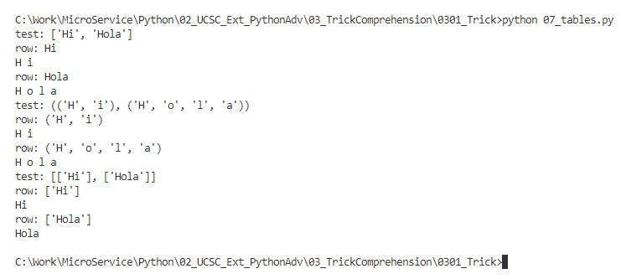
0201 Function
https://www.ucsc-extension.edu/certificate-program/offering/python-programmers
tables:

Slide 9
0201 Function
https://www.ucsc-extension.edu/certificate-program/offering/python-programmers
tables2:

Slide 10
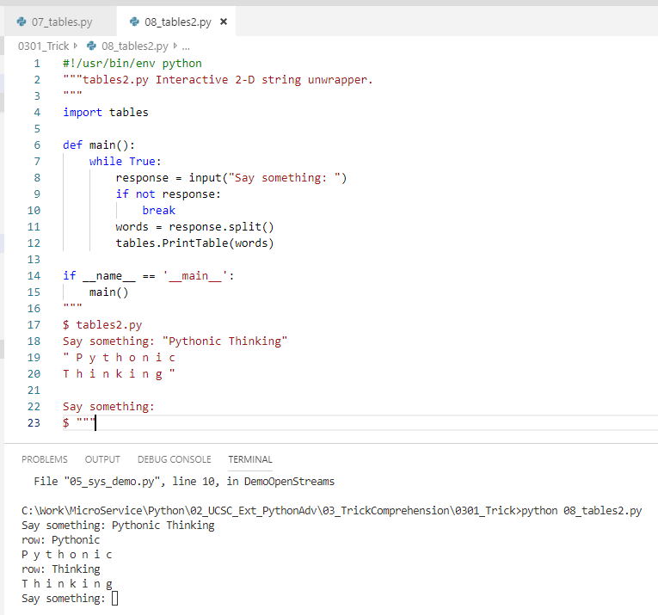
0201 Function
https://www.ucsc-extension.edu/certificate-program/offering/python-programmers
tables2:

Slide 11
End of Chapter

