Slide 1

0302 Comprehension
Peter H. Chen

Slide 2
0302 Comprehension
https://www.ucsc-extension.edu/certificate-program/offering/python-programmers
Topics:
Scope Issues
List Comprehension

Slide 3
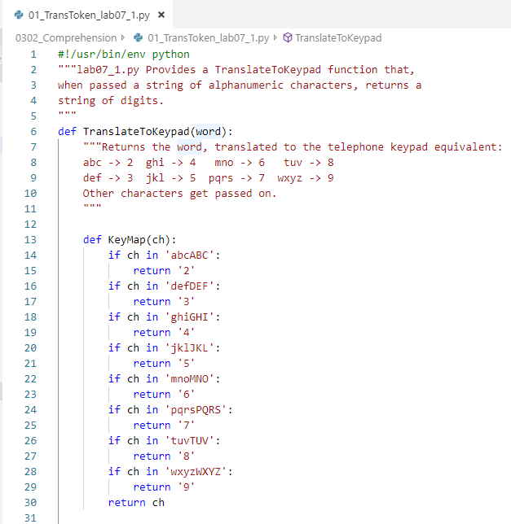
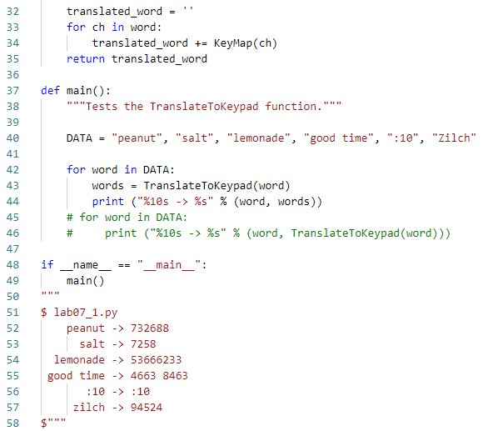
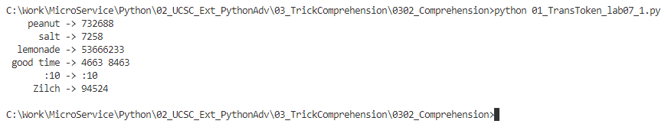
0302 Comprehension
https://www.ucsc-extension.edu/certificate-program/offering/python-programmers
Translate alphabetic into numeric key pad:

Slide 4
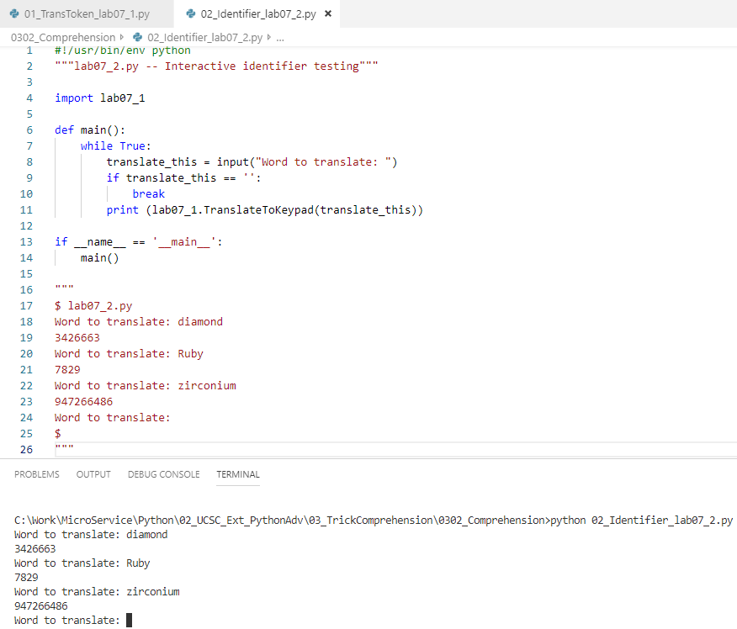
0302 Comprehension
https://www.ucsc-extension.edu/certificate-program/offering/python-programmers
Import lab07_1.py and translate the alphebetic key pad into numeric number.

Slide 5
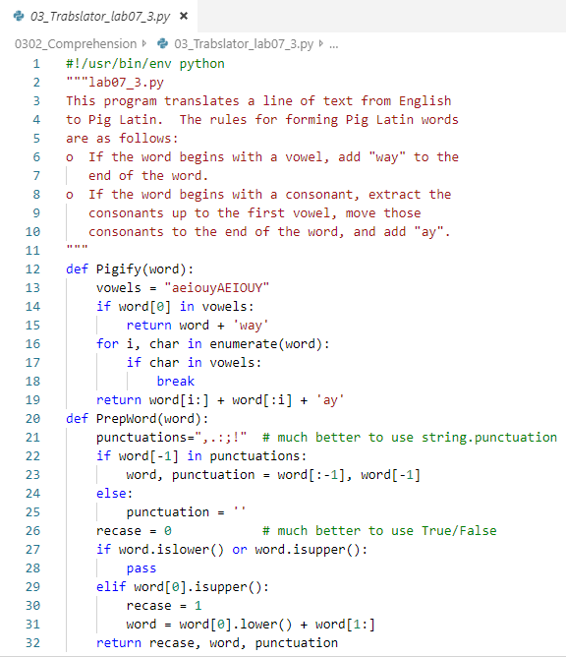
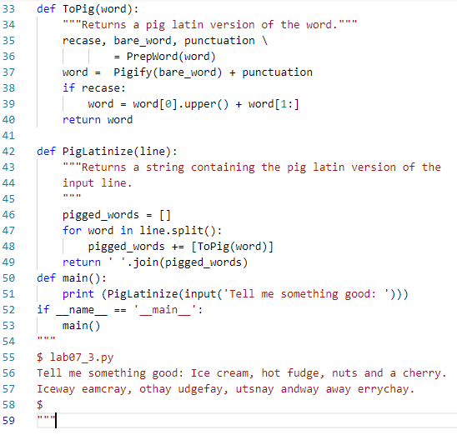

0302 Comprehension
https://www.ucsc-extension.edu/certificate-program/offering/python-programmers
Vowels and consonants swap patterns.

Slide 6
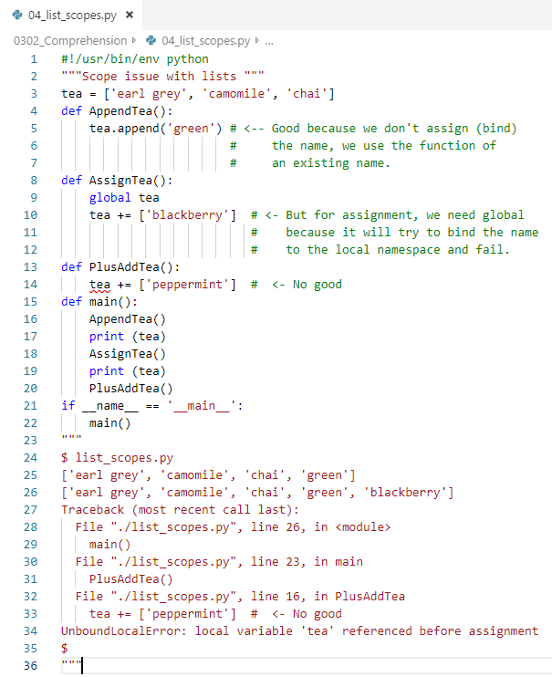
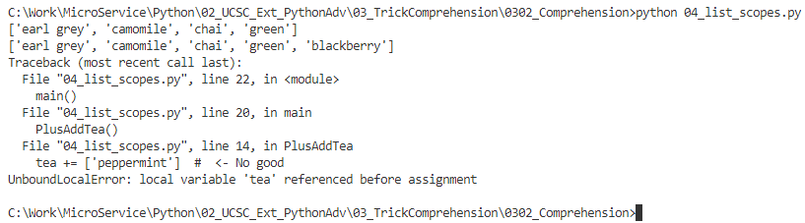
0302 Comprehension
https://www.ucsc-extension.edu/certificate-program/offering/python-programmers
Function append in local and operator += in global.

Slide 7
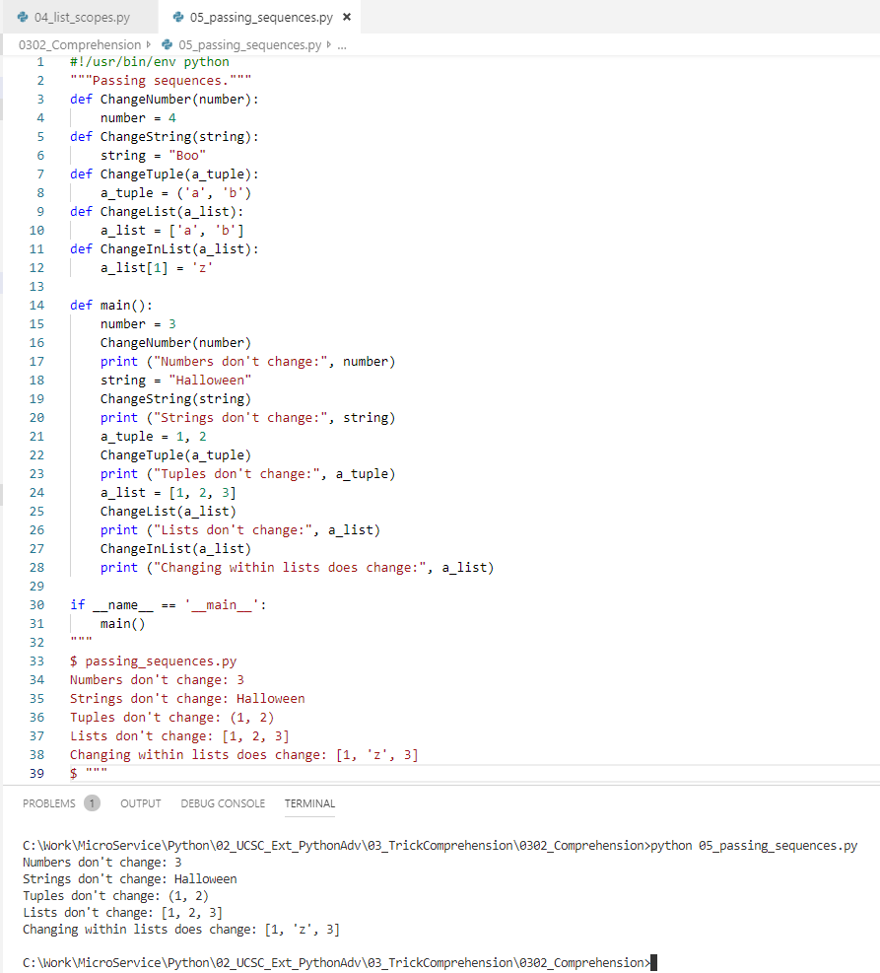
0302 Comprehension
https://www.ucsc-extension.edu/certificate-program/offering/python-programmers
Changing inside the list does change the element.

Slide 8
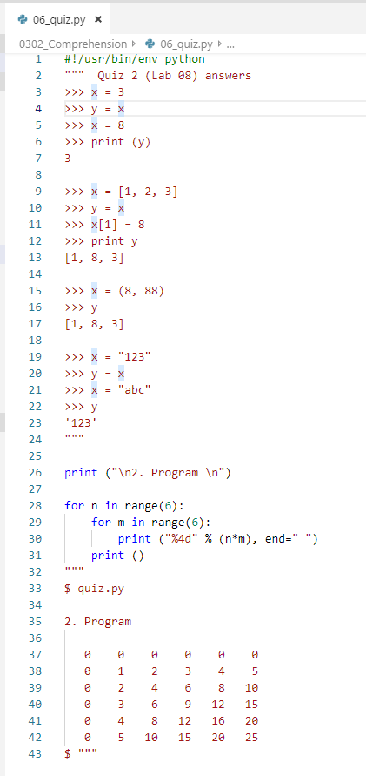
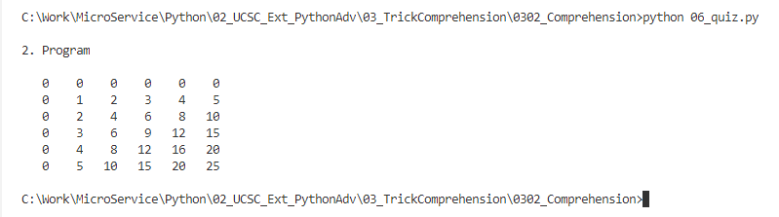
0302 Comprehension
https://www.ucsc-extension.edu/certificate-program/offering/python-programmers
Quiz 8 answer:

Slide 9
End of Chapter

