Slide 1

03 Quiz
Peter H. Chen

Slide 2
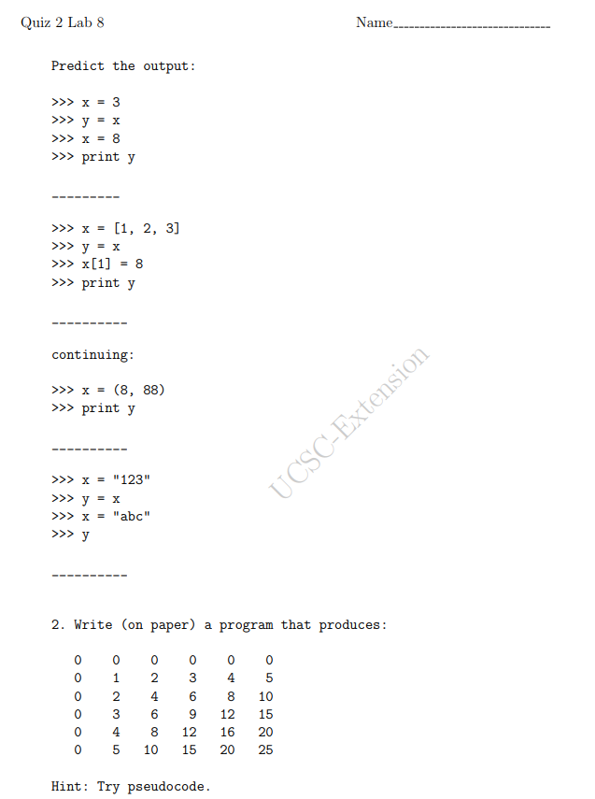
03 Quiz
https://www.ucsc-extension.edu/certificate-program/offering/python-programmers
Preview Quiz:

Slide 3
End of Chapter

