Slide 1

03 Quiz
Peter H. Chen

Slide 2
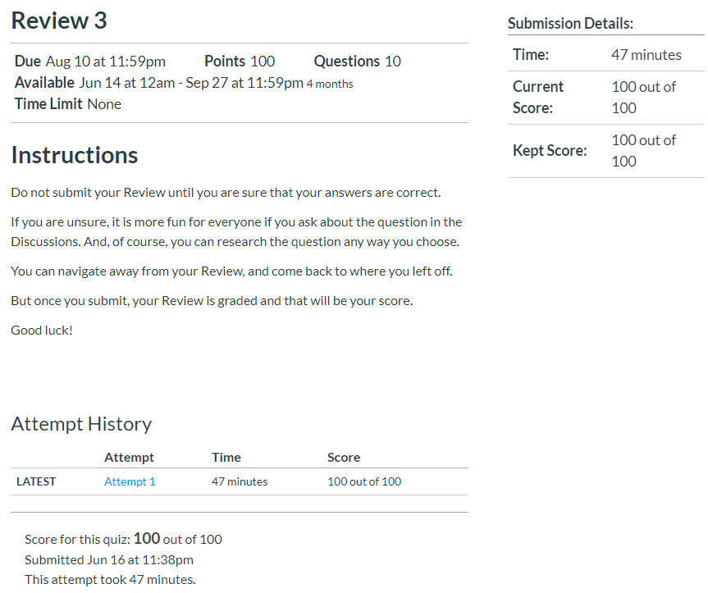
03 Quiz
https://www.ucsc-extension.edu/certificate-program/offering/python-programmers
Quiz:

Slide 3
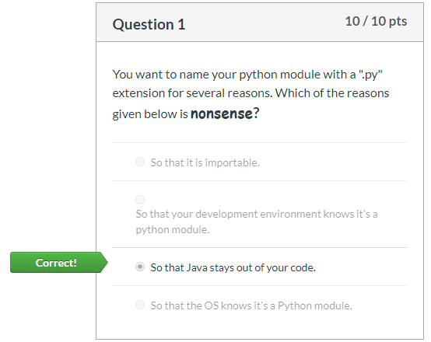
03 Quiz
https://www.ucsc-extension.edu/certificate-program/offering/python-programmers
Quiz:

Slide 4
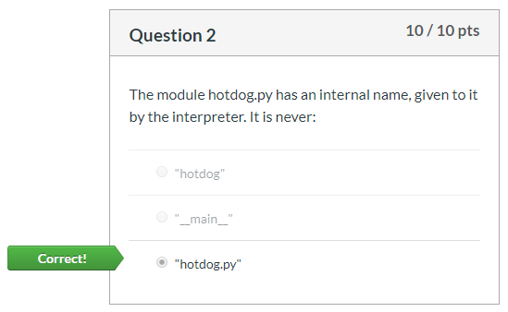
03 Quiz
https://www.ucsc-extension.edu/certificate-program/offering/python-programmers
Quiz:

Slide 5
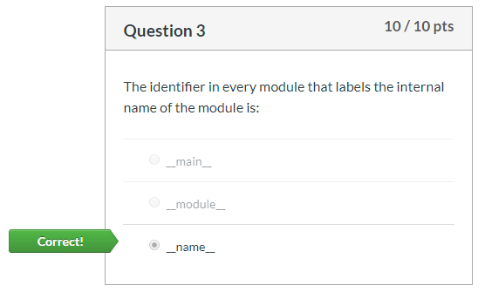
03 Quiz
https://www.ucsc-extension.edu/certificate-program/offering/python-programmers
Quiz:

Slide 6
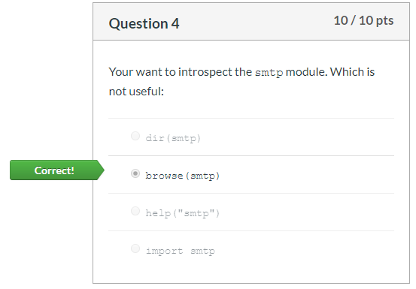
03 Quiz
https://www.ucsc-extension.edu/certificate-program/offering/python-programmers
Quiz:

Slide 7
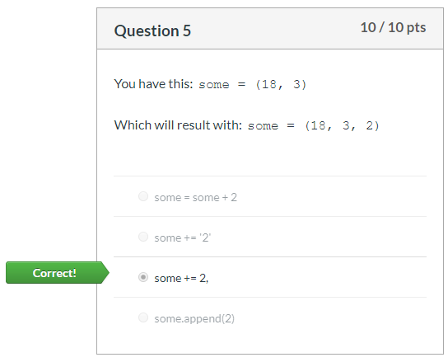
03 Quiz
https://www.ucsc-extension.edu/certificate-program/offering/python-programmers
Quiz:

Slide 8
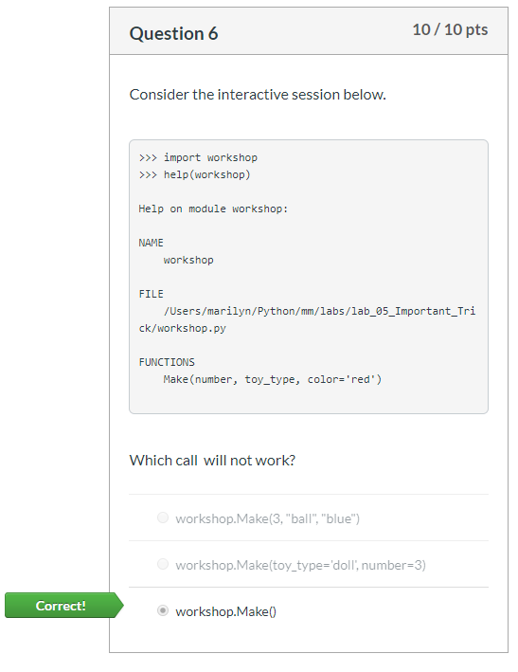
03 Quiz
https://www.ucsc-extension.edu/certificate-program/offering/python-programmers
Quiz:

Slide 9
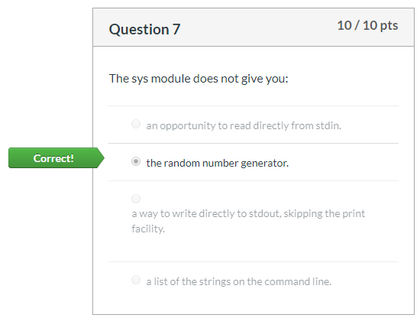
03 Quiz
https://www.ucsc-extension.edu/certificate-program/offering/python-programmers
Quiz:

Slide 10
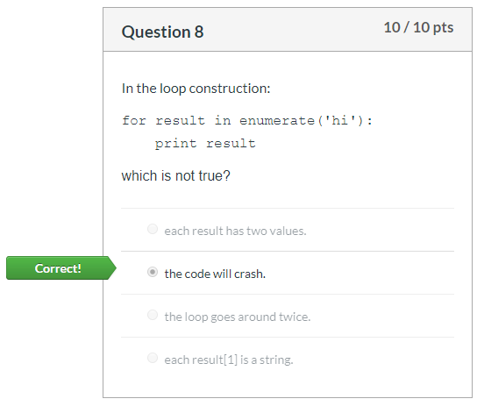
03 Quiz
https://www.ucsc-extension.edu/certificate-program/offering/python-programmers
Quiz:

Slide 11
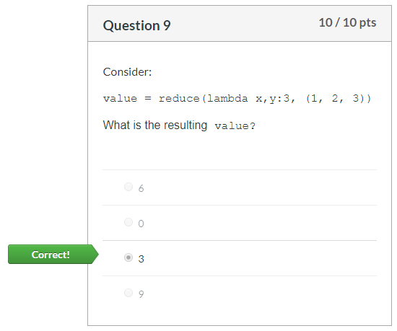
03 Quiz
https://www.ucsc-extension.edu/certificate-program/offering/python-programmers
Quiz:

Slide 12
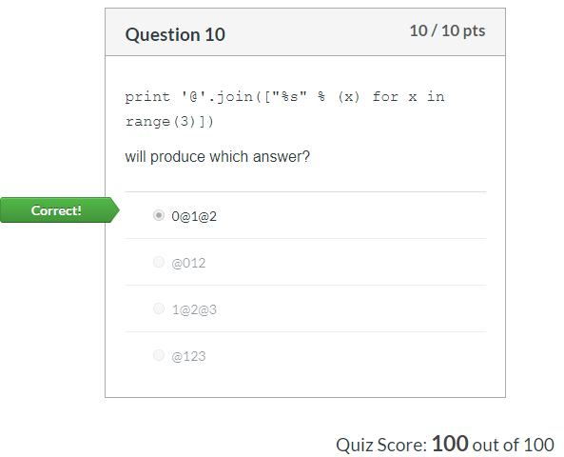
03 Quiz
https://www.ucsc-extension.edu/certificate-program/offering/python-programmers
Quiz:

Slide 13
End of Chapter

