Slide 1

0501 Package
Peter H. Chen

Slide 2
0501 Package
https://www.ucsc-extension.edu/certificate-program/offering/python-programmers
Topics:
Modules: shutil, tempfile
Python Packages

Slide 3
0501.1 Quiz

Slide 4
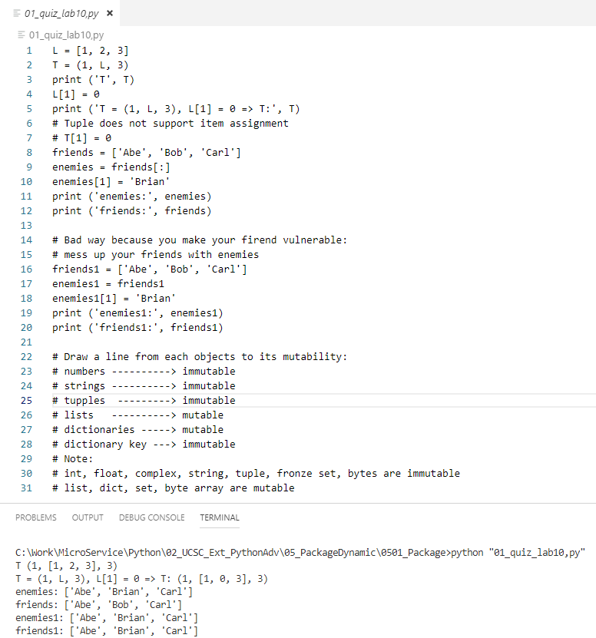
0501.1 Quiz
https://www.ucsc-extension.edu/certificate-program/offering/python-programmers
Lab 10 Quiz.py:
Immutable and mutable

Slide 5
0501.2 Swap Dog and Cat

Slide 6
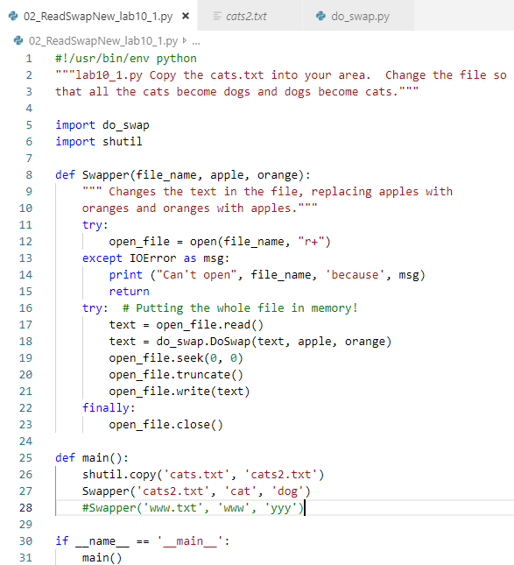
0501.2 Swap Dog and Cat
https://www.ucsc-extension.edu/certificate-program/offering/python-programmers
Read and Swap pattern:
Import shutil:

Slide 7
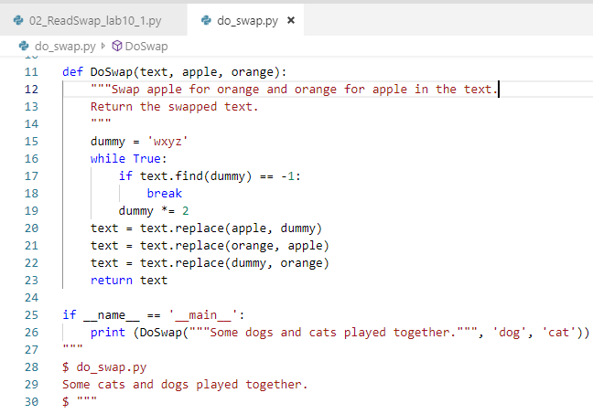
0501.2 Swap Dog and Cat
https://www.ucsc-extension.edu/certificate-program/offering/python-programmers
Module do_swap.py

Slide 8
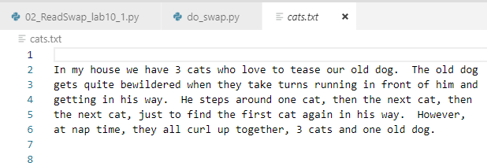
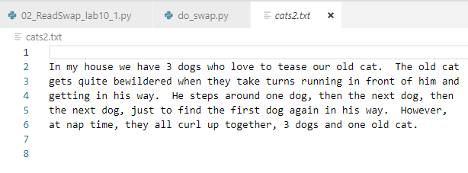
0501.2 Swap Dog and Cat
https://www.ucsc-extension.edu/certificate-program/offering/python-programmers
Original text file: cats.txt
Swap the the dog into cat and swap cat into dog: cats2.txt

Slide 9
0501.3 Use tempfile

Slide 10
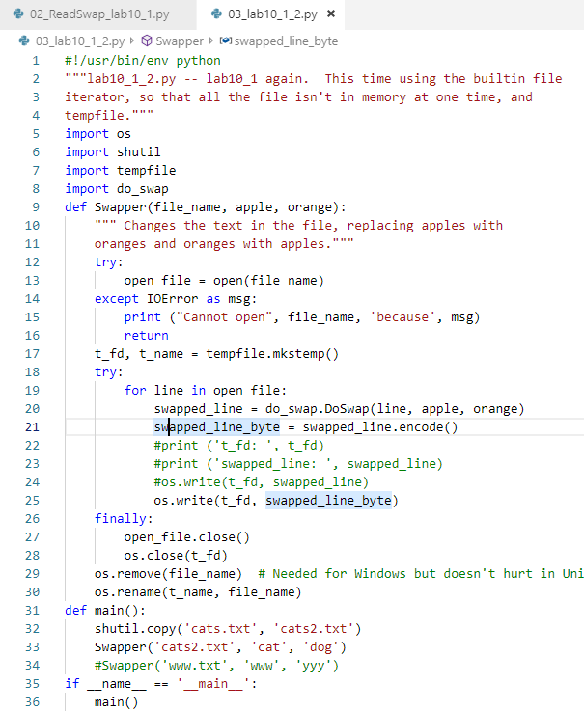
0501.3 Use tempfile
https://www.ucsc-extension.edu/certificate-program/offering/python-programmers
Use Tempfile to Read and Swap dog and cat: Use built-in file iterator.

Slide 11
0501.4 Use os.walk

Slide 12
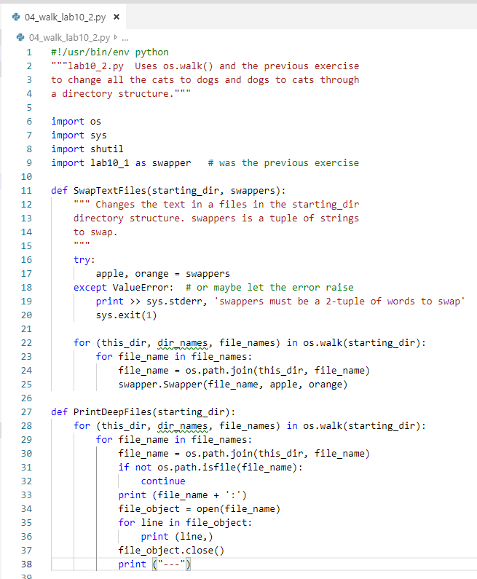
0501.4 Use os.walk
https://www.ucsc-extension.edu/certificate-program/offering/python-programmers
Use os.walk to change dog and cat.

Slide 13
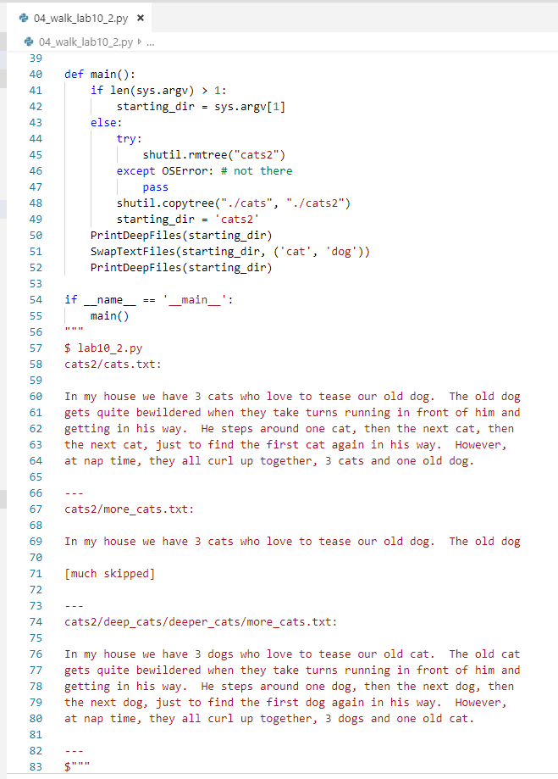
0501.4 Use os.walk
https://www.ucsc-extension.edu/certificate-program/offering/python-programmers
Use os.walk to change dog and cat.

Slide 14
0501.5 Word Count

Slide 15
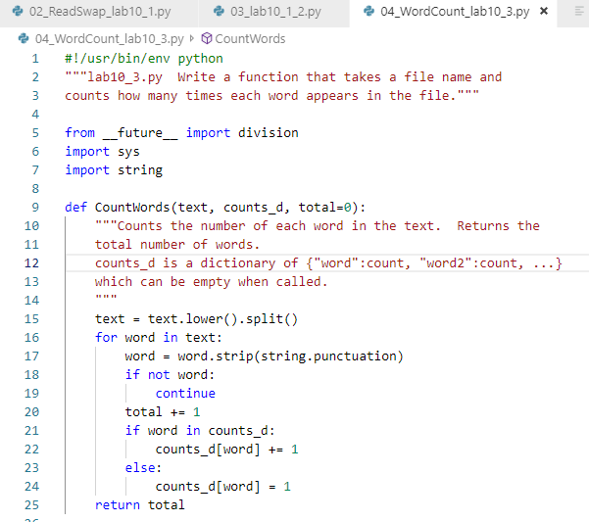
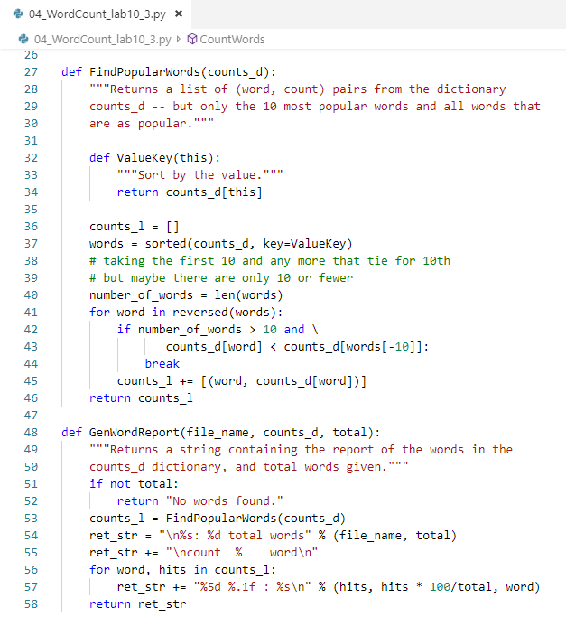
0501.5 Word Count
https://www.ucsc-extension.edu/certificate-program/offering/python-programmers
Word Count:

Slide 16
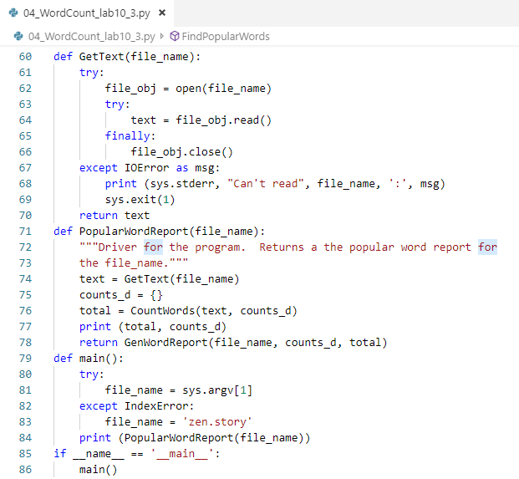
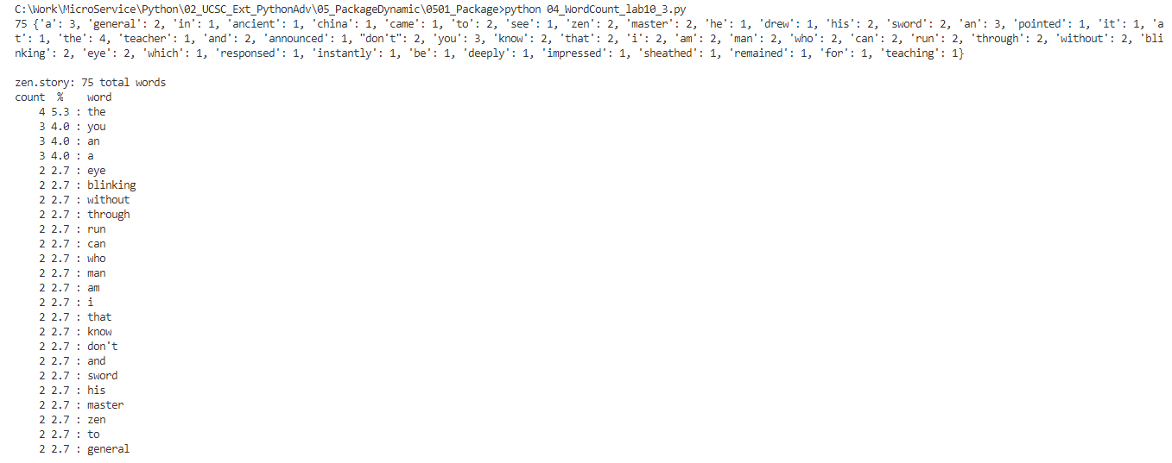
0501.5 Word Count
https://www.ucsc-extension.edu/certificate-program/offering/python-programmers
Word Count:

Slide 17
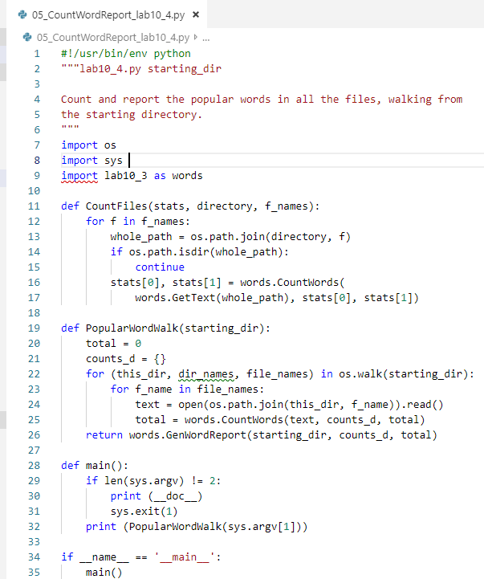
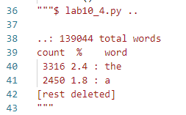
0501.5 Word Count
https://www.ucsc-extension.edu/certificate-program/offering/python-programmers
Word Count and Report:

Slide 18
End of Chapter

