Slide 1

0601 Function Fancies
Peter H. Chen

Slide 2
0601 Function Fancies
https://www.ucsc-extension.edu/certificate-program/offering/python-programmers
Topics:
Function protocols: variable length argument lists
Formatted printing using a dictionary for replacement
Unpacking sequences and dictionaries
Generators (Optional)
Decorators (Optional)

Slide 3
0601.1 Lab12_1.py
Peter H. Chen

Slide 4
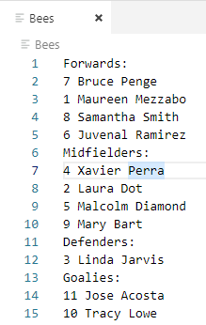
0601.1 Lab12_1.py
https://www.ucsc-extension.edu/certificate-program/offering/python-programmers
Lab12_1.py input data file: Bees

Slide 5
0601.1 Lab12_1.py
https://www.ucsc-extension.edu/certificate-program/offering/python-programmers
Lab12_1.py input data file: Bees
Soccer_teams.py
def:
ProcessTeam(), PrintTeam()
main()
NotifyForwards(), NotifyDefenders(), NotifyMidfielders(), NotifyGoales()
Inheritance
Lab12_1.py
def:
ProcessTeam(), PrintTeam()
main()
NotifyForwards(), NotifyDefenders(), NotifyMidfielders(), NotifyGoales()

Slide 6
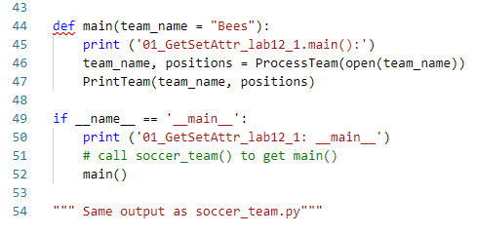
0601.1 Lab12_1.py
https://www.ucsc-extension.edu/certificate-program/offering/python-programmers
Lab12_1.py => main():
Lab12_1.py => main()
Call ProcessTeam(): Process File Information.
Call PrintTeam(): Print Team Information.

Slide 7
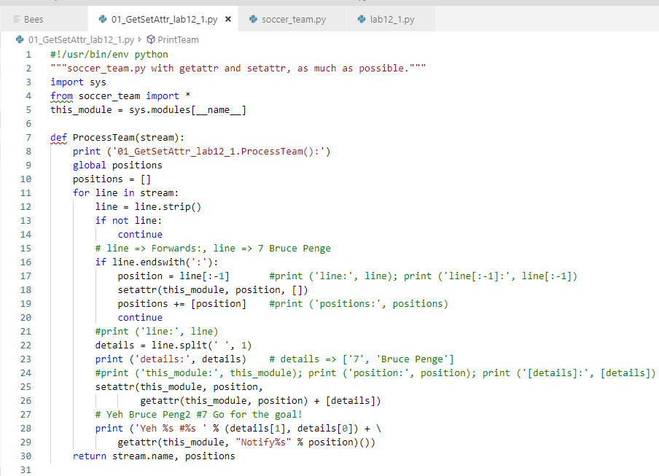
0601.1 Lab12_1.py
https://www.ucsc-extension.edu/certificate-program/offering/python-programmers
Lab12_1.py => ProcessTeam():
Lab12_1.py => ProcessTeam():
Parse the input file “Bees” information.
Setup data by “setattr()”: Store information (position and list details) inside this module (__main__).
The inherited functions from soccer_team.py (NotifyForwards(), and etc.) get called in the getattr().

Slide 8
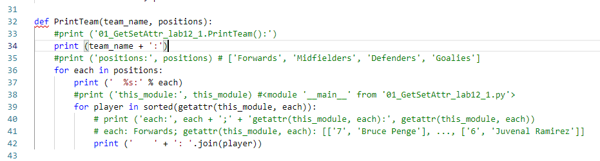
0601.1 Lab12_1.py
https://www.ucsc-extension.edu/certificate-program/offering/python-programmers
Lab12_1.py => PrintTeam()
The getattr() is used to get the data from this_module (__main__) with each list (e.g., Forwards list).
Use for to loop to print for each list (e.g., Forward list)

Slide 9
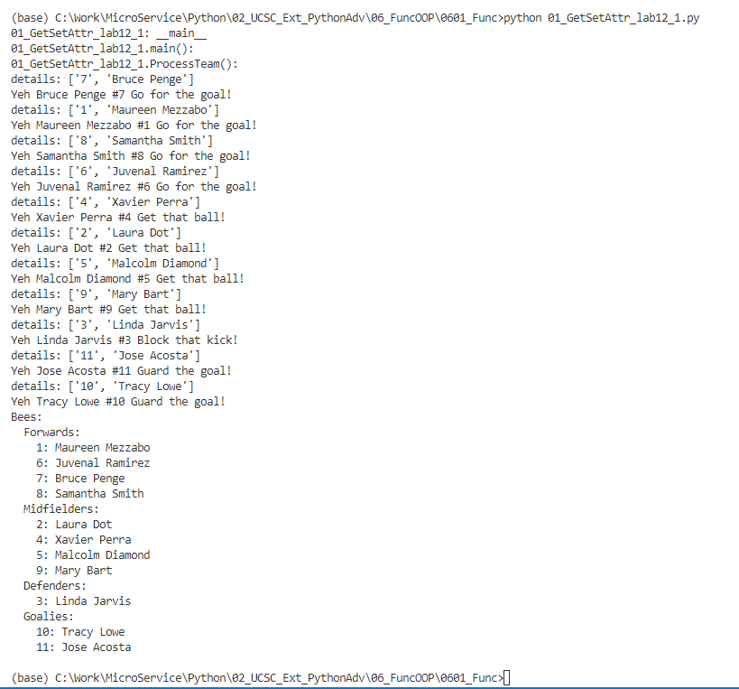
0601.1 Lab12_1.py
https://www.ucsc-extension.edu/certificate-program/offering/python-programmers
Lab12_1.py => ProcessTeam()
Lab12_1.py => PrintTeam()

Slide 10
0601.2 Lab12_2.py
Peter H. Chen

Slide 11
0601.2 Lab12_2.py
https://www.ucsc-extension.edu/certificate-program/offering/python-programmers
There are two tests in this lab12_2.py
AccuracyTest(): Count the file size in the current directory
ProfileTest(): Calculate the run time.
Each AccuracyTest() and ProfileTest() contains three ways:
Use os.listdir: This mode is 100% compatible with windows. Only the post processing are required for “dir” and “ls” format processing.
Use Popen with “ls –al”: Window use “dir” instead of “ls –ls”. The result are in separate list. It is easy to post processing.
Use subprocess: In windows, we can use check_output (“dir”, shell=True”).decode(). The result are in one line byte-by-byte.
To separate one line of byte-by-byte into line-by-line.
https://stackoverflow.com/questions/28842717/parsing-python-subprocess-check-output
for line in output.splitlines():

Slide 12
0601.2 Lab12_2.py
https://www.ucsc-extension.edu/certificate-program/offering/python-programmers
lab12_2.py:
main()
AccuracyTest()
Profile.run(ProfileTest())
AddFilesOsListdir()
AddFilesOsOpen()
AddFilesSubprocess()
TotalLsSize()
TotalShellSize()

Slide 13
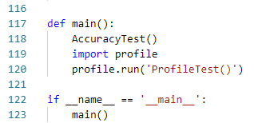
0601.2 Lab12_2.py
https://www.ucsc-extension.edu/certificate-program/offering/python-programmers
lab12_2.py: main()

Slide 14
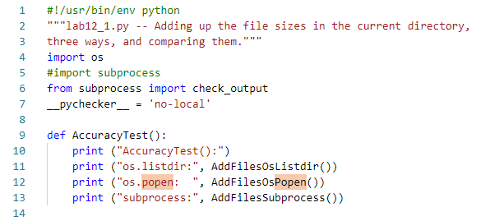
0601.2 Lab12_2.py
https://www.ucsc-extension.edu/certificate-program/offering/python-programmers
lab12_2.py: AccuracyTest ()

Slide 15
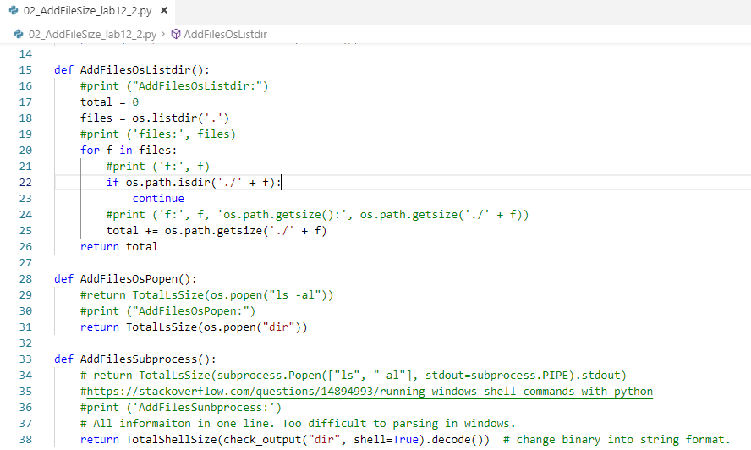
0601.2 Lab12_2.py
https://www.ucsc-extension.edu/certificate-program/offering/python-programmers
lab12_2.py: AddFilesOsListdir(), AddFilesOsPopen(), AddFilesSubprocess()

Slide 16
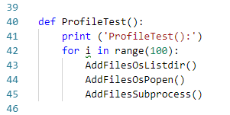
0601.2 Lab12_2.py
https://www.ucsc-extension.edu/certificate-program/offering/python-programmers
lab12_2.py: ProfileTest()

Slide 17
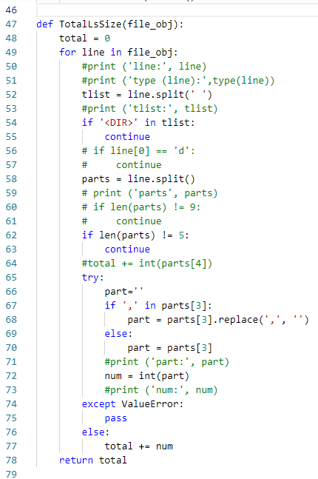
0601.2 Lab12_2.py
https://www.ucsc-extension.edu/certificate-program/offering/python-programmers
lab12_2.py: TotalLsSIze()

Slide 18
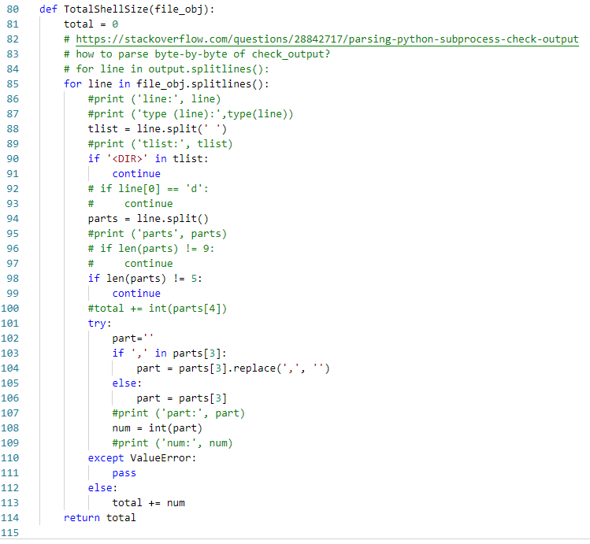
0601.2 Lab12_2.py
https://www.ucsc-extension.edu/certificate-program/offering/python-programmers
lab12_2.py: TotalShellSIze()

Slide 19
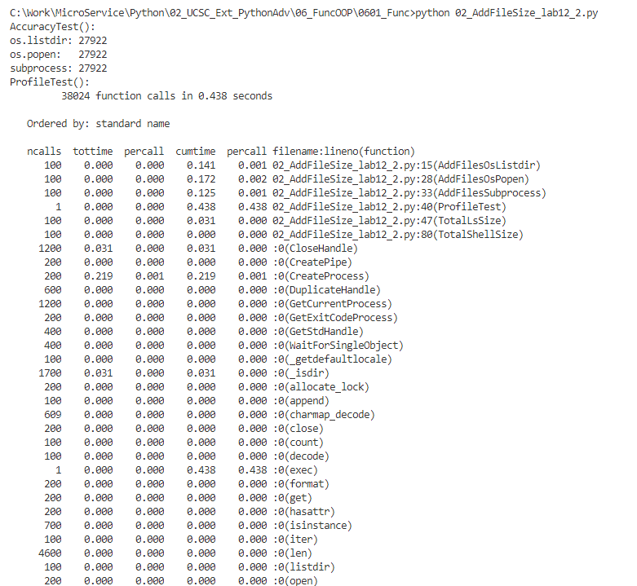
0601.2 Lab12_2.py
https://www.ucsc-extension.edu/certificate-program/offering/python-programmers
Run lab12_2.py

Slide 20
0601.3 Lab12_3.py
Peter H. Chen

Slide 21
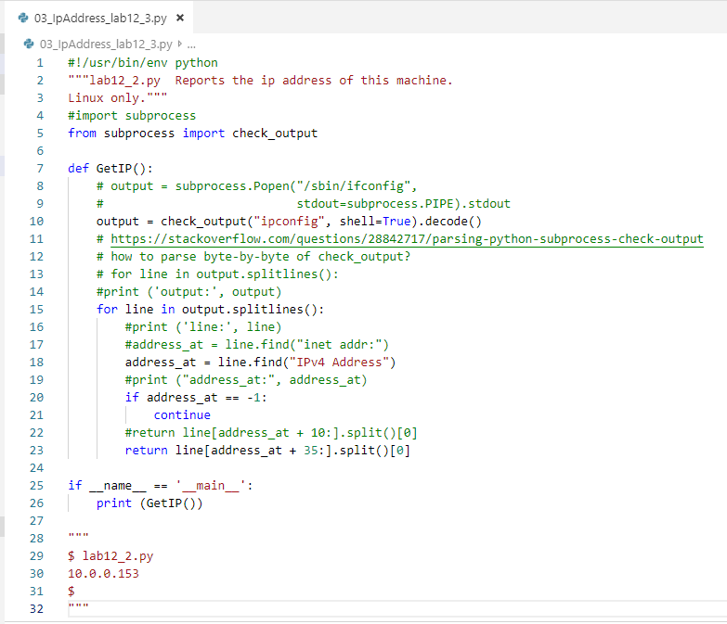

0601.3 Lab12_3.py
https://www.ucsc-extension.edu/certificate-program/offering/python-programmers
Run lab12_3.py

Slide 22
0601.4 more.py
Peter H. Chen

Slide 23
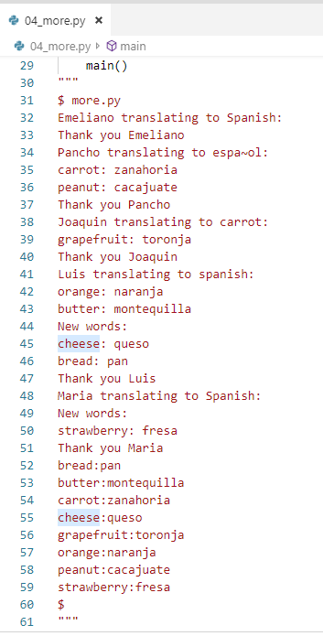
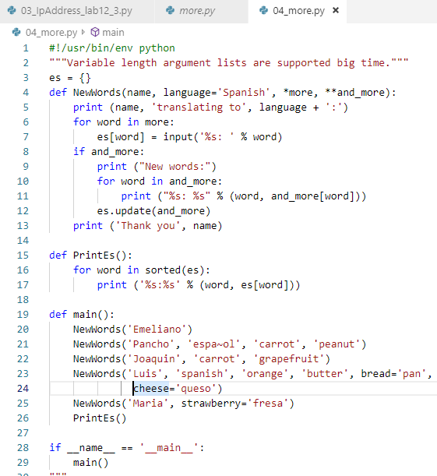
0601.4 more.py
https://www.ucsc-extension.edu/certificate-program/offering/python-programmers
more.py

Slide 24
0601.5 breakfast.py
Peter H. Chen

Slide 25
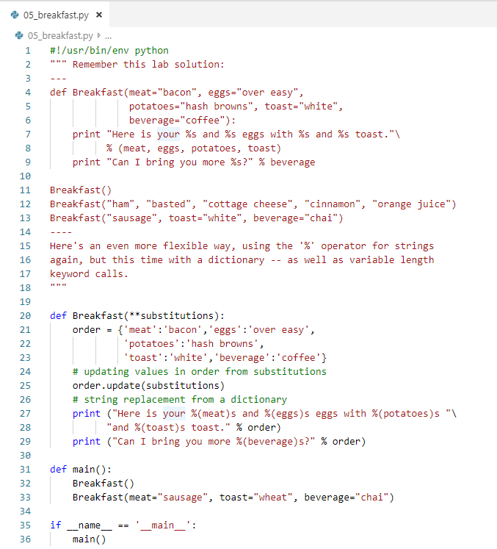
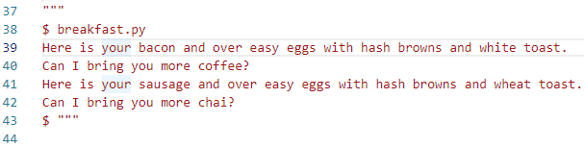
0601.5 breakfast.py
https://www.ucsc-extension.edu/certificate-program/offering/python-programmers
breakfast.py

Slide 26
0601.6 unpack.py
Peter H. Chen

Slide 27
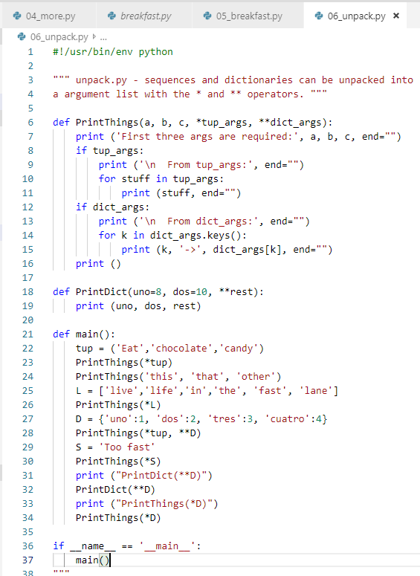
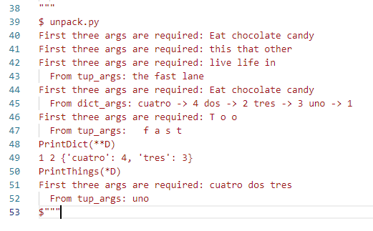
0601.6 unpack.py
https://www.ucsc-extension.edu/certificate-program/offering/python-programmers
unpack.py

Slide 28
0601.7 unique.py
Peter H. Chen

Slide 29
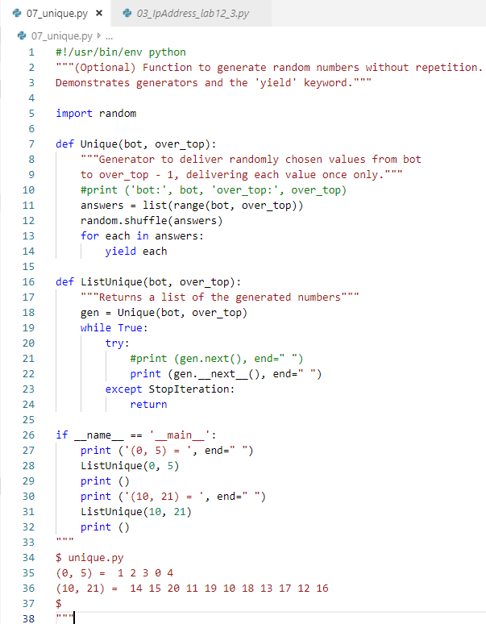
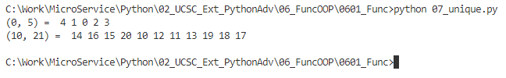
0601.7 unique.py
https://www.ucsc-extension.edu/certificate-program/offering/python-programmers
Unique.py: Random generator for unique number with repetition.
The “yield” is just like a return except the “yield” will be going back and continue to loop to the end.
When yield finished looping, it will stop at “except StopIteration” and return.
The first time, we call Unique() to generate the number and then we use __next__() to get the next number until “StopIteration”.

Slide 30
0601.8 decorator.py
Peter H. Chen

Slide 31
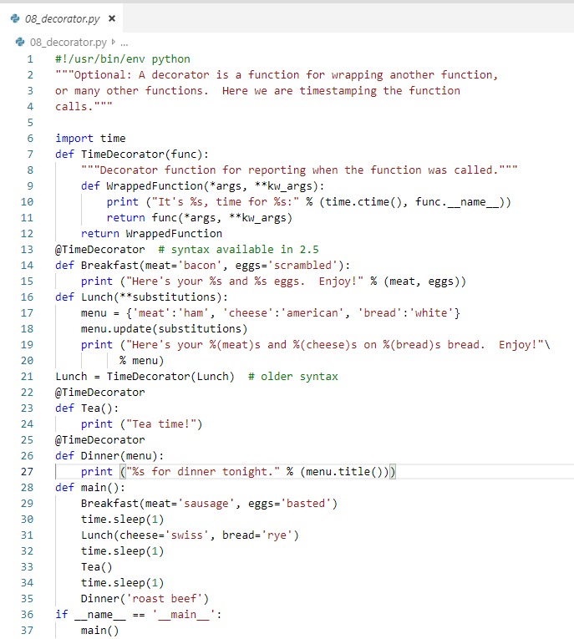
0601.8 decorator.py
https://www.ucsc-extension.edu/certificate-program/offering/python-programmers
decorator.py: The decorator is a technique. The @TimeDecorator” does not really do anything.
The TimeDecorator is a wrapper function that store and prinit additional information.
The old way we call function “TimeDecortator (Lunch)”

Slide 32
0601.9 timeout_decorator_0.py
Peter H. Chen

Slide 33
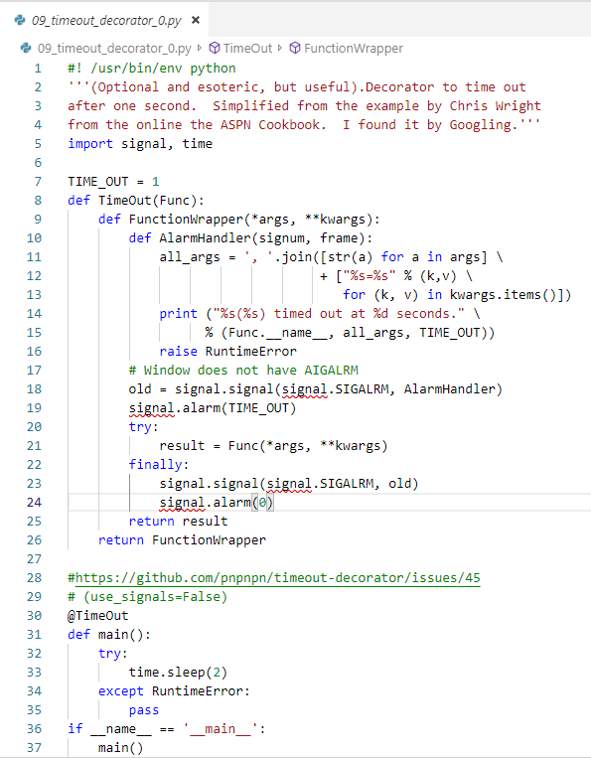
0601.9 timeout_decorator_0.py
https://www.ucsc-extension.edu/certificate-program/offering/python-programmers
Timeout_decorator_0.py: The signals (SIGALRM) is only for Linux user.
Signals does not work for windows users.

Slide 34
0601.10 timeout_decorator.py
Peter H. Chen

Slide 35
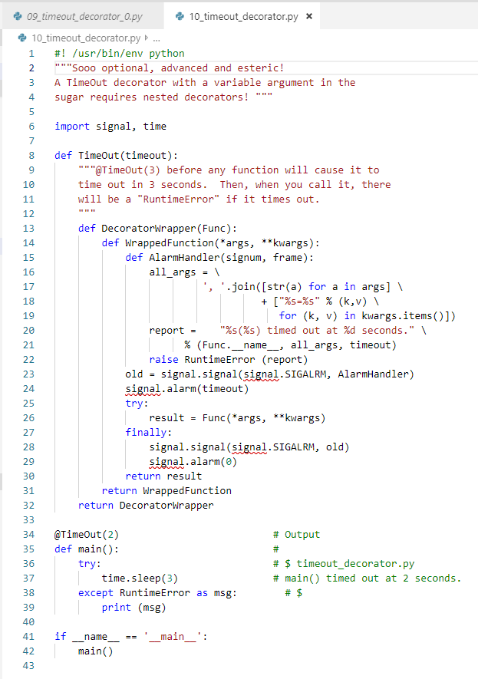
0601.10 timeout_decorator.py
https://www.ucsc-extension.edu/certificate-program/offering/python-programmers
Timeout_decorator.py:.

Slide 36
End of Chapter

