Slide 1

0602 OOP
Peter H. Chen

Slide 2
0602 OOP
https://www.ucsc-extension.edu/certificate-program/offering/python-programmers
Topics:
Module: Shelve
Classes
Inheritance
Class Variable

Slide 3
0602.1 lab13_1.py

Slide 4
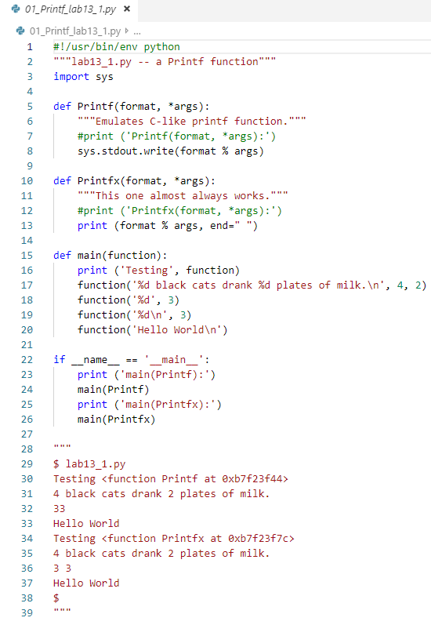
0602.1 lab13_1.py
https://www.ucsc-extension.edu/certificate-program/offering/python-programmers
Lab13_1.py: Python’s C style printf function.
The first argument is the format.
The second format is a tuple passed from calling function.
C style printf
Python style has extra space.

Slide 5
0602.2 lab13_2.py

Slide 6
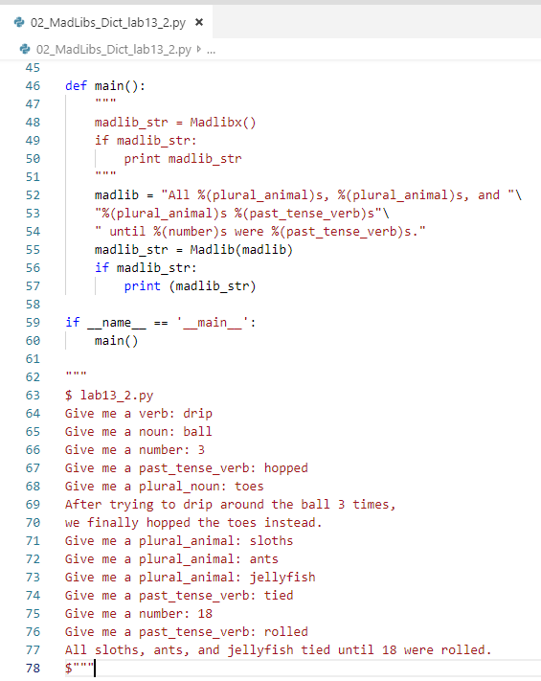
0602.2 lab13_2.py
https://www.ucsc-extension.edu/certificate-program/offering/python-programmers
Lab13_2.py: Mad Libs is a phrasal template word game where one player prompts others for a list of words to substitute for blanks in a story, before reading the – often comical or nonsensical – story aloud.
The game is frequently played as a party game or as a pastime.
The game was invented in the United States, and more than 110 million copies of Mad Libs books have been sold since the series was first published in 1958.

Slide 7
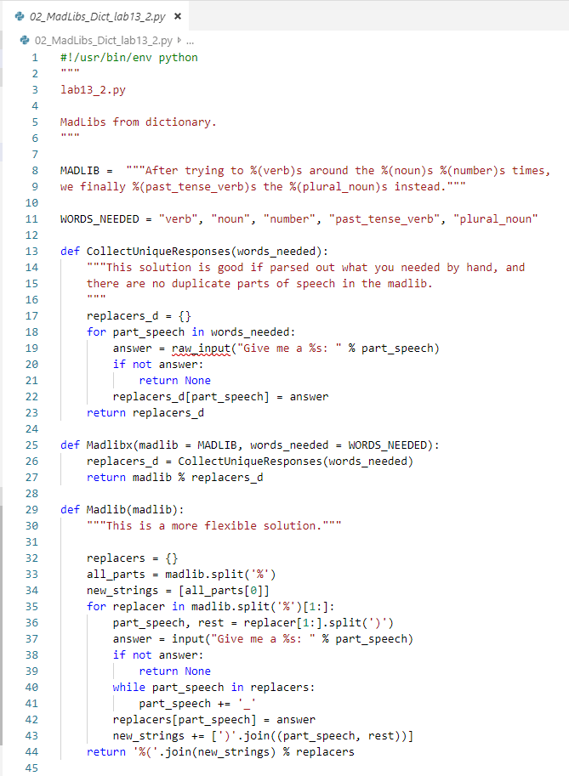
0602.2 lab13_2.py
https://www.ucsc-extension.edu/certificate-program/offering/python-programmers
Lab13_2.py: Use the format to replace the dictionary output.

Slide 8
0602.3 lab13_3.py

Slide 9
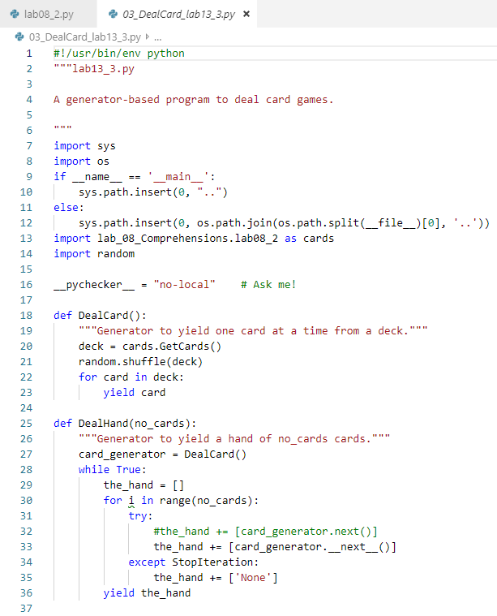
0602.3 lab13_3.py
https://www.ucsc-extension.edu/certificate-program/offering/python-programmers
Lab13_3.py: Use generator to Deal Card Game.
GetCards() function is from import lab08_2.py

Slide 10
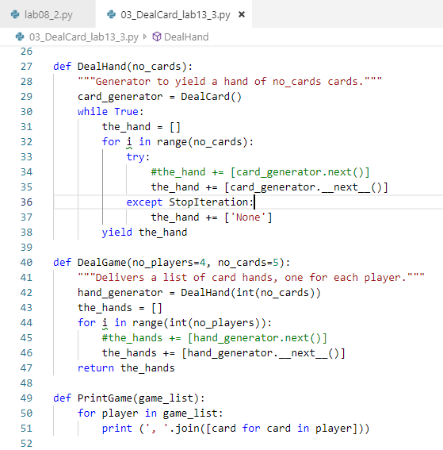
0602.3 lab13_3.py
https://www.ucsc-extension.edu/certificate-program/offering/python-programmers
Lab13_3.py:
DealHand: We have empty hand and get Card Generator around and around to get the card into the hand.
DealGame: Each game contains several player hands.

Slide 11
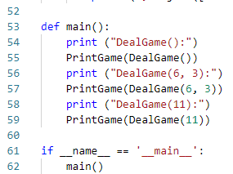
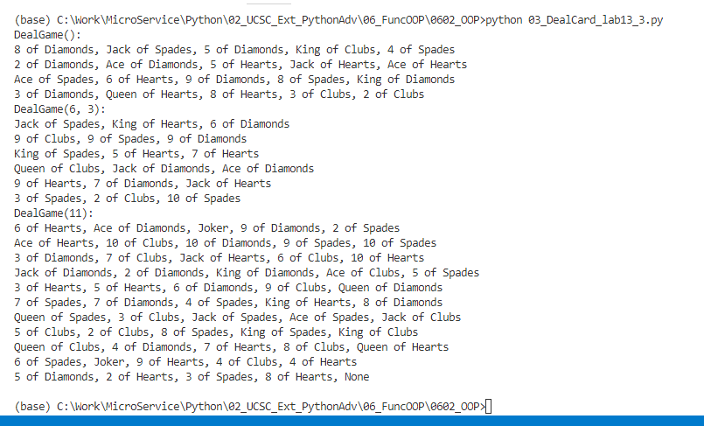
0602.3 lab13_3.py
https://www.ucsc-extension.edu/certificate-program/offering/python-programmers
Lab13_3.py:
DealGame(): No of Players = 4, No of cards = 5.
DealGame(6, 3): 6 Players, 3 cards.
DealFame (11): 11 players, cards = 5

Slide 12
0602.4 lab13_4.py

Slide 13
0602.4 lab13_4.py
https://www.ucsc-extension.edu/certificate-program/offering/python-programmers
Lab13_4.py:
def LogIt ():
print (…)
@LogIt
def Lott():
print (…)
def LogIt ():
print (…)
def Lott():
print(…)
Lott =LogIt(Lott)

Slide 14
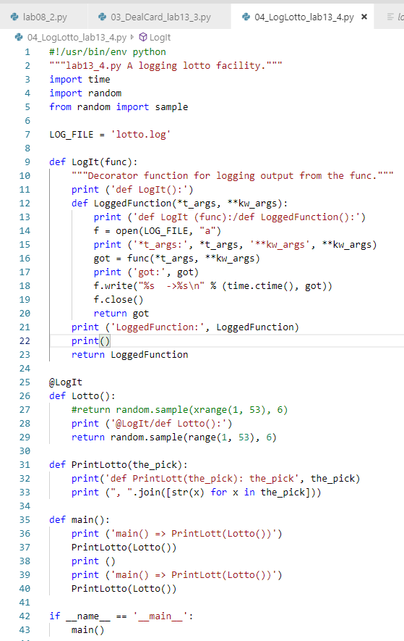
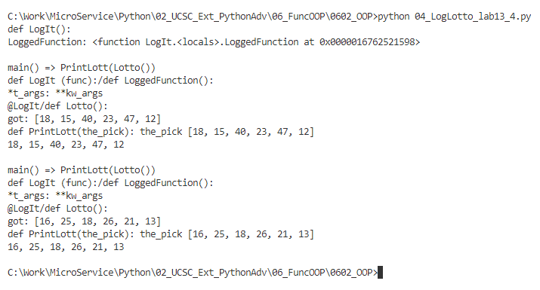
0602.4 lab13_4.py
https://www.ucsc-extension.edu/certificate-program/offering/python-programmers
Lab13_4.py:

Slide 15
0602.5 shelve_dictionary.py

Slide 16
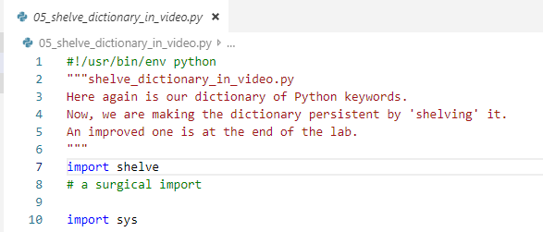
0602.5 shelve_dictionary.py
https://www.ucsc-extension.edu/certificate-program/offering/python-programmers
Shelve_dictionary.py:

Slide 17
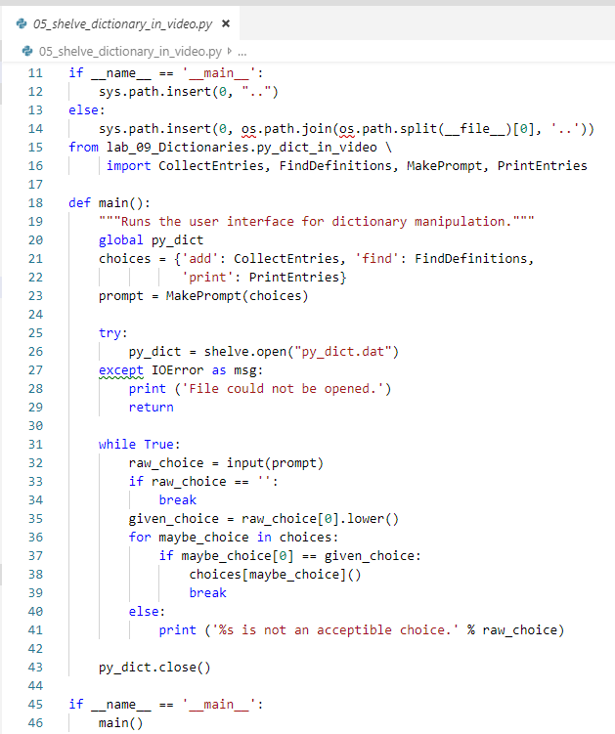
0602.5 shelve_dictionary.py
https://www.ucsc-extension.edu/certificate-program/offering/python-programmers
Shelve_dictionary.py:

Slide 18
0602.6 greeting1-7.py

Slide 19
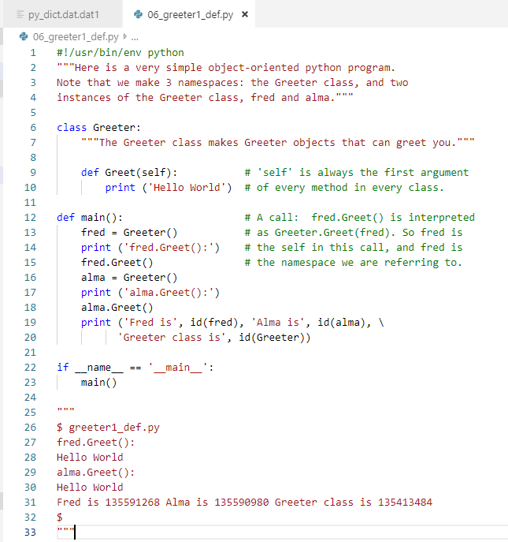
0602.6 greeting1.py
https://www.ucsc-extension.edu/certificate-program/offering/python-programmers
greeting1.py:
Greeter is the namespace
x.Greet is the object

Slide 20
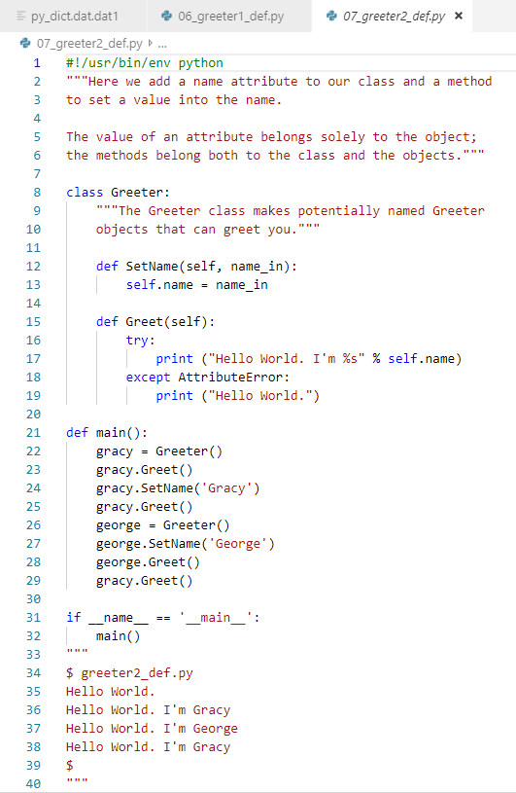
0602.6 greeting2.py
https://www.ucsc-extension.edu/certificate-program/offering/python-programmers
greeting2.py:

Slide 21
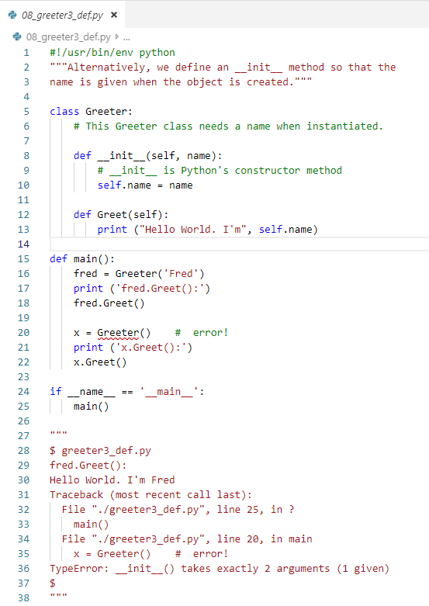
0602.6 greeting3.py
https://www.ucsc-extension.edu/certificate-program/offering/python-programmers
greeting3.py:
Error in Greeter(). Argument not match.

Slide 22
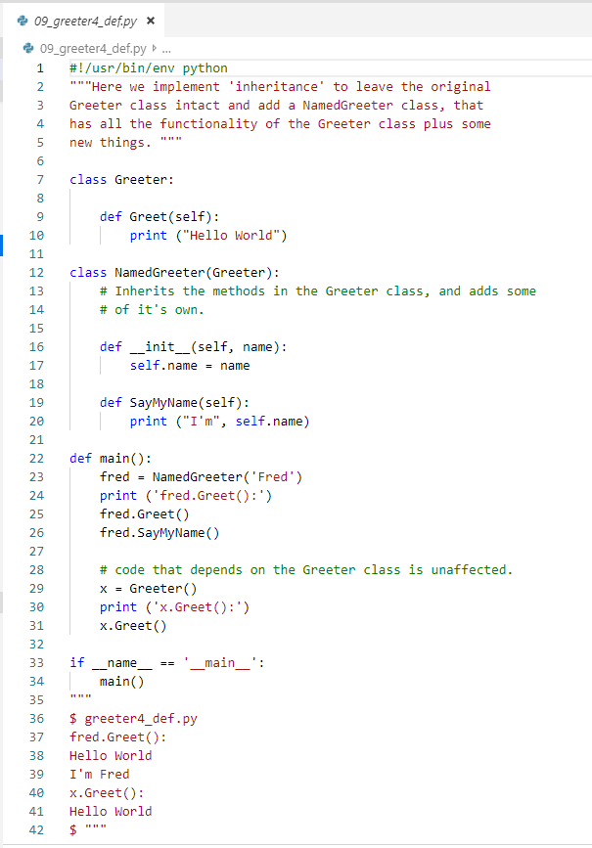
0602.6 greeting4.py
https://www.ucsc-extension.edu/certificate-program/offering/python-programmers
greeting4.py:
Inherit the class.

Slide 23
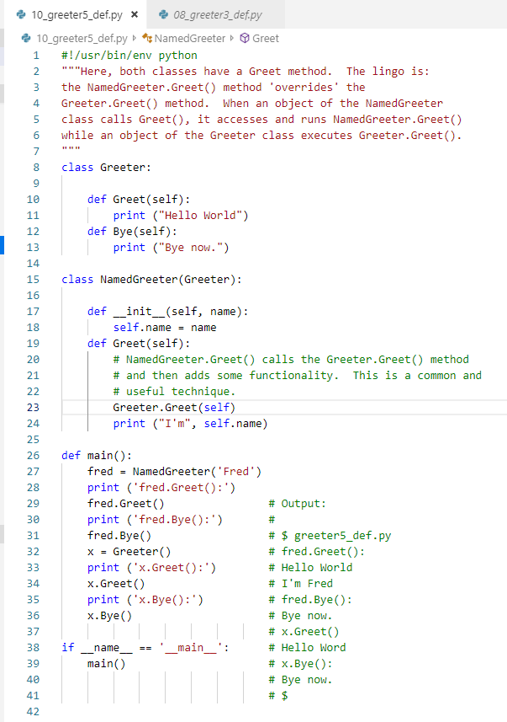
0602.6 greeting5.py
https://www.ucsc-extension.edu/certificate-program/offering/python-programmers
greeting5.py:
Greeter.Greet(): namespace for class itself and get the member function Greet().

Slide 24
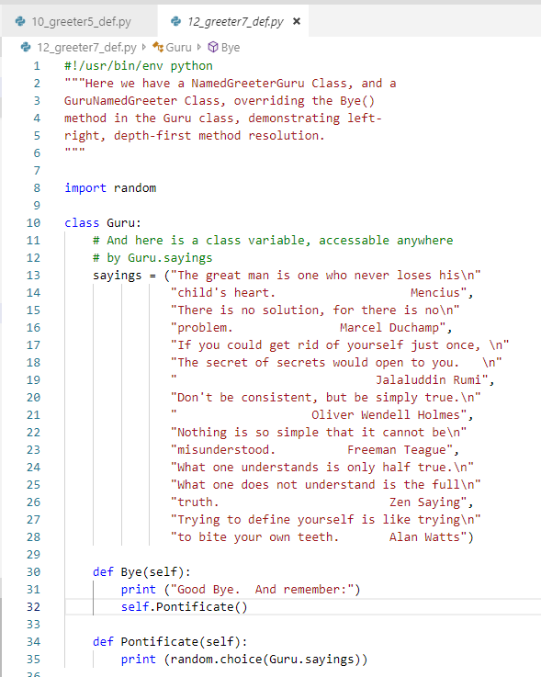
0602.6 greeting7.py
https://www.ucsc-extension.edu/certificate-program/offering/python-programmers
greeting.py:
Multiple Inheritance

Slide 25
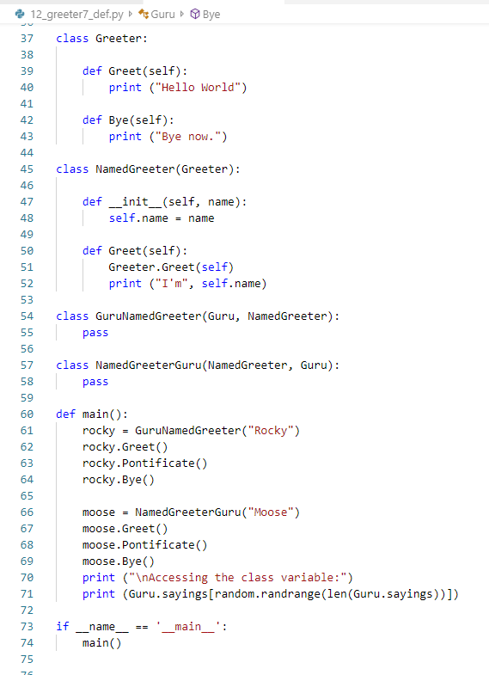
0602.6 greeting7.py
https://www.ucsc-extension.edu/certificate-program/offering/python-programmers
greeting.py:
Multiple Inheritance
Greeter
Guru
NameGreeter
GuruNameGreeter
NameGreeterGuru

Slide 26
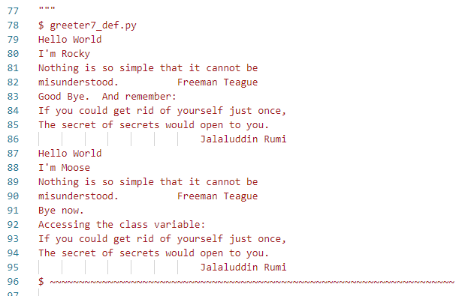
0602.6 greeting7.py
https://www.ucsc-extension.edu/certificate-program/offering/python-programmers
greeting.py:
Multiple Inheritance

Slide 27
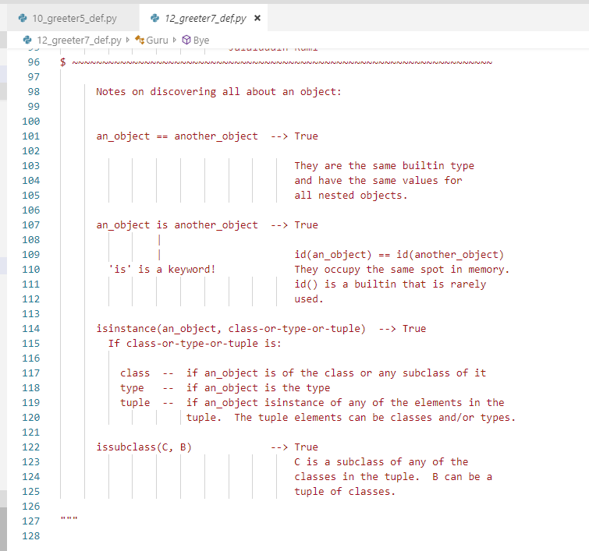
0602.6 greeting7.py
https://www.ucsc-extension.edu/certificate-program/offering/python-programmers
greeting.py:
Multiple Inheritance

Slide 28
0602.7 Qui 4

Slide 29
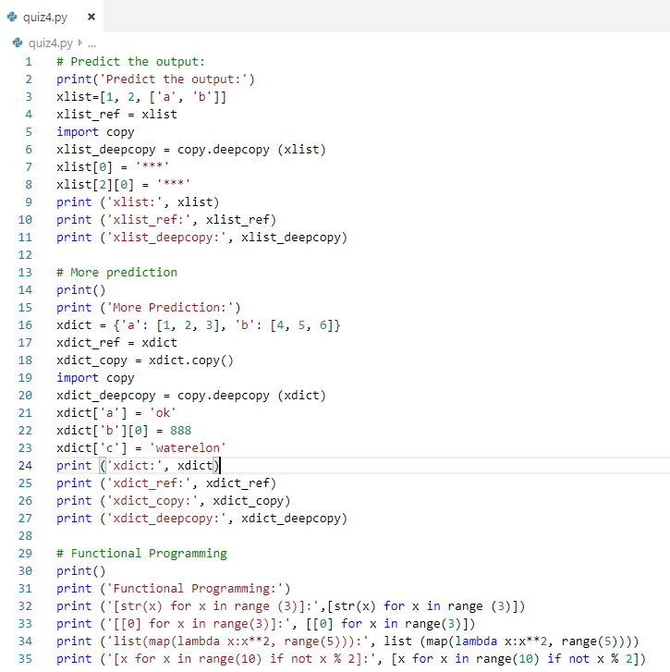
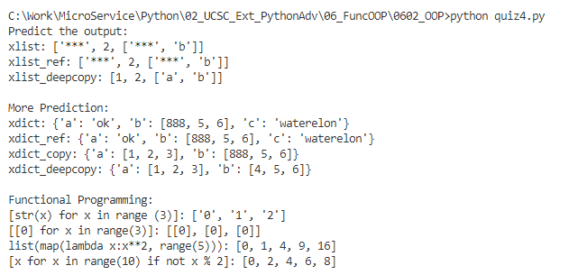
0602.7 quiz 4
https://www.ucsc-extension.edu/certificate-program/offering/python-programmers
Predict the output:

Slide 30
End of Chapter

