Slide 1

06 Quiz
Peter H. Chen

Slide 2
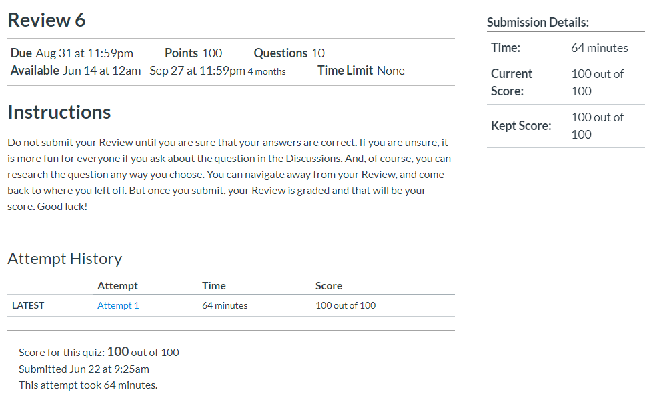
06 Quiz
https://www.ucsc-extension.edu/certificate-program/offering/python-programmers
Quiz:

Slide 3
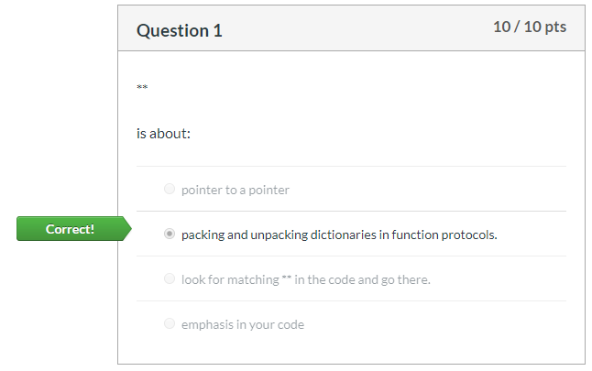
06 Quiz
https://www.ucsc-extension.edu/certificate-program/offering/python-programmers
Quiz:

Slide 4
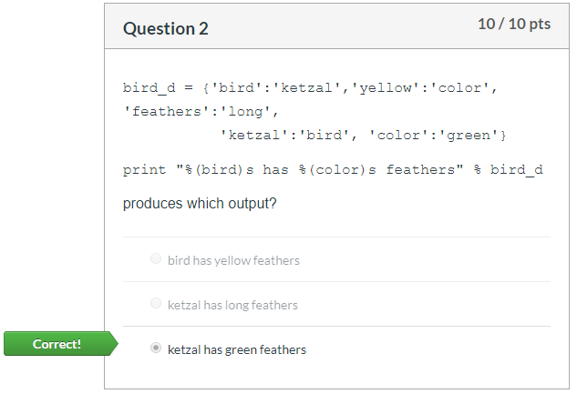
06 Quiz
https://www.ucsc-extension.edu/certificate-program/offering/python-programmers
Quiz:

Slide 5
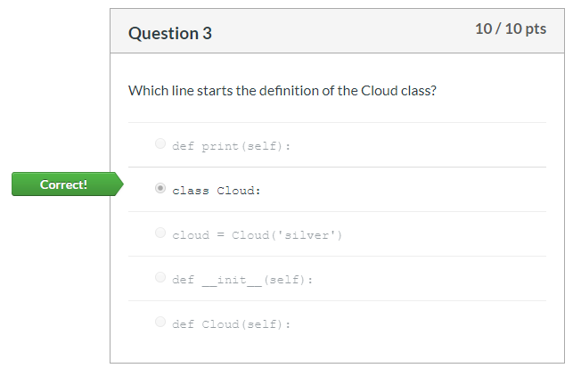
06 Quiz
https://www.ucsc-extension.edu/certificate-program/offering/python-programmers
Quiz:

Slide 6
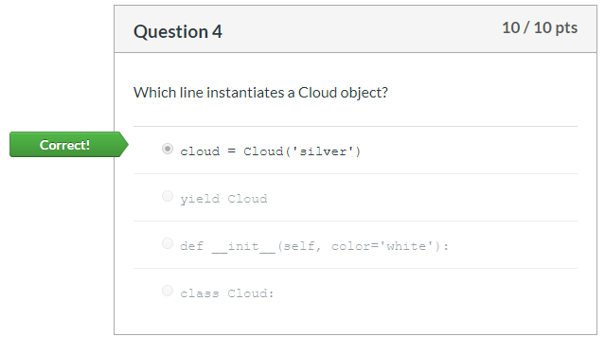
06 Quiz
https://www.ucsc-extension.edu/certificate-program/offering/python-programmers
Quiz:

Slide 7
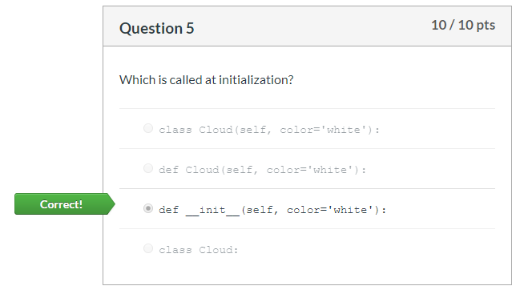
06 Quiz
https://www.ucsc-extension.edu/certificate-program/offering/python-programmers
Quiz:

Slide 8
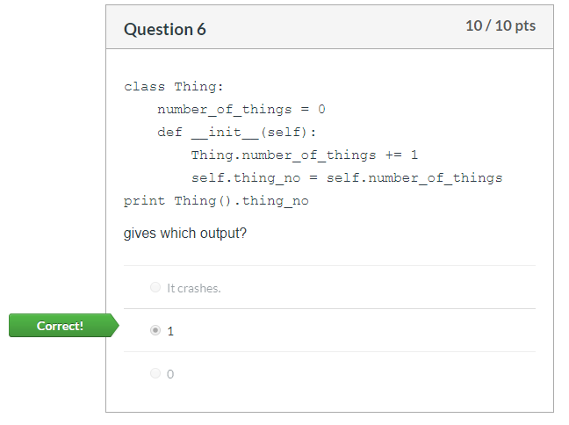
06 Quiz
https://www.ucsc-extension.edu/certificate-program/offering/python-programmers
Quiz:

Slide 9
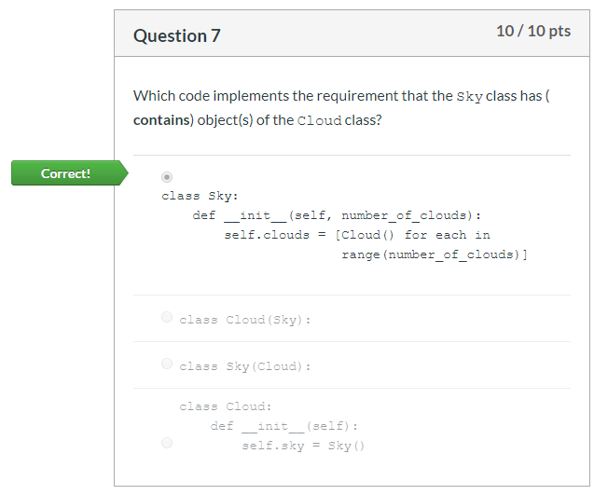
06 Quiz
https://www.ucsc-extension.edu/certificate-program/offering/python-programmers
Quiz:

Slide 10
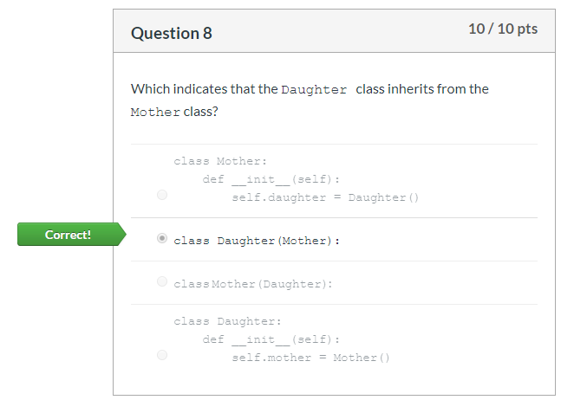
06 Quiz
https://www.ucsc-extension.edu/certificate-program/offering/python-programmers
Quiz:

Slide 11
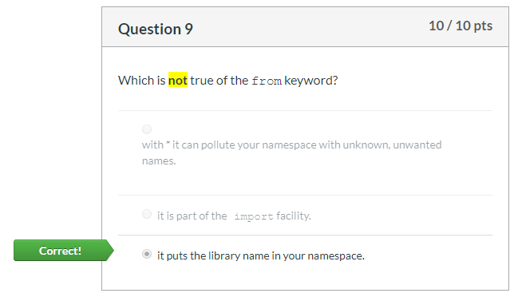
06 Quiz
https://www.ucsc-extension.edu/certificate-program/offering/python-programmers
Quiz:

Slide 12
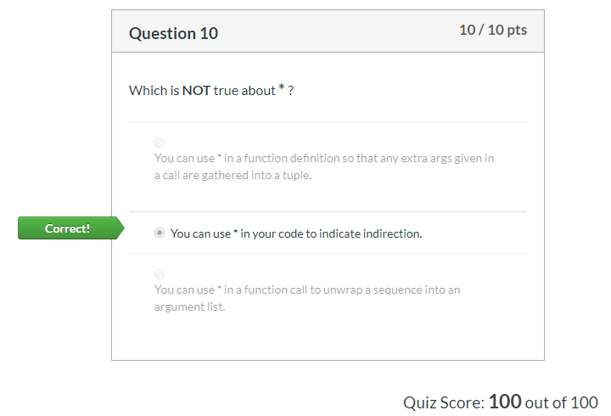
06 Quiz
https://www.ucsc-extension.edu/certificate-program/offering/python-programmers
Quiz:

Slide 13
End of Chapter

