Slide 1

1 History, Variable, and Operator
Peter H. Chen

Slide 2
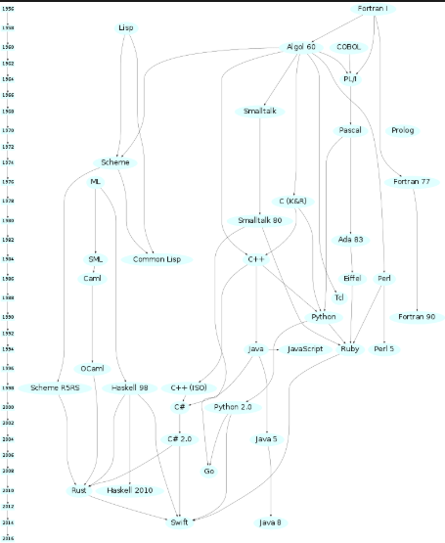
1 History, Variable, and Operator
https://www.ucsc-extension.edu/certificate-program/offering/python-programming-beginners
History of Programming Languages
Python

Slide 3
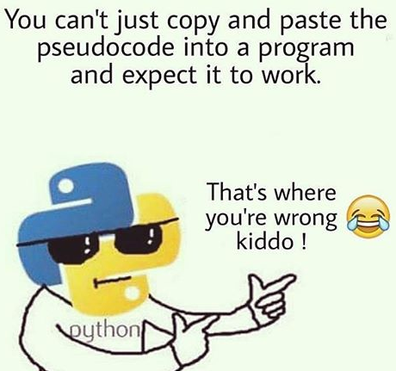
1 History, Variable, and Operator
https://www.ucsc-extension.edu/certificate-program/offering/python-programming-beginners
Background on Python
Created in 1989, by Guido Van Rossum
https://en.wikipedia.org/wiki/Python_(programming_language)
Named after Monty Python comedy troupe
NOT a type of snake
Has evolved over the years
Python 2.0 10/2000
Python 3.0 12/2008
Very active Open Source project: https://www.python.org/
Initial goals focused on readability, extensibility, flexibility
Good for small scripts as well as large applications
An interpreted language vs compiled, so pluses and minuses with that

Slide 4
1 History, Variable, and Operator
https://www.ucsc-extension.edu/certificate-program/offering/python-programming-beginners
Python is used across many different domains
Image Processing (Skimage)
Computer Vision (PIL, Pillow, Scipy)
Numerical Computing (Numpy)
Raw number crunching handed off to deeper/native math libraries
Web Development (Flask or Django)
Deep Learning (Tensorflow & PyTorch)
Machine Learning (SKlearn)
Desktop Applications (Pygame, PyQt, WxPython)
That means Python Programmers are in high demand!
https://www.quora.com/Why-is-there-such-a-demand-for-Python-programmers

Slide 5
1 History, Variable, and Operator
https://www.ucsc-extension.edu/certificate-program/offering/python-programming-beginners
Python Today
Language is up to version 3.7
Language is Open Source, available for free
Resources at www.python.org
Getting Started Guide https://www.python.org/about/gettingstarted/
General programming community www.stackoverflow.org
Specialized site for Pythoners www.pythontutor.com
More Practice exercises at http://www.practicepython.org/
History/Summary/links at
https://en.wikipedia.org/wiki/Python_(programming_language)

Slide 6
1 History, Variable, and Operator
https://www.ucsc-extension.edu/certificate-program/offering/python-programming-beginners
Let’s Get Started!
First, Download the development/run-time environment
We will be using:
The Anaconda package environment
The Jupiter text/coding environment
The Spyder Integrated Development Environment
Python shell, command line
https://www.anaconda.com/distribution/

Slide 7


1 History, Variable, and Operator
https://www.ucsc-extension.edu/certificate-program/offering/python-programming-beginners
Running The Code

Slide 8
1 History, Variable, and Operator
https://www.ucsc-extension.edu/certificate-program/offering/python-programming-beginners
Run Some Code in 4 Ways
From a code notebook (Jupiter)
From an IDE (Spyder)
From a shell (Python or IDLE)
From a file executed in a terminal/CMD window

Slide 9
1 History, Variable, and Operator
https://www.ucsc-extension.edu/certificate-program/offering/python-programming-beginners
Cool Code Running -> Jupiter
Launch Jupiter from Anaconda
Use File menu to navigate to a good folder
Then click the new button and create a notebook
Use Code menu to set cell to code/markdown/Raw
Use Start/Stop button to start/refresh the kernel
Use Help menu to get info on Python / libraries
In a code cell, type: print(“hello world”)
Click Play button or Press Shift+Enter

Slide 10
1 History, Variable, and Operator
https://www.ucsc-extension.edu/certificate-program/offering/python-programming-beginners
Cool Code Running -> IDE
Launch Spyder in Anaconda
3 sections, editor, console, list of variables / files
Select File/New…
Add Code (e.g. Print(“Hello World”)
Save the file as file.py
Select Play button, File/Run, or press F5

Slide 11
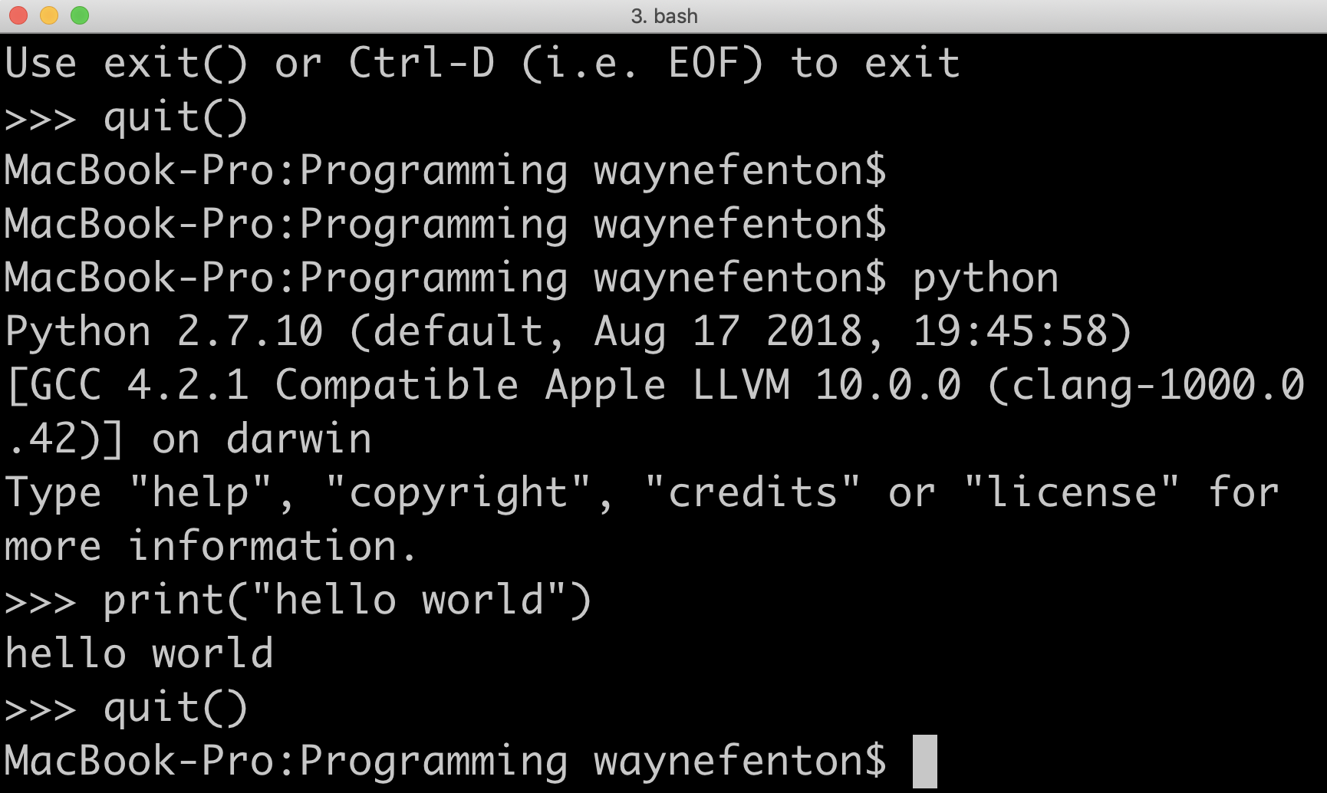
1 History, Variable, and Operator
https://www.ucsc-extension.edu/certificate-program/offering/python-programming-beginners
Cool Code Running -> Command Line
Open a terminal window
Execute “python” or “idle” to launch shell+interpreter
Type: print(“Hello world”)
Type: quit() to leave environment

Slide 12
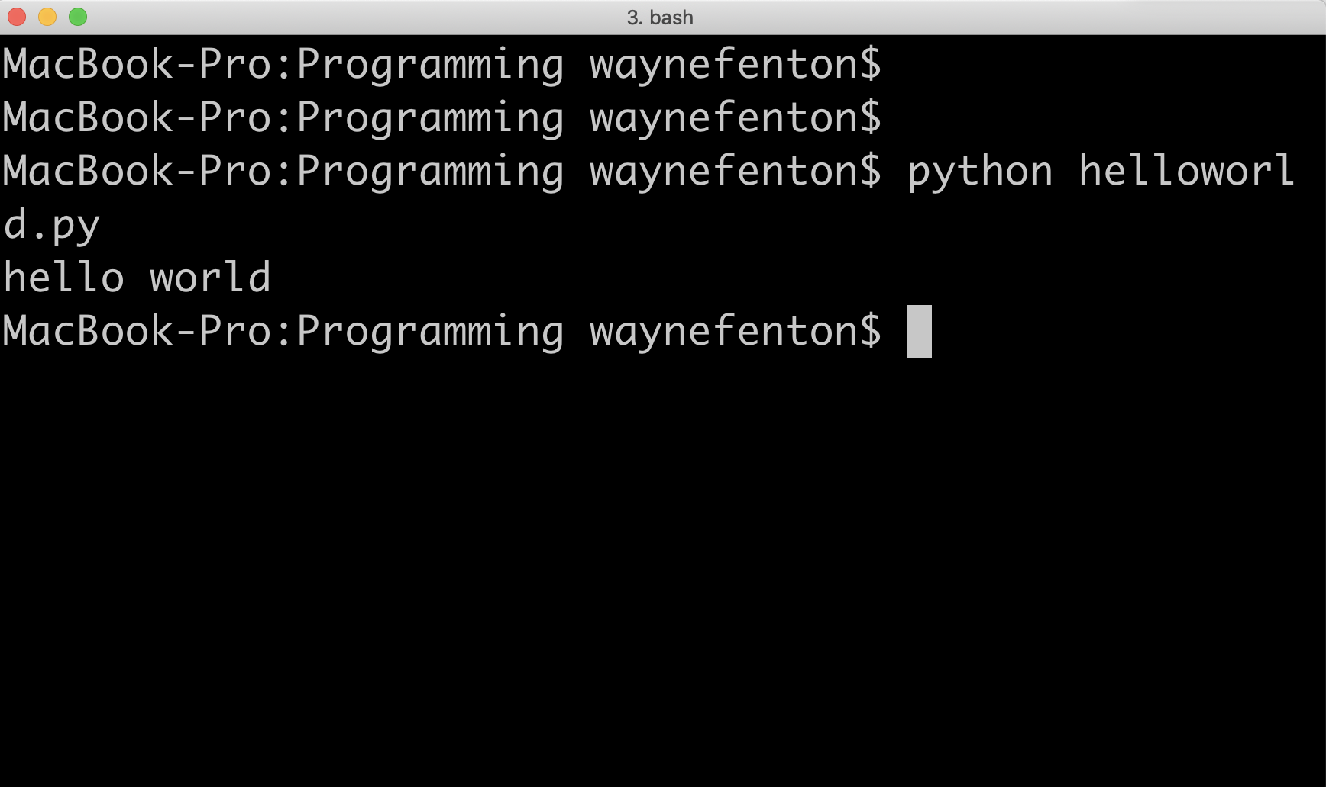
1 History, Variable, and Operator
https://www.ucsc-extension.edu/certificate-program/offering/python-programming-beginners
Cool Code Running -> Running a script from shell
From OS terminal
cd to folder where file.py is present
Execute “python file.py”
…
…
NOTE: There are several other ways to run Python Code too!!

Slide 13
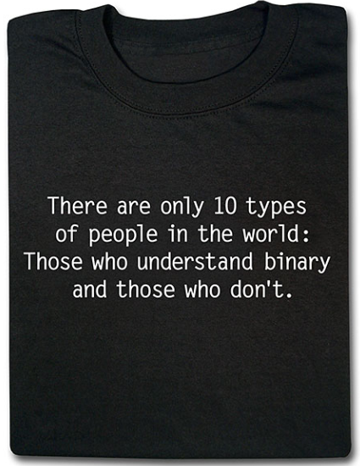
1 History, Variable, and Operator
https://www.ucsc-extension.edu/certificate-program/offering/python-programming-beginners
Learning the language!!

Slide 14
1 History, Variable, and Operator
https://www.ucsc-extension.edu/certificate-program/offering/python-programming-beginners
Comments
All programming languages have a way to tell the environment to ignore text intended to describe/explain the code, not BE the code. Python has two types, single line and multiple line
Single line comments
Start with a # sign, and includes anything after until the end of the line
Multiple line comments
First line starts with triple-quotes, i.e. “””
Last line starts with triple-quotes, i.e. “””
All lines in between are ignored
Examples
TBD show examples

Slide 15
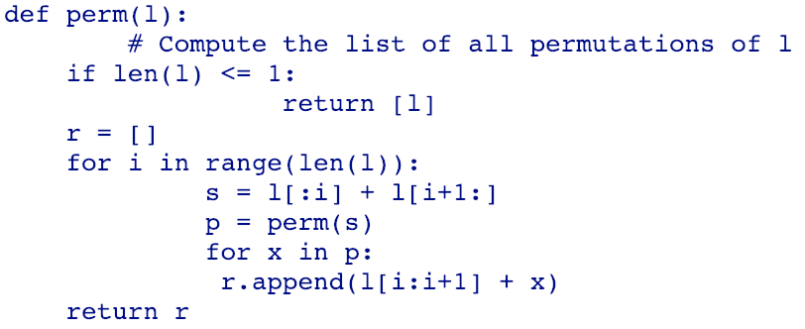
1 History, Variable, and Operator
https://www.ucsc-extension.edu/certificate-program/offering/python-programming-beginners
Indentation
Python tracks indentation to match code nesting levels
Tabs are allowed and replaced with spaces based on configuration
Strong recommendation is to
a) don’t use tabs
b) indent 4 spaces for loops, branches, etc.
Here’s an example of formatted code:
The eternal struggle of tabs vs spaces:
https://www.youtube.com/watch?v=SsoOG6ZeyUI

Slide 16
1 History, Variable, and Operator
https://www.ucsc-extension.edu/certificate-program/offering/python-programming-beginners
Data Types
Numbers: whole
Numbers: float/complex
Strings
Booleans
Others (we’ll learn these later)
Lists, tuples, dictionaries

Slide 17
1 History, Variable, and Operator
https://www.ucsc-extension.edu/certificate-program/offering/python-programming-beginners
Numbers: Whole + Floating Point
Whole numbers
Can be positive, negative, or zero
Examples: -193, 0, 78, 1,300,850
0 is trivial, all others are non-trivial
Floating Point Numbers (float)
Numbers that have decimal places
Examples: 0.123, -9.677
0.0 is trivial, all others are non-trivial
Note: We’ll discuss trivial vs non-trivial a little later

Slide 18
1 History, Variable, and Operator
https://www.ucsc-extension.edu/certificate-program/offering/python-programming-beginners
Strings
String = Sequence of characters enclosed in single or double quotes
“Pebble”
“++++”
“”
’Hello There’
You can insert ‘ in “” strings and vice versa
print("you're looking awesome today!")
print(‘Then Alexander said "Come here Watson, I want you”’)
“” is trivial, all other strings are non-trivial
Demo

Slide 19
1 History, Variable, and Operator
https://www.ucsc-extension.edu/certificate-program/offering/python-programming-beginners
Bool
Can be either True or False (case sensitive)
Examples:
a = True
b = False
Note: this will get more interesting later

Slide 20
1 History, Variable, and Operator
https://www.ucsc-extension.edu/certificate-program/offering/python-programming-beginners
Converting Between Types
Conversion functions are used to convert from one data type to another
bool(), int(), float(), str()
Converting between types is called typecasting or casting
Bool Operations
bool(0) = False
Applying bool() to trivial values returns False. Applying bool() to non-trivial values returns True
bool(1) = True
bool(0.0) = False
Int Conversions
int(“923”) = 923
int(8.25) = 8
int(11) = 11
int(“9t”) - will raise ValueError Exception

Slide 21
1 History, Variable, and Operator
https://www.ucsc-extension.edu/certificate-program/offering/python-programming-beginners
Converting Between Types – Cont.
Float Conversions
float(“99”) = 99.0
float(32) = 32.0
float(“39w”) - will raise ValueError Exception
String Conversions
str(80) = “80”
str(18.97) = “18.97”
str(“box”) = “box”
All objects in Python have a type. Use the type() function access
type(“apple”) is str
type(99) is int
type(70.12) is float

Slide 22
1 History, Variable, and Operator
https://www.ucsc-extension.edu/certificate-program/offering/python-programming-beginners
Variables
Definition: A name used to represent/”store” a data value. Once assigned a value, later references to that value indicate using that stored value instead
Naming Rules:
Can contain only numbers, letters, and underscores
May NOT start with a number
Naming guidelines:
Choose descriptive names
Be consistent: Can choose
“a_very_descriptive_name” or “aVeryDescriptiveName” or “name” (last one is BEST!)
Don’t make names too long!
Don’t to embed types in variable names
name = “Peter” is better than nameStr = “Peter”

Slide 23
1 History, Variable, and Operator
https://www.ucsc-extension.edu/certificate-program/offering/python-programming-beginners
Variables – Cont.
Examples:
gasPrice = 3.45
billsHeight = 2.34
yearsSinceMagnaCarta = 342
myAge = 21
a = 10
a = “apple”
print(a, type(a))
>>> “apple”, str
Constants (all caps by convention)
PI = 3.14
radius = 12
area_circle = PI * radius * radius
print(“The area of the circle is: “, area_circle)
>>> 37.68

Slide 24
1 History, Variable, and Operator
https://www.ucsc-extension.edu/certificate-program/offering/python-programming-beginners
Let’s Do Some Math!
Addition (+) 5 + 4 = 9
Subtraction (-) 8 - 1 = 7
Multiplication (*) 3 * 5 = 15
Division (/) 24 / 6 = 4.0, 24 / 5 = 4.8, 24.3 / 1.3 = 18.69230
TODO Explain this better, give reasons why you would do it
Floor division (//) 25 // 4 = 6
TODO Explain this better, give reasons why you would do it

Slide 25
1 History, Variable, and Operator
https://www.ucsc-extension.edu/certificate-program/offering/python-programming-beginners
Let’s Do Some Math! – Part 2
Modulus (%) 15 % 4 = 3
TODO Explain this better, give reasons why you would do it
Example for this one might be calculating change for coins
Exponent (**) 5 ** 4 = 625, 2.1 ** 1.4 = 2.8255
Order of precedence (highest to lowest):
**
*, /, // %
+, -
Hint: Use parenthesis

Slide 26
1 History, Variable, and Operator
https://www.ucsc-extension.edu/certificate-program/offering/python-programming-beginners
Let’s Do Some Math! – Part 3
Comparison
Equality (==) 7 == 7 is True
Not Equal (!=) 9 != 8 is True
Greater than (>) 5 > 4 is True
Less than (<) 4 < 6 is True
Greater than or equal (>=) 3>=3 is True
Less than or equal (<=) 8 <= 9 is True
Assignment
Assign (=)
Add and (+=)
Subtract and (-=)
Multiply and (*=)
Divide and (/=)
Exponent and (**=)
Floor division and (//=)

Slide 27
1 History, Variable, and Operator
https://www.ucsc-extension.edu/certificate-program/offering/python-programming-beginners
Let’s Do Some Math! – Part 4
Membership
in - “a” in “apple" is a True statement
not in - “b” not in “apple” is a True statement
print(“a” in “apple”) prints true
print(“b” not in “apple”) prints true
Identity
is –
a = 4
b = 4
c = 7
print(a is c) prints False
print(a is b) prints True
is not -
print(a is not c) prints True

Slide 28
End of Chapter

