Slide 1

2 Homework 2
Peter H. Chen

Slide 2
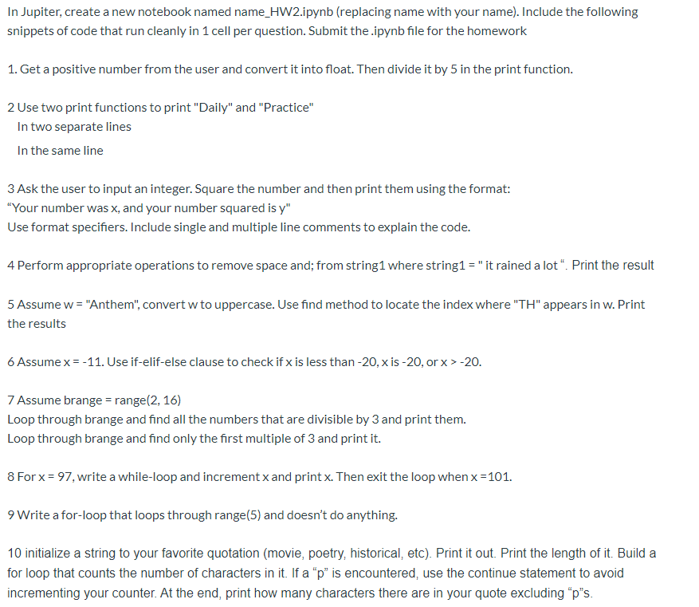
2 I/O, String, Branch, and Loop
https://www.ucsc-extension.edu/certificate-program/offering/python-programming-beginners
Homework 2

Slide 3
End of Chapter

