Slide 1

4 File IO, Error Handling, Module
Peter H. Chen

Slide 2
4 File IO, Error Handling, Module
https://www.ucsc-extension.edu/certificate-program/offering/python-programming-beginners
Topic:
Review of Section 3 material
Review HW 3 Answers
File I/O
Error/Exception Handling
Built-In Modules
Math
Random
Time
DateTime
Sample app “Challenge 1” from ch7 the book (The Trivia challenge)
Preview HW 4 questions

Slide 3
4 File IO, Error Handling, Module
https://www.ucsc-extension.edu/certificate-program/offering/python-programming-beginners
Summary of Section 3 material
Data Structures
Lists
Tuples
Dictionaries: (key, value) can be all strings, [“Peter”, “chen”, “652 Calle Victoria”]
Functions
Defining a function
Calling a function
Returning no value, 1 value, multiple values
Positional arguments
Keyword arguments
Scope, local, and global variables
HW 3 Review

Slide 4
4 File IO, Error Handling, Module
https://www.ucsc-extension.edu/certificate-program/offering/python-programming-beginners
Summary of Section 3 material
Data Structures
Lists
Tuples
Dictionaries: (key, value) can be all strings, [“Peter”, “chen”, “652 Calle Victoria”]
Functions
Defining a function
Calling a function
Returning no value, 1 value, multiple values
Positional arguments
Keyword arguments
Scope, local, and global variables
HW 3 Review

Slide 5
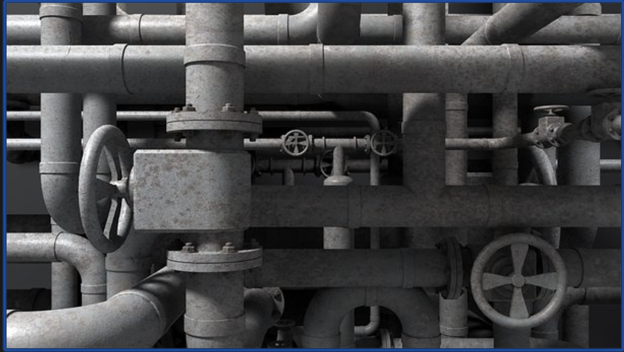
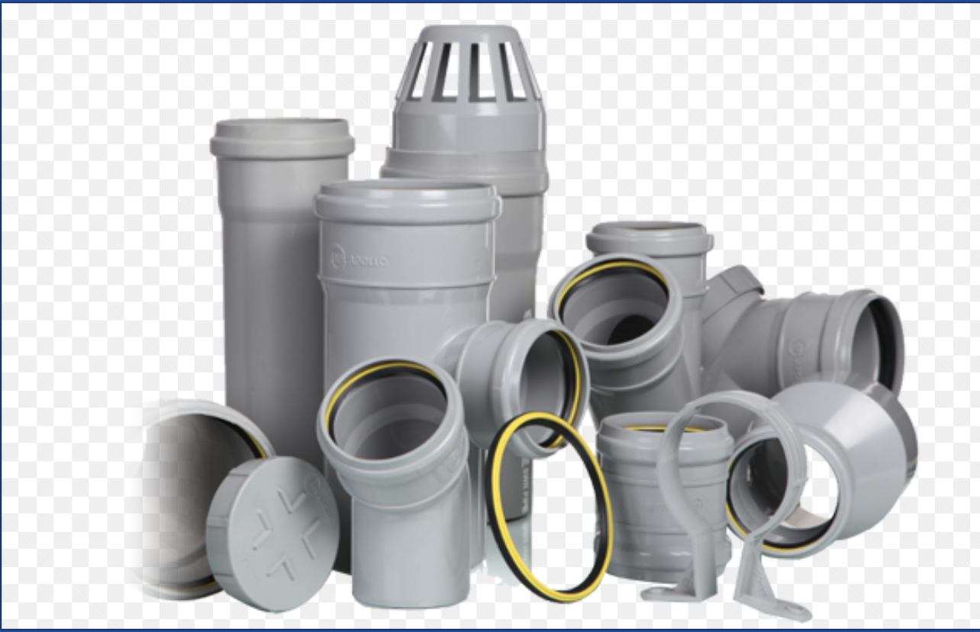
4 File IO, Error Handling, Module
https://www.ucsc-extension.edu/certificate-program/offering/python-programming-beginners
File I/O - 1
File I/O
Program
Database
Network

Slide 6
4 File IO, Error Handling, Module
https://www.ucsc-extension.edu/certificate-program/offering/python-programming-beginners
File I/O – 2
Main goals are to open, read, write, close files
Different operations, file formats
Easiest format are: *.txt, *.csv
e.g.: fname, lname, address
Peter, Chen, 652 Calle Victoria
….
2 major concepts involved
File object that handles the file
Access mode that specifies the actions that are permissible
The open() function returns a file object which can be then used to read from or write to the file

Slide 7
4 File IO, Error Handling, Module
https://www.ucsc-extension.edu/certificate-program/offering/python-programming-beginners
File I/O – 2
Syntax for opening a file
file_object = open(file_name, [access_mode]) # Note this isn’t a method on file
Syntax for closing a file is:
file_object.close()
file_object has 3 main members/components(there are others)
File Name
Access Mode
Current Position in file: “The quick brown fox jumped over” (beginning of the file)
In a File
Line numbers start from 0
Each character is 1 byte

Slide 8
4 File IO, Error Handling, Module
https://www.ucsc-extension.edu/certificate-program/offering/python-programming-beginners
File I/O – 3
file_name
Note: path is relative to where the script is running from
access_mode (optional) – Indicates the intended operation that the program intends to perform on the file
Primary options:
“r” - read only (TODO: Explain modes)
“r+” - read and write: like append
“w” - write only (Note: if file already exists, it will be erased and over-written)
“w+” write and read
“a” - append only
“a+” - append and read
Comprehension list at:
http://www.tutorialspoint.com/python/python_files_io.htm
After completing operations on a file, use the close() method to close the file object
Demo – Examples in Jupyter

Slide 9
4 File IO, Error Handling, Module
https://www.ucsc-extension.edu/certificate-program/offering/python-programming-beginners
File I/O – 4
Other file methods
read()
readlines()
write()
writelines()

Slide 10
4 File IO, Error Handling, Module
https://www.ucsc-extension.edu/certificate-program/offering/python-programming-beginners
File I/O – 5
read() method reads either some bytes or all the file. Syntax:
file_object.read([bytes])
readlines() reads multiple lines from the file. Syntax:
TODO add readline()
file_object.readlines()
Returns lines of the file as elements in a list
write() writes a string to the file. Syntax:
file_object.write(string)
writelines() writes an iterable sequence to a file. Syntax:
file_object.writelines(sequence)

Slide 11
4 File IO, Error Handling, Module
https://www.ucsc-extension.edu/certificate-program/offering/python-programming-beginners
File I/O – 6: open()/close() example
Set up file with sample data
# Initialize our file to show the other operations
f = open("fruits.txt", "w")
f.write("Apple\n\n") # Note that newline needs to be added.
f.write("Pear\n")
f.write("banana\n")
f.write(" \n")
f.write("Grapes")
f.close()
Open()/close()
# file open/close example. Does this create a file if not already present, or not?
f = open("fruits.txt", "r")
f.close()
print(f.closed) # This member shows whether the file is closed

Slide 12
4 File IO, Error Handling, Module
https://www.ucsc-extension.edu/certificate-program/offering/python-programming-beginners
File I/O – 7: read() example
Open file and print it out as list of lines
# Looping through file directly. Note file organizes as a list of lines. Why?
f = open("fruits.txt", "r")
for line in f:
print(line)
f.close()
Use read() with a specific # of characters
# Read / write a specific # of characters. when would you do this?
f = open("fruits.txt", "r")
print(f.read(20))
f.close()
Read the whole file and print it
# with no parameter read() pulls in the whole file, then we print it out
f = open("fruits.txt", "r")
whole_file = f.read()
print(whole_file)
f.close()

Slide 13
4 File IO, Error Handling, Module
https://www.ucsc-extension.edu/certificate-program/offering/python-programming-beginners
File I/O – 8: readline() example
Read a line at a time
# Using readline()
f = open("fruits.txt", "r")
b = True
while(b):
line = f.readline() # returns empty string at end of file,
# but note \n is NOT empty
if(line): # string is "trivial" only if it is empty
print(line)
else:
Break
f.close()

Slide 14
4 File IO, Error Handling, Module
https://www.ucsc-extension.edu/certificate-program/offering/python-programming-beginners
File I/O – 9: readlines() example
Attempt 1, try to get rid of blank lines
# Use readlines() to read in the whole file, breaking lines apart into a list
# Then iterate the list, trying to remote whitespace. Note it doesn't remove \n
f = open("fruits.txt", "r")
lines = f.readlines()
print(lines)
for line in lines:
print(line.strip()). # regular strip() doesn’t get rid of newline
f.close()
Attempt 2, try to get rid of blank lines
# 2nd attempt to remove "blank" lines by using boolean logic
f = open("fruits.txt", "r")
for line in f.readlines():
strLine = line.strip()
If (strLine): # takes advantage of the fact that \n is "trivial". Is that a good idea?
print(line.strip())
f.close()

Slide 15
4 File IO, Error Handling, Module
https://www.ucsc-extension.edu/certificate-program/offering/python-programming-beginners
File I/O – 10: write() example
write() example
# now let's use write mode
f = open("cities.txt", "w")
f.write("New York \n")
f.write("Seattle \n")
f.write("Austin \n")
f.close()
With “w” mode, if file already exists, it will be erased and over-written. If it doesn’t, it will be created

Slide 16
4 File IO, Error Handling, Module
https://www.ucsc-extension.edu/certificate-program/offering/python-programming-beginners
File I/O – 11: append() example
Append() example
f = open("cities.txt", "a")
f.write("Sacramento\n")
f.write("Portlane\n")
f.close()
Now print the file out again
# print the file again
g = open("cities.txt")
for line in g:
print(line)
g.close()

Slide 17
4 File IO, Error Handling, Module
https://www.ucsc-extension.edu/certificate-program/offering/python-programming-beginners
File I/O – 12: tell()/seek()
Tell() reports the current offset in the file
Seek() adjusts pointer. Syntax
File_object.seek(offset, position)
Offset is adjusted number of bytes
Position is (0=beginning, 1= current location, 2 = end of file)
Example
g = open("cities.txt")
for line in g.readlines():
print(line.strip())
print(g.tell()) # tell() indicates current offset
g.seek(3,0) # this sets Pointer to 3 characters from beginning of file
for line in g.readlines():
print(line.strip())
g.close()

Slide 18
4 File IO, Error Handling, Module
https://www.ucsc-extension.edu/certificate-program/offering/python-programming-beginners
File I/O – 13: a+ mode
a+ mode
Examples:
# using a+ mode and seek()
h = open("cities_new.txt", "a+")
h.write("Albany \n")
h.write("Syracuse \n")
h.write("Buffalo \n")
h.seek(0,0) # note we don't have to close / re-open the file
for line in h.readlines():
print(line.strip())
h.close()

Slide 19
4 File IO, Error Handling, Module
https://www.ucsc-extension.edu/certificate-program/offering/python-programming-beginners
File I/O – 14: w+ mode
w+ mode
Example:
# w+ mode
list1 = ["simple", "code"]
i = open("list1.txt", "w+")
i.writelines(list1)
i.writelines("\ndone")
i.seek(0,0)
for line in i.readlines():
print(line.strip())
i.close()

Slide 20
4 File IO, Error Handling, Module
https://www.ucsc-extension.edu/certificate-program/offering/python-programming-beginners
File I/O – 15: Summary
Reading from text files readlines() method
Different modes for opening/reading from a file
r, r+, w, w+, a, a+
Writing to a file using the write() method
tell()
seek()

Slide 21
4 File IO, Error Handling, Module
https://www.ucsc-extension.edu/certificate-program/offering/python-programming-beginners
Try/catch - 1
A mechanism to detect error conditions and continue processing logic depending on error.

Slide 22
4 File IO, Error Handling, Module
https://www.ucsc-extension.edu/certificate-program/offering/python-programming-beginners
try/catch – 2: Exceptions
Definition
An error that is detected by the interpreter at the time of execution of the code
Types
SyntaxError: Occurs when the syntax is incorrect
IndexError: Occurs when the code tries to access an index that is out of range of an array, list, or tuple
ValueError: Occurs when casting from data type to another when no legal conversion is possible
Many others
https://docs.python.org/3/library/exceptions.html

Slide 23
4 File IO, Error Handling, Module
https://www.ucsc-extension.edu/certificate-program/offering/python-programming-beginners
try/catch – 3: Exceptions – try/except block
Used to recover from errors and execute alternative code
Syntax:
try:
Try block
except except_error as variable:
except block
Example:
# try / except example
w = "34t“
try:
x = int(w)
except ValueError:
x = 2
print(x)

Slide 24
4 File IO, Error Handling, Module
https://www.ucsc-extension.edu/certificate-program/offering/python-programming-beginners
try/catch – 4: Exceptions – try/except block
Variation, can capture the error string and use it
Example
# try / except example
w = "34t“
try:
x = int(w)
except ValueError as v:
x = 2
print(v) # prints "invalid literal...“
print(x)

Slide 25
4 File IO, Error Handling, Module
https://www.ucsc-extension.edu/certificate-program/offering/python-programming-beginners
try/catch – 5: Exceptions – try/except block
Do not try to catch multiple exception types in one try/except block. Can confuse recovery code
Best practice is to perform operations separatey and check separately
Example 1:
# try / except example - using separate blockx
w = "34t“
try:
x = int(w)
except ValueError:
x = 2
Example 2:
A = 10
B = 0
try:
C = A / B
except ZeroDivisionError:
C = A
print(x)
print(C)

Slide 26
4 File IO, Error Handling, Module
https://www.ucsc-extension.edu/certificate-program/offering/python-programming-beginners
try/catch – 6: Exceptions – try/except/else block
try:
…
except … as V
…
else:
…

Slide 27
4 File IO, Error Handling, Module
https://www.ucsc-extension.edu/certificate-program/offering/python-programming-beginners
try/catch – 7: Exceptions – Summary
Exceptions
Try-Except
Error Handling

Slide 28
4 File IO, Error Handling, Module
https://www.ucsc-extension.edu/certificate-program/offering/python-programming-beginners
Modules - 1
Definition:
A module is a Python file with functions, definitions, and statements.
A module is a collections of API.
To access F/D/S (Function/Definition/Statements) in a module, import it first
Syntax for importing
import module_name
Accessing a function in a module
module_name.functionname()

Slide 29
4 File IO, Error Handling, Module
https://www.ucsc-extension.edu/certificate-program/offering/python-programming-beginners
Modules – 2: Built-In Modules
Math
Random
Time
DateTime

Slide 30
4 File IO, Error Handling, Module
https://www.ucsc-extension.edu/certificate-program/offering/python-programming-beginners
Modules – 3: Built-In Modules: Math
sqrt(), Example:
# importing a module and accessing a function from it
import math
print(math.sqrt(121))
pow(), Example:
print(math.pow(3,4))
print("what is the differences between", math.pow(3,4), "and", 3**4,"?")
https://stackoverflow.com/questions/20969773/exponentials-in-python-x-y-vs-math-powx-y]
Pi, Example:
# pi constant
radius = 10
area = math.pi*radius*radius
print("The area is ", area)

Slide 31
4 File IO, Error Handling, Module
https://www.ucsc-extension.edu/certificate-program/offering/python-programming-beginners
Modules – 4: Built-In Modules: Random
random(), Example
# importing random, calling random() function
import random
print(random.random())
choice(), Example
# using choice() on iterable objects
list1 = [12, 14, 19]
tuple1 = (12, 14, 19)
print(random.choice(list1), random.choice(tuple1))

Slide 32
4 File IO, Error Handling, Module
https://www.ucsc-extension.edu/certificate-program/offering/python-programming-beginners
Modules – 5: Built-In Modules: Random
randrange(), Example
# Giving a single int picks a number from 0 to (but not including)number
print(random.randrange(6))
print(random.randrange(0,6))
print(random.randrange(0,6,1))
# prints a random even integer between 2 and 10, inclusive
print(random.randrange(2,12,2))
shuffle(), Example
# First use a manually generated a list
list1 = [1,2,3,4,5,6]
random.shuffle(list1)
print(list1)
# Now try building list from range and shuffling
list2 = list(range(1,7))
random.shuffle(list2)
print(list2)

Slide 33
4 File IO, Error Handling, Module
https://www.ucsc-extension.edu/certificate-program/offering/python-programming-beginners
Modules – 6: Built-In Modules: Time
Tzname(), example:
# tzname shows options for current local timezone
print("TZ name is", time.tzname)
Sleep(), example:
# sleep just sleeps
print("hello", end=" ")
time.sleep(5)
print("there")

Slide 34
4 File IO, Error Handling, Module
https://www.ucsc-extension.edu/certificate-program/offering/python-programming-beginners
Modules – 7: Built-In Modules: Datetime
time(), Example:
#import datetime, build a time from HH/MM/SS
import datetime
print(datetime.time(12,30, 0))
today(), Example:
# Get today's date
print(datetime.date.today()) # Note this specifies just provide date
print(datetime.datetime.today()) # This one specifies datetime

Slide 35
4 File IO, Error Handling, Module
https://www.ucsc-extension.edu/certificate-program/offering/python-programming-beginners
Section Summary:
File I/O
Error/Exception Handling
Modules, importing
Built-In Modules
Math
Random
Time
DateTime
In class sample app exercise
HW 4 preview

Slide 36
4 File IO, Error Handling, Module
https://www.ucsc-extension.edu/certificate-program/offering/python-programming-beginners
In Class Sample App Exercise
Download “trivia_challenge.py” and “trivia.txt”
Go into Python shell (Spyder, IDLE), open the .py file and run it
Exercise: Improve the Trivia Challenge game so that each question has a unique point value associated with it. The player’s score should be the total of all the point values of the questions he or she answers correctly.
Answer: Download and check “trivia_challenge1.py” and “trivia-chanllenge1.txt

Slide 37
End of Chapter

