Slide 1

5 Python OOP
Peter H. Chen

Slide 2
5 Python OOP
https://www.ucsc-extension.edu/certificate-program/offering/python-programming-beginners
Topic:
Summarize section 4
Review HW 3
Review HW 4
Object-Oriented-Programming
General concepts
Review Jupyter Notebook examples
In Class exercise
Preview HW 5 questions

Slide 3
5 Python OOP
https://www.ucsc-extension.edu/certificate-program/offering/python-programming-beginners
Summary of Section 4:
File I/O
Open/Close
Access modes, r, w, a, r+, w+, a+
Current offset (tell())
Error/Exception Handling
try: except: else: finally:
Modules, importing
Built-In Modules
Math
Random
Time
DateTime
HW 4 Review

Slide 4
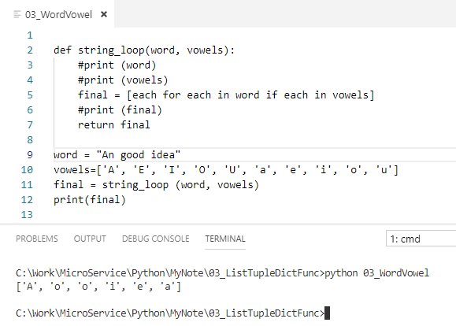
5 Python OOP
https://www.ucsc-extension.edu/certificate-program/offering/python-programming-beginners
HW 3 Review:
Functions - #2 (Tricky looping logic)
def string_loop(word, vowels):
final = [each for each in word if each in vowels]
return final

Slide 5
5 Python OOP
https://www.ucsc-extension.edu/certificate-program/offering/python-programming-beginners
HW 4 Review:
Look at Jupyter notebook of Section 4.

Slide 6
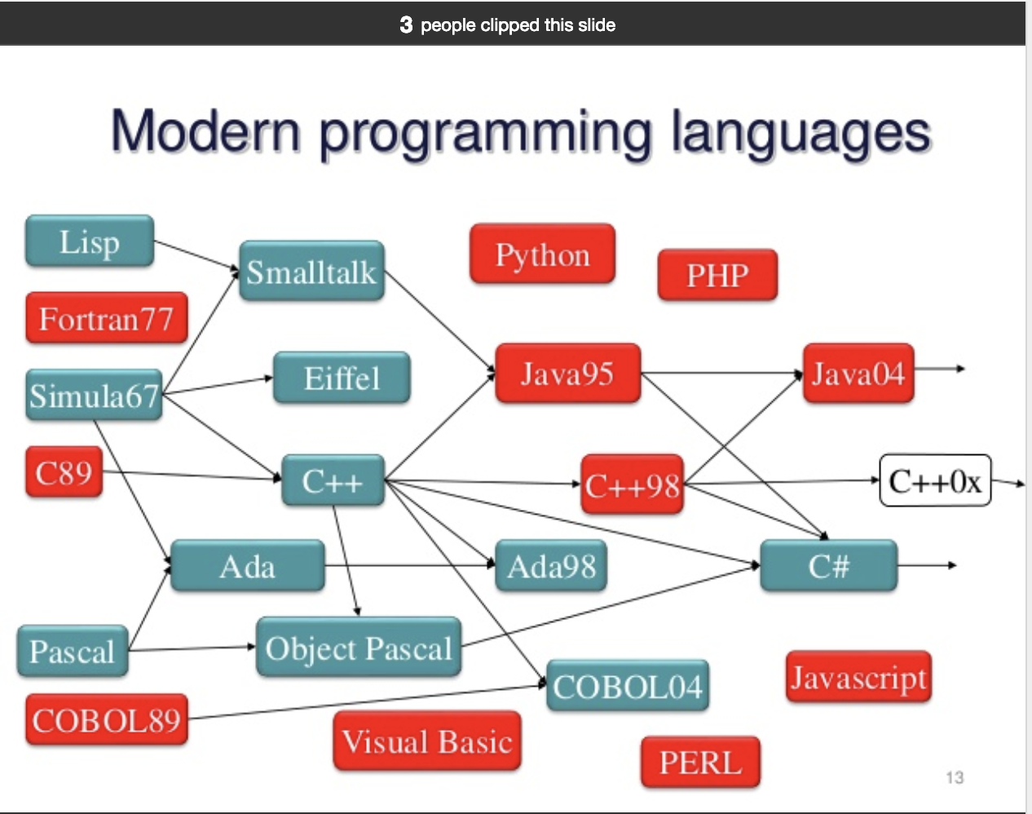
5 Python OOP
https://www.ucsc-extension.edu/certificate-program/offering/python-programming-beginners
Object-Oriented Programming

Slide 7
5 Python OOP
https://www.ucsc-extension.edu/certificate-program/offering/python-programming-beginners
Background in Language Type
3 Basic types of programming languages
High level languages
Assembly language
Machine language
Within HLL(High Level Language)’s, there are 3 types of programming models
Procedural (C, Perl, VBScript)
Functional (Scala, Erlang, LISP)
Object-Oriented (C++, Visual Basic, Java, Python)
Python is an HLL that has OOP features like classes, objects, inheritance
But some quirks (special gebavioral habit), weaknesses, feels like it was added afterward

Slide 8
5 Python OOP
https://www.ucsc-extension.edu/certificate-program/offering/python-programming-beginners
Procedural Languages (C, Perl, VBScript)
Focus is on managing the SOC (Sequence of Commands)
Helper mechanisms are provided, like procedures/subroutines
Data is managed manually as separate entities and passed between procedures/subroutines
Goal is to provide modularity/abstraction
This allows for separation of concerns
SOC has several benefits:
Improves scalability
Reduces system complexity
Better allows for additions to be made
Example from C:
int main() {
int n = 7;
printf("%d!=%ld\n", n, factorial(n));
}
long factorial(int n)
{
if (n == 0)
return 1;
else
return(n * factorial(n-1));
}

Slide 9
5 Python OOP
https://www.ucsc-extension.edu/certificate-program/offering/python-programming-beginners
Functional Programming Languages (Scala, Erlang, LISP)
Similar to Procedural
Functions are essentially procedures
Has similar goals of modularity/abstraction
Differences:
Emphasis on evaluation of complex expressions that are related by arguments / return values
Smaller reliance on control flow constructs like loops, branching
They avoid shared state constructs that can cause logic errors
Example from LISP:
(defun factorial (N)
"Compute the factorial of N."
(if (= N 1)
1
(* N (factorial (- N 1)))))

Slide 10
5 Python OOP
https://www.ucsc-extension.edu/certificate-program/offering/python-programming-beginners
Functional Programming Languages (Scala, Erlang, LISP)
Similar to Procedural
Functions are essentially procedures
Has similar goals of modularity/abstraction
Differences:
Emphasis on evaluation of complex expressions that are related by arguments/return values
Smaller reliance on control flow constructs like loops, branching
They avoid shared state constructs that can cause logic errors
Example from LISP:
(defun factorial (N)
"Compute the factorial of N."
(if (= N 1)
1
(* N (factorial (- N 1)))))

Slide 11
5 Python OOP
https://www.ucsc-extension.edu/certificate-program/offering/python-programming-beginners
Object-Oriented Programming (C++, Visual Basic, Java, Python)
Focus is to model the problem as a set of objects, data, and behavior
Data associated with objects are called Attributes or Members
Behavior associated with objects are functions called Methods
Objects can inherit data and behavior from other objects in a hierarchy
The basic lifecycle is:
Create an object
Set / Get data using the object’s attributes
Invoke behavior using the object’s methods
Destroy the object
Example from Java
public class Factorial {
public static void main(String[] args) {
int num = 5, i = 1;
long factorial = 1;
while(i <= num)
{
factorial *= i; i++;
}
System.out.printf("Factorial of %d = %d",
num, factorial);
}
}

Slide 12
5 Python OOP
https://www.ucsc-extension.edu/certificate-program/offering/python-programming-beginners
OOP – General Object Hierarchy Example
Object
Animal
Mineral
Vegetable
Vehicle
Airplane
Car
Boat
Ford
BMW
Volkswagon

Slide 13
5 Python OOP
https://www.ucsc-extension.edu/certificate-program/offering/python-programming-beginners
OOP – General Object Hierarchy Example (with methods/attributes)
Object
Animal
Mineral
Vegetable
Vehicle
Attr=fuel-level
Method=Start()
Airplane
Car
Attr=mph
Method=Drive()
Boat
Ford
BMW
Attr=Ultimate Driving Machine
Method=Drive()
Volkswagon

Slide 14
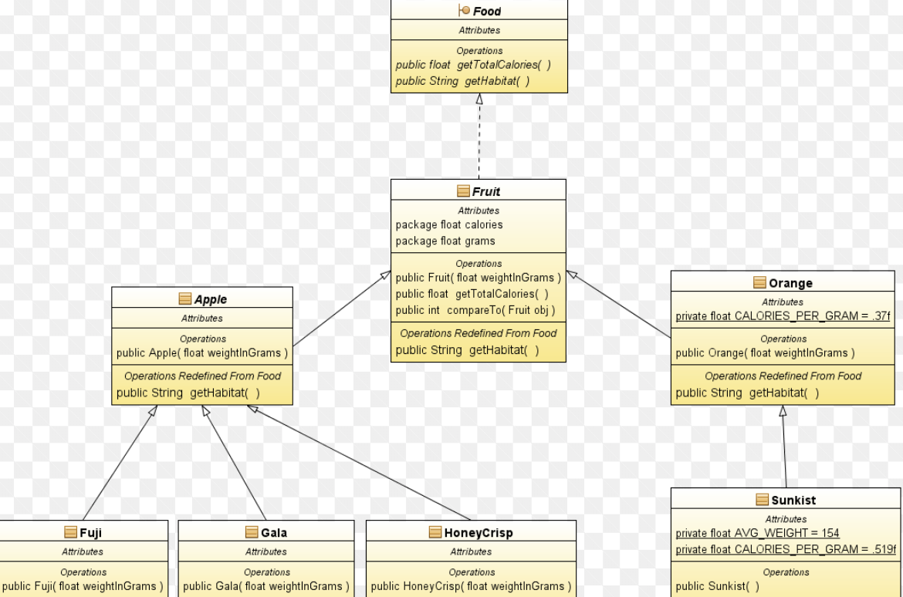
5 Python OOP
https://www.ucsc-extension.edu/certificate-program/offering/python-programming-beginners
OOP – Object Hierarchy Example 2

Slide 15
5 Python OOP
https://www.ucsc-extension.edu/certificate-program/offering/python-programming-beginners
OOP – Python Main Concept - 1
Class
A blueprint for how an object will be built, use
Examples: See Jupiter Notebook
Method
Functions attached to a class that implement its behavior
Examples: See Jupiter Notebook
Attribute
Data embedded in an object that encapsulate its state
Examples: See Jupiter Notebook
Constructor
A special method called when creating an object to initialize data/behavior
Examples: See Jupyter Notebook

Slide 16
5 Python OOP
https://www.ucsc-extension.edu/certificate-program/offering/python-programming-beginners
In Class Exercise – 1
Create classes to reflect this Object Hierarchy: Object <- Vegetable <- Apple
Create three different apples and add them to a list
Add a constructor to Apple that takes a Type parameter
Update object creation calls to pass apple type
e.g. (“Golden Delicious”, “Honey Crisp”, “Gravenstein”)
Call print on the list
Object
Vegetable
Apple

Slide 17
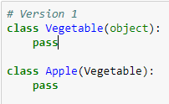
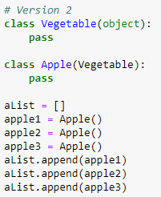
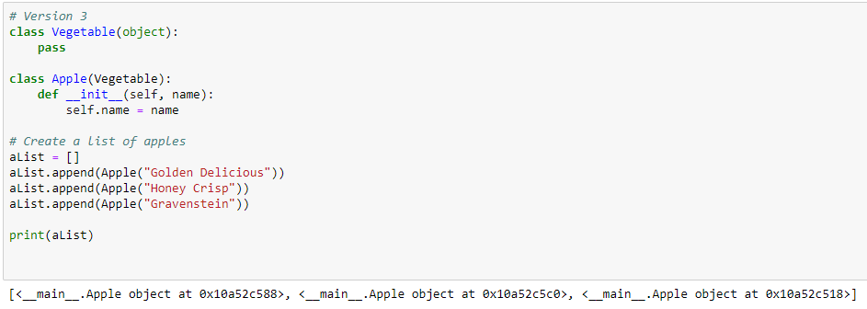
5 Python OOP
https://www.ucsc-extension.edu/certificate-program/offering/python-programming-beginners
In Class Exercise – 1
Answer:

Slide 18
5 Python OOP
https://www.ucsc-extension.edu/certificate-program/offering/python-programming-beginners
OOP – Python Main Concept – 2
Static method
Special methods not associated with a single object, but with the class
Examples: See Jupiter Notebook
Static attribute
Special methods not associated with a single object, but with the class
Examples: See Jupiter Notebook
Private method
Method that can only be accessed from other methods in the class but not from outside
Examples: See Jupiter Notebook
Private attribute
Attribute that can only be accessed from methods inside the class but not from outside
Examples: See Jupiter Notebook

Slide 19
5 Python OOP
https://www.ucsc-extension.edu/certificate-program/offering/python-programming-beginners
In Class Exercise 2
Add a static attribute to class Apple to keep track of # of apples.
Update constructor of Apple to increment the static variable.
Add a static method to class Apple that returns the # of apples.
Print out the number of apples, then create the 3 apples in a list as before, then print out the new number of apples

Slide 20
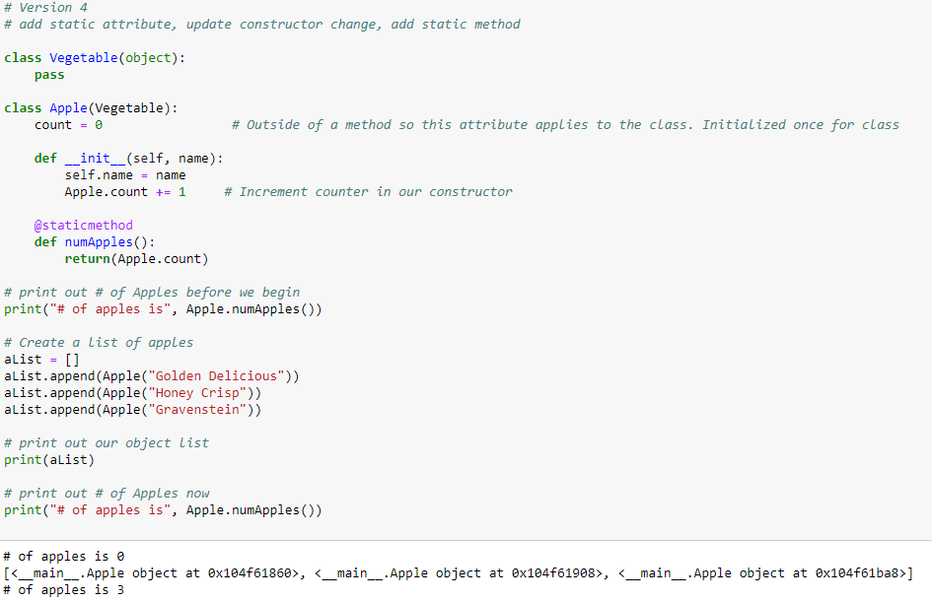
5 Python OOP
https://www.ucsc-extension.edu/certificate-program/offering/python-programming-beginners
In Class Exercise 2
Answer:

Slide 21
5 Python OOP
https://www.ucsc-extension.edu/certificate-program/offering/python-programming-beginners
In Class Exercise 3
Manage object deletion as well as creation.

Slide 22
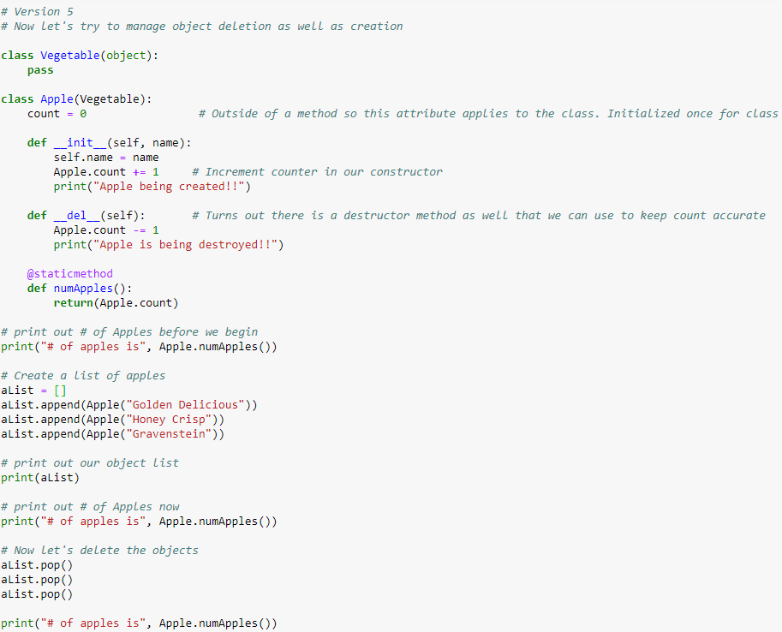
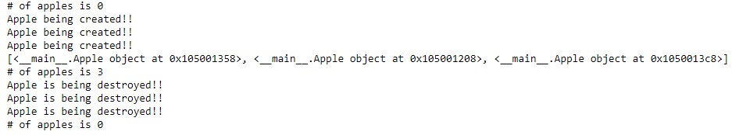
5 Python OOP
https://www.ucsc-extension.edu/certificate-program/offering/python-programming-beginners
In Class Exercise 3
Answer:

Slide 23
5 Python OOP
https://www.ucsc-extension.edu/certificate-program/offering/python-programming-beginners
In Class Exercise 3
Answer:

Slide 24
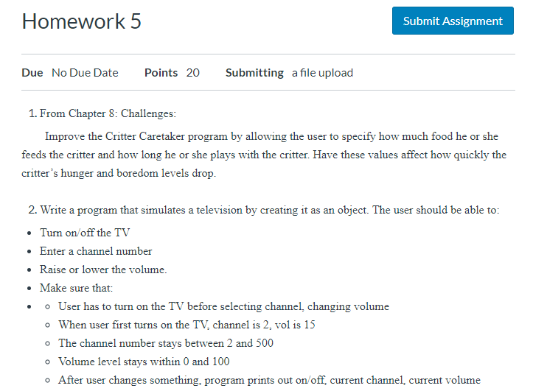
5 Python OOP
https://www.ucsc-extension.edu/certificate-program/offering/python-programming-beginners
Homework 5 preview

Slide 25
End of Chapter

