Slide 1

Homework 5
Peter H. Chen

Slide 2
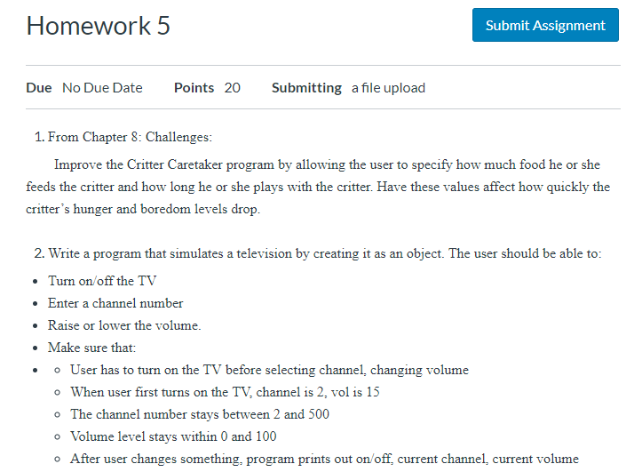
Homework 5
https://classroom.ucsc-extension.edu/courses/3271/assignments/24080

Slide 3
End of Chapter

