Slide 1

6 Python GUI
Peter H. Chen

Slide 2
6 Python GUI
https://www.ucsc-extension.edu/certificate-program/offering/python-programming-beginners
Topic:
Summary of material of section 5 (OOP, review classes)
Review HW 5 Answers
Miscellaneous Topics
Modules, How to find them, what functions are in them, etc.
“Trivial” concept, examples
GUI Programming (Textbook Chapter 10)
Wrap-up

Slide 3
6 Python GUI
https://www.ucsc-extension.edu/certificate-program/offering/python-programming-beginners
Review of Section 5: OOP
Focus is to model the problem as a set of objects, data, and behavior
The objects expose the data and behavior through interfaces
These are bundled together in one abstraction
The basic lifecycle is:
Create an object
Access behavior of the object
Pass data in / out of the object, either directly or as a result of behavior
Objects can pass data between each other using messages
Destroy the object

Slide 4
6 Python GUI
https://www.ucsc-extension.edu/certificate-program/offering/python-programming-beginners
Review answer of HW 5
Look at .ipynb answers
Focus on class topics

Slide 5
6.1 Python Modules

Slide 6
6.1 Python Modules
https://www.ucsc-extension.edu/certificate-program/offering/python-programming-beginners
Miscellaneous Topics – Modules 01
Allows for code re-use, a big part of SW development
Helps break apart big programs to manage them better
Can share code with others, and steal, err borrow, code from others
Encourages ”Modular” code design
There are built-in modules, like random, 3rd party modules you download, and modules You build
Named “module_name.py”
Accessed by including “import module_name” in script

Slide 7
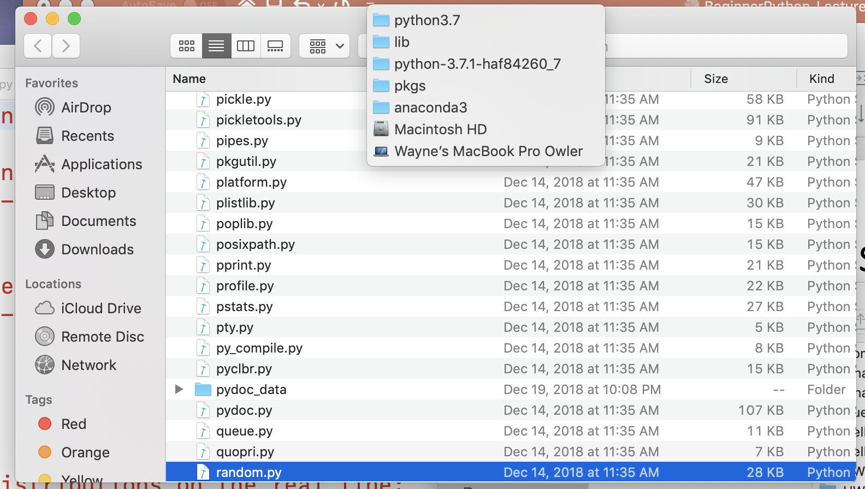
6.1 Python Modules
https://www.ucsc-extension.edu/certificate-program/offering/python-programming-beginners
Miscellaneous Topics – Modules 02: random module
Where are they? Global search for random.py
Configure Finder to open terminal at current folder
Go into finder/services/service preferences…
Make sure “New Terminal Tab Here” or “New Terminal Window Here” are checked
Navigate to folder
Search for datetime.py at computer level
Right click and select “New Terminal here”
Do “ls”, etc.

Slide 8
6.1 Python Modules
https://www.ucsc-extension.edu/certificate-program/offering/python-programming-beginners
Miscellaneous Topics – Modules 03
OS commands to help
printenv | grep PYTHON (Linux, MacOS)
env | grep PYTHON (other operating system)
We’ll assum that printenv works for below
Subtlety around python / python 3.7, etc. Commands
printenv (shows all environment variables)
printenv | grep PATH (shows path to executables)
which python (shows which interpreter will be invoked
printenv | grep -i conda (shows anaconda items)
printenv | grep -i python (separate variable for that python executable)

Slide 9
6.1 Python Modules
https://www.ucsc-extension.edu/certificate-program/offering/python-programming-beginners
Miscellaneous Topics – Modules 04
Multiple import statements are ignored
Spyder example
Can reduce overhead with “from” qualifier. Example:
from datetime import date
Implications
Have to know what to include for our use case
Are there sub-dependencies? Other relationship issues

Slide 10
6.1 Python Modules
https://www.ucsc-extension.edu/certificate-program/offering/python-programming-beginners
Miscellaneous Topics – Modules 05
How do you find them (modules) in your Python distribution?
a. Here's some general background on modules/packages https://www.tutorialspoint.com/python/python_modules.htm
b. can search your computer for a module like datetime.py and go look in that folder /anaconda3/lib/python3.7
c. Go look at the distribution documentation for version of Python you have installed https://docs.python.org/3/library/datetime.html python --version
d. call the dir(module_name) function (see code below) e. call the help(module_name) function (see code below)
f. Some IDE's will have language specific documentation integrated into them.

Slide 11
6.1 Python Modules
https://www.ucsc-extension.edu/certificate-program/offering/python-programming-beginners
Miscellaneous Topics – Modules 06
# Modules.
#Here's a way to enumerate the functions in a module that's in our path.
#This example uses datetime
import datetime
for entry in dir(datetime):
print(entry)
# This generates helptext for a module, assuming the writer follows convention detailed below
print ("help:")
help(datetime)

Slide 12
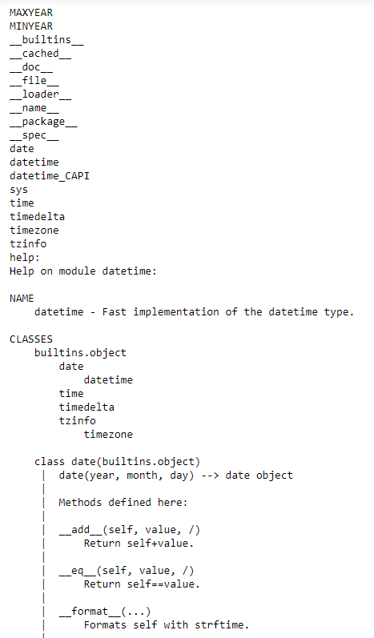
6.1 Python Modules
https://www.ucsc-extension.edu/certificate-program/offering/python-programming-beginners
Miscellaneous Topics – Modules 07
for entry in dir(datetime):
print(entry)
# This generates helptext for a module,
#assuming the writer follows convention
# detailed below
print ("help:")
help(datetime)

Slide 13
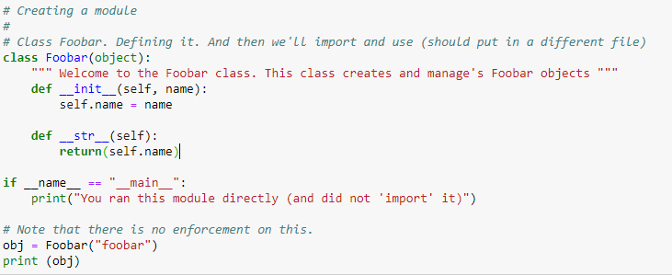

6.1 Python Modules
https://www.ucsc-extension.edu/certificate-program/offering/python-programming-beginners
Miscellaneous Topics – Modules 08

Slide 14
6.2 GUI Programming

Slide 15
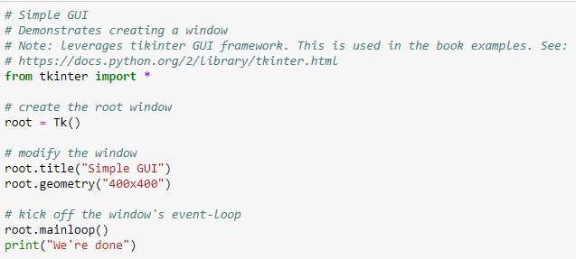
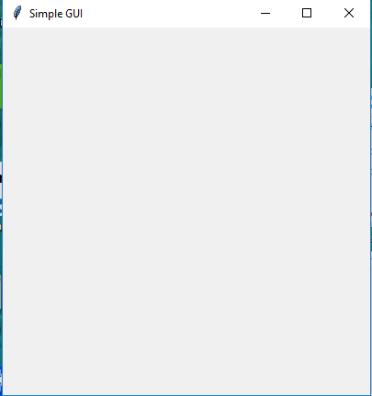
6.2 GUI Programming
https://www.ucsc-extension.edu/certificate-program/offering/python-programming-beginners
GUI Programming: 01 Simple GUI
Look at Jupiter notebook

Slide 16
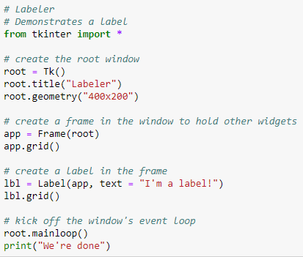
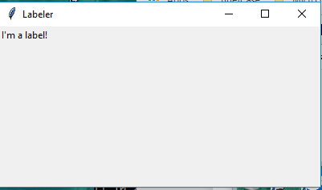
6.2 GUI Programming
https://www.ucsc-extension.edu/certificate-program/offering/python-programming-beginners
GUI Programming – 02: Labeler
Look at Jupiter notebook

Slide 17
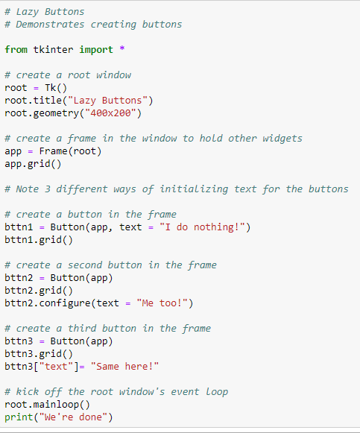
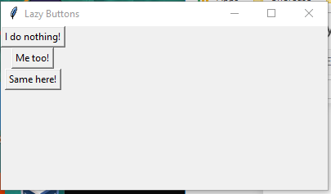
6.2 GUI Programming
https://www.ucsc-extension.edu/certificate-program/offering/python-programming-beginners
GUI Programming – 03: Lazy Buttons
Look at Jupiter notebook

Slide 18
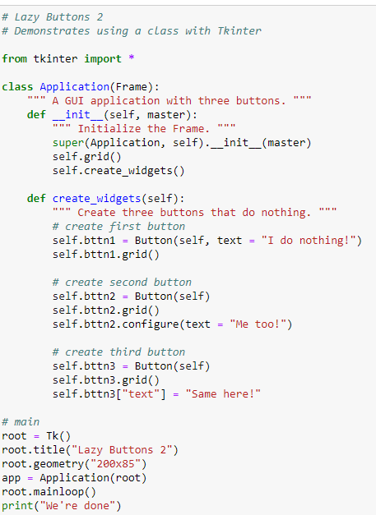
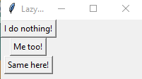
6.2 GUI Programming
https://www.ucsc-extension.edu/certificate-program/offering/python-programming-beginners
GUI Programming – 04: Lazy Buttons with class Application
Look at Jupiter notebook

Slide 19
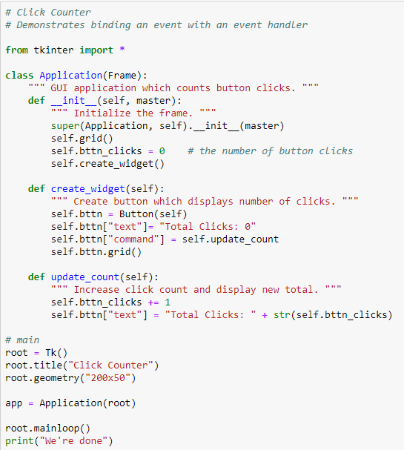

6.2 GUI Programming
https://www.ucsc-extension.edu/certificate-program/offering/python-programming-beginners
GUI Programming – 05: Click Counter
Look at Jupiter notebook

Slide 20
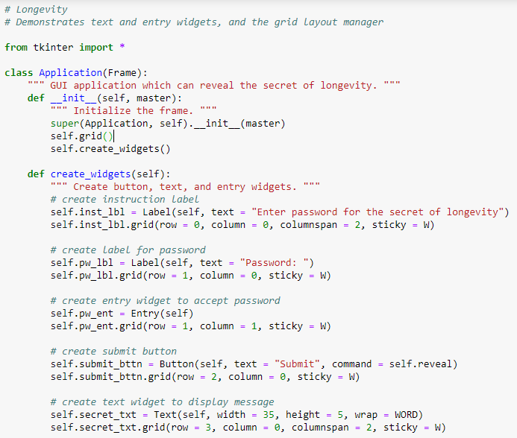
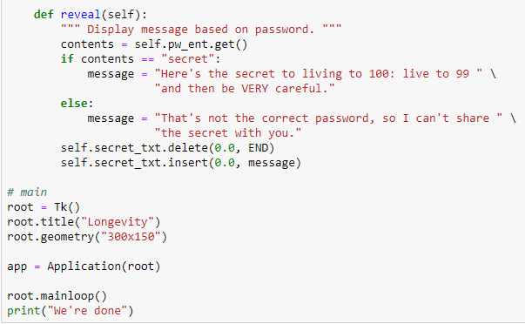
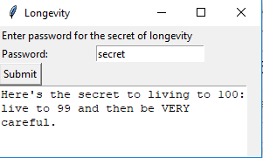
6.2 GUI Programming
https://www.ucsc-extension.edu/certificate-program/offering/python-programming-beginners
GUI Programming – 06: Longevity
Look at Jupiter notebook

Slide 21
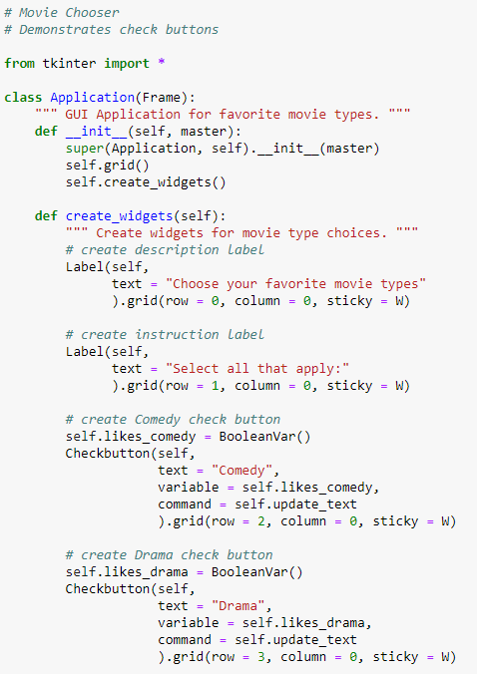
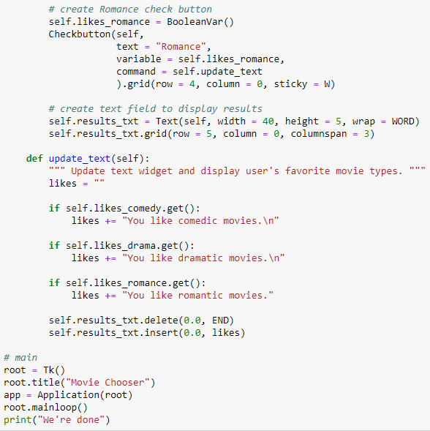
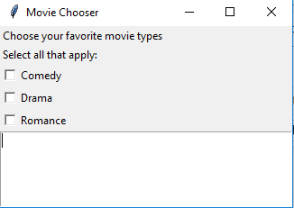
6.2 GUI Programming
https://www.ucsc-extension.edu/certificate-program/offering/python-programming-beginners
GUI Programming – 07: Movie Chooser
Look at Jupiter notebook

Slide 22
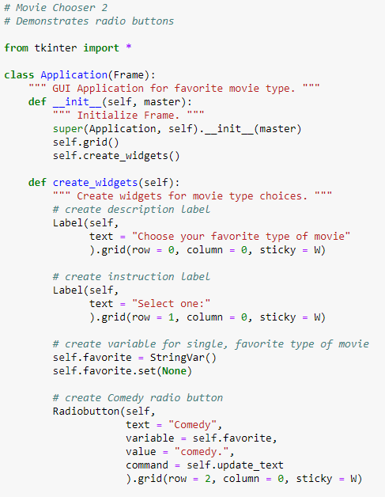
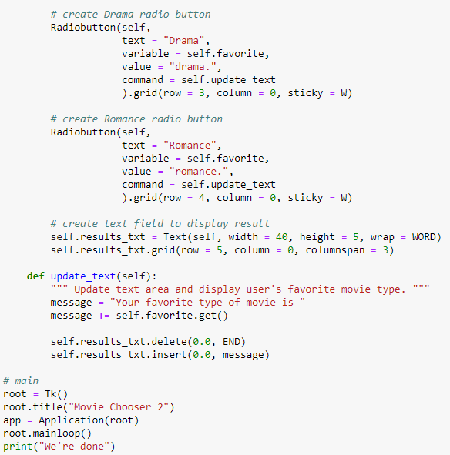
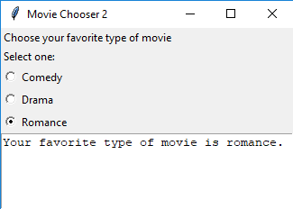
6.2 GUI Programming
https://www.ucsc-extension.edu/certificate-program/offering/python-programming-beginners
GUI Programming – 08: Movie Chooser 2
Look at Jupiter notebook

Slide 23
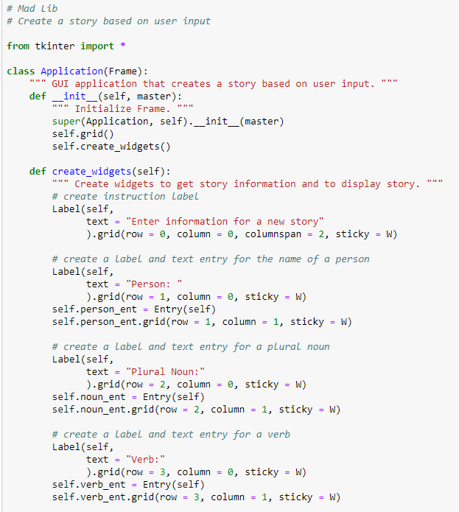
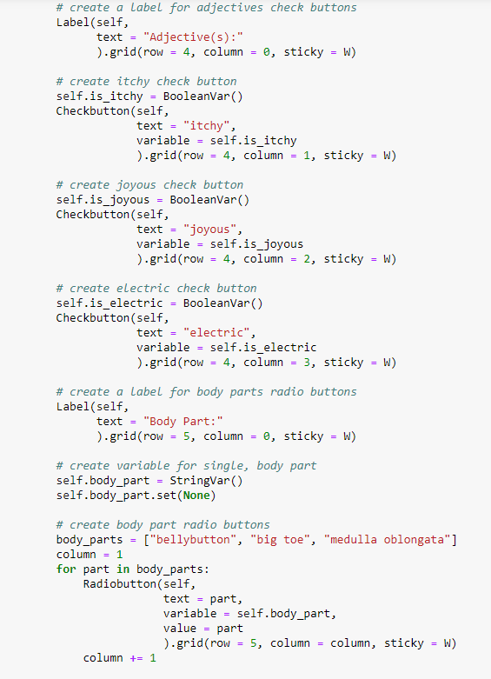
6.2 GUI Programming
https://www.ucsc-extension.edu/certificate-program/offering/python-programming-beginners
GUI Programming – 09: Mad Lib - 01
Look at Jupiter notebook

Slide 24
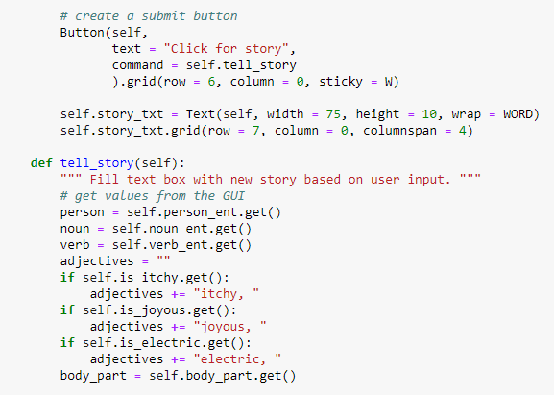
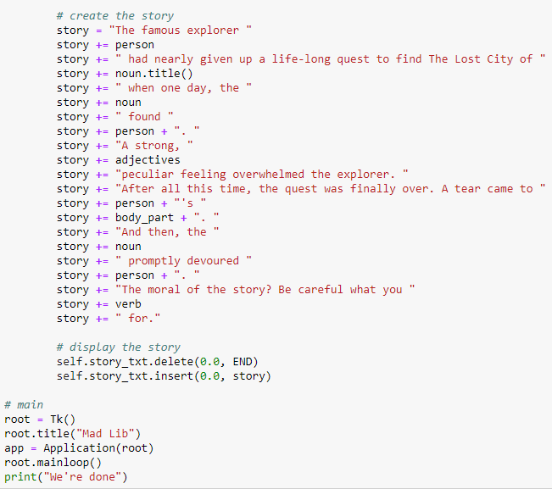
6.2 GUI Programming
https://www.ucsc-extension.edu/certificate-program/offering/python-programming-beginners
GUI Programming – 09: Mad Lib - 02
Look at Jupiter notebook

Slide 25
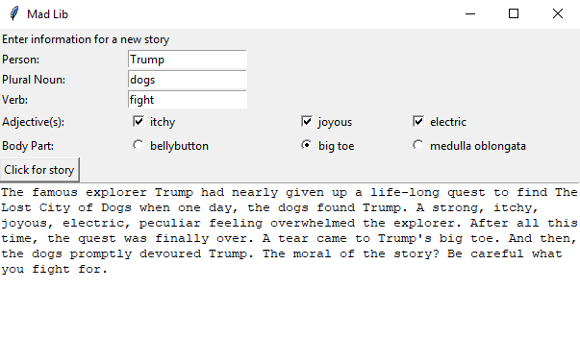
6.2 GUI Programming
https://www.ucsc-extension.edu/certificate-program/offering/python-programming-beginners
GUI Programming – 09: Mad Lib - 03
Look at Jupiter notebook

Slide 26
6.3 Trivial Concept

Slide 27
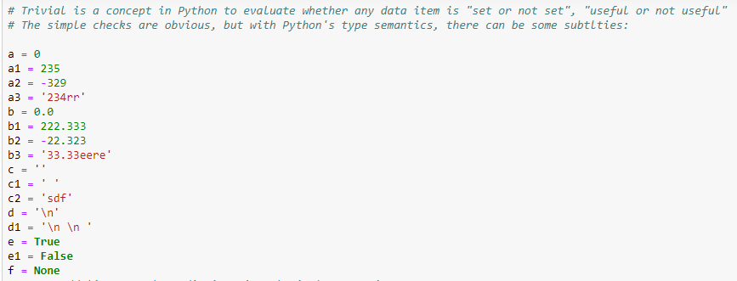
6.3 Trivial Concept
https://www.ucsc-extension.edu/certificate-program/offering/python-programming-beginners
Trivial Concept: 01
Trivial is a concept in Python to evaluate whether any data item is “set or not set”, “useful or not useful.”
The simple checks are obvious, but with Python’s type semantics, there can be some subtlties.

Slide 28
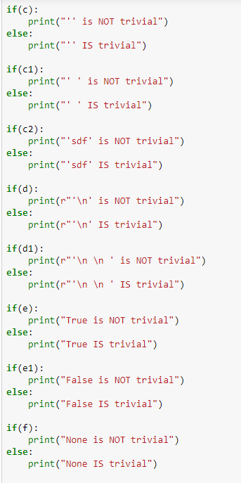
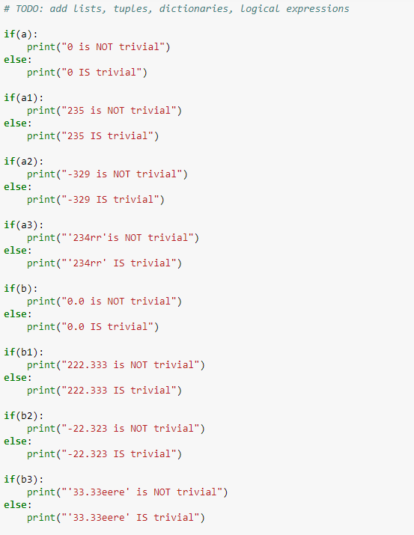
6 Python GUI
https://www.ucsc-extension.edu/certificate-program/offering/python-programming-beginners
Trivial Concept: 02

Slide 29
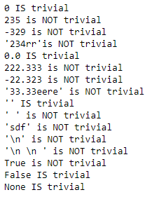
6.3 Trivial Concept
https://www.ucsc-extension.edu/certificate-program/offering/python-programming-beginners
Trivial Concept: 03

Slide 30
6.4 Working with Request Modules

Slide 31
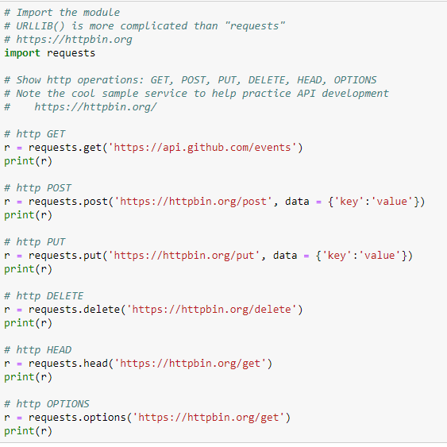
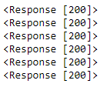
6.4 HTTP Request Modules
https://www.ucsc-extension.edu/certificate-program/offering/python-programming-beginners
Httpbin.org is a website which provide a simple HTTP Request & Response Service.
You can write HTTP Request: get, post, put, delete, head and test the code you write.

Slide 32
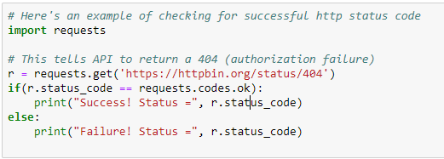

6.4 HTTP Request Modules
https://www.ucsc-extension.edu/certificate-program/offering/python-programming-beginners
Test for Success or Failure.

Slide 33
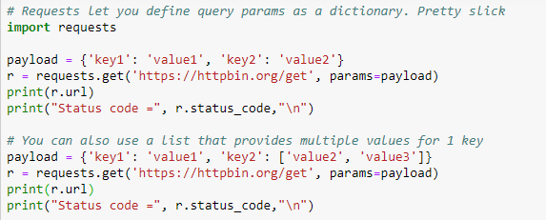
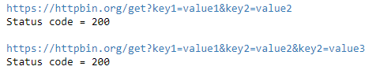
6.4 HTTP Request Modules
https://www.ucsc-extension.edu/certificate-program/offering/python-programming-beginners
Request with parameters and return status.

Slide 34
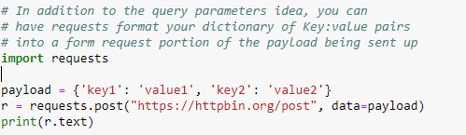
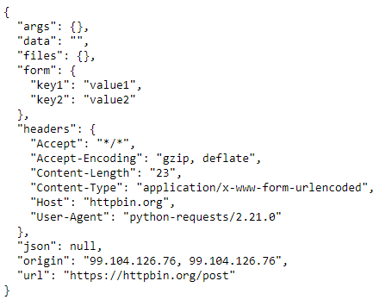
6.4 HTTP Request Modules
https://www.ucsc-extension.edu/certificate-program/offering/python-programming-beginners
Request with payload in JSON (key: value) format.

Slide 35
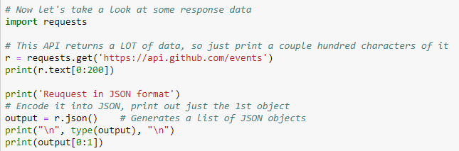
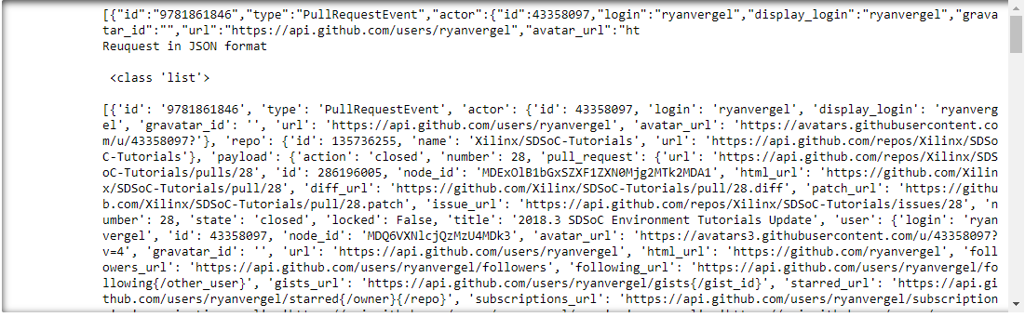
6.4 HTTP Request Modules
https://www.ucsc-extension.edu/certificate-program/offering/python-programming-beginners
Specify the data in response.

Slide 36
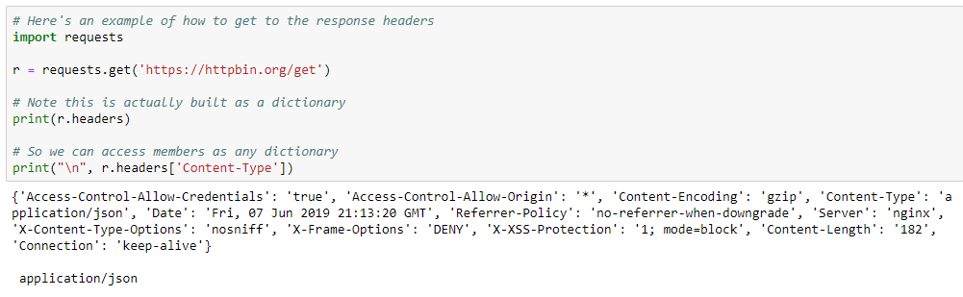
6.4 HTTP Request Modules
https://www.ucsc-extension.edu/certificate-program/offering/python-programming-beginners
Get the response headers.

Slide 37
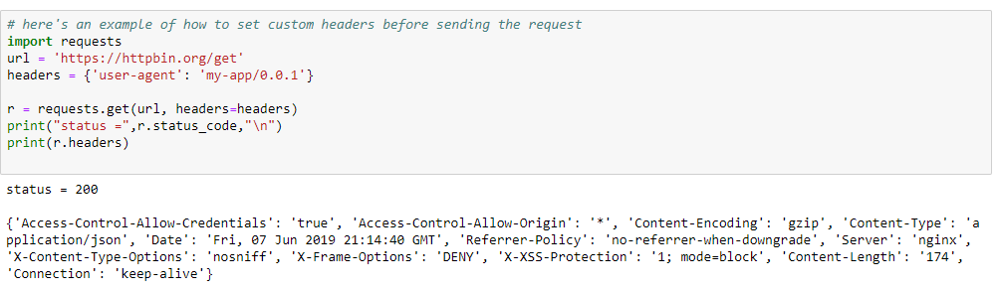
6.4 HTTP Request Modules
https://www.ucsc-extension.edu/certificate-program/offering/python-programming-beginners
Set up the custom headers before sending the request.

Slide 38
6.5 UCSC Extension Classes

Slide 39
6.5 UCSC Extension Classes
https://www.ucsc-extension.edu/certificate-program/offering/python-programming-beginners
Miscellaneous Topics – USCS Class
Certificate Program
https://www.ucsc-extension.edu/certificate-program
Computer Programming
https://www.ucsc-extension.edu/certificate-program/technology/computer-programming
Database and Analytics
https://www.ucsc-extension.edu/certificate-program/technology/database-and-data-analytics
Embedded Systems
https://www.ucsc-extension.edu/certificate-program/technology/embedded-systems
Information Technology
https://www.ucsc-extension.edu/certificate-program/technology/information-technology

Slide 40
6.5 UCSC Extension Classes
https://www.ucsc-extension.edu/certificate-program/offering/python-programming-beginners
Miscellaneous Topics – USCS Class
Internet Programming and Development
https://www.ucsc-extension.edu/certificate-program/technology/internet-programming-and-development
Linux Programming and Administration
https://www.ucsc-extension.edu/certificate-program/technology/linux-programming-and-administration
Mobile Application Development Professional Award
https://www.ucsc-extension.edu/certificate-program/technology/mobile-application-development-professional-award
Software Engineering and Quality
https://www.ucsc-extension.edu/certificate-program/technology/software-engineering-and-quality
VLSI Engineering
https://www.ucsc-extension.edu/certificate-program/technology/vlsi-engineering

Slide 41
End of Chapter

