Slide 1

0701 Override
Peter H. Chen

Slide 2
0701 Override
https://www.ucsc-extension.edu/certificate-program/offering/python-programmers
Topics:
Override
Has-a vs. Is-A Relationships

Slide 3
0701.1 lab14-1.py

Slide 4
0701.1 lab14-1.py
https://www.ucsc-extension.edu/certificate-program/offering/python-programmers
Lab14_1.py: AB (A,B), it look for A for initializer. It found x initializer x =1 and y = 2. The second argument B also has x and Y are ignored, and then z is ignored.
X
Y
x = 1
z = 3
A
B
y = 2
x = 2
AB (A, B)
BA (B, A)

Slide 5
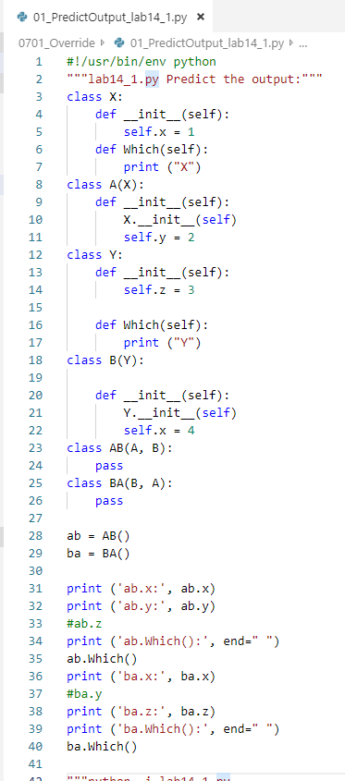
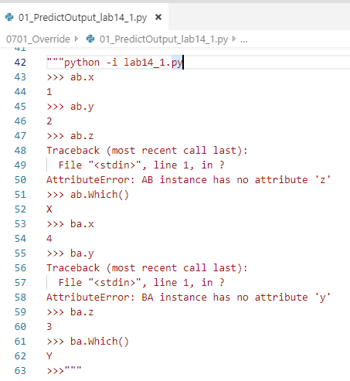
0701.1 lab14-1.py
https://www.ucsc-extension.edu/certificate-program/offering/python-programmers
Lab14_1.py:

Slide 6
0701.2 lab14-2.py

Slide 7
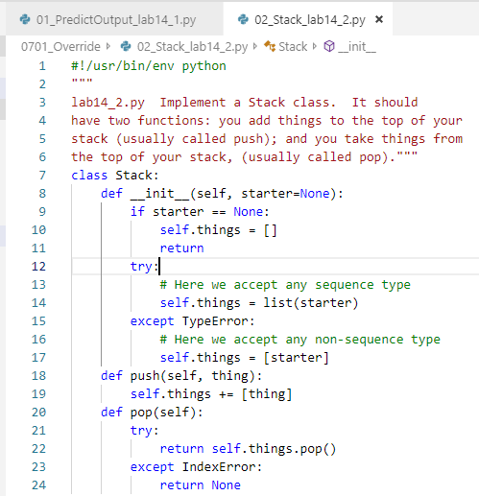
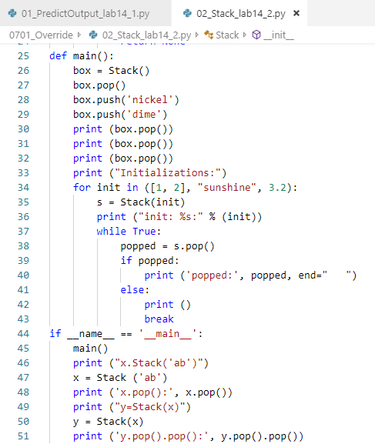
0701.2 lab14-2.py
https://www.ucsc-extension.edu/certificate-program/offering/python-programmers
Lab14_2.py: Make a list in the initializer. Anybody call it will be push and then pop the list.

Slide 8
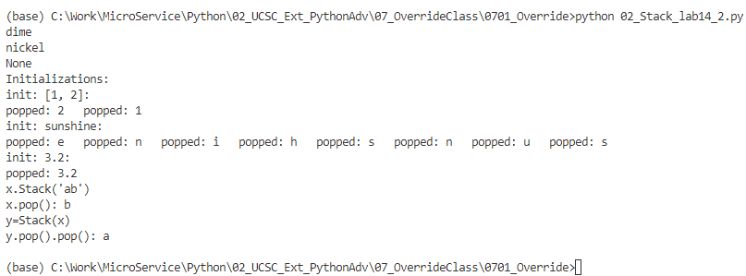
0701.2 lab14-2.py
https://www.ucsc-extension.edu/certificate-program/offering/python-programmers
Lab14_2.py: Push and pop the list.

Slide 9
0701.3 printable_stack_def.py

Slide 10
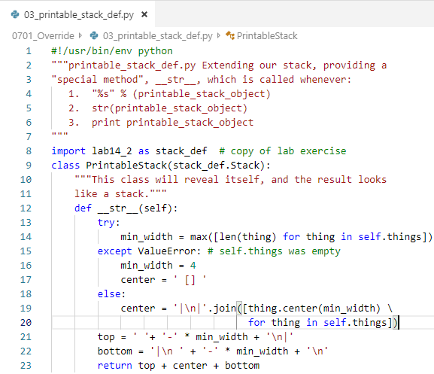
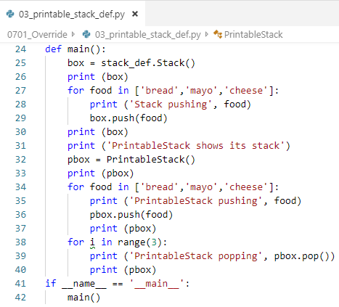
0701.3 printable_stack_def.py
https://www.ucsc-extension.edu/certificate-program/offering/python-programmers
Printable_stack_def.py: __str__ is called whenever:
1) “%s” % (printable_satck_object)
2) str (printable_stack_object)
3) print (prtibale_satck_object)

Slide 11
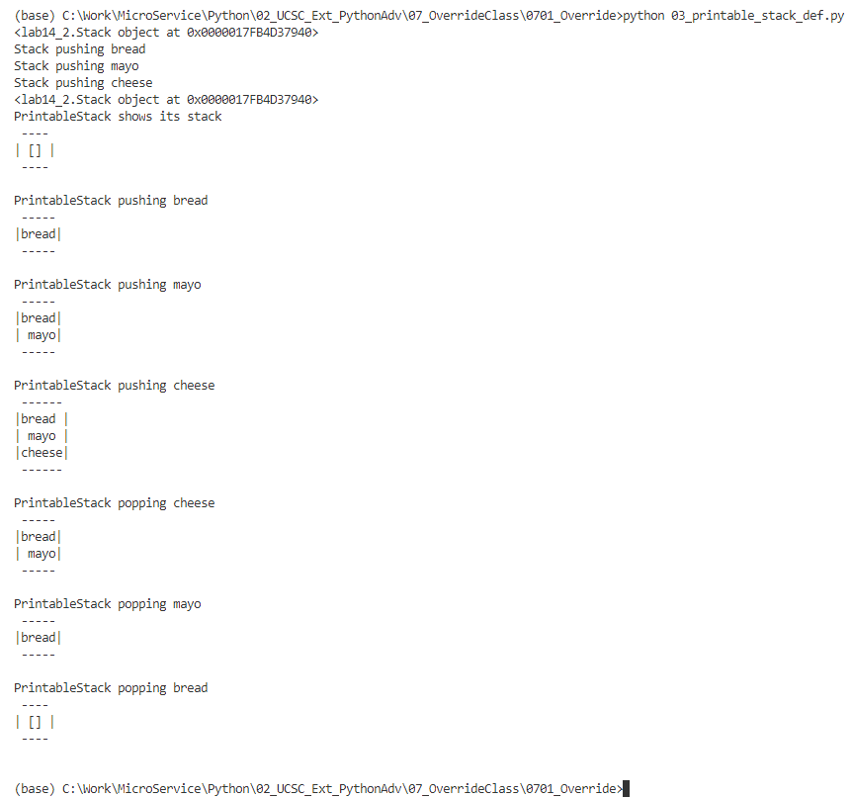
0701.3 printable_stack_def.py
https://www.ucsc-extension.edu/certificate-program/offering/python-programmers
Printable_stack_def.py:

Slide 12
0701.4 lab14-3.py

Slide 13
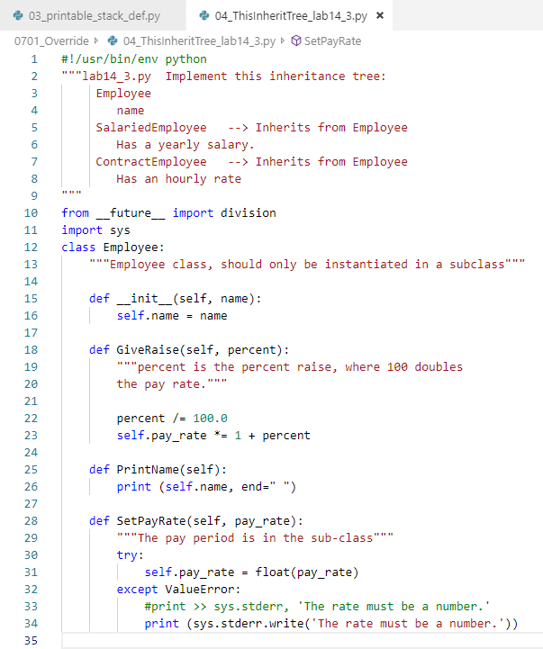
0701.4 lab14-3.py
https://www.ucsc-extension.edu/certificate-program/offering/python-programmers
Lab14-3.py: Employee class has some methods will be inherited. Nothing special.

Slide 14
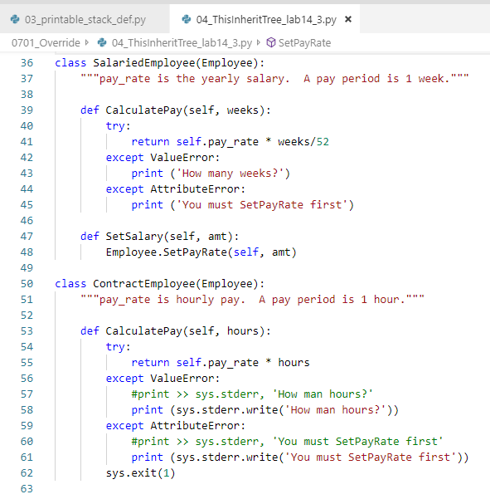
0701.4 lab14-3.py
https://www.ucsc-extension.edu/certificate-program/offering/python-programmers
Lab14-3.py:

Slide 15
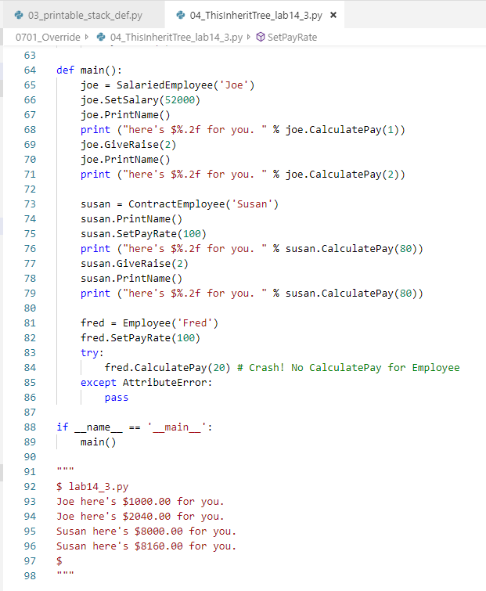
0701.4 lab14-3.py
https://www.ucsc-extension.edu/certificate-program/offering/python-programmers
Lab14-3.py:

Slide 16
0701.5 welcomer-def.py

Slide 17
0701.5 welcomer_def.py
https://www.ucsc-extension.edu/certificate-program/offering/python-programmers
Welcopmer-def.py: we inherit the employee_def.py and greeter_def.py before.
Create a class Welcomer with mixing of class NamedGreeter and class SalariedEmployee.
The welcomers = 0 is the static variable in C language.
In the initializer __init__ will add one (welcomers += 1) when each time get called
Magic __call__ for call operator, e.g.., pass a string.
Magic __del__ for deletion.
Magic __str__ for print and etc.

Slide 18
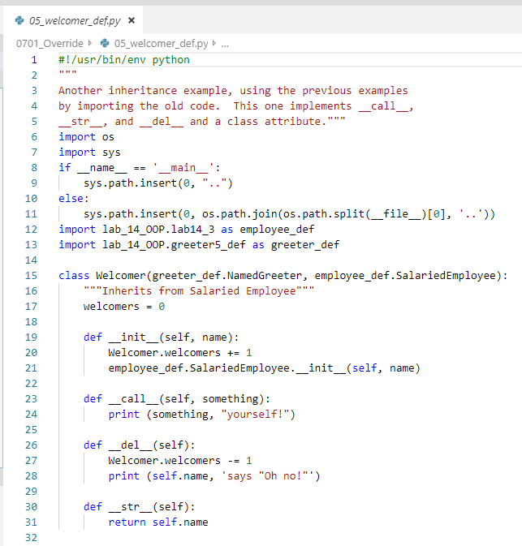
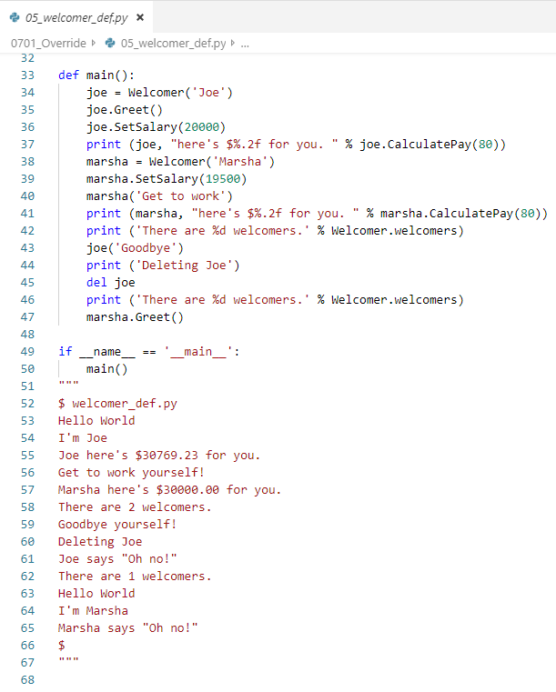
0701.5 welcomer_def.py
https://www.ucsc-extension.edu/certificate-program/offering/python-programmers
Welcopmer-def.py:

Slide 19
0701.6 circle-def.py

Slide 20
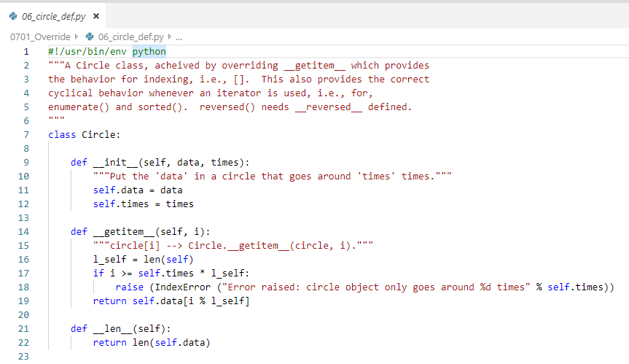
0701.6 circle_def.py
https://www.ucsc-extension.edu/certificate-program/offering/python-programmers
circle-def.py:
Here we implemented the __getitem__ for get Item, whenever there are square bracket of the object, i.e., Object[i]. Then, the magic__getitem__ got called.
The magic__len__ gets called for whenever we use len().

Slide 21
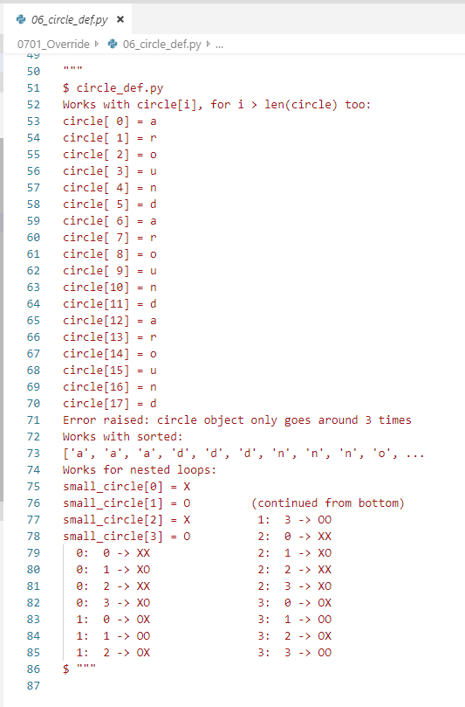
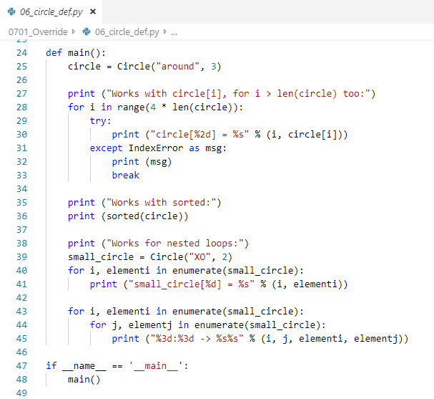
0701.6 circle_def.py
https://www.ucsc-extension.edu/certificate-program/offering/python-programmers
circle-def.py:

Slide 22
0701.7 Store Diagram

Slide 23
0701.7 Store Diagram
https://www.ucsc-extension.edu/certificate-program/offering/python-programmers
Store Diagram: Simplified Class Diagram for a Store, using UML (Unified Modeling Language)
Employee
Greeter
(is-a)
(is-a)
Salaried Employee
Named Greeter
(is-a)
(is-a)
Welcomer
(has-a)
Personal Dept
(has-a or contains)
Store

Slide 24
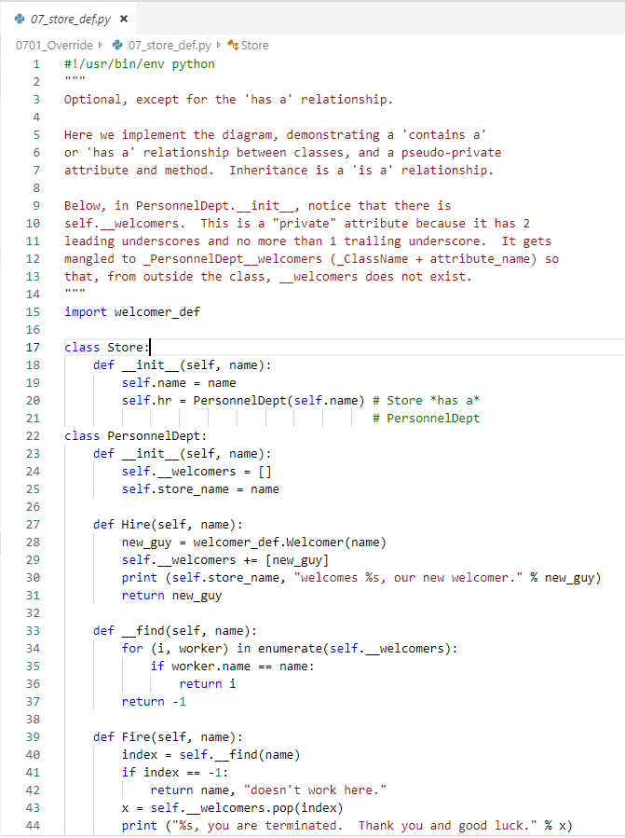
0701.8 store_def.py
https://www.ucsc-extension.edu/certificate-program/offering/python-programmers
Class Store and class PersonalDept.
“__Welcomers”: __ means private variable. Please do not use this variable outside the class.
The ”__” is called pseudo-privacy and mingled with in front of name but not after the name.
The “__find” is the pseudo-privacy function for the class.

Slide 25
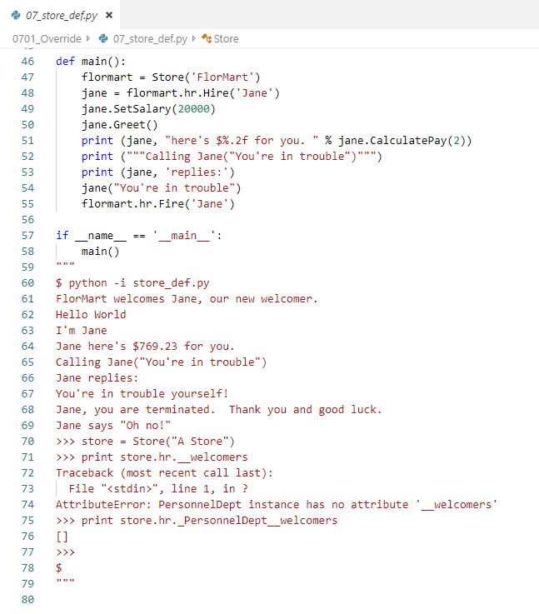
0701.8 store_def.py
https://www.ucsc-extension.edu/certificate-program/offering/python-programmers
Try to access “__” variable get error.
We cannot access the pseudo-privacy variable ”__” is called pseudo-privacy.

Slide 26
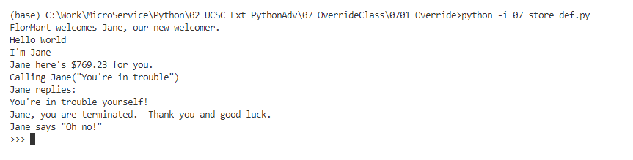
0701.8 store_def.py
https://www.ucsc-extension.edu/certificate-program/offering/python-programmers
> python -i
The “-i” is interactive mode for command prompt (>>>).

Slide 27
0701.9 Lab 15

Slide 28
0701.9 Lab 15
https://www.ucsc-extension.edu/certificate-program/offering/python-programmers
Use magic string __str__ for print object and
Magic __add__
To add the c3 = c1 and c2.

Slide 29
End of Chapter

