Slide 1

0702 New Style Class
Peter H. Chen

Slide 2
0702 New Style Class
https://www.ucsc-extension.edu/certificate-program/offering/python-programmers
Topics:
Useful Attributes
Iterators
New Style Classes
Attribute Control (Optional)
Property (Optional)
Static Methods (Optional)
Class Methods (Optional)
Diamond Inheritance (Optional)

Slide 3
0702.1 Lab15.py

Slide 4
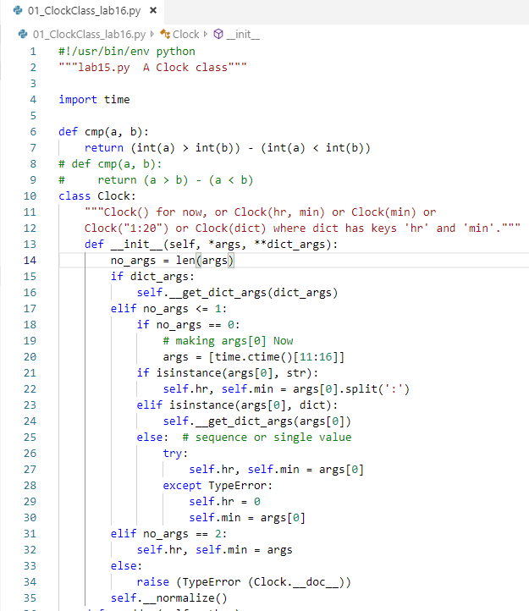
0702.1 Lab15.py
https://www.ucsc-extension.edu/certificate-program/offering/python-programmers
Lab15.py: Initializer.
__init__(): check the number of arguments and a bunch of key words.
__normalize() put the data into the Clock class. See the next page of the implementation of __normalize() privacy method.

Slide 5
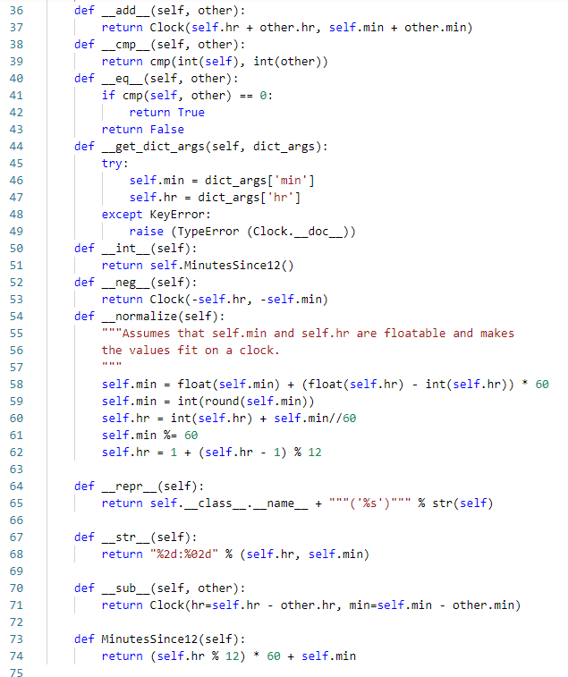
0702.1 Lab15.py
https://www.ucsc-extension.edu/certificate-program/offering/python-programmers
Lab15.py: Look at the magic string __str__(). This print the clock object.
__add__(): Add two clock together.
__cmp__(): Compare the integer of two clock.

Slide 6
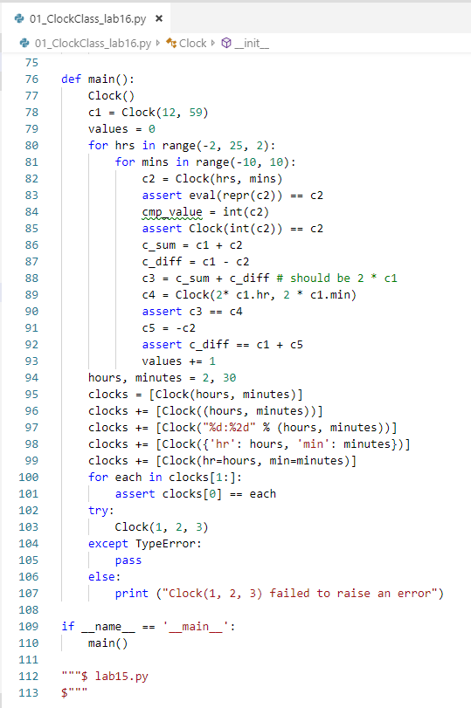
0702.1 Lab15.py
https://www.ucsc-extension.edu/certificate-program/offering/python-programmers
Lab15.py: The assert is very useful in evaluating code. It must be true during the execution. Otherwise, it will have execution error.
The assert statement are set to true for development.
These are the assert() statement and make sure all the assert() are all true.
During the development, we use assert() statement to test.
In the release, we remove assert() statement for execution optimization.

Slide 7
0702.2 Useful Attributes

Slide 8
0702.2 Useful Attributes
https://www.ucsc-extension.edu/certificate-program/offering/python-programmers
There are useful attributes:
These are built_in class attributes, available for all classes. For example:
Your_class.__module__: Module where you class is defined.
Your_class.__name__: String nbame of your class.
Your_class.__doc__: Doc string for your class.
Your_class.__class__: This is the MetaClass. Your_class is an instance of MetaClass.
Your_class.__basses__: Tuple of your class’ base classes.
Instances have special built_in attributes:
Your_obj.__class__: Class that instantiated your object
Your_obj.__dict__: Dictionary pf your object attributes and values
These built_in functions are always available:
globals(): Returns a dictionary of the global attributes.
locals(): Returns a dictionary of your local attributes.
The MetaClass is the class of class. It is a class that instantiated your class. There must be one since everything, even classes, are objects.

Slide 9
0702.3 New Style Class

Slide 10
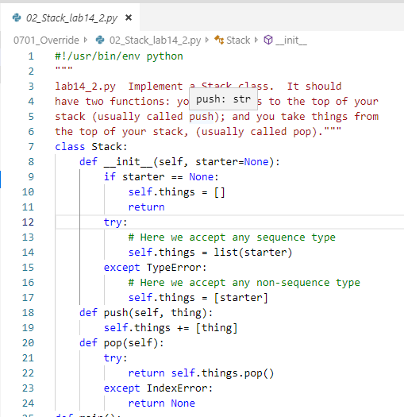
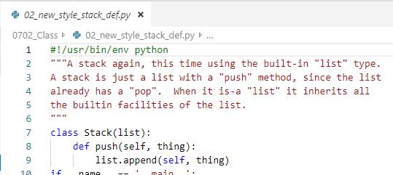
0702.3 New Style Class
https://www.ucsc-extension.edu/certificate-program/offering/python-programmers
New_style_stack_def.py:
Python 2.1 uses the old style class:
class Stack:
After Python 2.1, the new style class is inherited from python object (lower case ‘o’) class.
class Stack (list):

Slide 11
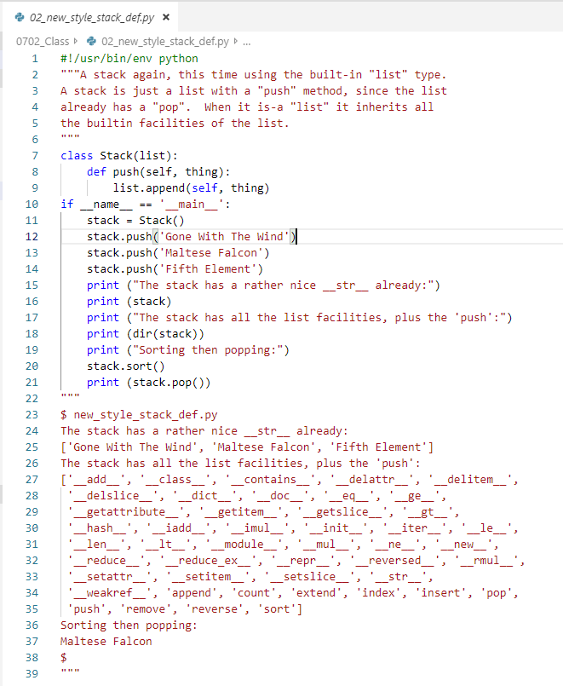
0702.3 New Style Class
https://www.ucsc-extension.edu/certificate-program/offering/python-programmers
New_style_stack_def.py:

Slide 12
0702.4 new_style_circle_def.py

Slide 13
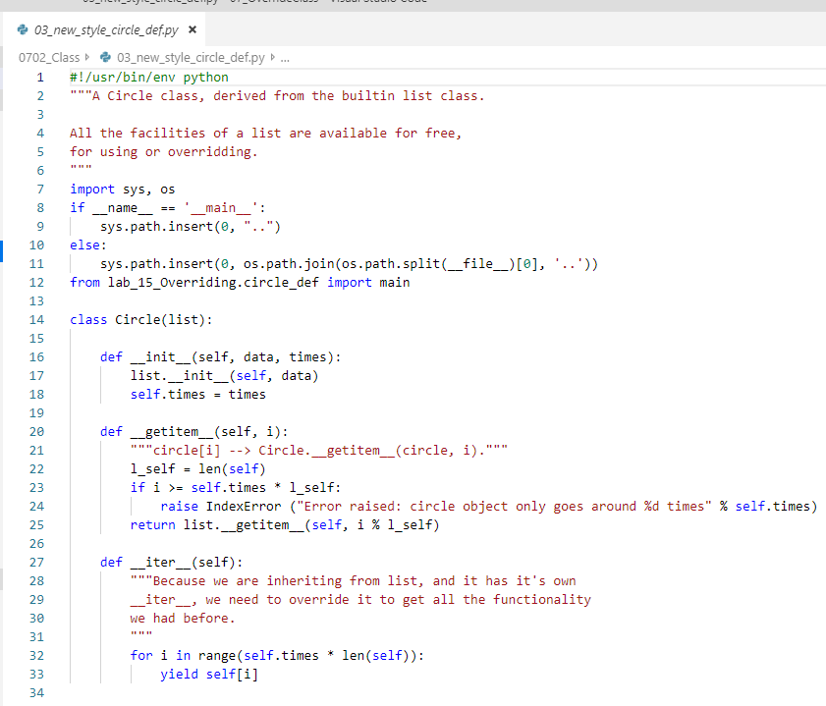
0702.4 new_style_circle_def.py
https://www.ucsc-extension.edu/certificate-program/offering/python-programmers
New_style_circle_def.py:
Line 12: We are inheriting the Circle_def.py and importing main so that I can run the main.
The “Circle(list):” inheriting list.
__init__(): Initialize the list and times.
The __iter__(): yield the item.

Slide 14
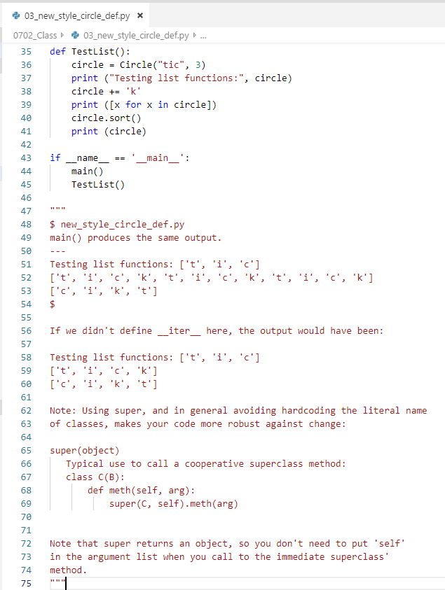
0702.4 new_style_circle_def.py
https://www.ucsc-extension.edu/certificate-program/offering/python-programmers
New_style_circle_def.py:
When you inherit the object, if you want to use the method of inherited object, you need to use “super (object)”.
class C (B):
def method (self, arg):
super (C, self).method (arg)
Note: The super () returns an object, so that you do not need to put ‘self’ in the argument lust when you call to the immediate superclass method.

Slide 15
0702.5 att.py

Slide 16
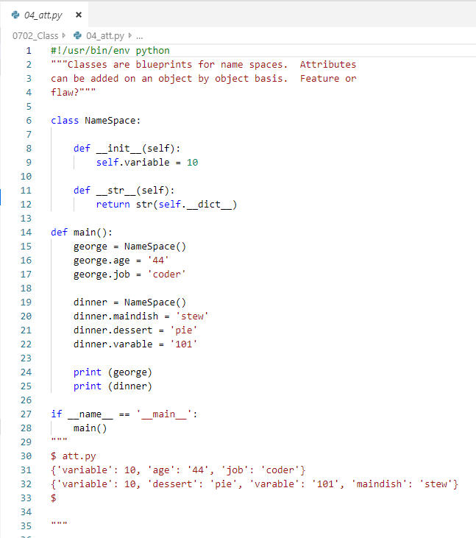
0702.5 att.py
https://www.ucsc-extension.edu/certificate-program/offering/python-programmers
att.py:
Each object have their own namespace.
The same variable can be appeared twice in the other namespace.
This may be make a big mistake and introduce the bugs.

Slide 17
0702.6 att2.py

Slide 18
0702.6 att2.py
https://www.ucsc-extension.edu/certificate-program/offering/python-programmers
The syntax of getattr() method is: getattr(object, name[, default])
The above syntax is equivalent to: object.name
getattr() Parameters:
The getattr() method takes multiple parameters:
object - object whose named attribute's value is to be returned
name - string that contains the attribute's name
default (Optional) - value that is returned when the named attribute is not found
The syntax of setattr() method is: setattr(object, name, value)
If you want to get an attribute of an object, use getattr().
setattr() Parameters
The setattr() method takes three parameters:
object - object whose attribute has to be set
name - string which contains the name of the attribute to be set
value - value of the attribute to be set

Slide 19
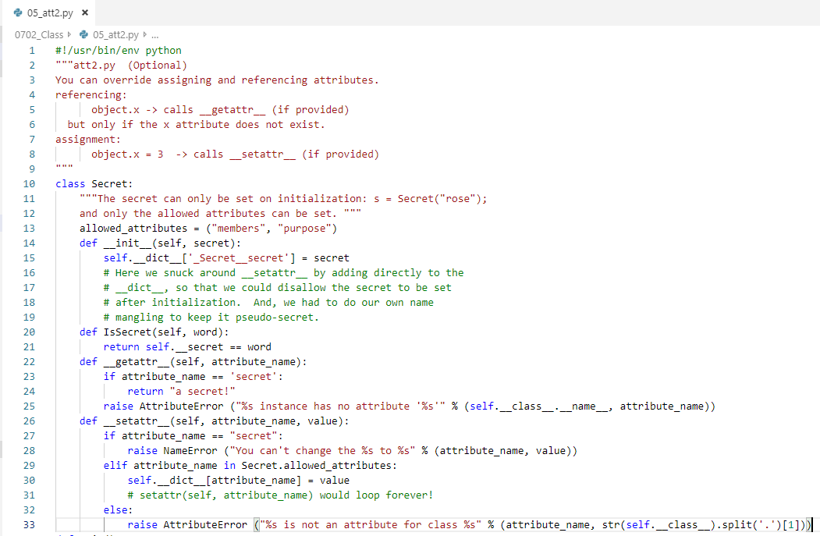
0702.6 att2.py
https://www.ucsc-extension.edu/certificate-program/offering/python-programmers
att2.py: __getattr()__ and __setattr__()

Slide 20
0702.6 att2.py
https://www.ucsc-extension.edu/certificate-program/offering/python-programmers
att2.py: The initializer write the data in pseudo secret index (‘_Secrect__secrect’)

Slide 21
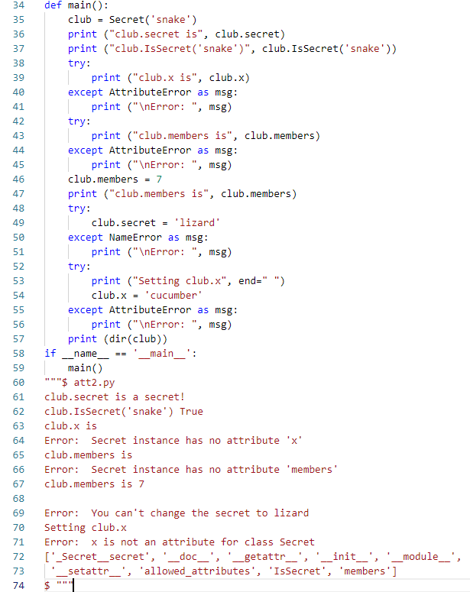
0702.6 att2.py
https://www.ucsc-extension.edu/certificate-program/offering/python-programmers
att2.py: main()

Slide 22
0702.7 att3.py

Slide 23
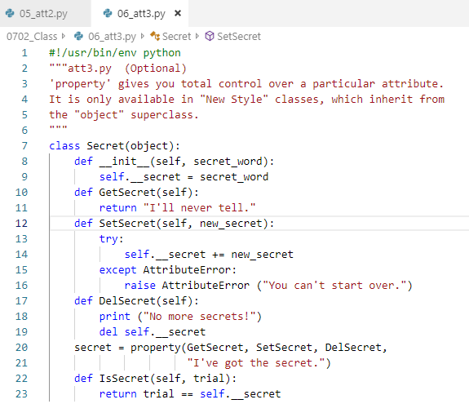
0702.7 att3.py
https://www.ucsc-extension.edu/certificate-program/offering/python-programmers
att3.py: The property gives you total control over a particular attribute. The property is the initial provide for us.

Slide 24
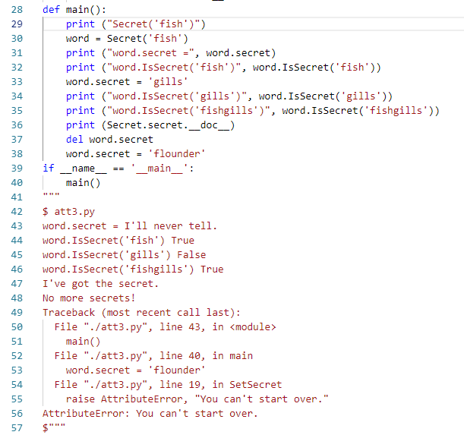
0702.7 att3.py
https://www.ucsc-extension.edu/certificate-program/offering/python-programmers
att3.py: set secret word ‘fish’ and get the secret word ‘fish’.

Slide 25
0702.8 Static.py

Slide 26
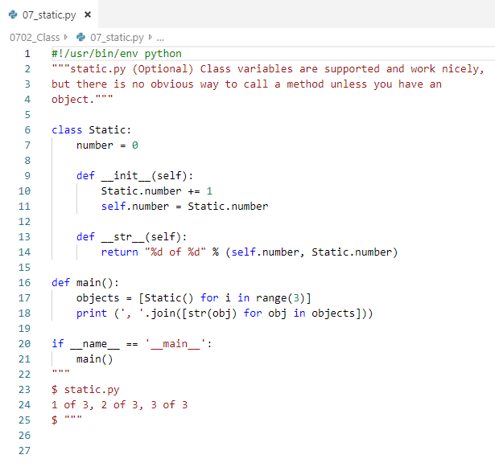
0702.8 Static.py
https://www.ucsc-extension.edu/certificate-program/offering/python-programmers
Static.py:

Slide 27
0702.9 Static2.py

Slide 28
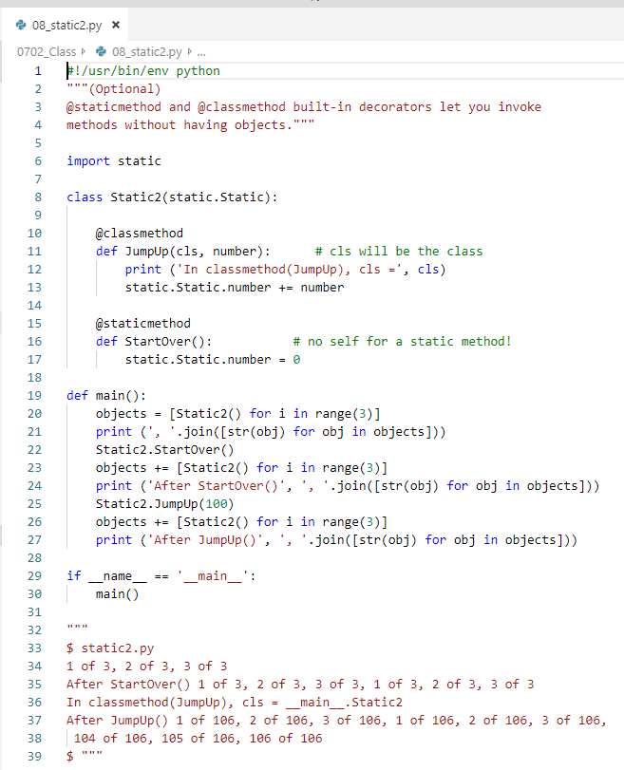
0702.9 Static2.py
https://www.ucsc-extension.edu/certificate-program/offering/python-programmers
Static2.py:
Classthod and Staticmethod:
‘cls’ is the passed in ‘class’

Slide 29
0702.10 Diamond.py

Slide 30
0702.10 Diamond.py
https://www.ucsc-extension.edu/certificate-program/offering/python-programmers
Diamond.py:
For multiple inheritance, the old style class always left first and depth first.
D().x = 1
The old style class rules are:
List all the class visited in the classic order (left first, depth first)
[D, B, A, C, A]
It there are duplicated eliminate all but the last:
[D, B, C, A]
That is the search order.

Slide 31
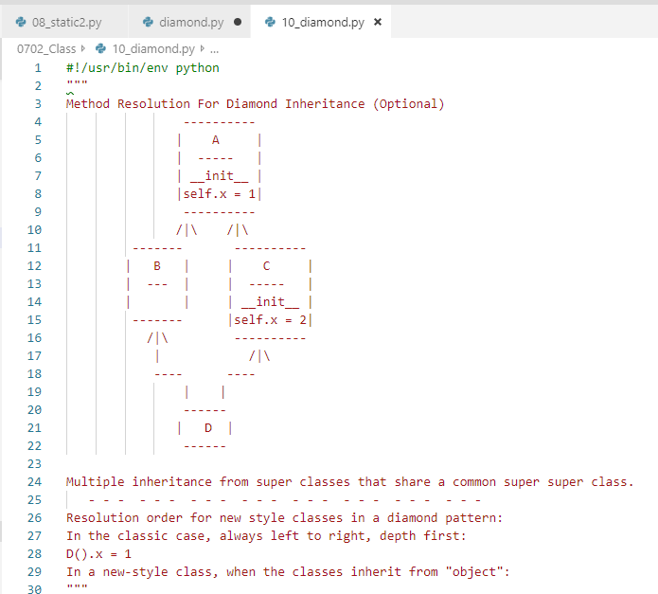
0702.10 Diamond.py
https://www.ucsc-extension.edu/certificate-program/offering/python-programmers
Diamond.py:

Slide 32
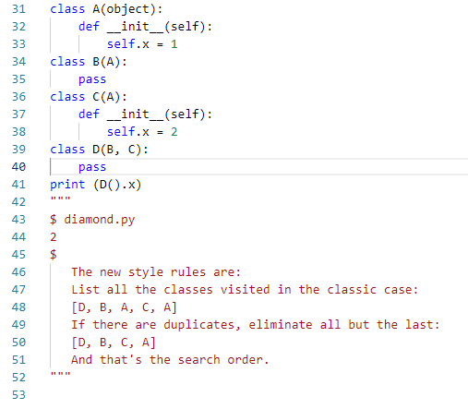
0702.10 Diamond.py
https://www.ucsc-extension.edu/certificate-program/offering/python-programmers
Diamond.py:

Slide 33
End of Chapter

