Slide 1

07 Quiz
Peter H. Chen

Slide 2
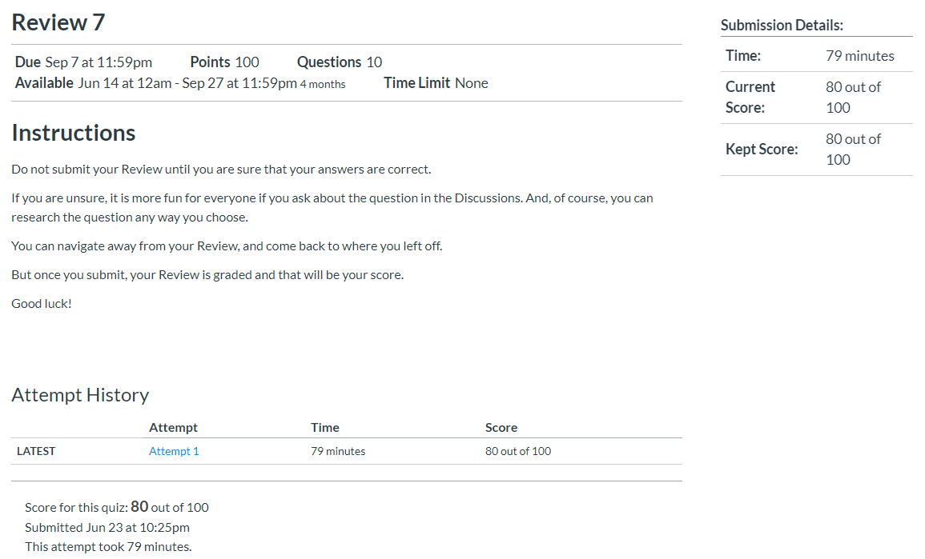
07 Quiz
https://www.ucsc-extension.edu/certificate-program/offering/python-programmers
Quiz:

Slide 3
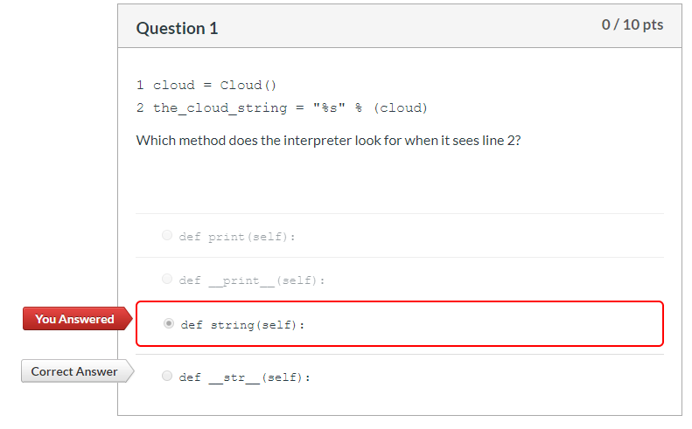
07 Quiz
https://www.ucsc-extension.edu/certificate-program/offering/python-programmers
Quiz:

Slide 4
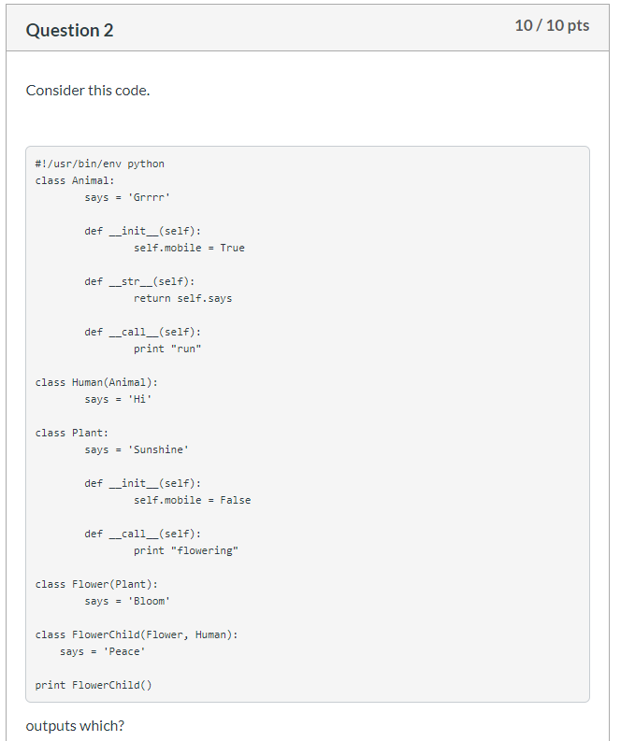
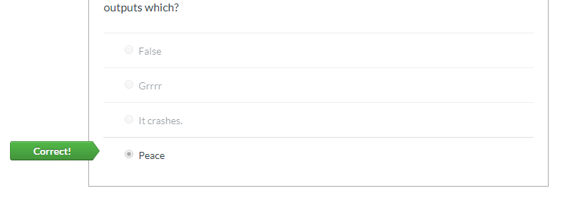
07 Quiz
https://www.ucsc-extension.edu/certificate-program/offering/python-programmers
Quiz:

Slide 5
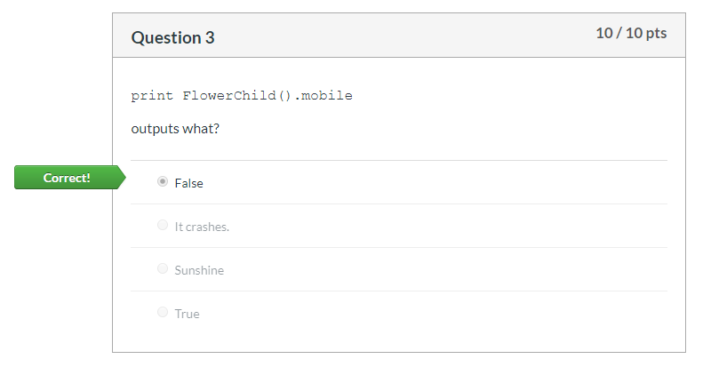
07 Quiz
https://www.ucsc-extension.edu/certificate-program/offering/python-programmers
Quiz:

Slide 6
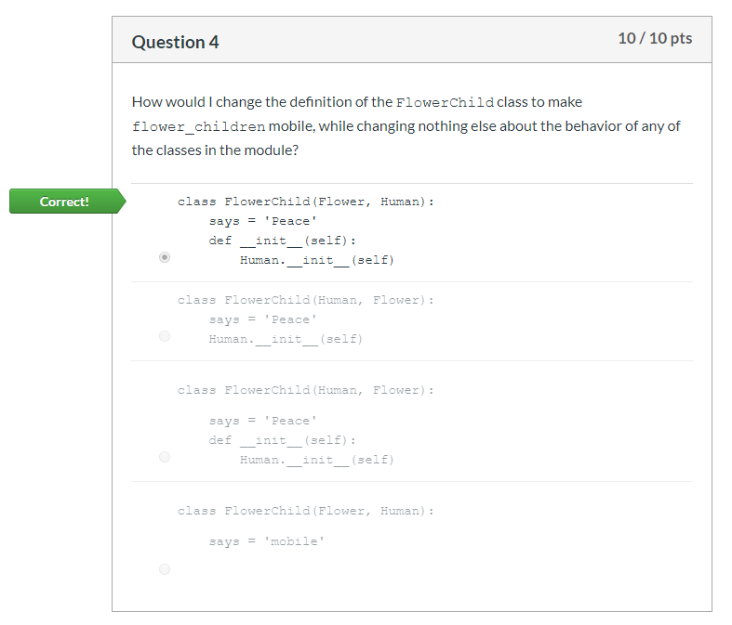
07 Quiz
https://www.ucsc-extension.edu/certificate-program/offering/python-programmers
Quiz:

Slide 7
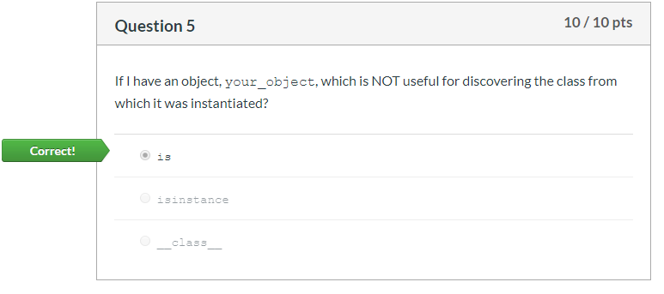
07 Quiz
https://www.ucsc-extension.edu/certificate-program/offering/python-programmers
Quiz:

Slide 8
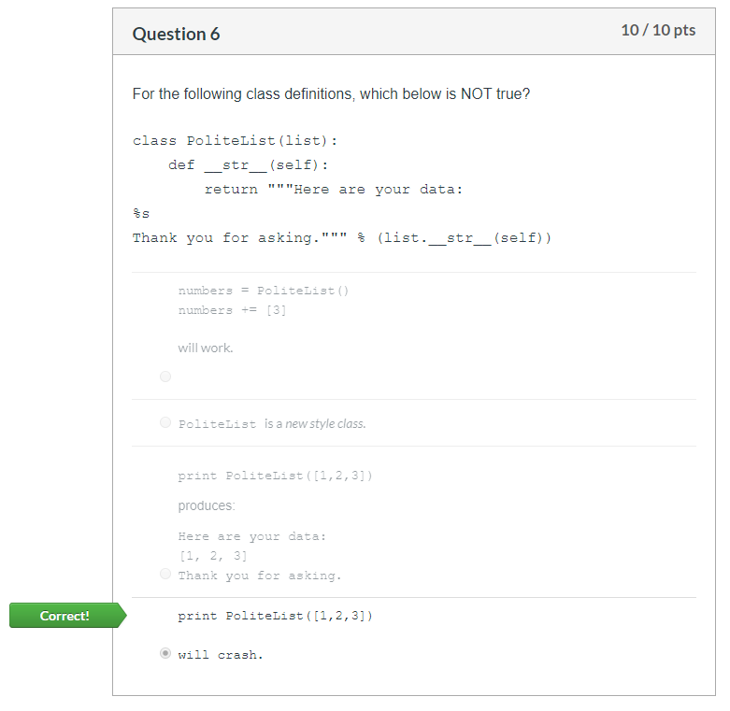
07 Quiz
https://www.ucsc-extension.edu/certificate-program/offering/python-programmers
Quiz:

Slide 9
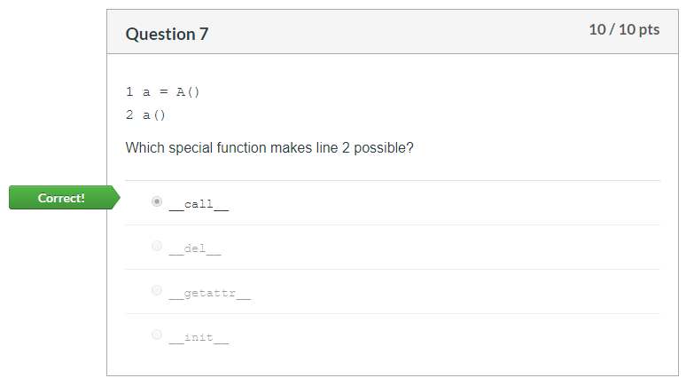
07 Quiz
https://www.ucsc-extension.edu/certificate-program/offering/python-programmers
Quiz:

Slide 10
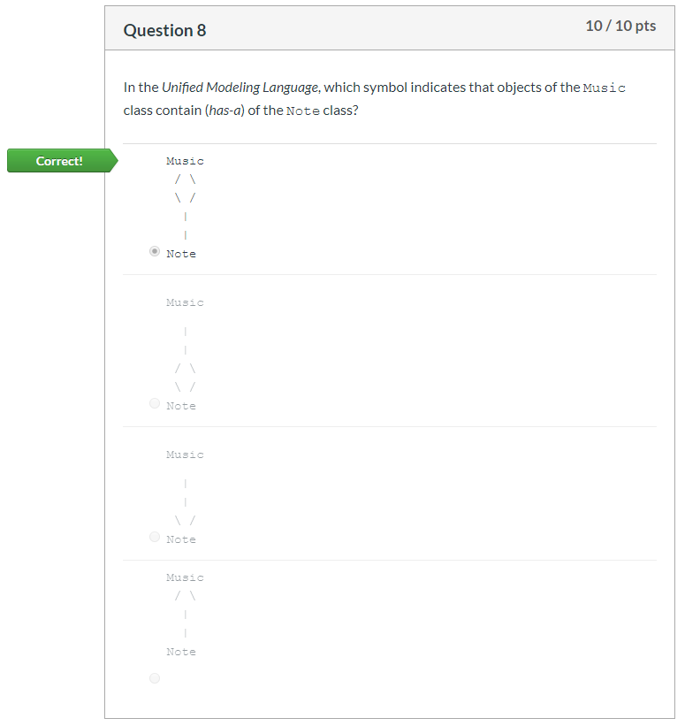
07 Quiz
https://www.ucsc-extension.edu/certificate-program/offering/python-programmers
Quiz:

Slide 11
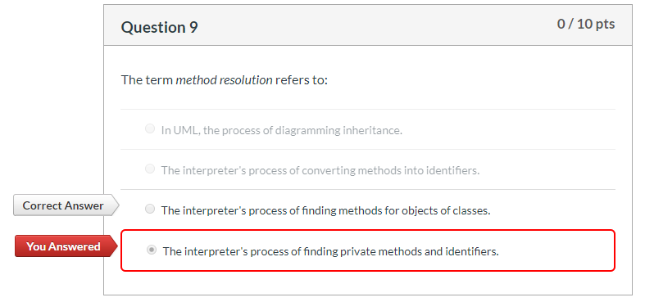
07 Quiz
https://www.ucsc-extension.edu/certificate-program/offering/python-programmers
Quiz:

Slide 12
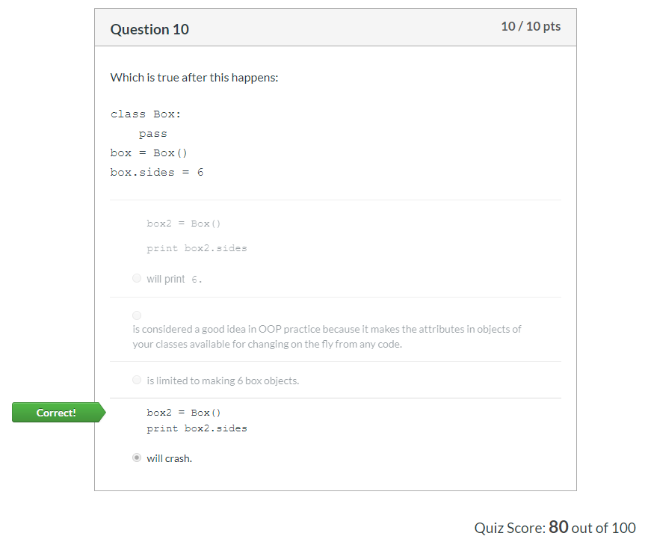
07 Quiz
https://www.ucsc-extension.edu/certificate-program/offering/python-programmers
Quiz:

Slide 13
End of Chapter

