Slide 1
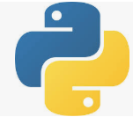
1 Virtual Environment
Peter H. Chen

Slide 2
1 Virtual Environment
https://www.youtube.com/watch?v=3TqO5FfhV28
Why do we need the Virtual Environment?
For example, we have several Django versions for several projects. Each project uses one particular Django version. When we switch the project, we want to use that particular version of Django and other frameworks for that project. That is why the virtual environment comes in.
When you use virtual environment, we need the Python 3.3 or higher.
Because Tenforflow use Python 3.7, we will use Python 3.7 for virtual environment for Tensorflow Deep Learning.
In the virtual env or pip env, you do not need to install anything.
The virtual env and pip env already come with Python standard libraries.
The following example show there is a problem in Python and Tensorflow.

Slide 3
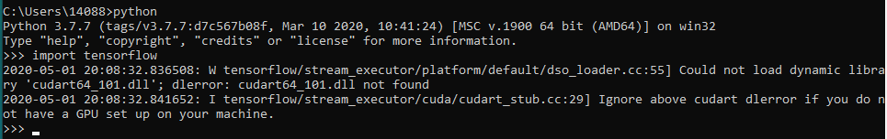
1 Virtual Environment
https://www.youtube.com/watch?v=APOPm01BVrk
Environment
Check Tensorflow folder
https://www.google.com/search?q=which+python+version+work+with+tensorflow&rlz=1C1KDEC_enUS826US826&oq=which+python+version+work+with+tensorflow&aqs=chrome..69i57.15367j0j4&sourceid=chrome&ie=UTF-8
Note: TensorFlow supports Python 3.5, 3.6 and 3.7 on Windows 10. Although TensorFlow 2.1 will be the final version of TensorFlow that will support Python 2 (regardless of OS).
Note:
> import tensorflow ==> OK
> import keras ==> OK
> import theano ==> NG

Slide 4
1.1 Create Virtual Environment

Slide 5
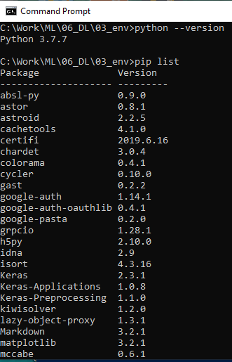
1.1 Create Virtual Environment
https://www.youtube.com/watch?v=3TqO5FfhV28
Create Virtual Environment
> python --version
python 3.7.x
> cd \Work\06_DL\03_env
> pip list
We can see packages installed on our system.

Slide 6
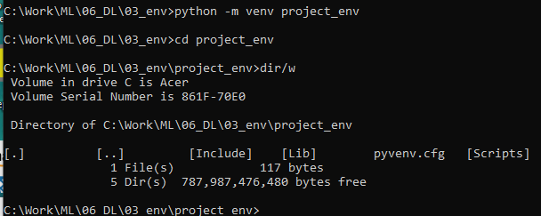
1.1 Create Virtual Environment
https://www.youtube.com/watch?v=3TqO5FfhV28
Create Virtual Environment
To create a project for virtual environment, the syntax is as follow:
python -m venv <project_name>
> python -m venv project_env
We create a module (-m) venv for you under the project_env

Slide 7
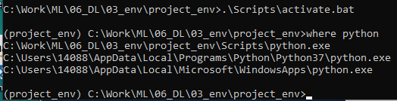
1.1 Create Virtual Environment
https://www.youtube.com/watch?v=3TqO5FfhV28
Create Virtual Environment
Activate the project environment
> .\Scripts\activate.bat
(project_env) C:\ …> where python
…\Script\python.exe
…
The Python version we used is in the project_env\Scripts folder.

Slide 8
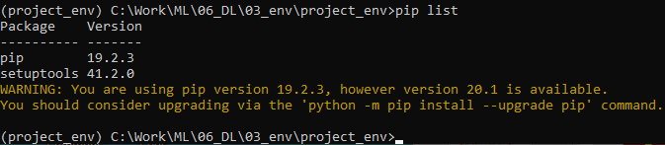
1.1 Create Virtual Environment
https://www.youtube.com/watch?v=3TqO5FfhV28
Create Virtual Environment
Then, we do a pip list again.
> pip list
We only see the pip and setuptools only.

Slide 9
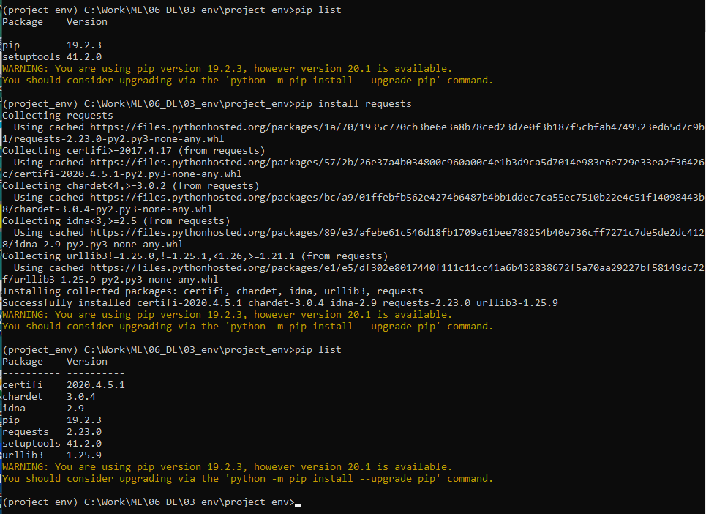
1.1 Create Virtual Environment
https://www.youtube.com/watch?v=3TqO5FfhV28
Create Virtual Environment
Assume our project need ‘requests’ and ‘pytz’
> pip install requests
> pip list

Slide 10
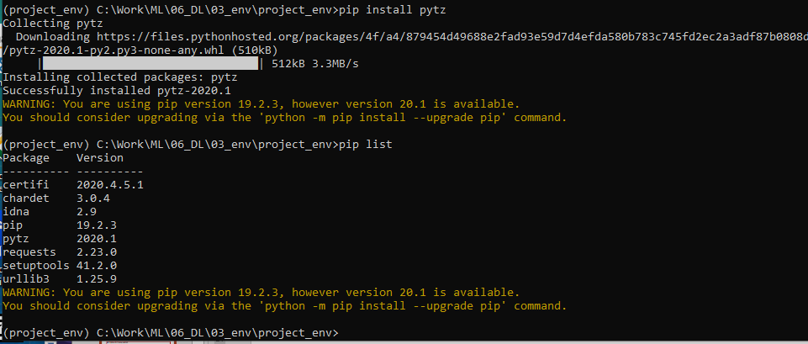
1.1 Create Virtual Environment
https://www.youtube.com/watch?v=3TqO5FfhV28
Create Virtual Environment
Assume our project need ‘requests’ and ‘pytz’
> pip install pytz
> pip list

Slide 11
3.2 Create Venv by require.txt

Slide 12
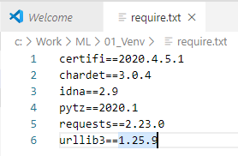
3.2 Create Venv by require.txt
https://www.youtube.com/watch?v=3TqO5FfhV28
Create Venv by require.txt
Step 1: Create the require.txt
1.1: Freeze the packages
> pip freeze
…
1.2: Copy the freeze package names into a file “require.txt” and save to outside the project folder.
> deactivate
We exit the virtual environment and prepare to create the new project and environment.

Slide 13
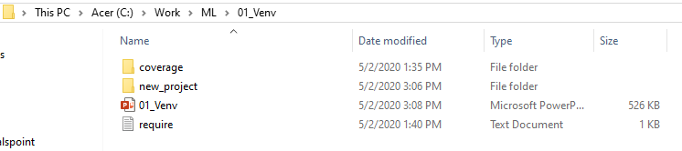
3.3 Create Venv by require.txt
https://www.youtube.com/watch?v=3TqO5FfhV28
Create Virtual Environment by requires.txt
Now, we have the require.txt in the current folder.

Slide 14
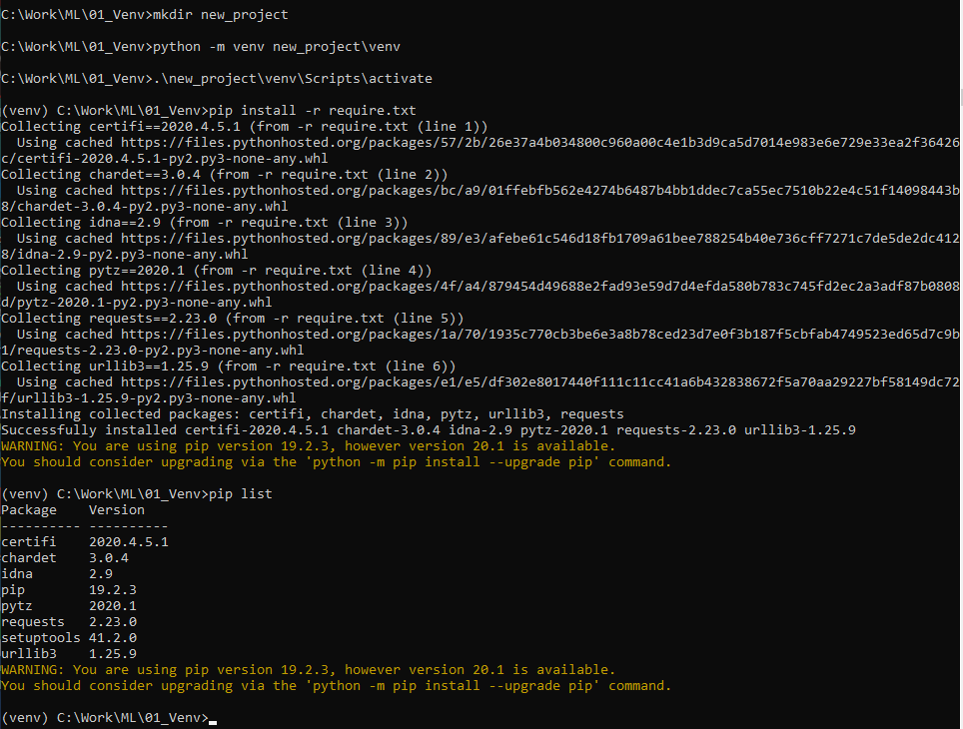
3.3 Create Venv by require.txt
https://www.youtube.com/watch?v=3TqO5FfhV28
Create Virtual Environment by requires.txt
Step 2: Create a new project folder
> mkdir new_project

Slide 15
3.3 Create Venv by require.txt
https://www.youtube.com/watch?v=3TqO5FfhV28
Create Virtual Environment by requires.txt
Step 3: Create the Python environment. We normally put the environment in separate folder called ‘new_peoject\venv’
> python -m venv new_project\venv

Slide 16
3.3 Create Venv by require.txt
https://www.youtube.com/watch?v=3TqO5FfhV28
Create Virtual Environment by requires.txt
Step 4: Activate the virtual environment and then install the require.txt
> .\new_project\venv\Scripts\activate
(venv) > pip install -r requests.txt

Slide 17
3.3 Create Venv by require.txt
https://www.youtube.com/watch?v=3TqO5FfhV28
Create Virtual Environment by requires.txt
Step 5: Verify the installed virtual environment
> pip list

Slide 18


3.3 Create Venv by require.txt
https://www.youtube.com/watch?v=3TqO5FfhV28
Create Virtual Environment by requires.txt
We can type
> deactivate
To exit the virtual environment
If we want to get into environment, we can
> .\new_project\venv\Scripts\activate
(venv) …
You can use “git init” in the “new_project” folder to initialize the git repository.
> (venv) … > git init

Slide 19
End of Chapter

