Slide 1

1 Materialize Introduction
Peter H. Chen

Slide 2
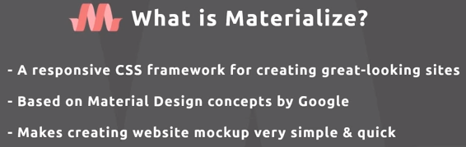
1 Materialize Introduction
https://www.youtube.com/watch?v=gCZ3y6mQpW0&list=PL4cUxeGkcC9gGrbtvASEZSlFEYBnPkmff
What is Materialize? Materialize CSS is a responsive CSS framework that enable us to quickly create great-looking website and it is based on materialized design concept by Google.
Whatever you see the Google website like with Google documentation or firebase or something like that a lot of times it is based on these material design concept and that is what materialize is based on is a library.
Let us create a websites based on Google design concepts. It is similar to bootstrap . The button, colors, layout, and etc. The layouts and components are more tightly coupled with Google’s design philosophy where bootstrap isn’t.

Slide 3
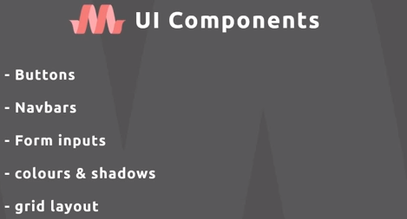
1 Materialize Introduction
https://www.youtube.com/watch?v=gCZ3y6mQpW0&list=PL4cUxeGkcC9gGrbtvASEZSlFEYBnPkmff
Some of UI components that it comes with are buttons, navbar, form input and other controls, colors and shadows, grid layout and other things as well as all be achieved with a few different classes in materialized.
We will create responsive website with materialize.

Slide 4
End of Chapter

