Slide 1

2 Setup
Peter H. Chen

Slide 2
2 Setup
https://www.youtube.com/watch?v=gCZ3y6mQpW0&list=PL4cUxeGkcC9gGrbtvASEZSlFEYBnPkmff
EM, REM, and PX https://www.futurehosting.com/blog/web-design-basics-rem-vs-em-vs-px-sizing-elements-in-css/
PX, REM, and EM are the most commonly used measures of length in CSS, but there are a lot more available to use if you want to.
Pixels are ignorant, don’t use them. Use REMs for sizes and spacing. Use EMs for media queries
Pixels: Pixels (px) are pixel or picture element is a physical point in a raster image. It is the smallest controllable element of a picture represented on the screen, for example, 600 DPI (600 Dot Per Inch) screen, 1 pixel = 1/600 = 0.00166 inch.
Accessibility: If you set font-sizes, element sizes, and spacing in pixels, you are not treating the end user with respect. If the website sets font-sizes in pixels, a heading set at 30px will always be 30px. Setting font-sizes in pixels doesn’t completely ruin accessibility. The user can still zoom in and out with ctrl plus +/- (cmd instead of ctrl on OS X). However, we can do better.

Slide 3
2 Setup
https://www.youtube.com/watch?v=gCZ3y6mQpW0&list=PL4cUxeGkcC9gGrbtvASEZSlFEYBnPkmff
The EM:
EMs are a relative measure of length. The size of an EM is relative to the font-size of its parent element. If you have a <div> with the font size is set to 16px, and a <p> element inside that div with a font-size set to 2em, the font-size of text in the <p> will be 32px; set it to 0.5px, and the font-size will be 8px.
This is useful because it lets you change the absolute size of elements like the font-size without changing their size relative to each other. Lets say you set the font-size of <div> to 22px. Inside that <div> you have a <p> with the width set to 200em, the margins set to 3em, and the font-size set to 0.8em. If you wanted to halve the size of that <p>, you could simply change the font-size on the surrounding <div> to 11px and the width, margins, and font-size on the <p> would scale accordingly.
As you might imagine, this is great for responsive design, where you can set breakpoints for device screen sizes with media queries, change the absolute px measure for elements at different break points, and have all the em-measured elements resize for you — it makes responsive CSS much easier to write and maintain.

Slide 4
2 Setup
https://www.youtube.com/watch?v=gCZ3y6mQpW0&list=PL4cUxeGkcC9gGrbtvASEZSlFEYBnPkmff
The REM:
EM have a problem. Because everything is sized relative to its parent element, the meaning of an EM changes as elements are nested. If we take the same scenario we discussed above: a <div> with a font-size of 22px containing a <p> with an font-size of 0.5 em but add a <blockquote> inside the <p> with a font size of 0.5em too, the result might not be what we want. The font-size in the <p> will be equal to 11px, but the font-size inside the <blockquote> would be half of that again, because em is relative the immediate ancestor (the paragraph), not the div.
REM (Root EM) are always relative to the font-size of the <html> element. It doesn’t matter how deeply nested an element is, its REM lengths will always be a proportion of the font-size of <html>.
REM are awesome in theory and in practice.

Slide 5
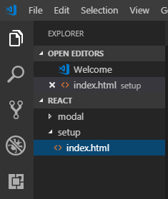
2 Setup
https://www.youtube.com/watch?v=gCZ3y6mQpW0&list=PL4cUxeGkcC9gGrbtvASEZSlFEYBnPkmff
Create setup folder.
Create emtpy “index.html”

Slide 6
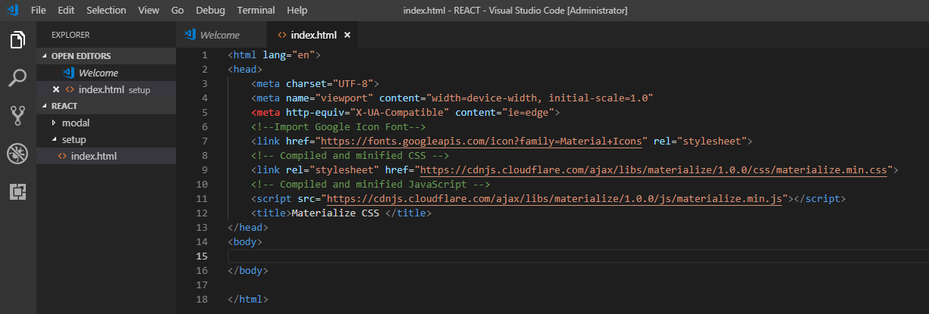
2 Setup
https://www.youtube.com/watch?v=gCZ3y6mQpW0&list=PL4cUxeGkcC9gGrbtvASEZSlFEYBnPkmff
Materialize required setup:
Google font/icon
CSS and JavaScript

Slide 7
2.1 Install Live Server

Slide 8
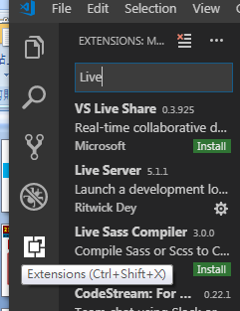
2.1 Install Live Server
https://www.youtube.com/watch?v=gCZ3y6mQpW0&list=PL4cUxeGkcC9gGrbtvASEZSlFEYBnPkmff
Click Extension (Ctrl+Shit+X)
Search for “Live Server”
Install “Live Server” for VS Code if you did not install for VS Code before.

Slide 9
2.2 Open HTML with Live Server

Slide 10
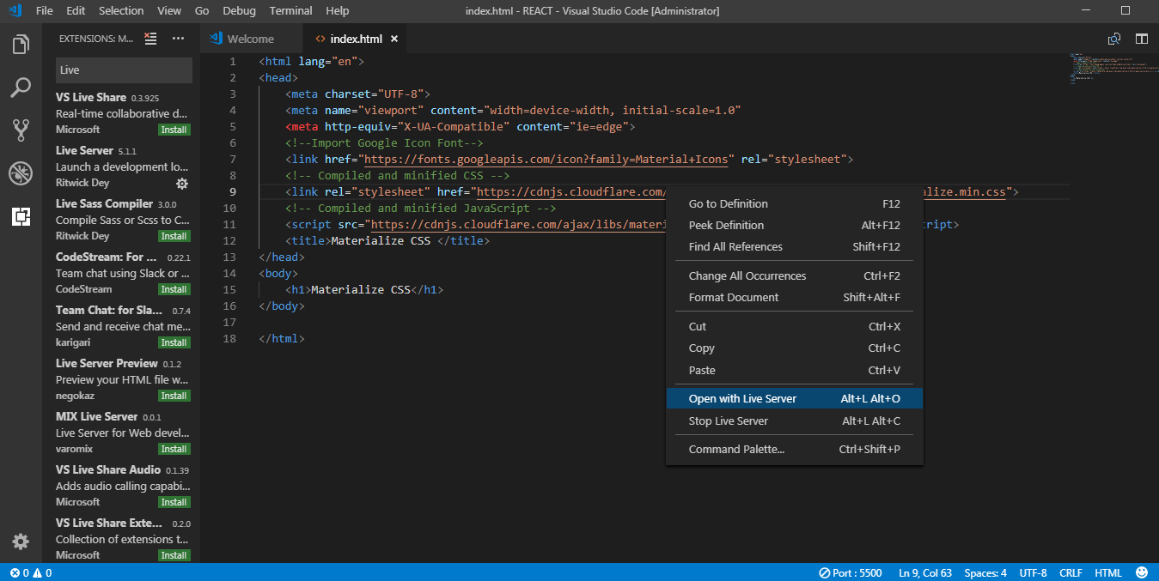
2.2 Open HTML with Live Server
https://www.youtube.com/watch?v=gCZ3y6mQpW0&list=PL4cUxeGkcC9gGrbtvASEZSlFEYBnPkmff
In index.html, RMB (Right Mouse Button) and select “Open with Live Server”.

Slide 11
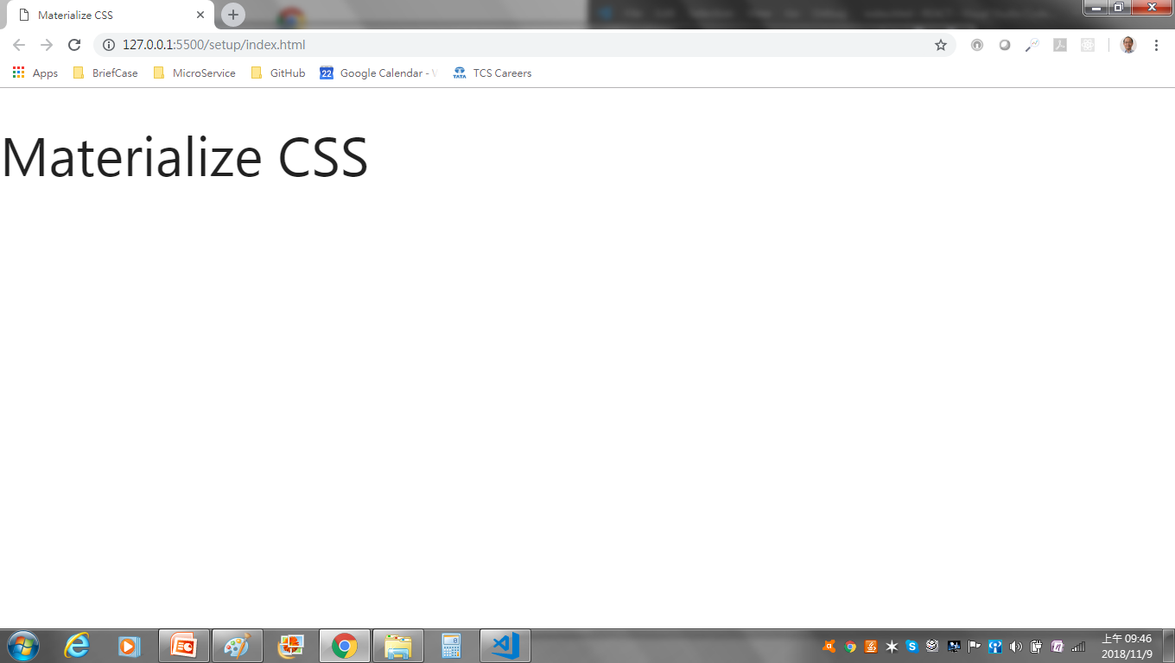
2.2 Open HTML with Live Server
https://www.youtube.com/watch?v=gCZ3y6mQpW0&list=PL4cUxeGkcC9gGrbtvASEZSlFEYBnPkmff
Chrome display.

Slide 12
2.3 div.container

Slide 13
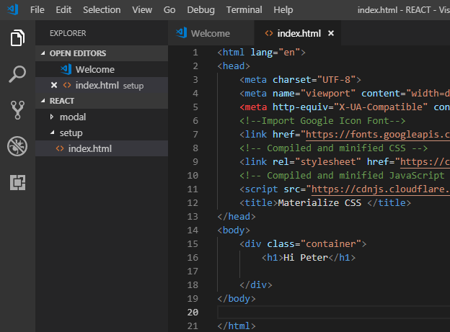
2.3 div.container
https://www.youtube.com/watch?v=gCZ3y6mQpW0&list=PL4cUxeGkcC9gGrbtvASEZSlFEYBnPkmff
Type “div.container” will generate <div class=“container”> </div>
This div have a class of container. This is a materialize class.
The div.container keeps everything inside a central column. It gives the left margin and right margin and make the max width of that column, a certain amount of pixels for different screen sizes.

Slide 14
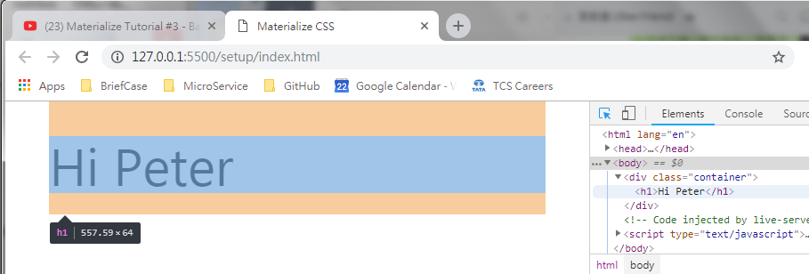
2.3 div.container
https://www.youtube.com/watch?v=gCZ3y6mQpW0&list=PL4cUxeGkcC9gGrbtvASEZSlFEYBnPkmff
Open with Live Server, will see the container.
It contain certain margin on the left and right side.
Width of container is 90%.

Slide 15
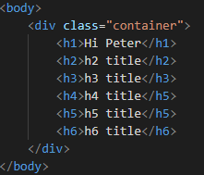
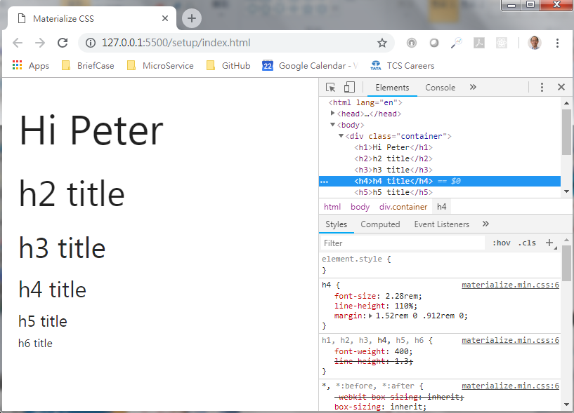
2.3 div.container
https://www.youtube.com/watch?v=gCZ3y6mQpW0&list=PL4cUxeGkcC9gGrbtvASEZSlFEYBnPkmff
You can see each element with different margin.

Slide 16
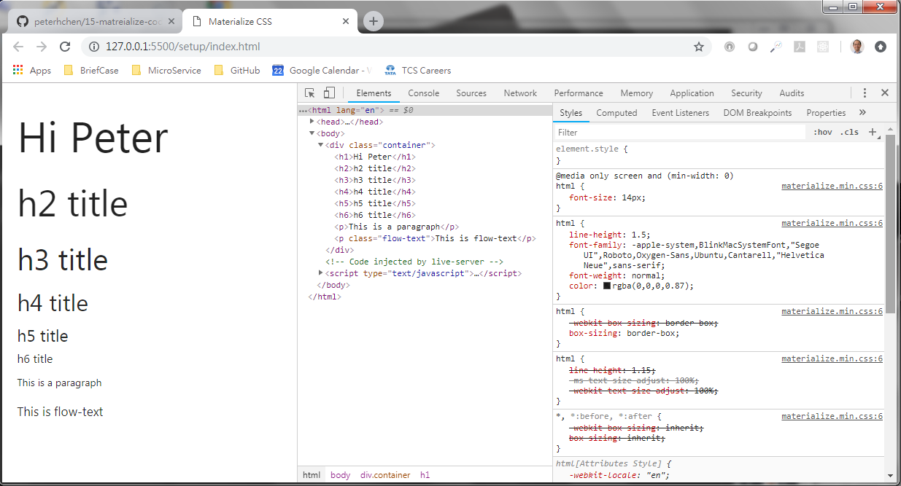
2.3 div.container
https://www.youtube.com/watch?v=gCZ3y6mQpW0&list=PL4cUxeGkcC9gGrbtvASEZSlFEYBnPkmff
Click <html> root element to the root html font-size: 14px.
Font-size 14px means 14 element point per character.

Slide 17
End of Chapter

