Slide 1

3 Basic Text Type
Peter H. Chen

Slide 2
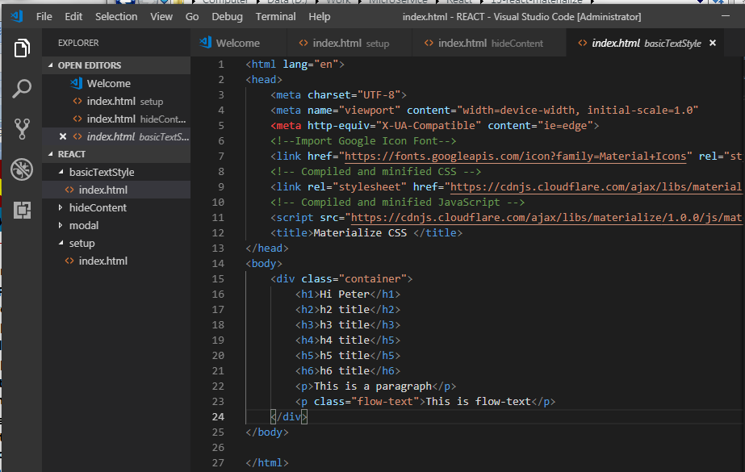
3 Basic Text Type
https://www.youtube.com/watch?v=gCZ3y6mQpW0&list=PL4cUxeGkcC9gGrbtvASEZSlFEYBnPkmff
Basic Text Type: H1-H6, p, flow-text.

Slide 3
End of Chapter

