Slide 1

4 Hide Content
Peter H. Chen

Slide 2
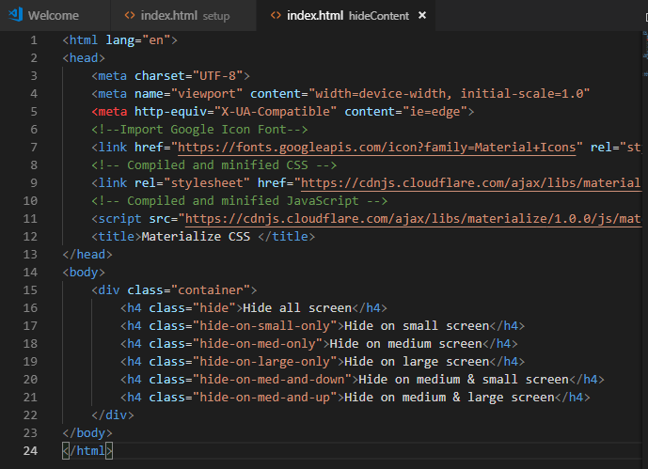
4 Hide Content
https://www.youtube.com/watch?v=gCZ4y6mQpW0&list=PL4cUxeGkcC9gGrbtvASEZSlFEYBnPkmff
Hide Content

Slide 3
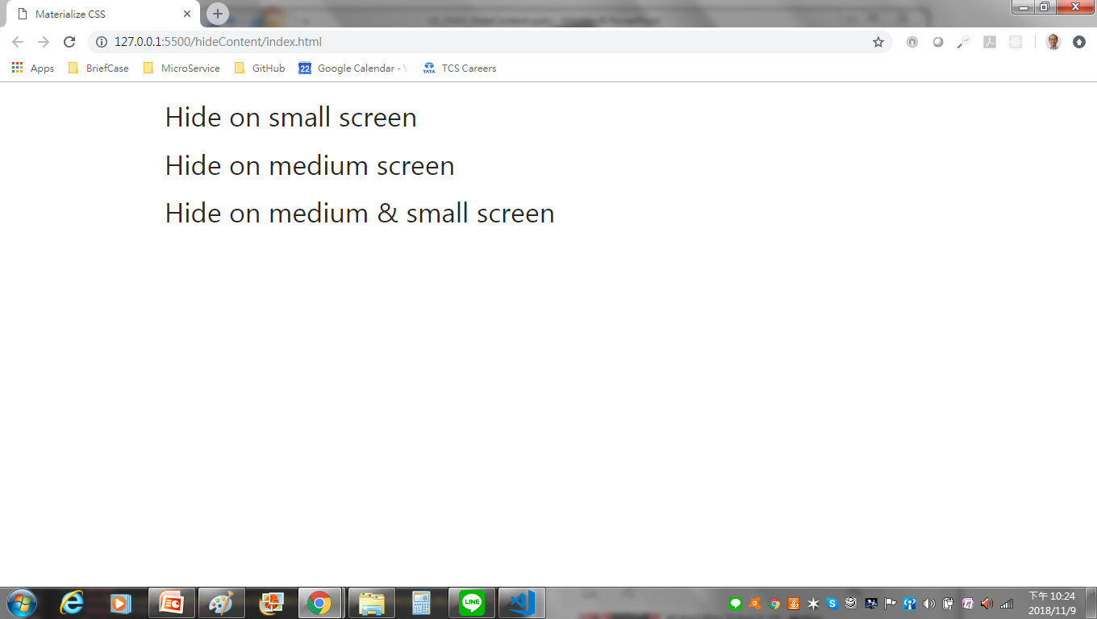
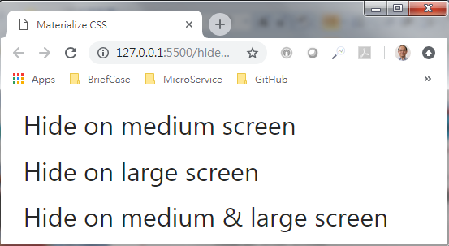
4 Hide Content
https://www.youtube.com/watch?v=gCZ4y6mQpW0&list=PL4cUxeGkcC9gGrbtvASEZSlFEYBnPkmff
Hide on large Screen, hide on small screen.

Slide 4
End of Chapter

