Slide 1

5 Color
Peter H. Chen

Slide 2
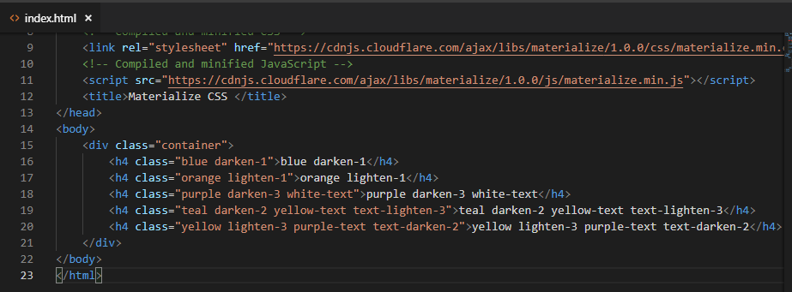
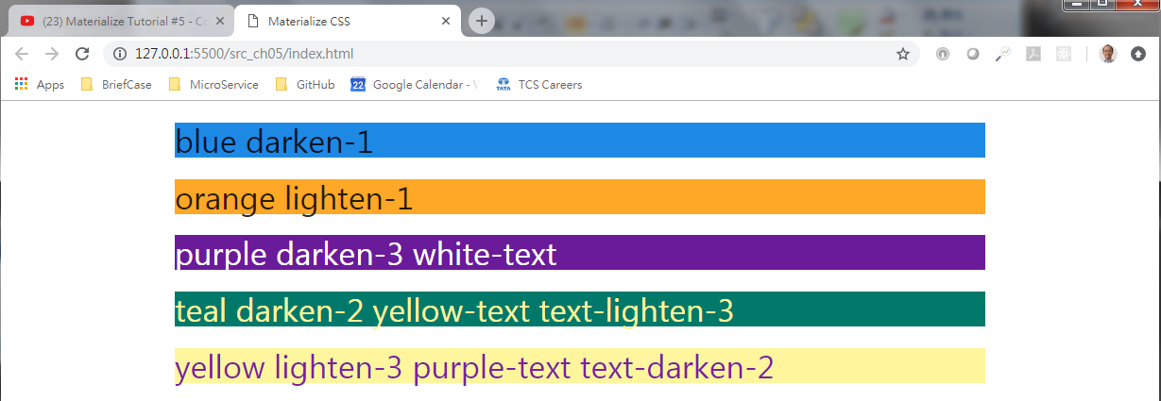
5 Color
https://www.youtube.com/watch?v=gCZ5y6mQpW0&list=PL4cUxeGkcC9gGrbtvASEZSlFEYBnPkmff
Color

Slide 3
End of Chapter

