Slide 1

6 Format
Peter H. Chen

Slide 2
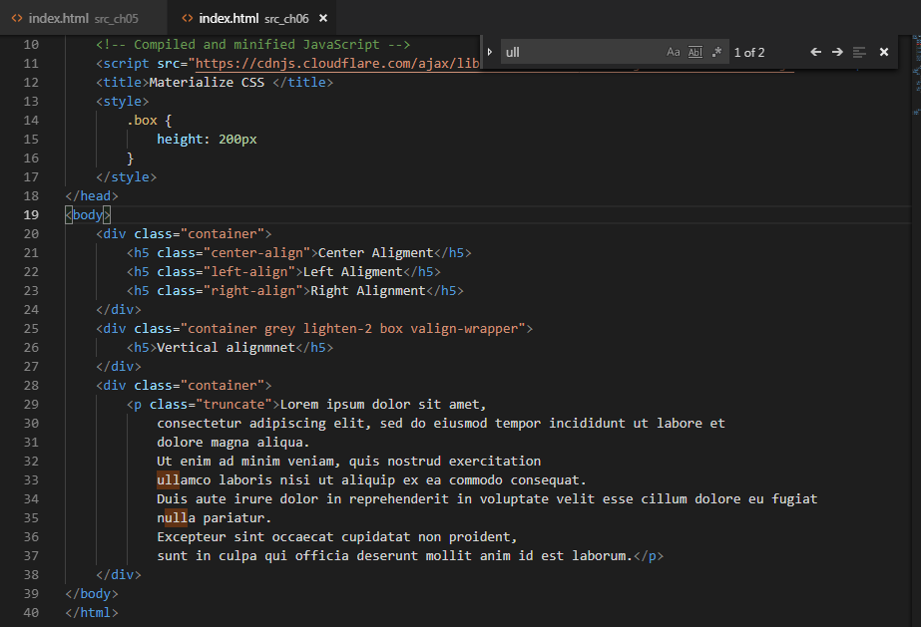
6 Format
https://www.youtube.com/watch?v=gCZ6y6mQpW0&list=PL4cUxeGkcC9gGrbtvASEZSlFEYBnPkmff
Text Format options: Text Alignment, Vertical Alignment, and Truncate Text (Shorten Text).

Slide 3
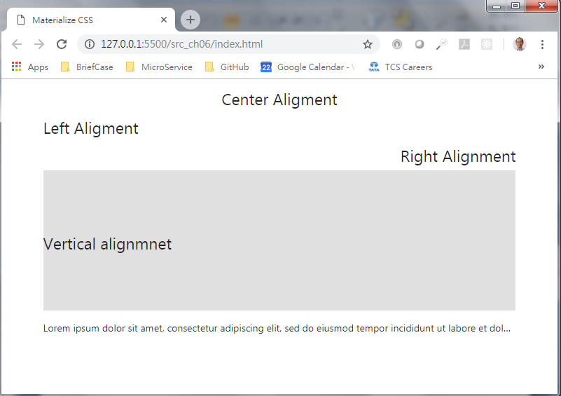
6 Format
https://www.youtube.com/watch?v=gCZ6y6mQpW0&list=PL4cUxeGkcC9gGrbtvASEZSlFEYBnPkmff
Text Format options: Text Alignment, Vertical Alignment, and Truncate Text (Shorten Text).

Slide 4
End of Chapter

