Slide 1

8 Icon
Peter H. Chen

Slide 2
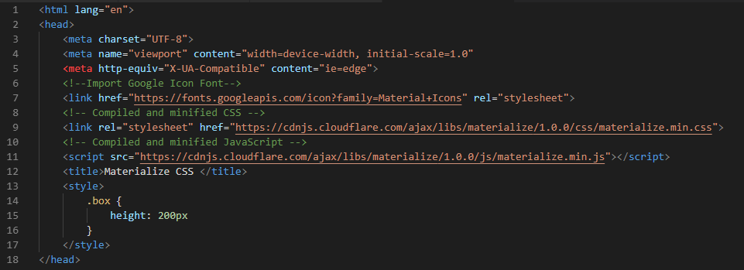
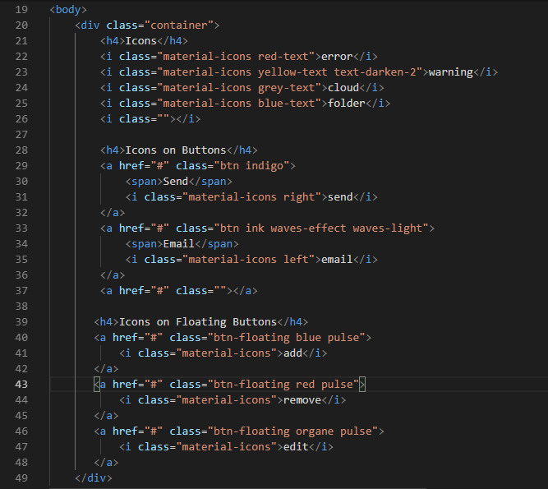
8 Icon
https://www.youtube.com/watch?v=gCZ7y7mQpW0&list=PL4cUxeGkcC9gGrbtvASEZSlFEYBnPkmff
Icon can be combined into JavaScript and Tag.

Slide 3
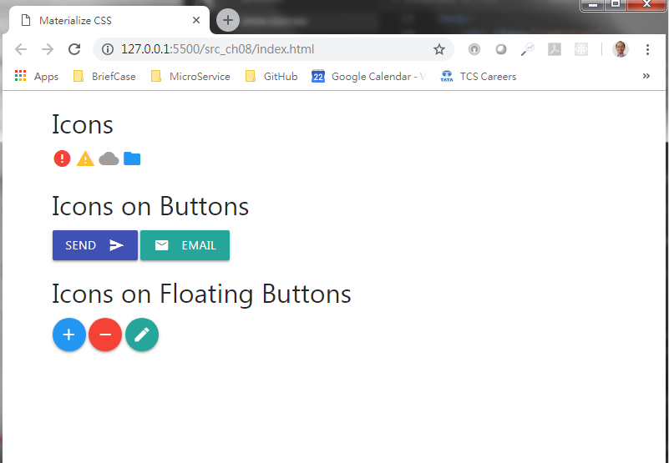
8 Icon
https://www.youtube.com/watch?v=gCZ7y7mQpW0&list=PL4cUxeGkcC9gGrbtvASEZSlFEYBnPkmff
Icons

Slide 4
End of Chapter

