Slide 1

7 Button
Peter H. Chen

Slide 2
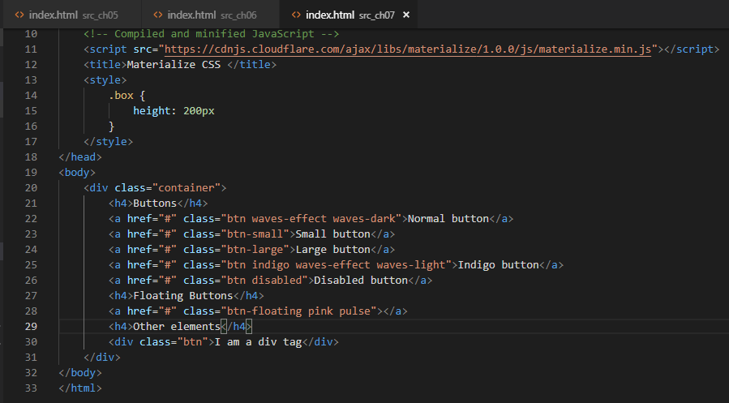
7 Button
https://www.youtube.com/watch?v=gCZ7y7mQpW0&list=PL4cUxeGkcC9gGrbtvASEZSlFEYBnPkmff
Button can be combined into JavaScript and Tag.

Slide 3
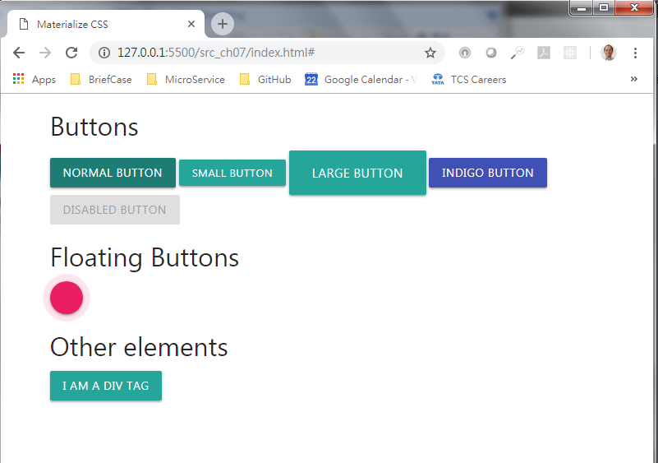
7 Button
https://www.youtube.com/watch?v=gCZ7y7mQpW0&list=PL4cUxeGkcC9gGrbtvASEZSlFEYBnPkmff
Buttons

Slide 4
End of Chapter

