Slide 1

10 Depth Shadow
Peter H. Chen

Slide 2
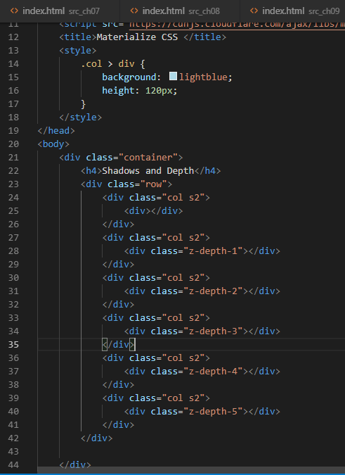
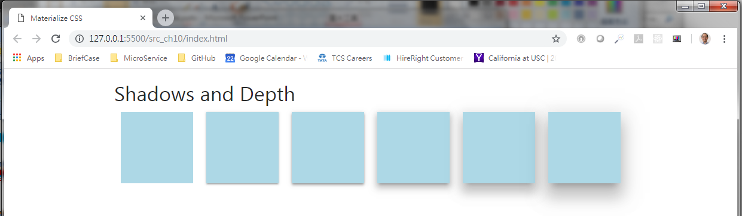
10 Depth Shadow
https://www.youtube.com/watch?v=gCZ7y7mQpW0&list=PL4cUxeGkcC10gGrbtvASEZSlFEYBnPkmff
Shadows and Depth

Slide 3
End of Chapter

