Slide 1

9 Responsive Grid
Peter H. Chen

Slide 2
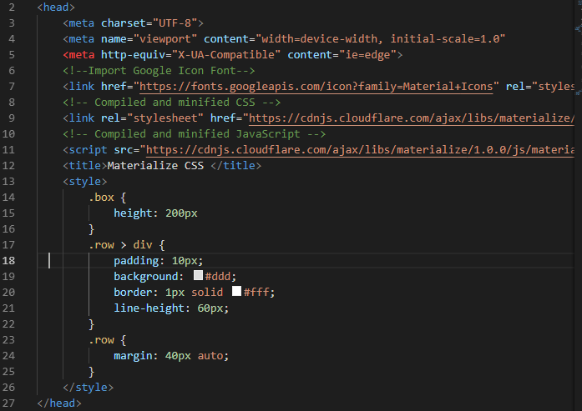
9 Responsive Grid
https://www.youtube.com/watch?v=gCZ7y7mQpW0&list=PL4cUxeGkcC9gGrbtvASEZSlFEYBnPkmff
Both Bootstrap and Material-UI use grid system.
They split contents into rows and columns.
You can have an element occupy 12 columns, 4 columns, 6 columns, and etc.

Slide 3
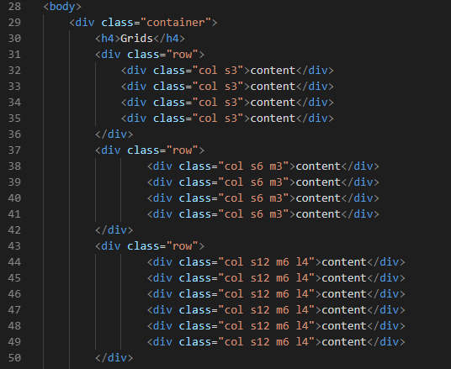
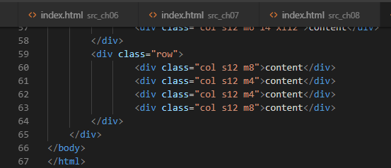
9 Responsive Grid
https://www.youtube.com/watch?v=gCZ7y7mQpW0&list=PL4cUxeGkcC9gGrbtvASEZSlFEYBnPkmff
Set different size of column format.

Slide 4
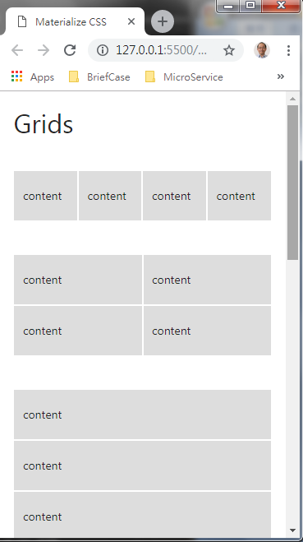
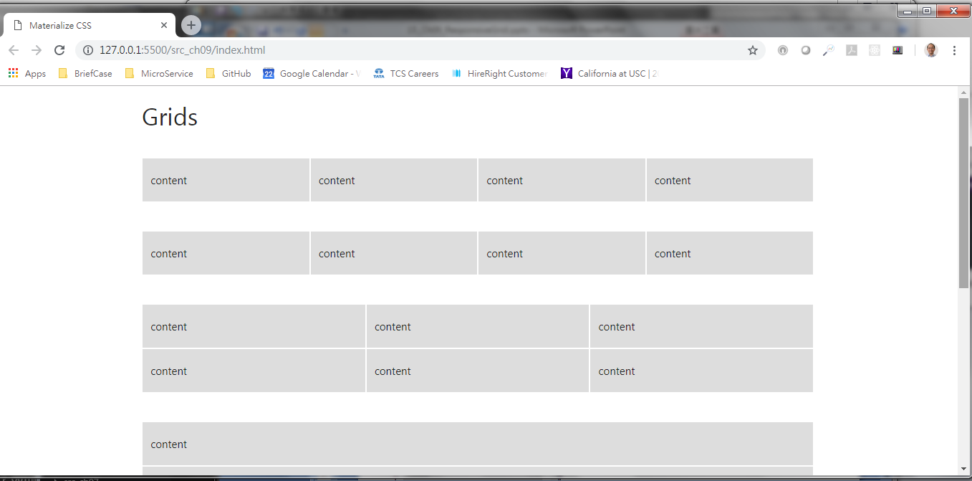
9 Responsive Grid
https://www.youtube.com/watch?v=gCZ7y7mQpW0&list=PL4cUxeGkcC9gGrbtvASEZSlFEYBnPkmff
Responsive Grids for small and large system

Slide 5
End of Chapter

