Slide 1
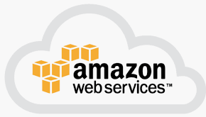
3 AWS Introduction
Peter H. Chen

Slide 2
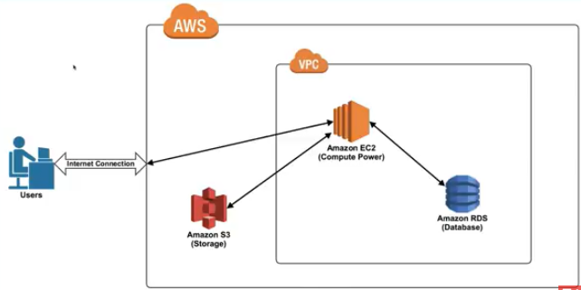
2 AWS Introduction
https://www.youtube.com/watch?v=qcY-uiEHhn0&list=PLv2a_5pNAko2Jl4Ks7V428ttvy-Fj4NKU&index=2
This is very common diagram for AWS architecture.
First, you are the user tries to access AWS right through an internet connection.
AWS is as a whole or the entirely of AWS and then things that are inside of AWS.
Now, inside the AWS, you have services you have networking architecture you have a lot of different things that are going on.
We are going to talk about VPCs and what is this box means?

Slide 3
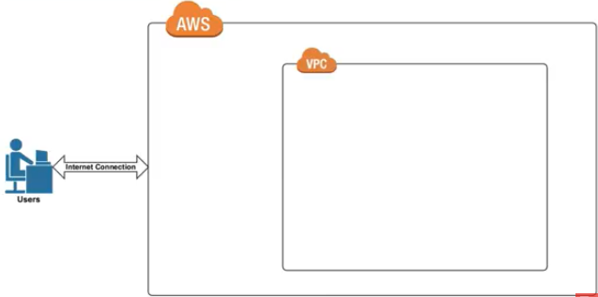
2 AWS Introduction
https://www.youtube.com/watch?v=qcY-uiEHhn0&list=PLv2a_5pNAko2Jl4Ks7V428ttvy-Fj4NKU&index=2
Let’s take everything for now and understand that VPC is short for Virtual Private Cloud.

Slide 4
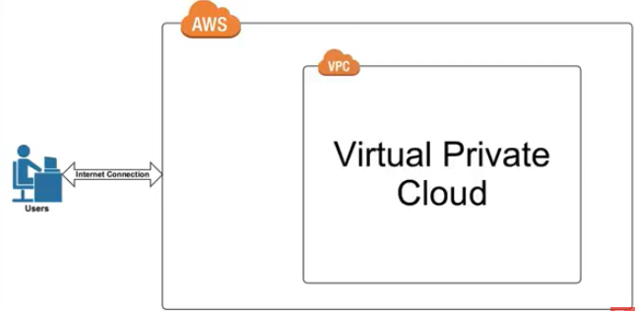
2 AWS Introduction
https://www.youtube.com/watch?v=qcY-uiEHhn0&list=PLv2a_5pNAko2Jl4Ks7V428ttvy-Fj4NKU&index=2
What is Virtual Private Cloud and what is that mean for us?

Slide 5

2 AWS Introduction
https://www.youtube.com/watch?v=qcY-uiEHhn0&list=PLv2a_5pNAko2Jl4Ks7V428ttvy-Fj4NKU&index=2
We are going to use Facebook as a Frame of reference for what a VPC is.

Slide 6
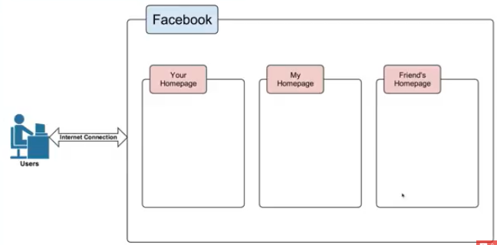
2 AWS Introduction
https://www.youtube.com/watch?v=qcY-uiEHhn0&list=PLv2a_5pNAko2Jl4Ks7V428ttvy-Fj4NKU&index=2
Facebook is a oversimplification but it give us a good conceptual understanding.
We are the user access the Facebook.
Within Facebook, you have your home page, I have my home page, friends have their home pages.

Slide 7
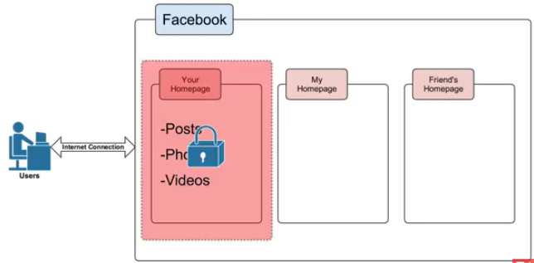
2 AWS Introduction
https://www.youtube.com/watch?v=qcY-uiEHhn0&list=PLv2a_5pNAko2Jl4Ks7V428ttvy-Fj4NKU&index=2
There are millions of other home pages. Now, your homepage is your own private section of Facebook where you can do things like insert your posts, photos, and your videos.
If you want, you even have a level of security on top in terms of who you allow to view your post videos or photos depending on who you allow to be your friend. So your own private section of Facebook in which you can put your important information you want to share with other people. Different people have different private sections of Facebook for them to put phots and videos.

Slide 8
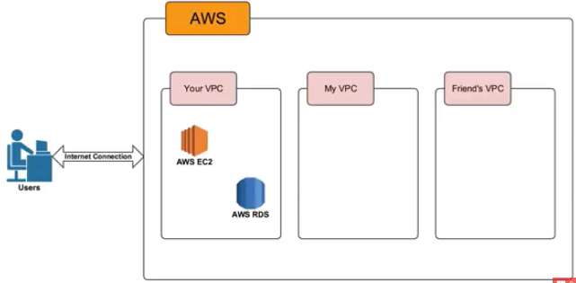
2 AWS Introduction
https://www.youtube.com/watch?v=qcY-uiEHhn0&list=PLv2a_5pNAko2Jl4Ks7V428ttvy-Fj4NKU&index=2
Now, look at AWS, you have your VPC, My VPC, and friends’ VPC.
Your VPC have your own EC2 and RDS. You are able to put your own items your Virtual Private Cloud.

Slide 9
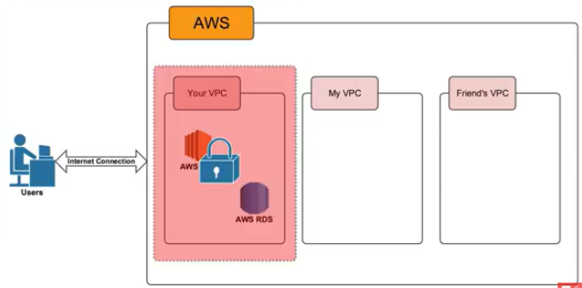
2 AWS Introduction
https://www.youtube.com/watch?v=qcY-uiEHhn0&list=PLv2a_5pNAko2Jl4Ks7V428ttvy-Fj4NKU&index=2
You can put your resources, your profiles, your information you want to use AWS and you can put a level of security in your VPC just like Facebook does.
In AWS, you can put your own resources in ad either allow or restrict access.

Slide 10
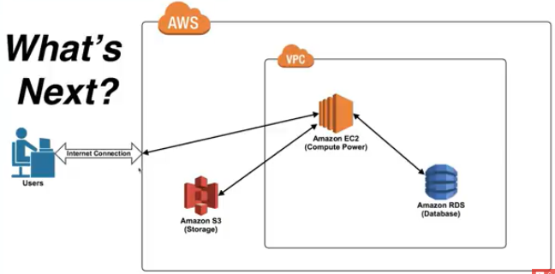
2 AWS Introduction
https://www.youtube.com/watch?v=qcY-uiEHhn0&list=PLv2a_5pNAko2Jl4Ks7V428ttvy-Fj4NKU&index=2
Recap:
A Virtual Private Cloud is your private section of AWS, where you can place AWS resources, and allow/restrict access to them.
Whenever you think of VPC, you can think Facebook example.
Next section will discuss EC2 (Compute Power), S3 (Storage), and RDS (database).

Slide 11
2.1 What is Cloud?

Slide 12
End of Chapter

