Slide 1
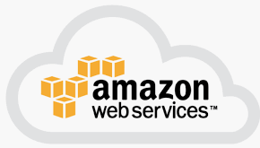
5 RDS
Peter H. Chen

Slide 2
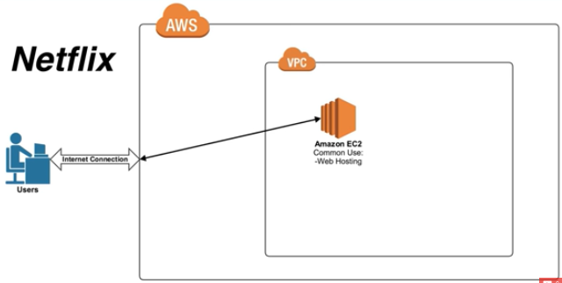
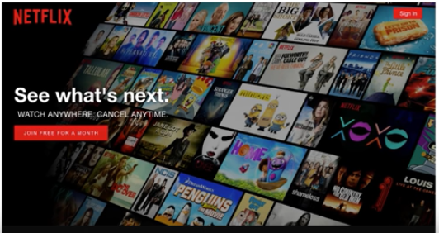
5 RDS
https://www.youtube.com/watch?v=h1-QG_shi24&list=PLv2a_5pNAko2Jl4Ks7V428ttvy-Fj4NKU&index=5
In the previous section, we use AWS EC2 for Netflix server.
www.Netflix.com is essentially the AWS EC2 instance.

Slide 3
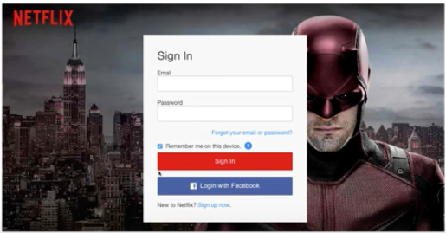
5 RDS
https://www.youtube.com/watch?v=h1-QG_shi24&list=PLv2a_5pNAko2Jl4Ks7V428ttvy-Fj4NKU&index=5
When you go to netflit web site, you need to sign into the Netflix account.

Slide 4
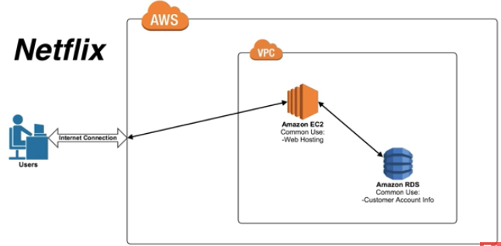
5 RDS
https://www.youtube.com/watch?v=h1-QG_shi24&list=PLv2a_5pNAko2Jl4Ks7V428ttvy-Fj4NKU&index=5
You need to provide the personal information.
The information is stored in database RDS.

Slide 5
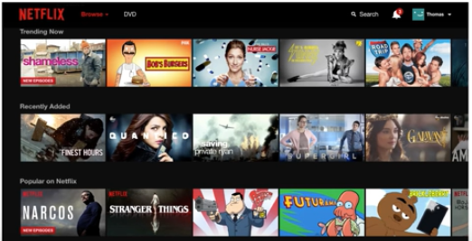
5 RDS
https://www.youtube.com/watch?v=h1-QG_shi24&list=PLv2a_5pNAko2Jl4Ks7V428ttvy-Fj4NKU&index=5
After you log in, there are entire list or the entire catalog of all of the shows and all of the episodes.
Netflix has to offer the catalog.
The inventory catalog is also another common use of RDS or database programs.

Slide 6
5 RDS
https://www.youtube.com/watch?v=h1-QG_shi24&list=PLv2a_5pNAko2Jl4Ks7V428ttvy-Fj4NKU&index=5
A full list of episodes are all stored in the database program.
The information will be requested and then served back by EC2 server.
EC2 server hosts the website and running the code.

Slide 7
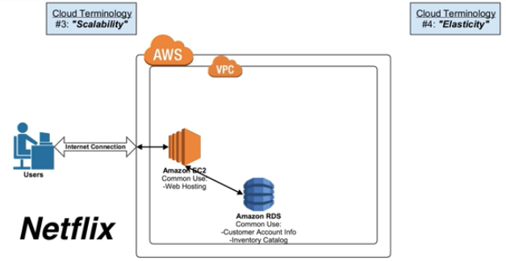
5 RDS
https://www.youtube.com/watch?v=h1-QG_shi24&list=PLv2a_5pNAko2Jl4Ks7V428ttvy-Fj4NKU&index=5
Shrink and rearrange the Diagram.
Netflit can have Scalability and Elasticity through the AWS.
The Users can represent thousands of you.

Slide 8
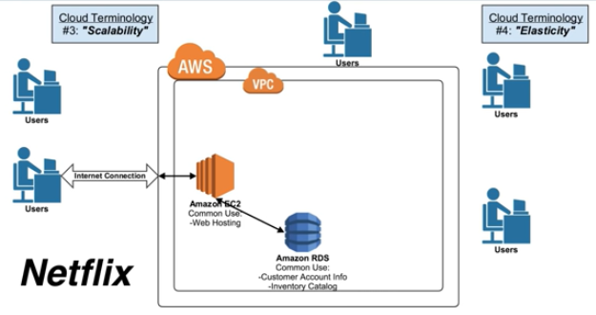
5 RDS
https://www.youtube.com/watch?v=h1-QG_shi24&list=PLv2a_5pNAko2Jl4Ks7V428ttvy-Fj4NKU&index=5
The Americans watch TV at 8 pm after finished their dinner.
There are more and more users watching TV after 8 pm.
The scalability and elasticity can have any number of users.
If Netflix is on-premise, they cannot handle this scenario.

Slide 9
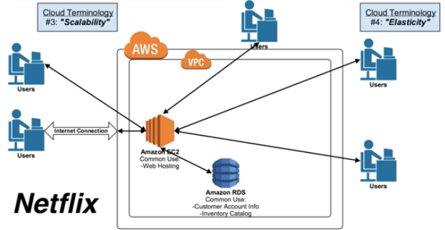
5 RDS
https://www.youtube.com/watch?v=h1-QG_shi24&list=PLv2a_5pNAko2Jl4Ks7V428ttvy-Fj4NKU&index=5
If too many users try to access the servers, the server will be crashes.

Slide 10
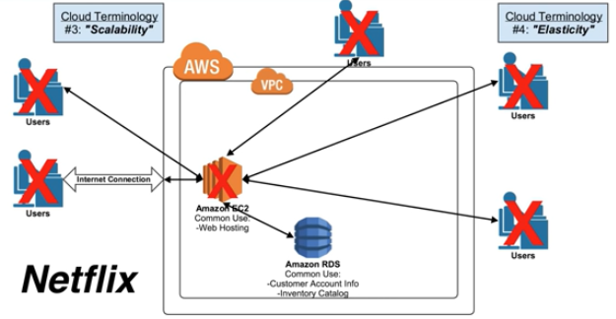
5 RDS
https://www.youtube.com/watch?v=h1-QG_shi24&list=PLv2a_5pNAko2Jl4Ks7V428ttvy-Fj4NKU&index=5
Too many people try to access the server.
Too much traffic causes the server crashes.
When server crashes, then nobody else can access.

Slide 11
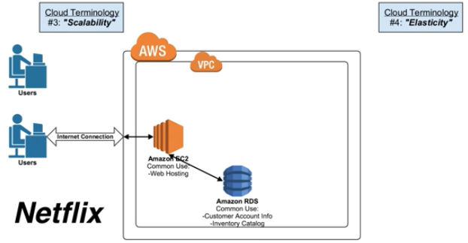
5 RDS
https://www.youtube.com/watch?v=h1-QG_shi24&list=PLv2a_5pNAko2Jl4Ks7V428ttvy-Fj4NKU&index=5
At 7:30 pm, the AWS will automatically add more server.

Slide 12
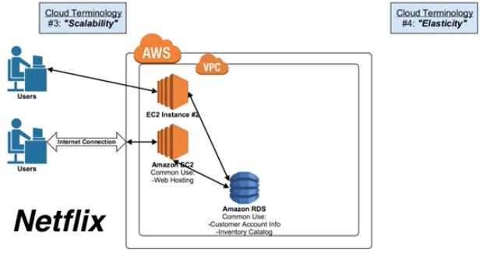
5 RDS
https://www.youtube.com/watch?v=h1-QG_shi24&list=PLv2a_5pNAko2Jl4Ks7V428ttvy-Fj4NKU&index=5
AT 7:30 pm, the AWS will automatically add another EC2 server.

Slide 13
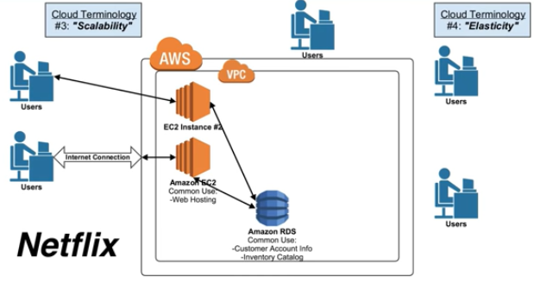
5 RDS
https://www.youtube.com/watch?v=h1-QG_shi24&list=PLv2a_5pNAko2Jl4Ks7V428ttvy-Fj4NKU&index=5
At 8 pm, more users login.

Slide 14
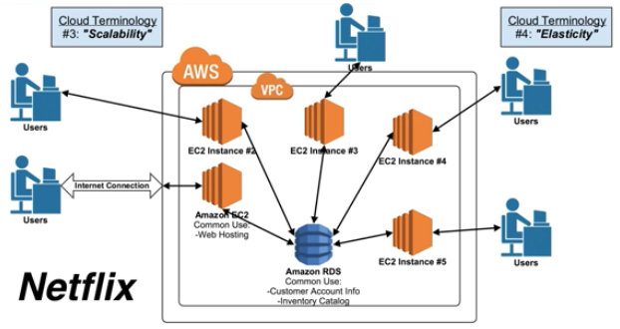
5 RDS
https://www.youtube.com/watch?v=h1-QG_shi24&list=PLv2a_5pNAko2Jl4Ks7V428ttvy-Fj4NKU&index=5
At 8 pm, more users login. AWS add more EC2 instances.
All EC2 instances access the RDS database.
This is the case of Scalability.

Slide 15
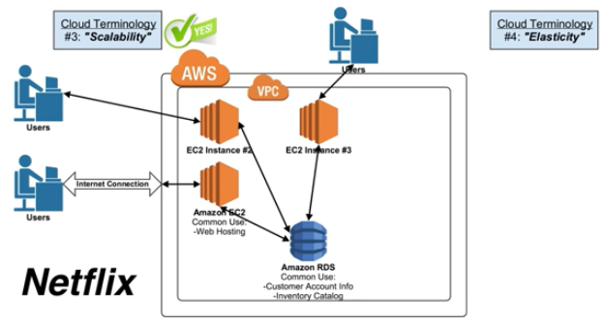
5 RDS
https://www.youtube.com/watch?v=h1-QG_shi24&list=PLv2a_5pNAko2Jl4Ks7V428ttvy-Fj4NKU&index=5
After 9 pm, 10 pm, 11 pm, the user keep on dropping out.
The AWS EC2 instances also reduced.

Slide 16
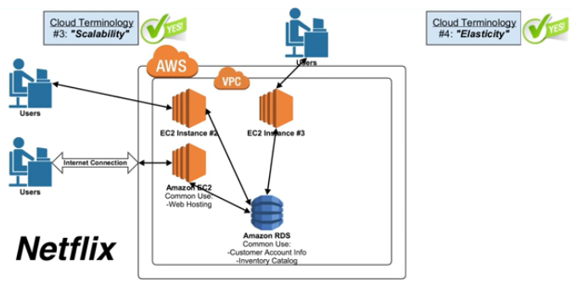
5 RDS
https://www.youtube.com/watch?v=h1-QG_shi24&list=PLv2a_5pNAko2Jl4Ks7V428ttvy-Fj4NKU&index=5
This is the case of Elasticity.

Slide 17
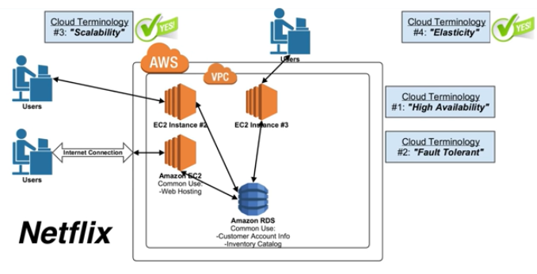
5 RDS
https://www.youtube.com/watch?v=h1-QG_shi24&list=PLv2a_5pNAko2Jl4Ks7V428ttvy-Fj4NKU&index=5
In additional to Scalability and Elasticity, AWS also have High Availability and fault tolerant.

Slide 18
End of Chapter

