Slide 1
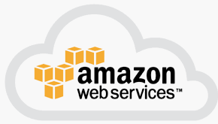
4 EC2: Part 1
Peter H. Chen

Slide 2
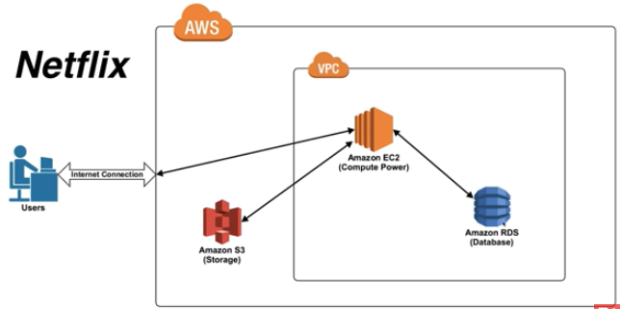
4 EC2: Part 1
https://www.youtube.com/watch?v=izyqJPl9wW8&list=PLv2a_5pNAko2Jl4Ks7V428ttvy-Fj4NKU&index=4
In the previous section, we use Netflix as example. It is a oversimplified example to example AWS.
We will dive into the Netflix and understand how Netflix uses AWS resources, such as, EC2, RDS, and Amazon S3 to power their web site.
Netflix is the number one video content streaming and AWS is the number one customer or user of cloud resources.

Slide 3
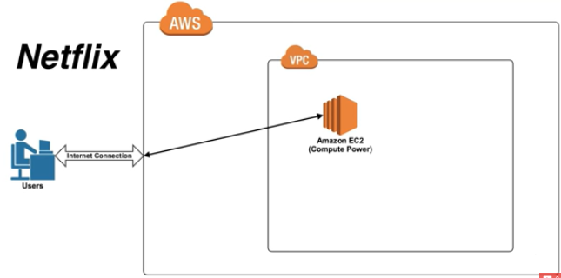
4 EC2: Part 1
https://www.youtube.com/watch?v=izyqJPl9wW8&list=PLv2a_5pNAko2Jl4Ks7V428ttvy-Fj4NKU&index=4
How Netflix uses AWS EC2, RDS, and S3?
We get rid of RDS and S3 and focus on EC2 only.

Slide 4
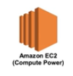
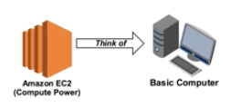
4 EC2: Part 1
https://www.youtube.com/watch?v=izyqJPl9wW8&list=PLv2a_5pNAko2Jl4Ks7V428ttvy-Fj4NKU&index=4
What is EC2?
We can think ECS as a Basic Computer.
EC2 is Virtual equivalent of Computer that is currently sitting in front of you.

Slide 5
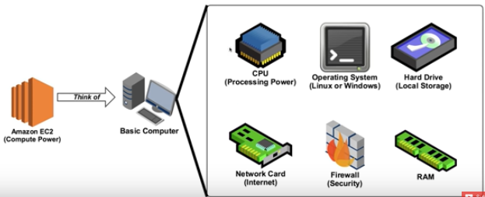
4 EC2: Part 1
https://www.youtube.com/watch?v=izyqJPl9wW8&list=PLv2a_5pNAko2Jl4Ks7V428ttvy-Fj4NKU&index=4
This is a oversimplified concept.
The Virtual Basic Computer can be expanded on the right.
The virtual Basic Computer contains the followings:
CPU for the processing power
the Operating system in AWS is either Linux or Windows
the Hard drive or local storage
a network card to access the internet
a firewall for security and RAM to access and run programs.

Slide 6
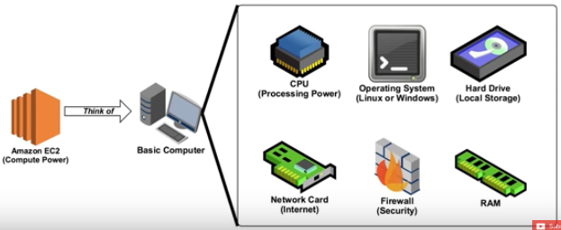
4 EC2: Part 1
https://www.youtube.com/watch?v=izyqJPl9wW8&list=PLv2a_5pNAko2Jl4Ks7V428ttvy-Fj4NKU&index=4
However, when think of actual AWS, we do not want to think about basic computer.

Slide 7
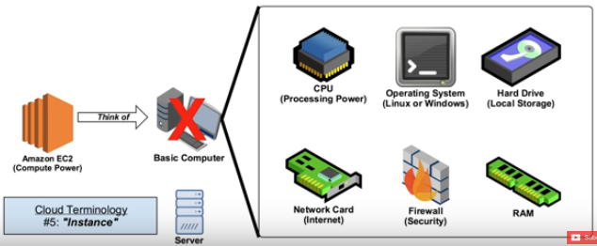
4 EC2: Part 1
https://www.youtube.com/watch?v=izyqJPl9wW8&list=PLv2a_5pNAko2Jl4Ks7V428ttvy-Fj4NKU&index=4
We want to think EC2 as Server. AWS provides the compute power.
Now, we have another Cloud Terminology: Instance.
In AWS, EC2 server can be referred to as an EC2 instance.

Slide 8
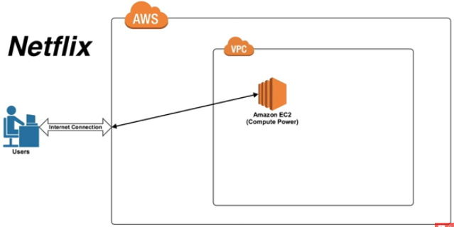
4 EC2: Part 1
https://www.youtube.com/watch?v=izyqJPl9wW8&list=PLv2a_5pNAko2Jl4Ks7V428ttvy-Fj4NKU&index=4
How the Netflix with EC2?

Slide 9
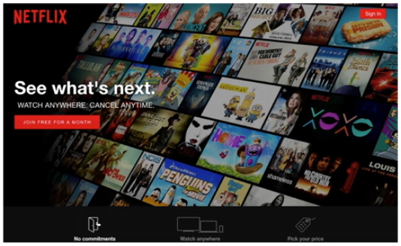
4 EC2: Part 1
https://www.youtube.com/watch?v=izyqJPl9wW8&list=PLv2a_5pNAko2Jl4Ks7V428ttvy-Fj4NKU&index=4
When you load with the www.netflix.com, you are actually connect to the AWS EC2 sever.

Slide 10
4 EC2: Part 1
https://www.youtube.com/watch?v=izyqJPl9wW8&list=PLv2a_5pNAko2Jl4Ks7V428ttvy-Fj4NKU&index=4
The AWS EC2 instance which is currently serves as a web host.
This instance contains all the files and the code of Netflix.

Slide 11
4 EC2: Part 1
https://www.youtube.com/watch?v=izyqJPl9wW8&list=PLv2a_5pNAko2Jl4Ks7V428ttvy-Fj4NKU&index=4
Recap:
Think of EC2 as a Virtual computer that you can use for whatever you like.
The Cloud Terminology: Instance. The Instance is a EC2 Virtual Computer.

Slide 12
End of Chapter

