Slide 1
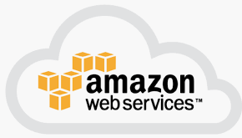
2 AWS Introduction
Peter H. Chen

Slide 2
2 AWS Introduction
https://www.youtube.com/watch?v=qcY-uiEHhn0&list=PLv2a_5pNAko2Jl4Ks7V428ttvy-Fj4NKU&index=2
Introduction to AWS
This is a high level introduction
This is an over simplified concept
The purpose is to provide a frame of Reference for move forward.

Slide 3
2.1 What is Cloud?

Slide 4
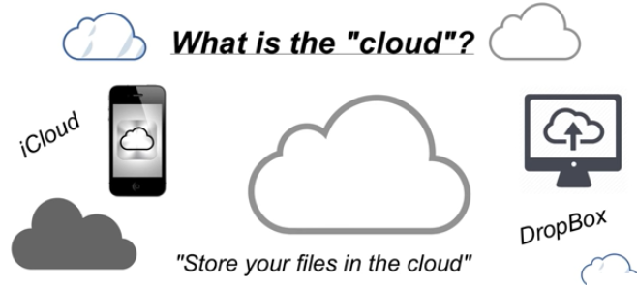
2.1 What is Cloud?
https://www.youtube.com/watch?v=qcY-uiEHhn0&list=PLv2a_5pNAko2Jl4Ks7V428ttvy-Fj4NKU&index=2
What is cloud?
When you are using a iPhone for communication.
When you use computer to store data.

Slide 5
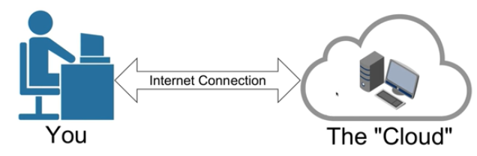
2.1 What is Cloud?
https://www.youtube.com/watch?v=qcY-uiEHhn0&list=PLv2a_5pNAko2Jl4Ks7V428ttvy-Fj4NKU&index=2
You use a computer via the internet connection in somewhere that you utilize the storage and the processing in the cloud.

Slide 6
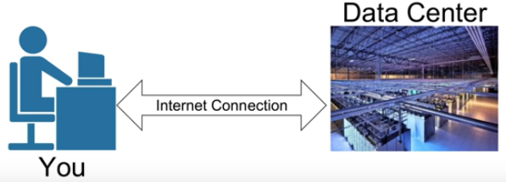
2.1 What is Cloud?
https://www.youtube.com/watch?v=qcY-uiEHhn0&list=PLv2a_5pNAko2Jl4Ks7V428ttvy-Fj4NKU&index=2
A cloud is not a computer, it is a data center that contains a lot (rows and rows) of computers.
In the iCloud, Dropbox, or Amazon Web Services, you files are stored in one of these racks in the data center.
There are many data centers that all around the worlds.

Slide 7
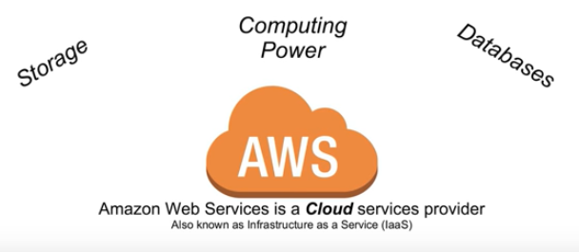
2.1 What is Cloud?
https://www.youtube.com/watch?v=qcY-uiEHhn0&list=PLv2a_5pNAko2Jl4Ks7V428ttvy-Fj4NKU&index=2
The Amazon Web Services or AWS is a cloud services provider and that is as known as an IaaS (Infrastructure as a Services).
Commonly, people refer to cloud server providers. They think about storage, computing power, and databases.

Slide 8
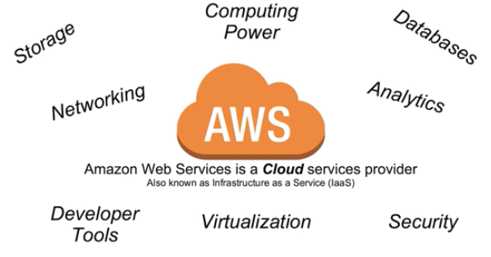
2.1 What is Cloud?
https://www.youtube.com/watch?v=qcY-uiEHhn0&list=PLv2a_5pNAko2Jl4Ks7V428ttvy-Fj4NKU&index=2
In addition, Amazon Web Services offer a lot more in terms of networking, analytics, developer tools, virtualization, security, and etc.
The iCloud and Dropbox store the videos and documents are only a very small subset of cloud computing.
The AWS is much broader than iCloud and Dropbox.

Slide 9
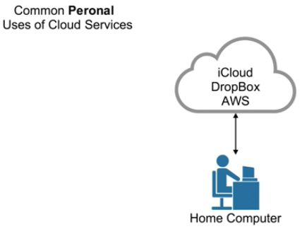
2.1 What is Cloud?
https://www.youtube.com/watch?v=qcY-uiEHhn0&list=PLv2a_5pNAko2Jl4Ks7V428ttvy-Fj4NKU&index=2
Why do individuals and companies use AWS?
What are the benefits?
How is the “Cloud” different from what has been used in the past?
For some common personal uses of cloud services, to think about iCloud, Dropbox, or AWS to a certain extent.
Here is your home computer. You may use iCloud or Dropbox to store videos, pictures or some personal files that you may have.

Slide 10
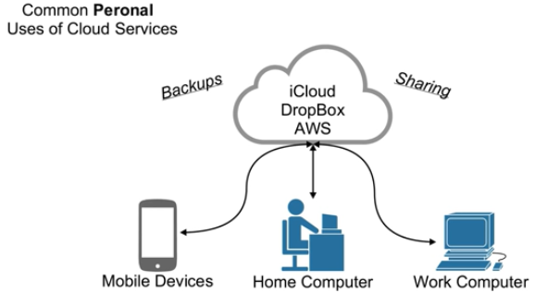
2.1 What is Cloud?
https://www.youtube.com/watch?v=qcY-uiEHhn0&list=PLv2a_5pNAko2Jl4Ks7V428ttvy-Fj4NKU&index=2
What cloud allows you to do specifically for an individual is backup and sharing.
You use iCloud or Dropbox as an additional backup for the pictures that you have from vacations or some documents that you have or music or videos that you want to save.
On your hard drive of your home computer, there is always a risk that your hard drive will fail.
You use the cloud for backup.
Cloud is also great for sharing. Sharing is not only to share the files to pictures to other people, it also crosses the devices.

Slide 11
2.2 High Availability and Fault Tolerant

Slide 12
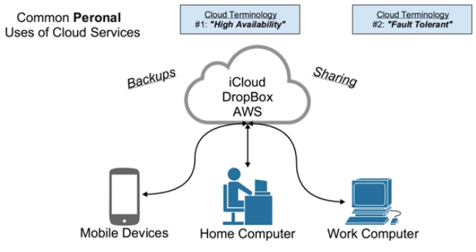
2.2 High Availability and Fault Tolerant
https://www.youtube.com/watch?v=qcY-uiEHhn0&list=PLv2a_5pNAko2Jl4Ks7V428ttvy-Fj4NKU&index=2
You can access the same files on your mobile devices. It means that your files will be available anywhere and access with any type of devices.
With that, we have two terminologies, one is “High Availability” and the other is “Fault Tolerant”.
The “High Availability” means that you can access any type of devices and computers as long as you have internet connection.
The “Fault Tolerance” means that you files is on the cloud is always backup on multiples services. You always have the ability or retrieve that file.
You files are always available across multiple devices.

Slide 13
2.3 On-Premise

Slide 14
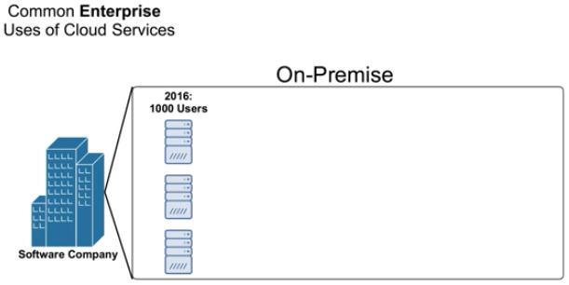
2.3 On-Premise
https://www.youtube.com/watch?v=qcY-uiEHhn0&list=PLv2a_5pNAko2Jl4Ks7V428ttvy-Fj4NKU&index=2
This is a common example of software company. If this company is not using the cloud services that means they are currently using On-Premise (in-house) Servers
They have server computer which are used to store their data, handling their code, or when customers use their software they are accessing the software on the company servers.
In 2016, the company has 1000 users which takes three servers to power the software for 1000 users.

Slide 15
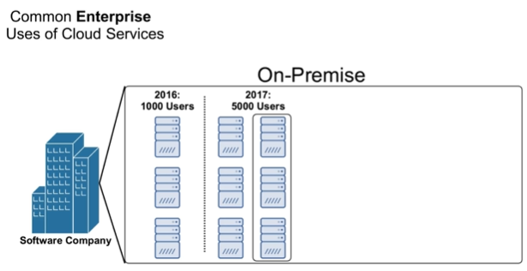
2.3 On-Premise
https://www.youtube.com/watch?v=qcY-uiEHhn0&list=PLv2a_5pNAko2Jl4Ks7V428ttvy-Fj4NKU&index=2
In 2017, the company have grow and going to have 5000 users. They are going to add three additional servers to handle the load of having users but in order to add three additional servers to their on-premise data center, they are going to have one have the size and space to these servers into their data center.
They also need to have research what type of servers they need and need significant money to wait for delivery which cannot be anywhere between several weeks for several they are going to have to set them up and test them after installed and operation.
They will take a lot of time to increase three servers into 6 servers.

Slide 16
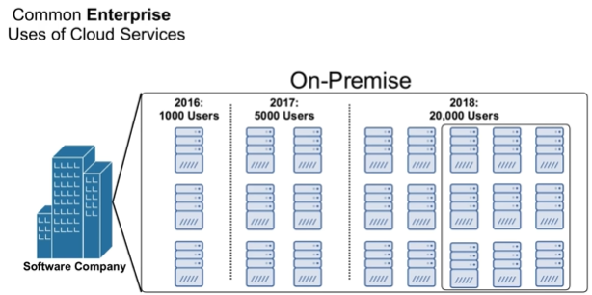
2.3 On-Premise
https://www.youtube.com/watch?v=qcY-uiEHhn0&list=PLv2a_5pNAko2Jl4Ks7V428ttvy-Fj4NKU&index=2
In 2018, the company estimates 20,000 users. Now, they need to add additional 15 servers.
They are going to repeat the process of money, time, test, operation, again and again.

Slide 17
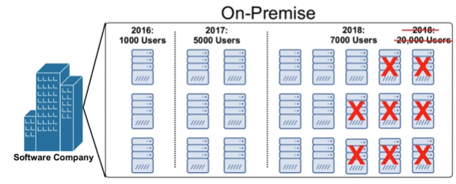
2.3 On-Premise
https://www.youtube.com/watch?v=qcY-uiEHhn0&list=PLv2a_5pNAko2Jl4Ks7V428ttvy-Fj4NKU&index=2
What happened their estimation is wrong in 2018?
They only need 7000 users. They waste the resources, money, and effort.
The resources are not used and have to sell the servers or just let them sit there until the users base were to increase.
For a specific growing company, spending the tens of thousands of dollars on these servers may be a big investment and if they did not get user base to back that up. It can be a major loss for the company, this is a problem with on-premise data centers.

Slide 18
2.4 Cloud Provider

Slide 19
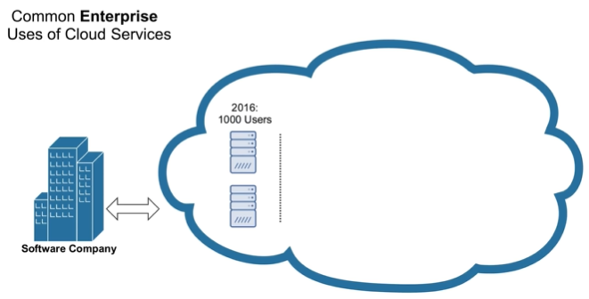
2.4 Cloud Provider
https://www.youtube.com/watch?v=qcY-uiEHhn0&list=PLv2a_5pNAko2Jl4Ks7V428ttvy-Fj4NKU&index=2
Now, we take a lot at the same scenario using a cloud service provider, such as, AWS.
In 2016, company has 1000 users. We have 2 servers in the cloud.

Slide 20
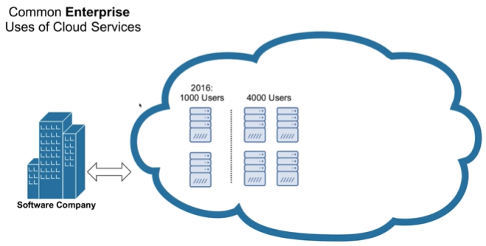
2.4 Cloud Provider
https://www.youtube.com/watch?v=qcY-uiEHhn0&list=PLv2a_5pNAko2Jl4Ks7V428ttvy-Fj4NKU&index=2
In 2017, we add 4000 users with total 6 servers.
We no longer need to estimate how many servers. We do not need to take several weeks to purchase computers, install operating systems, test, and etc.
The company just need several minutes to use a cloud service provider.

Slide 21
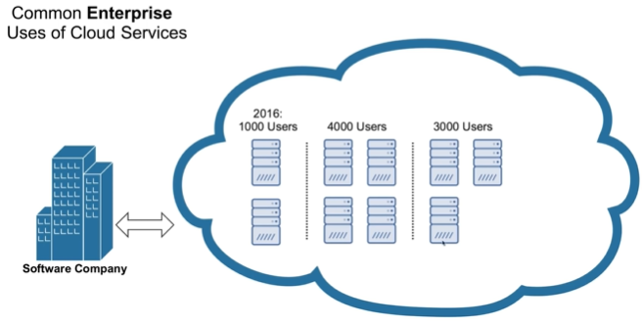
2.4 Cloud Provider
https://www.youtube.com/watch?v=qcY-uiEHhn0&list=PLv2a_5pNAko2Jl4Ks7V428ttvy-Fj4NKU&index=2
In 2018, the company drop to 3000 users with three servers.
We service provider, we only need to lease the hardware on demand base on your users.

Slide 22
2.5 Scalability and Elasticity

Slide 23
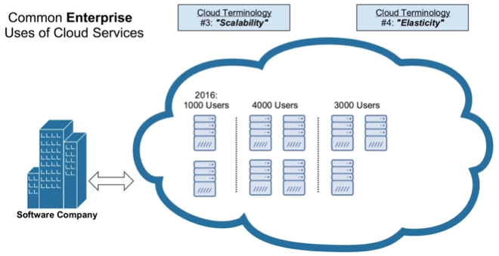
2.5 Scalability and Elasticity
https://www.youtube.com/watch?v=qcY-uiEHhn0&list=PLv2a_5pNAko2Jl4Ks7V428ttvy-Fj4NKU&index=2
We have two more terminologies, Scalability and Elasticity.
Scalability means the user base grows. You have ability to quickly and easily add more servers. You can scale up extremely easily.
Elasticity means that you can grow but you can also shrink. You can grow from 1000 users but you can drop down to three users. You can go back to three servers like a rubber band.

Slide 24
2.6 Recap

Slide 25
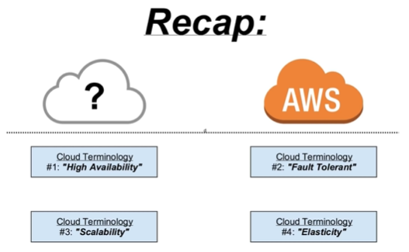
2.6 Recap
https://www.youtube.com/watch?v=qcY-uiEHhn0&list=PLv2a_5pNAko2Jl4Ks7V428ttvy-Fj4NKU&index=2
Let’s recap: We have four terminologies: High availability, Fault Tolerant, Scalability, and Elasticity.

Slide 26
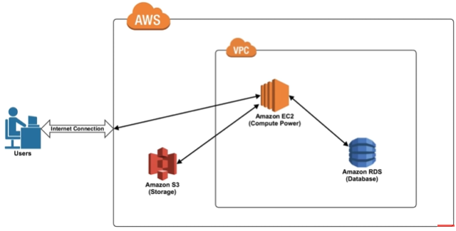
2.6 Recap
https://www.youtube.com/watch?v=qcY-uiEHhn0&list=PLv2a_5pNAko2Jl4Ks7V428ttvy-Fj4NKU&index=2
What is next?
We are going to see the architecture in the next section.
It looks this this albeit (although) probably a lot more complicated than this.
This is a very simple diagram of AWS architecture.
AWS includes S3 storage and VPC (Virtual Private Cloud).
The VPC includes the EC2 and RDS (database).

Slide 27
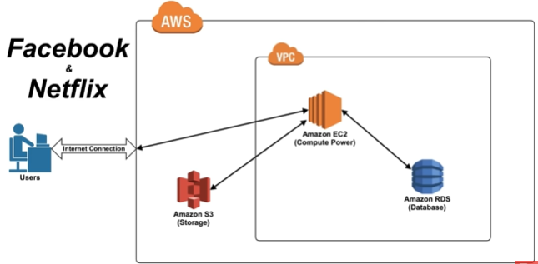
2.6 Recap
https://www.youtube.com/watch?v=qcY-uiEHhn0&list=PLv2a_5pNAko2Jl4Ks7V428ttvy-Fj4NKU&index=2
Netflix is the number one AWS users.
We will look at how Netflix use the AWS in the next section.

Slide 28
End of Chapter

