Slide 1

1 AWS
Peter H. Chen

Slide 2
1.1 Go to AWS Console

Slide 3
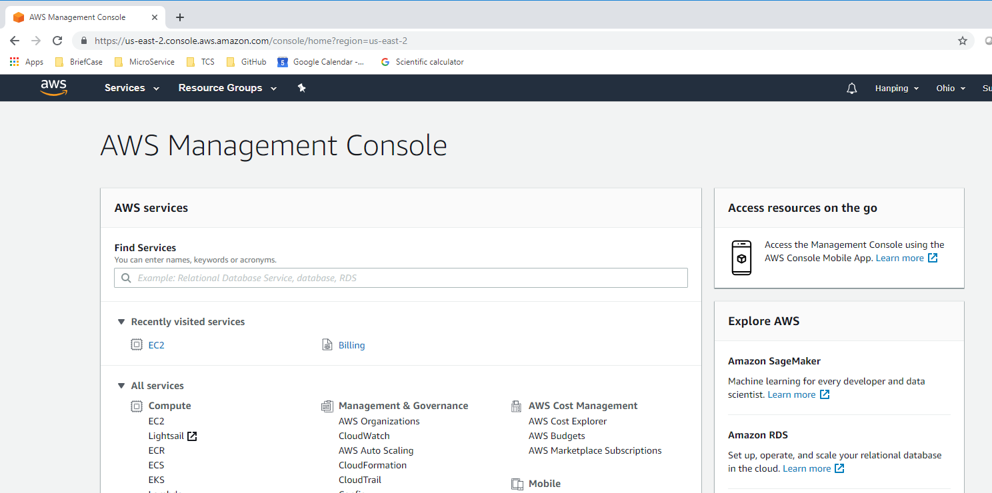

1.1 Go to AWS Console
https://www.youtube.com/watch?v=kQnNd-DyrpA
You need to create a email account and have a create card number to use AWS. You can create many gmail accounts. Use one of the gmail accounts with your credit card for AWS account. Search “AWS free tier” to login. The free tier does not charge you credit card.
Open chrome and type “console.aws.amazon.com”

Slide 4
1.2 Start EC2

Slide 5
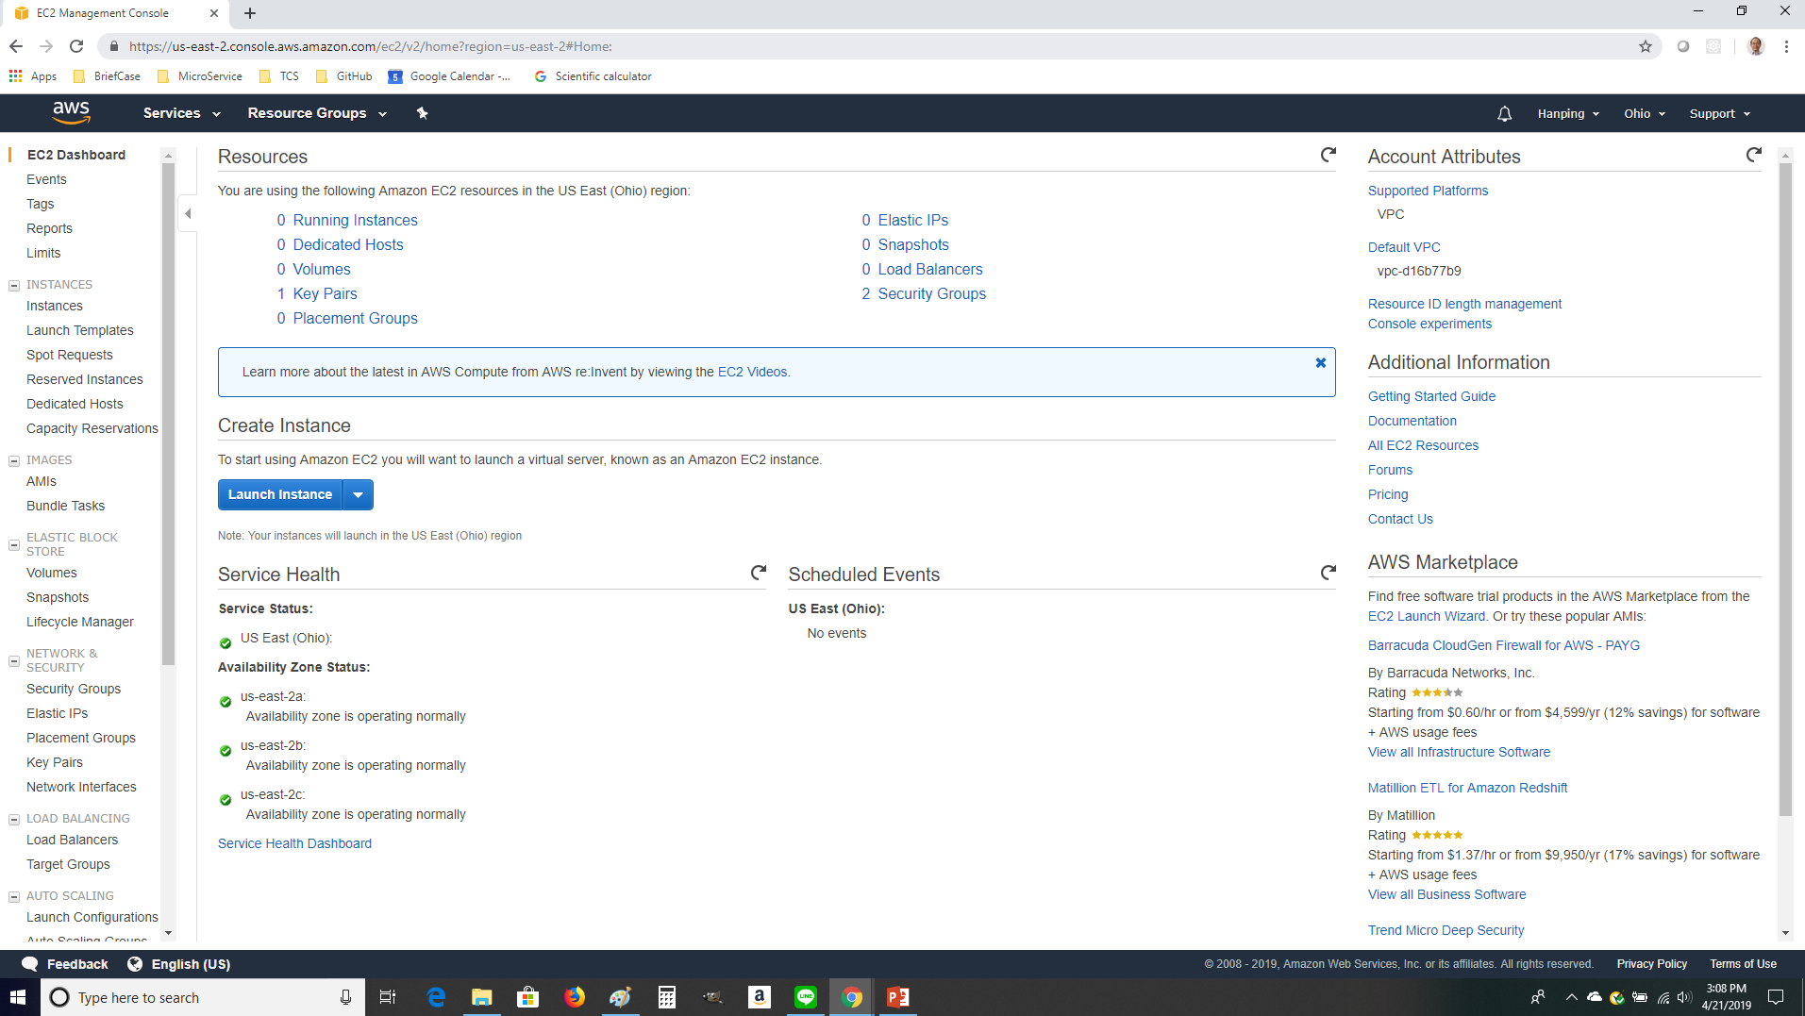
1.2 Start EC2
https://www.youtube.com/watch?v=kQnNd-DyrpA
We are going to create an Ubuntu Command Window: Click EC2.

Slide 6
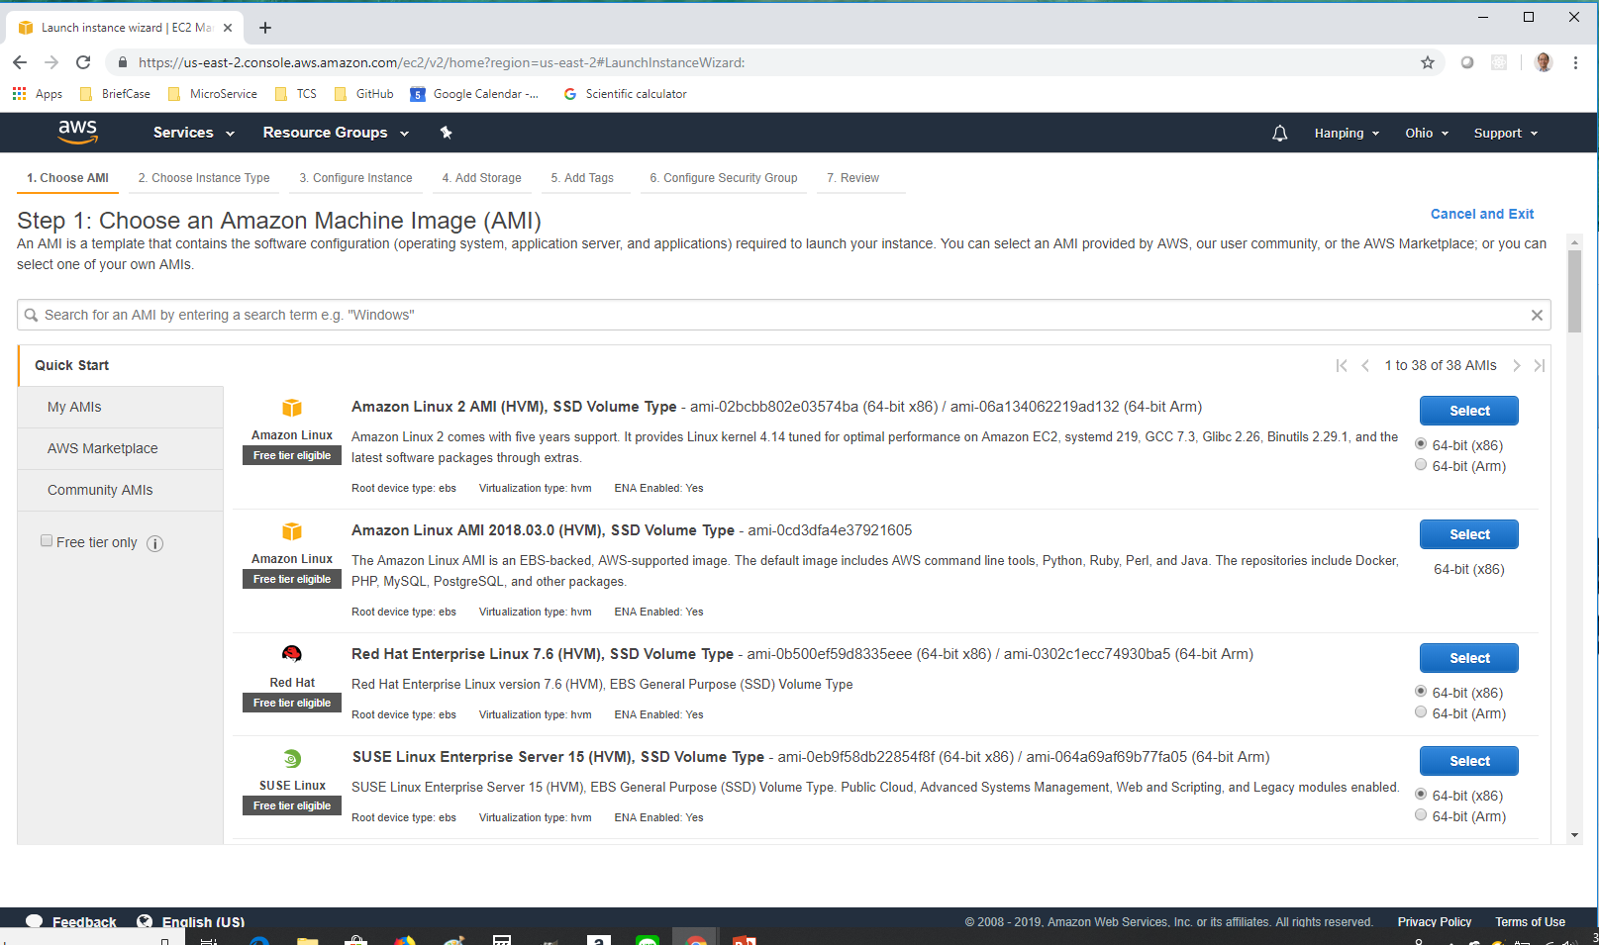
1.2 Start EC2
https://www.youtube.com/watch?v=kQnNd-DyrpA
We are going to create an Ubuntu Command Window: Click Launch button.

Slide 7
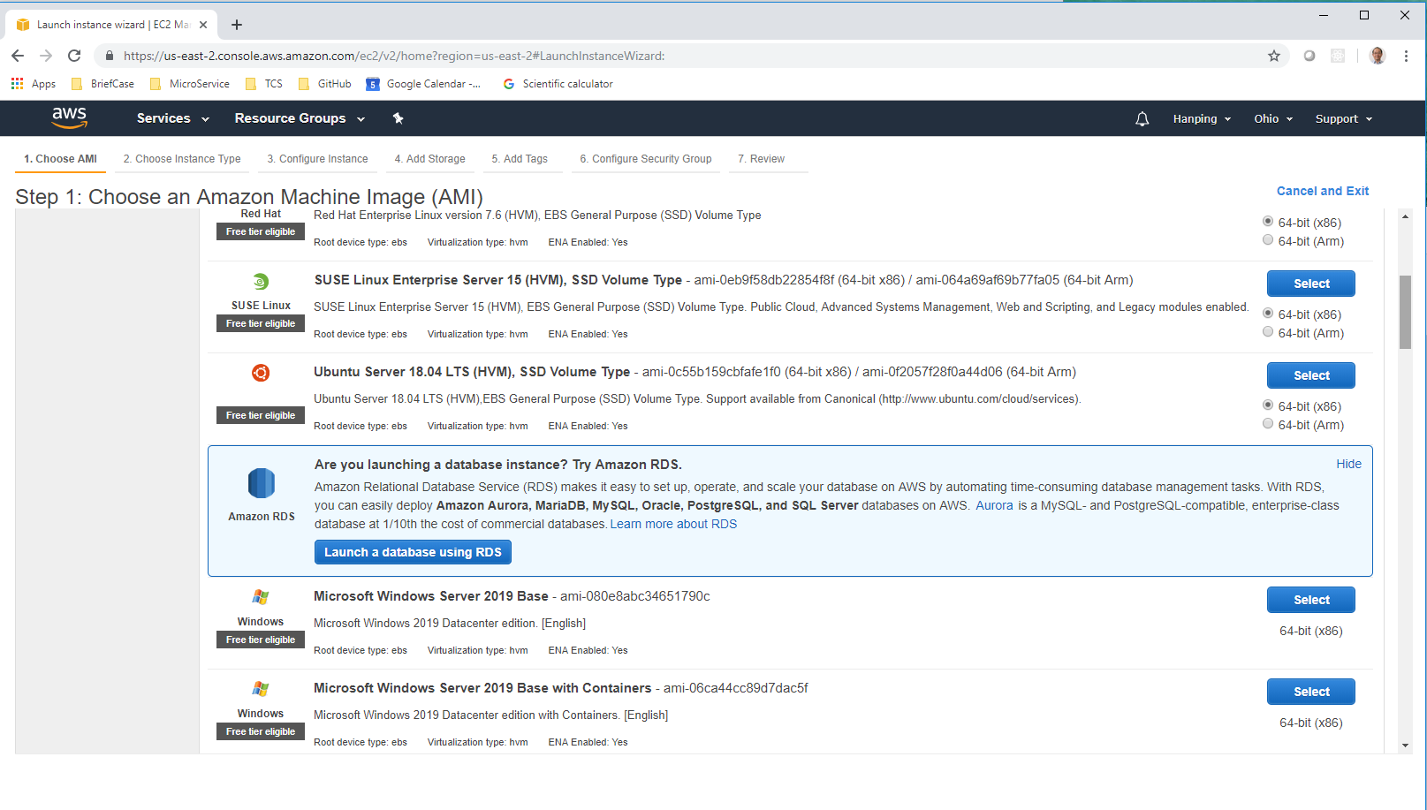
1.2 Start EC2
https://www.youtube.com/watch?v=kQnNd-DyrpA
Scroll down until you see the Ubuntu. Click “Select” button.

Slide 8
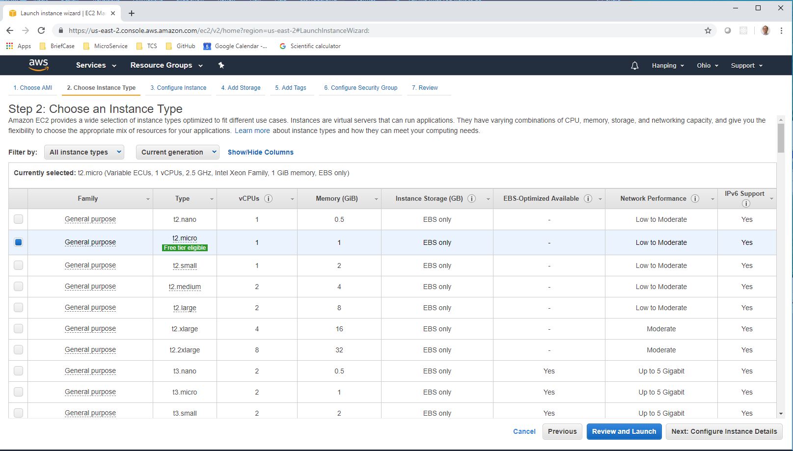
1.2 Start EC2
https://www.youtube.com/watch?v=kQnNd-DyrpA
Select the type with “Free tier eligible” and click “Next: Configure Instance Details”.

Slide 9
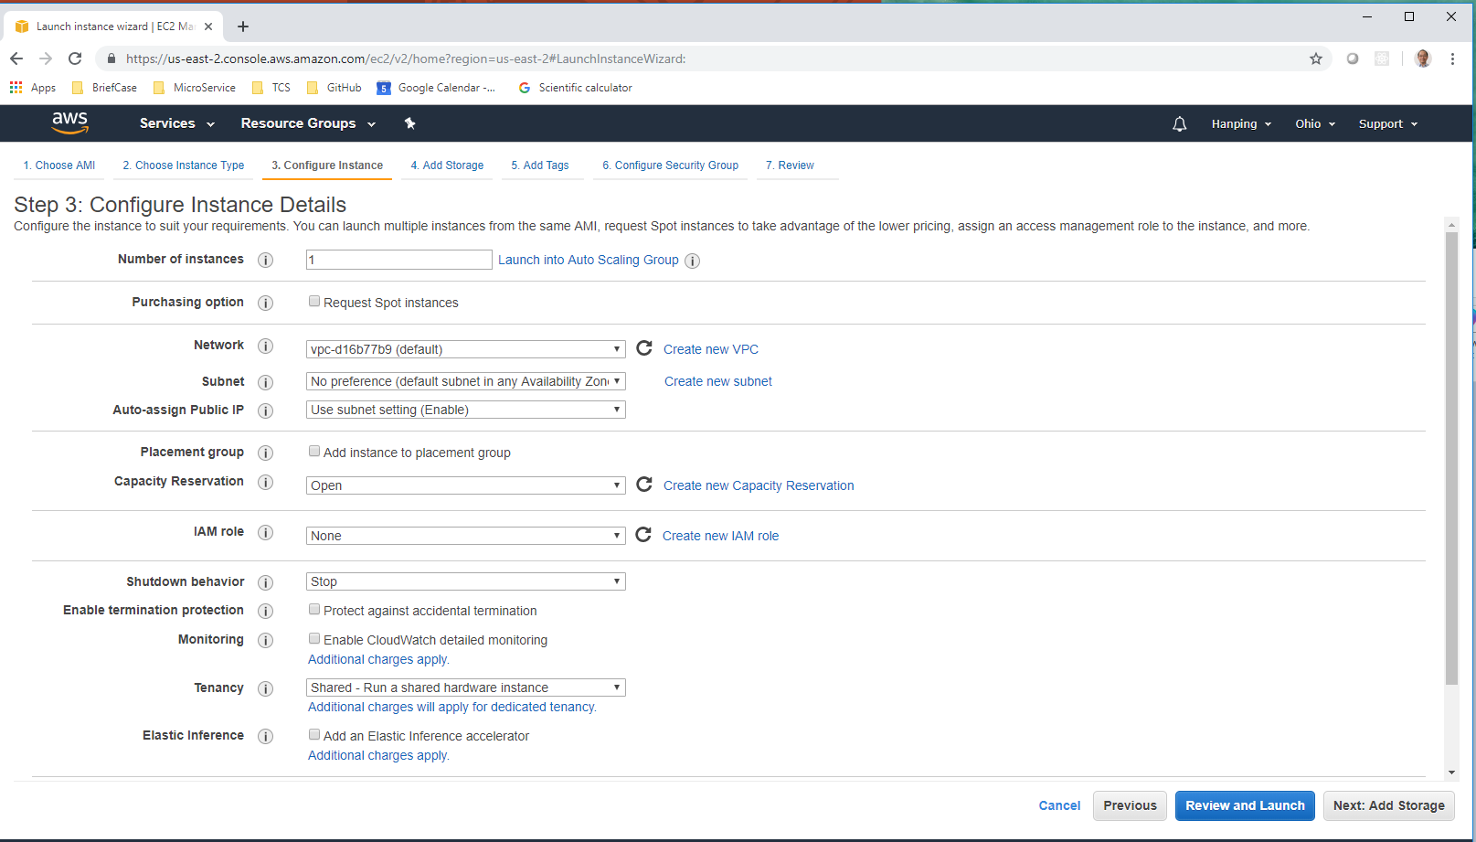
1.2 Start EC2
https://www.youtube.com/watch?v=kQnNd-DyrpA
Click “Review and Launch”

Slide 10
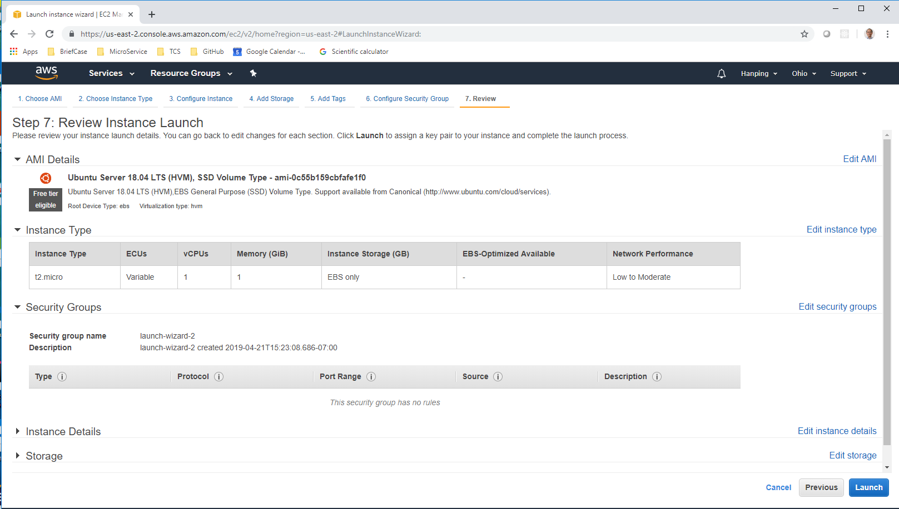
1.2 Start EC2
https://www.youtube.com/watch?v=kQnNd-DyrpA
Click “Launch”

Slide 11
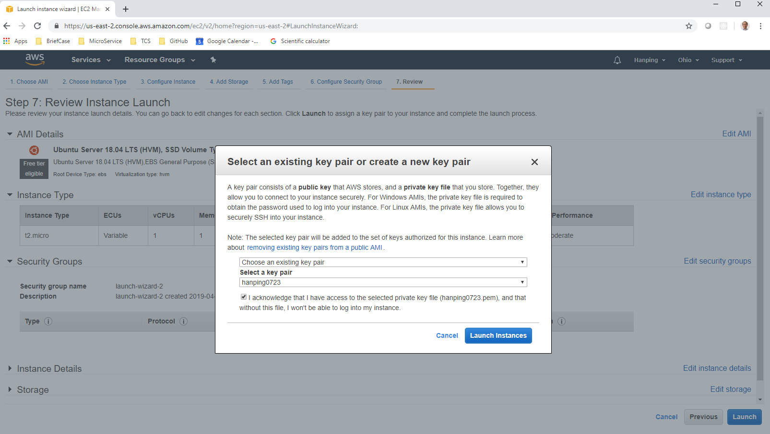
1.2 Start EC2
https://www.youtube.com/watch?v=kQnNd-DyrpA
Select a Key pair to launch. For the first time, select a name (here, I use my name “hanping0723”, the file type is “pem”.

Slide 12
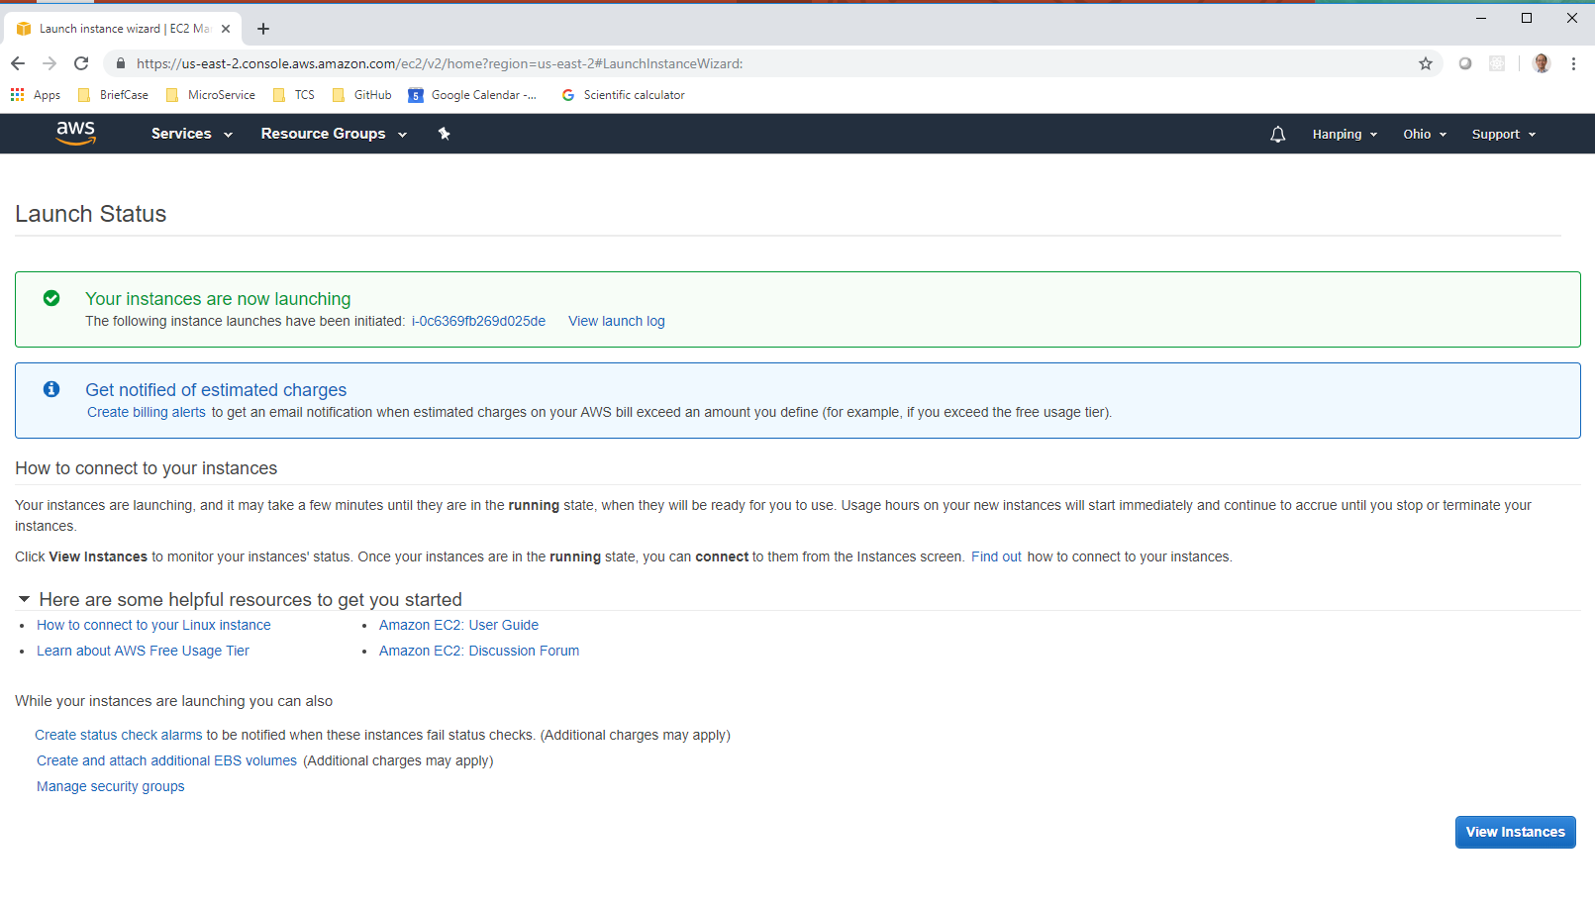
1.2 Start EC2
https://www.youtube.com/watch?v=kQnNd-DyrpA
View Instances.

Slide 13
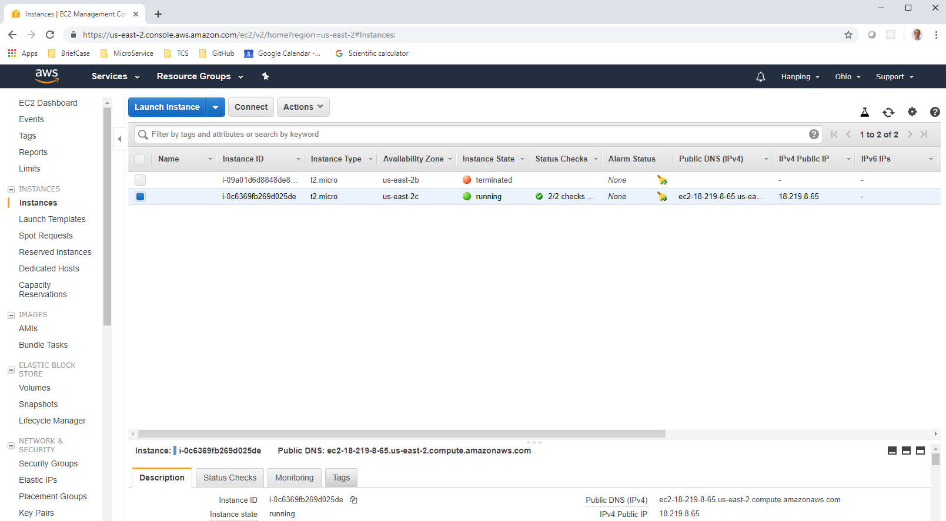
1.2 Start EC2
https://www.youtube.com/watch?v=kQnNd-DyrpA
Select instances, you can see the IPv4 Public IP address is “18.219.8.65”

Slide 14
1.3 Generate PuTTY Private Key

Slide 15
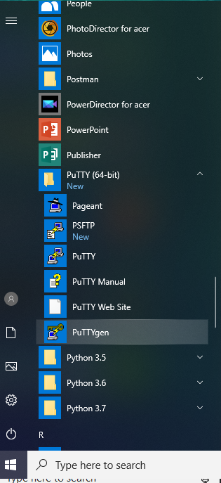
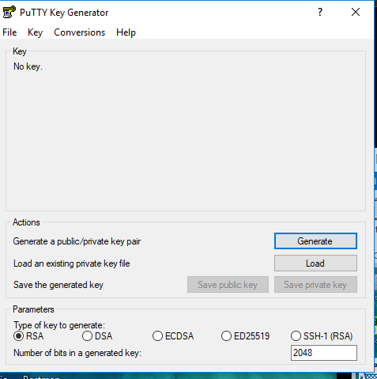
1.3 PuTTY for Terminal
https://www.youtube.com/watch?v=kQnNd-DyrpA
Start the PuTTYgen.

Slide 16
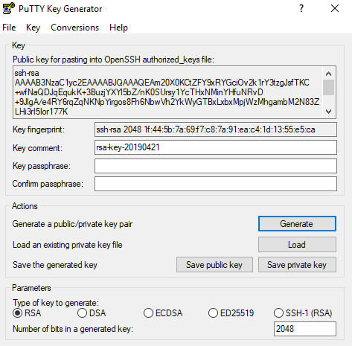
1.3 Generate PuTTY Private Key
https://www.youtube.com/watch?v=kQnNd-DyrpA
Click the Generate Button to generate the public key.

Slide 17
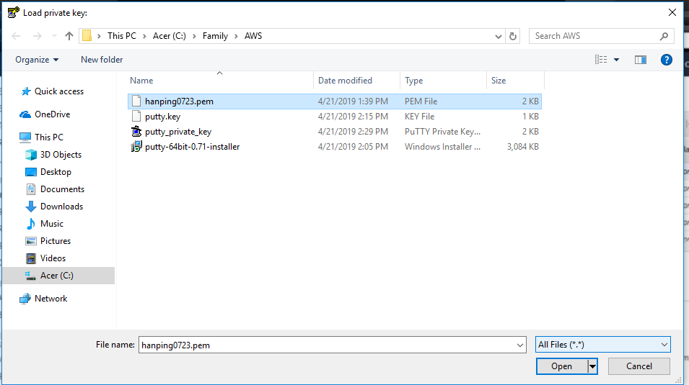
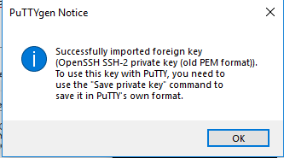
1.3 Generate PuTTY Private Key
https://www.youtube.com/watch?v=kQnNd-DyrpA
Click the Load Button and select the hanpin0723.pem to Translate the hanping0723.pem into the private key.

Slide 18
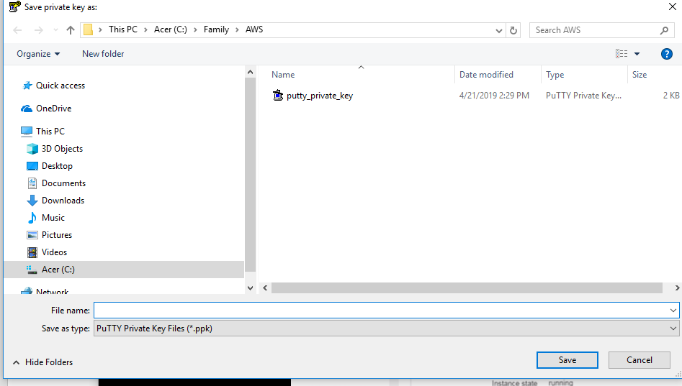
1.3 Generate PuTTY Private Key
https://www.youtube.com/watch?v=kQnNd-DyrpA
Click the “Save private key” and save the give name “putty_private_key.ppk”

Slide 19
1.4 PuTTY for Terminal

Slide 20
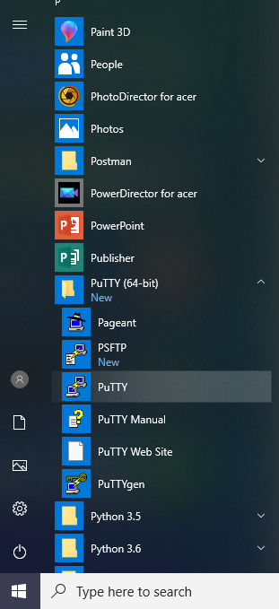
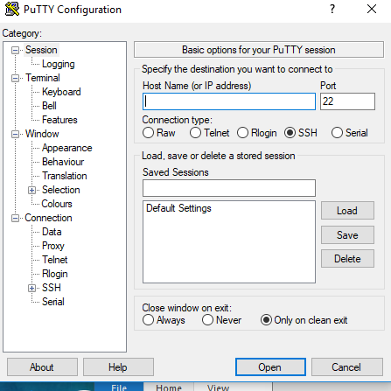
1.4 PuTTY for Terminal
https://www.youtube.com/watch?v=kQnNd-DyrpA
Start the PuTTY.

Slide 21
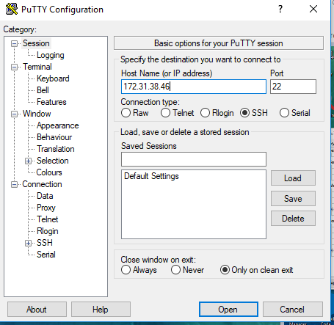
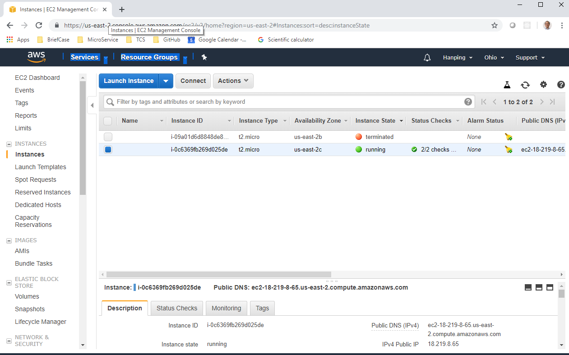
1.4 PuTTY for Terminal
https://www.youtube.com/watch?v=kQnNd-DyrpA
Copy the IPv4 address of AWS Server for PuTTY.

Slide 22
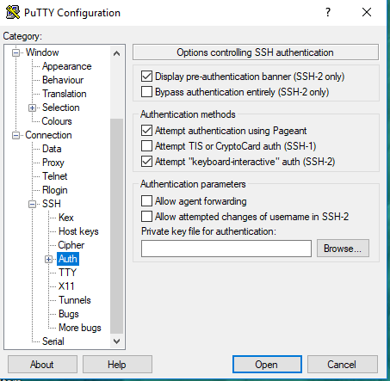
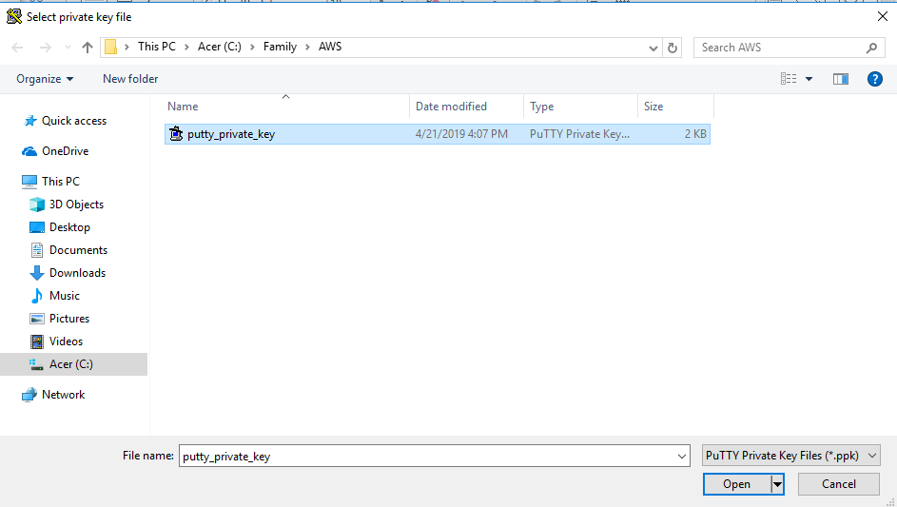
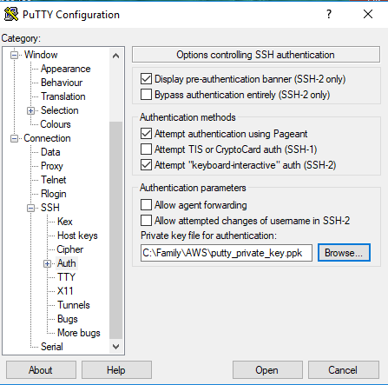
1.4 PuTTY for Terminal
https://www.youtube.com/watch?v=kQnNd-DyrpA
Click SSH > Auth and Click Browse to select the “putty_private_key.ppk”.

Slide 23
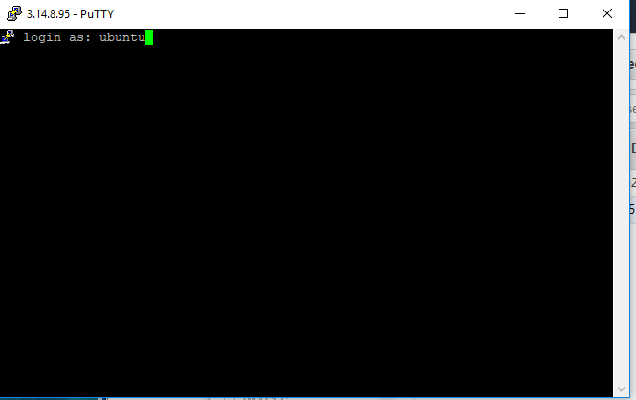
1.4 PuTTY for Terminal
https://www.youtube.com/watch?v=kQnNd-DyrpA
Click Open to start the PuTTY Terminal. Type “Ubuntu” to login.

Slide 24
1.5 Ubuntu Login

Slide 25
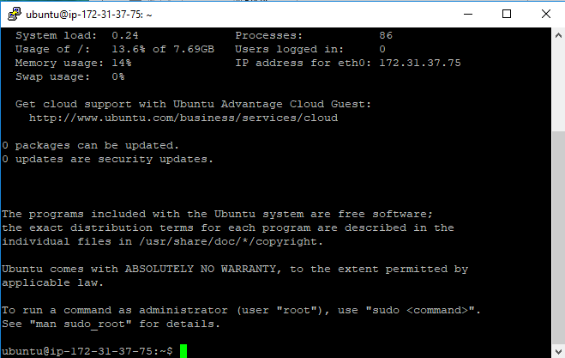
1.5 Ubuntu Login
https://www.youtube.com/watch?v=kQnNd-DyrpA
Type “Ubuntu” to login. The Ubuntu terminal is displayed. You can start to develop your application from here.

Slide 26
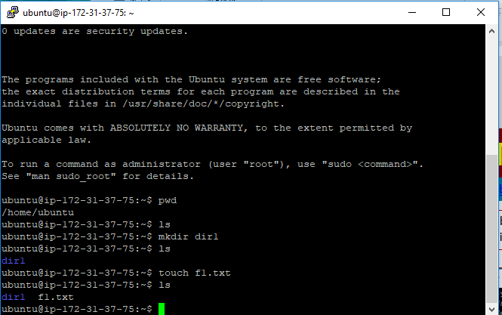
1.5 Ubuntu Login
https://www.youtube.com/watch?v=kQnNd-DyrpA
Linux Command: pwd, mkdir, ls

Slide 27
1.6 Terminate Instance

Slide 28
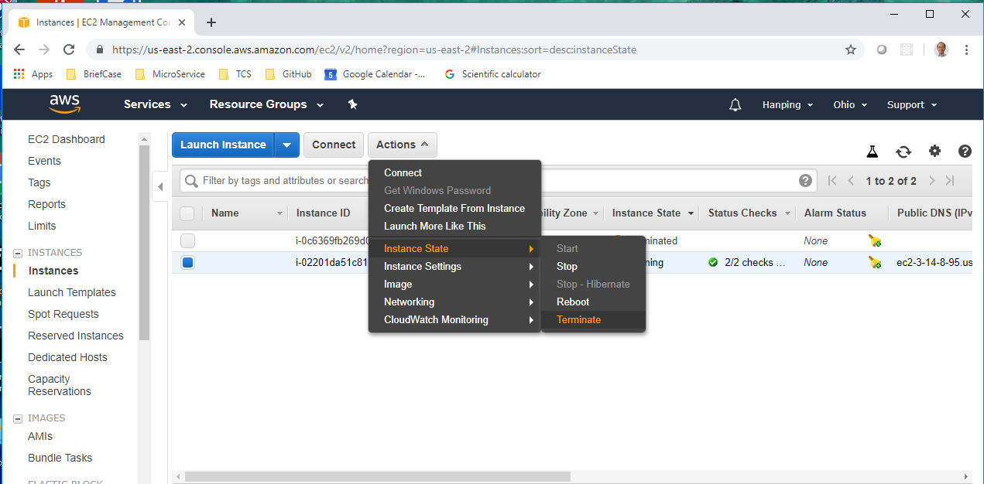
1.6 Terminate Instance
https://www.youtube.com/watch?v=kQnNd-DyrpA
Terminate the instance to avoid the charge from AWS: Actions > Instance State > Terminate.

Slide 29
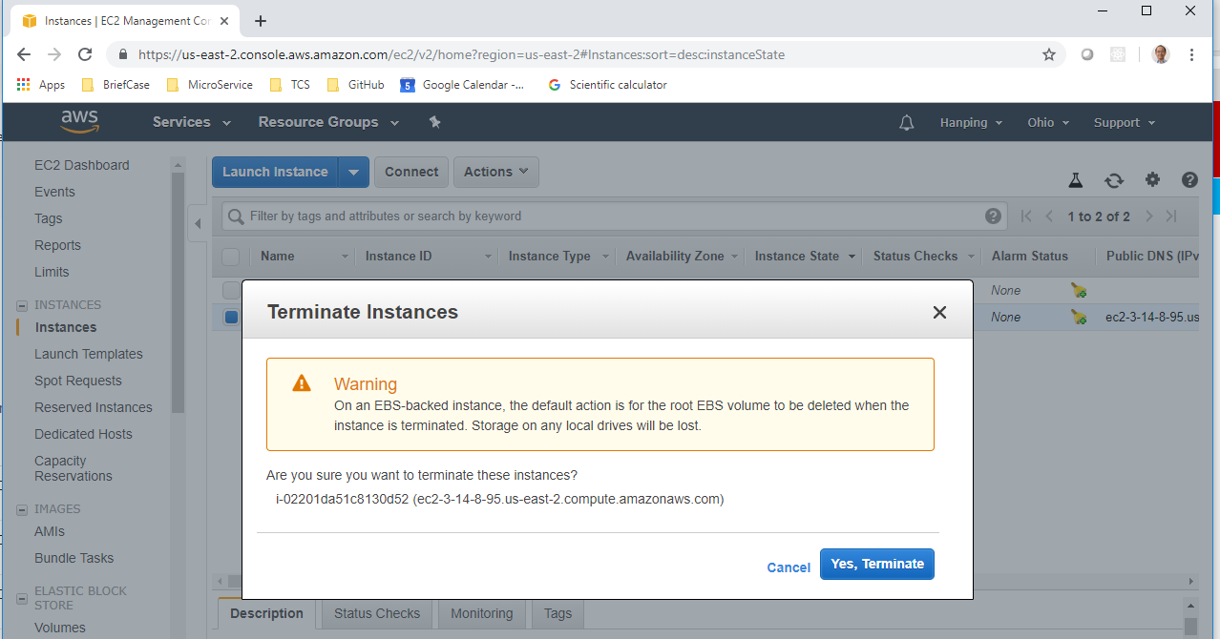
1.6 Terminate Instance
https://www.youtube.com/watch?v=kQnNd-DyrpA
Select “Yes, Terminate”.

Slide 30
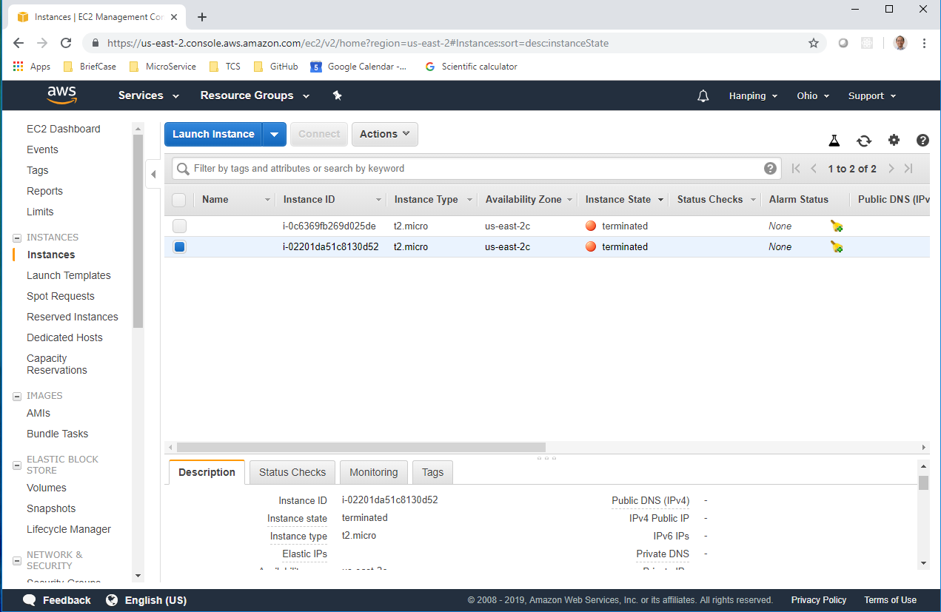
1.6 Terminate Instance
https://www.youtube.com/watch?v=kQnNd-DyrpA
Verify all the instances are terminate before leave AWS.

Slide 31
End of Chapter

