Slide 1

1 AWS
Peter H. Chen

Slide 2
1.1 Go to AWS Console

Slide 3
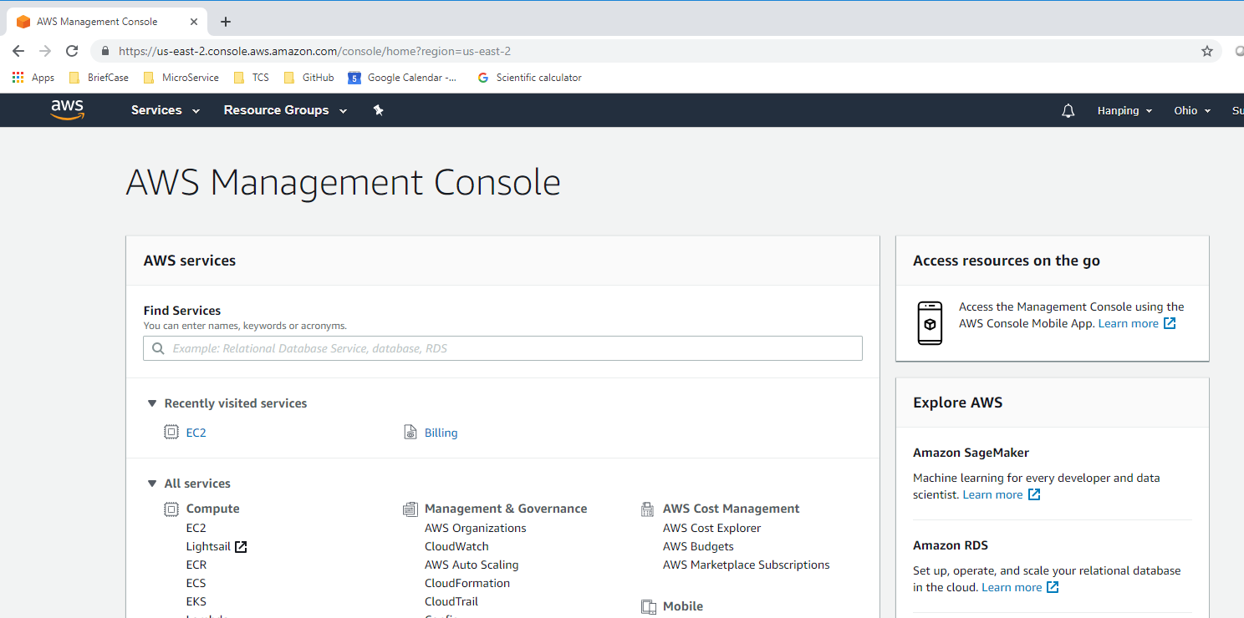

1.1 Go to AWS Console
https://www.youtube.com/watch?v=kQnNd-DyrpA
You need to create a email account and have a create card number to use AWS. You can create many gmail accounts. Use one of the gmail accounts with your credit card for AWS account. Search “AWS free tier” to login. The free tier does not charge you credit card.
Open chrome and type “console.aws.amazon.com”

Slide 4
1.2 Start EC2

Slide 5
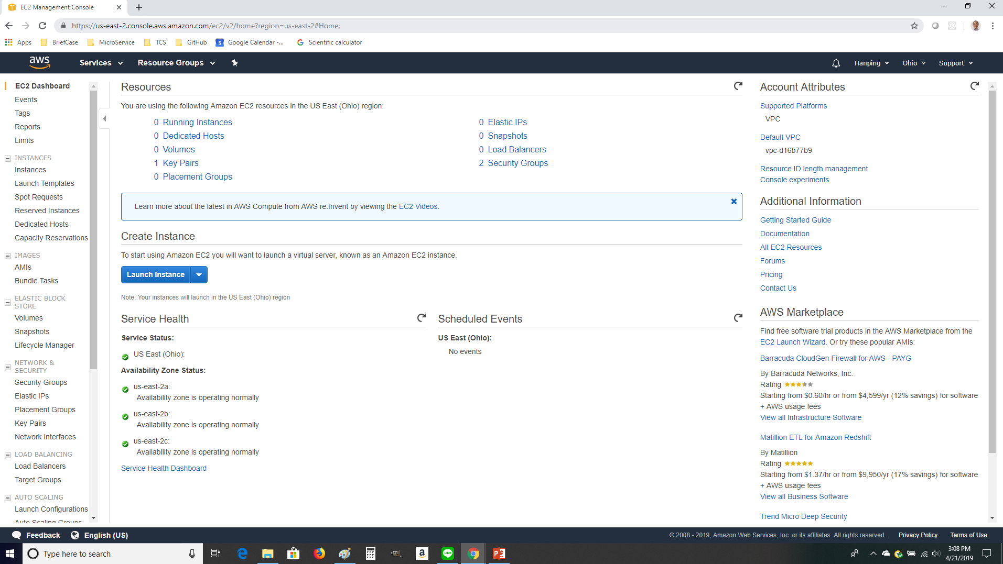
1.2 Start EC2
https://www.youtube.com/watch?v=kQnNd-DyrpA
We are going to create an Ubuntu Command Window: Click EC2.

Slide 6
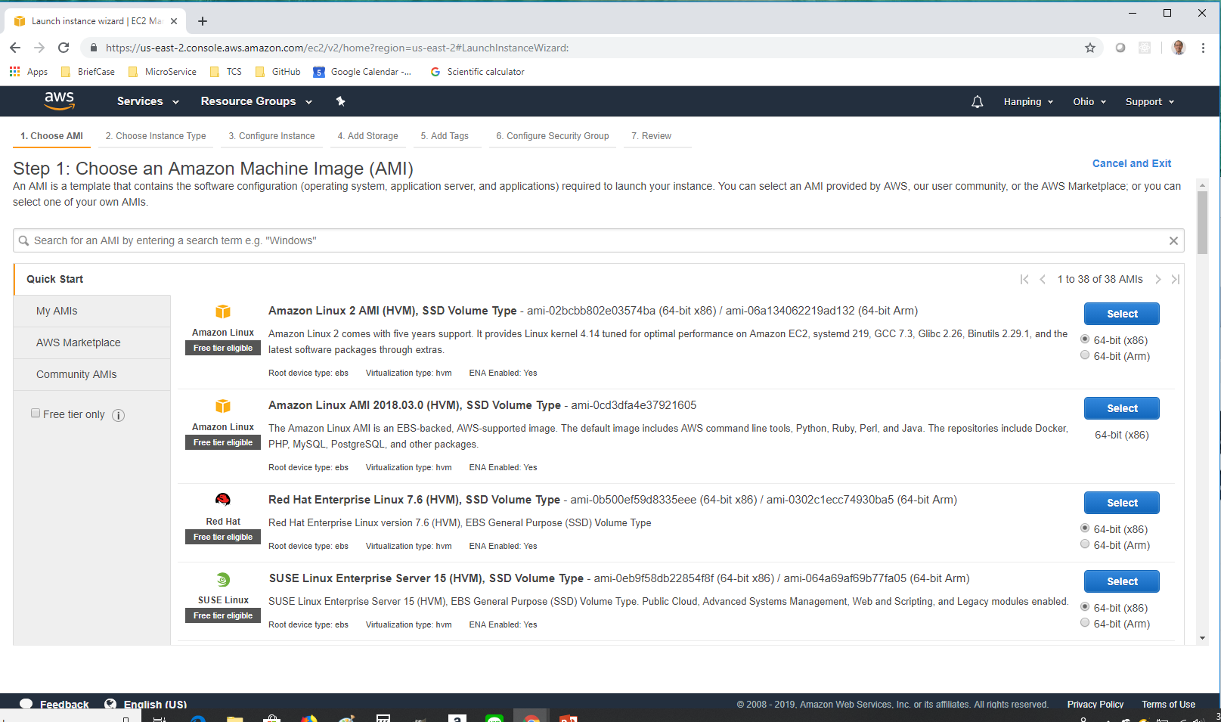
1.2 Start EC2
https://www.youtube.com/watch?v=kQnNd-DyrpA
We are going to create an Ubuntu Command Window: Click Launch button.

Slide 7
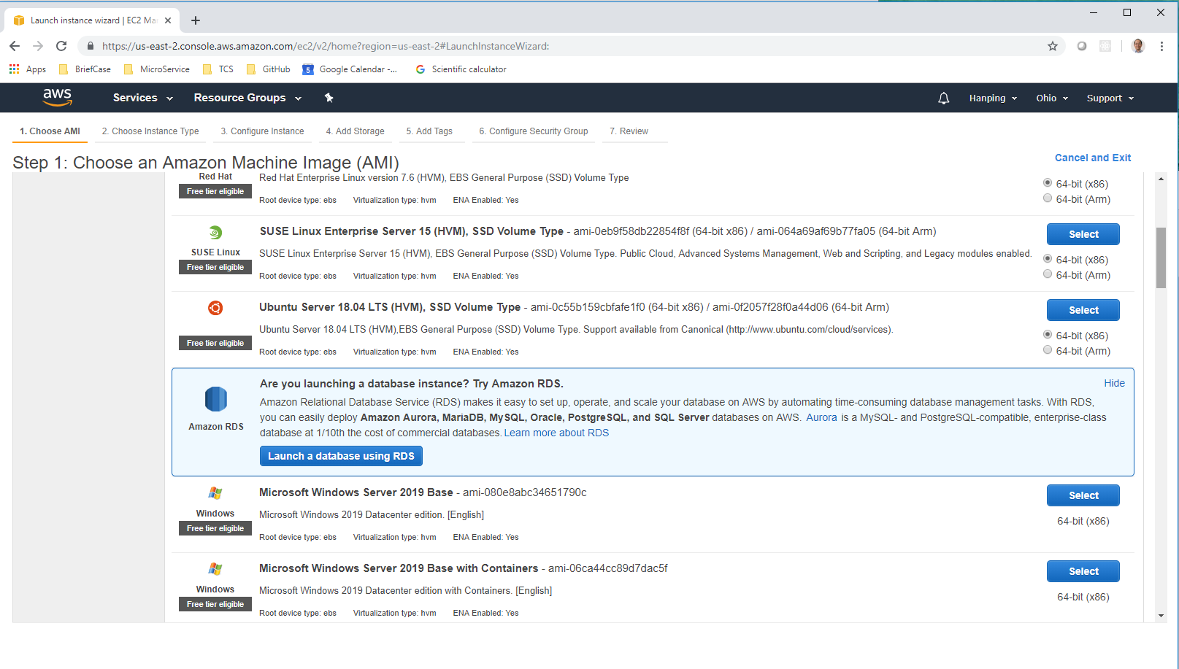
1.2 Start EC2
https://www.youtube.com/watch?v=kQnNd-DyrpA
Scroll down until you see the Ubuntu. Click “Select” button.

Slide 8
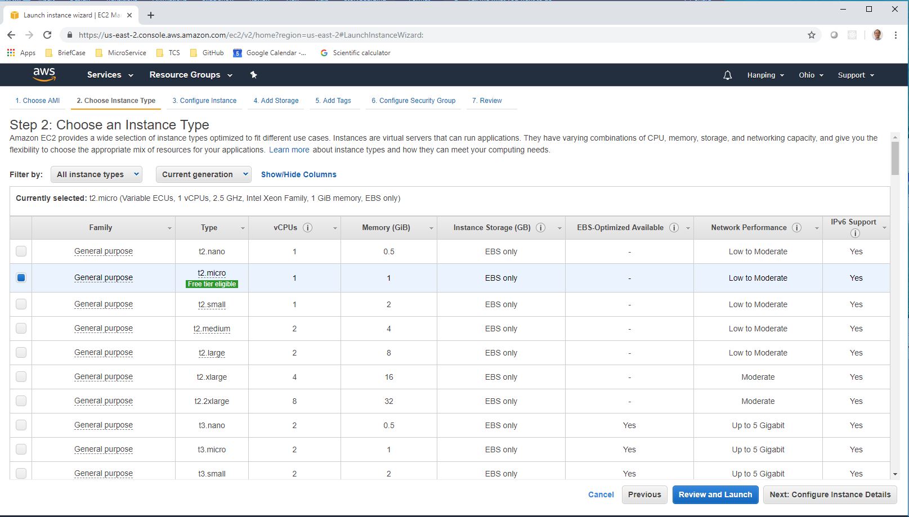
1.2 Start EC2
https://www.youtube.com/watch?v=kQnNd-DyrpA
Select the type with “Free tier eligible” and click “Next: Configure Instance Details”.

Slide 9
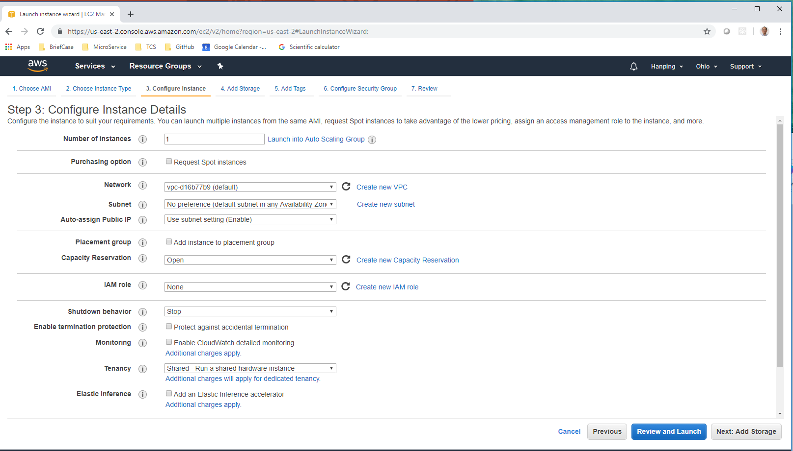
1.2 Start EC2
https://www.youtube.com/watch?v=kQnNd-DyrpA
Click “Review and Launch”

Slide 10
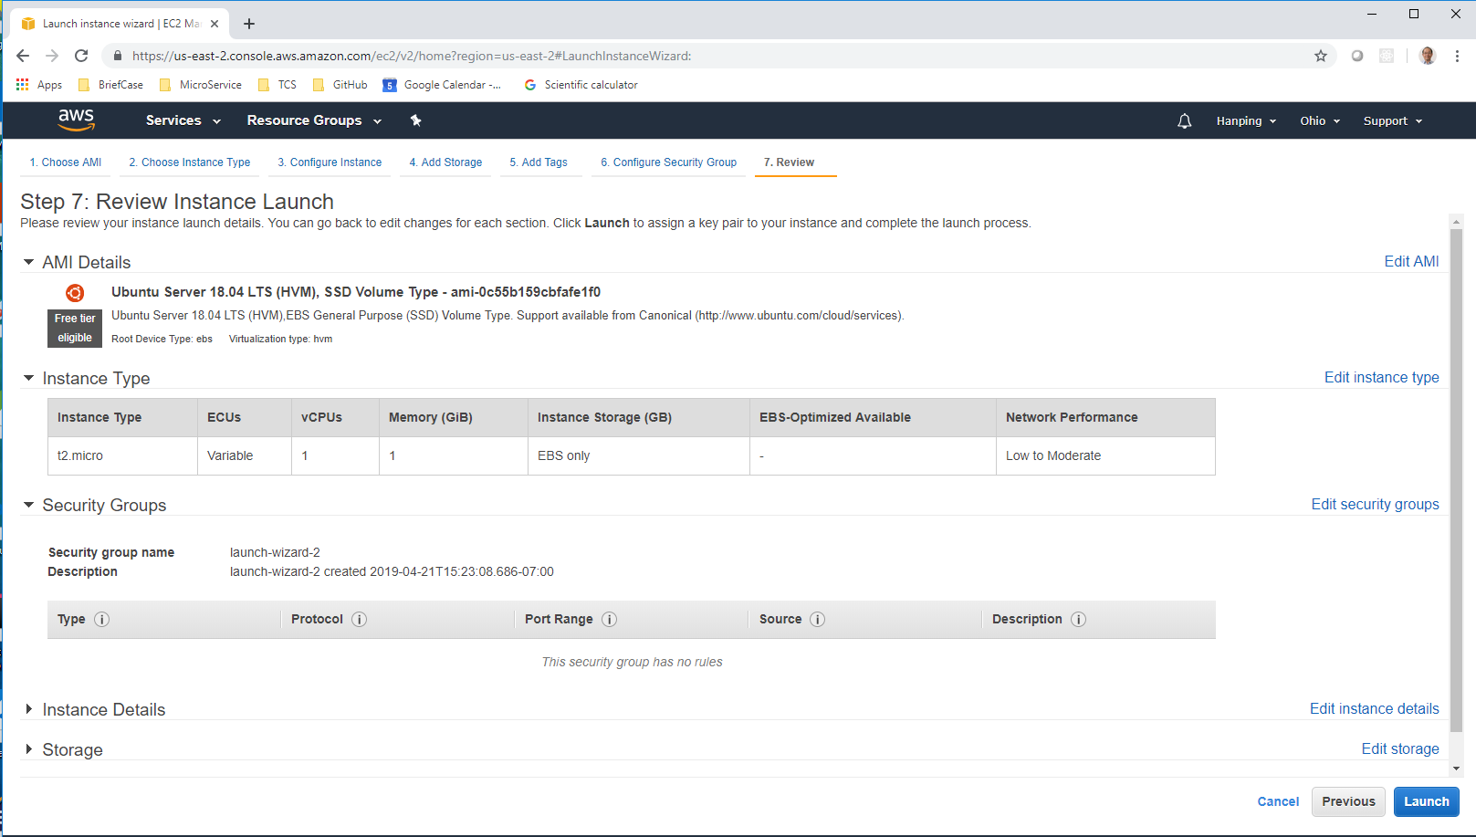
1.2 Start EC2
https://www.youtube.com/watch?v=kQnNd-DyrpA
Click “Launch”

Slide 11
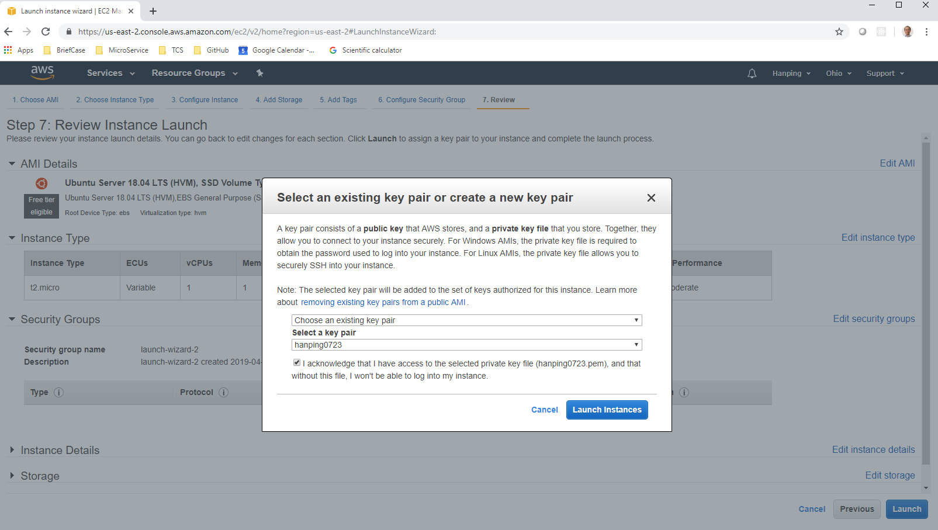
1.2 Start EC2
https://www.youtube.com/watch?v=kQnNd-DyrpA
Select a Key pair to launch. For the first time, select a name (here, I use my name “hanping0723”, the file type is “pem”.

Slide 12
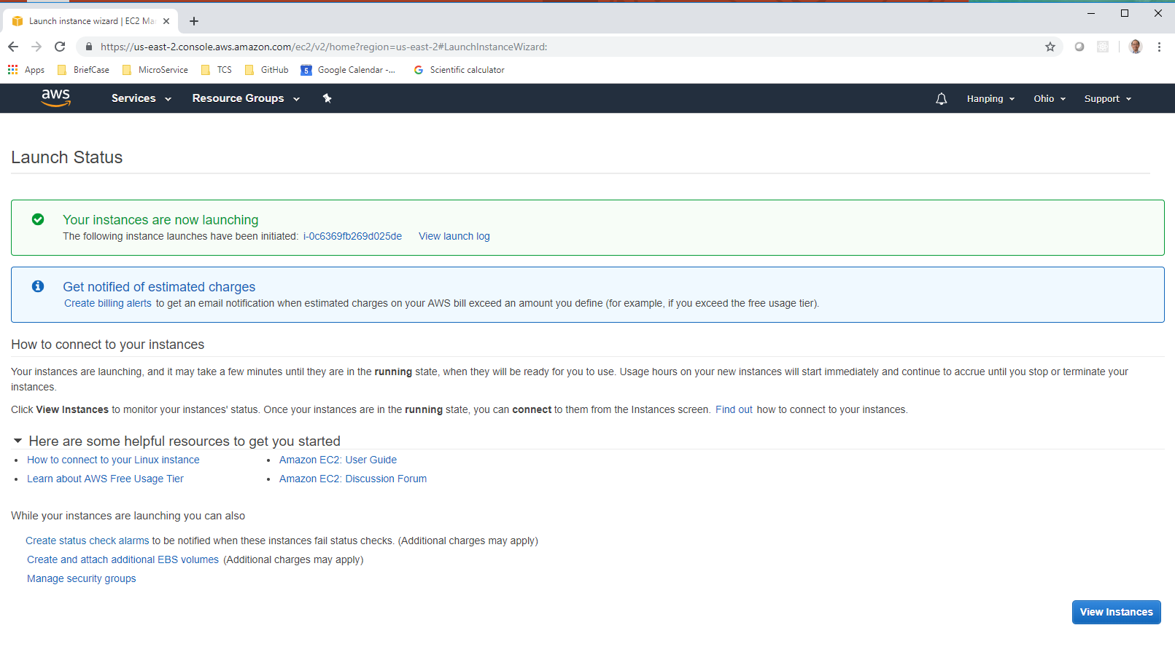
1.2 Start EC2
https://www.youtube.com/watch?v=kQnNd-DyrpA
View Instances.

Slide 13
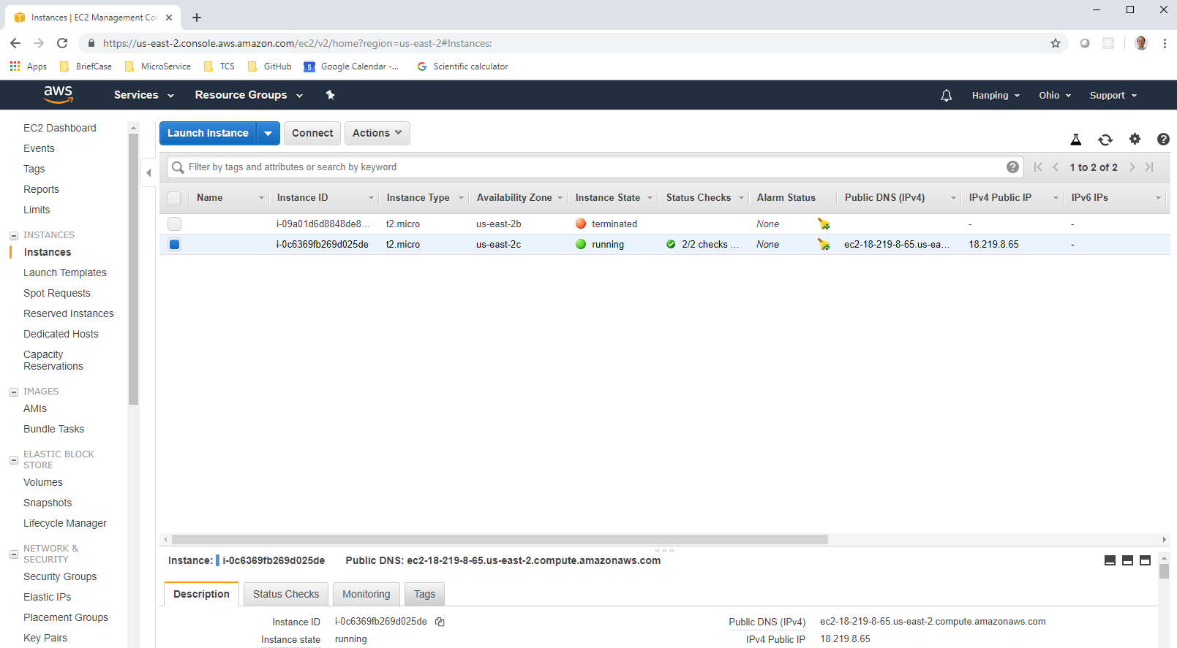
1.2 Start EC2
https://www.youtube.com/watch?v=kQnNd-DyrpA
Select instances, you can see the IPv4 Public IP address is “18.219.8.65”

Slide 14
End of Chapter

