Slide 1

2 Windows to EC2 with Putty
Peter H. Chen

Slide 2
2 Windows to EC2 with Putty
https://www.youtube.com/watch?v=bi7ow5NGC-U
In this section, we connect the ASW EC2 Server with Putty under Windows 10.

Slide 3
2.1 Putty Key Generator

Slide 4
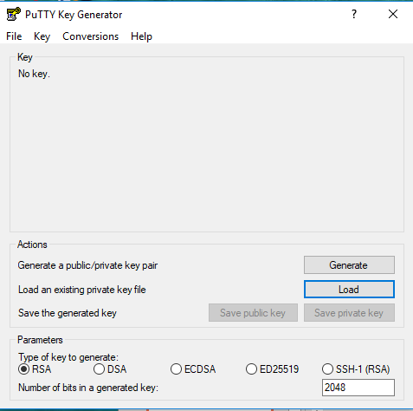
2.1 Putty Key Generator
https://www.youtube.com/watch?v=bi7ow5NGC-U
Putty does not like the PEM file.
We have to convert the PEM file into PPK file.
We need the Putty Generator to convert the PEM file into the PPK file.
Click “Load” the PEM file.

Slide 5
2.2 Convert PEM into PPK

Slide 6
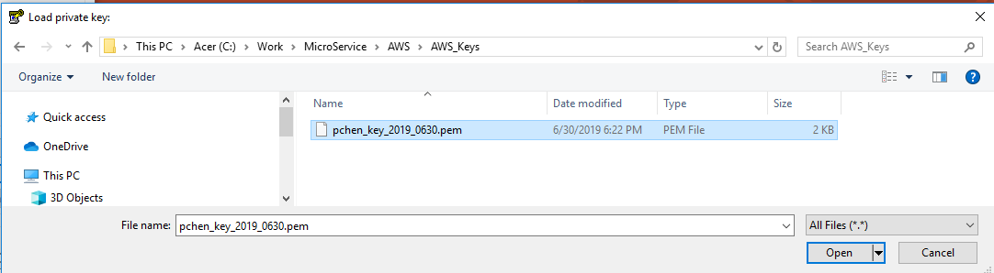
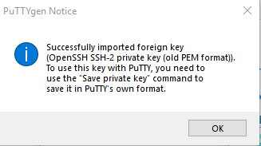
2.2 Convert PEM into PPK
https://www.youtube.com/watch?v=bi7ow5NGC-U
Browse the folder “C:\Work\Microservice\AWS\AWS+Keys\pchen_key_2019_0630.pem”.
Click “Open”
Click “OK”

Slide 7
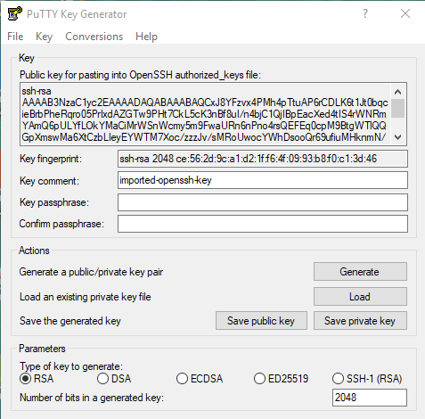
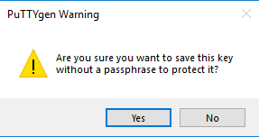
2.2 Convert PEM into PPK
https://www.youtube.com/watch?v=bi7ow5NGC-U
Then, we have Putty key is ready to use.
Click “Save private key” to save the Putty Key in the save location of the computer.
Click “Yes”

Slide 8
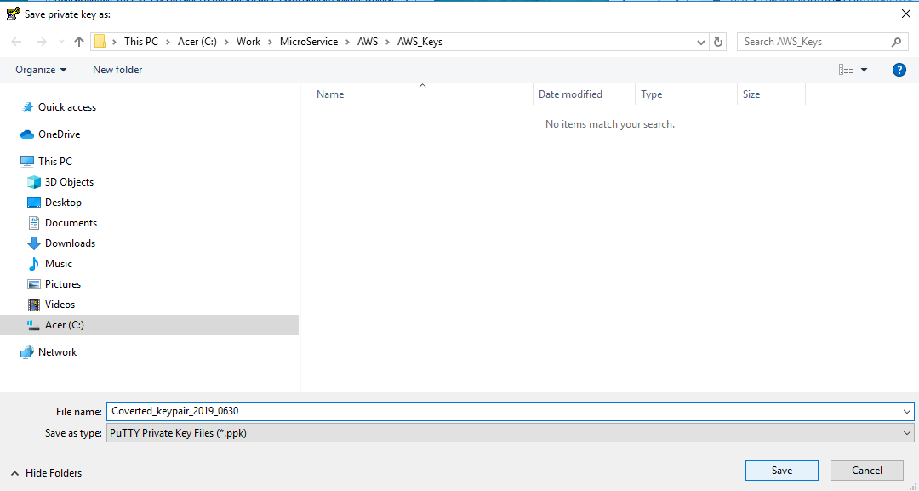
2.2 Convert PEM into PPK
https://www.youtube.com/watch?v=bi7ow5NGC-U
Save the converted pem into ppk file into “Converted_keypair_2019_0631.ppk”

Slide 9
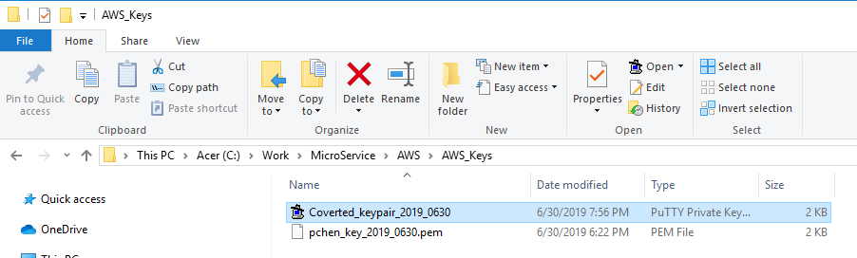
2.2 Convert PEM into PPK
https://www.youtube.com/watch?v=bi7ow5NGC-U
Now, we have “Converted_keypair_2019_0631.ppk” available ppk (Putty Private Key File)

Slide 10
2.3 Putty Tool

Slide 11
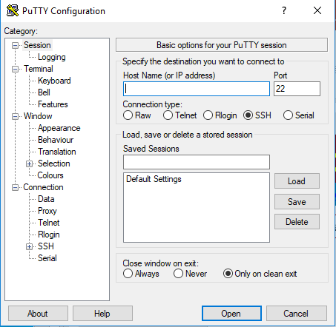

2.3 Putty Tool
https://www.youtube.com/watch?v=bi7ow5NGC-U
We are going to launch the Putty connection.

Slide 12
2.3 Putty Tool
https://www.youtube.com/watch?v=bi7ow5NGC-U
Putty Tool needs three things:
First, Host name.
Second, the user name that we are going to connect with.
Third, the authentication file.
We can find the host name and user name from EC2 console on AWS. Just click on “Connect”

Slide 13
2.4 Host Name

Slide 14
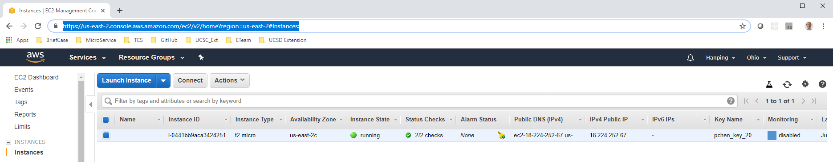
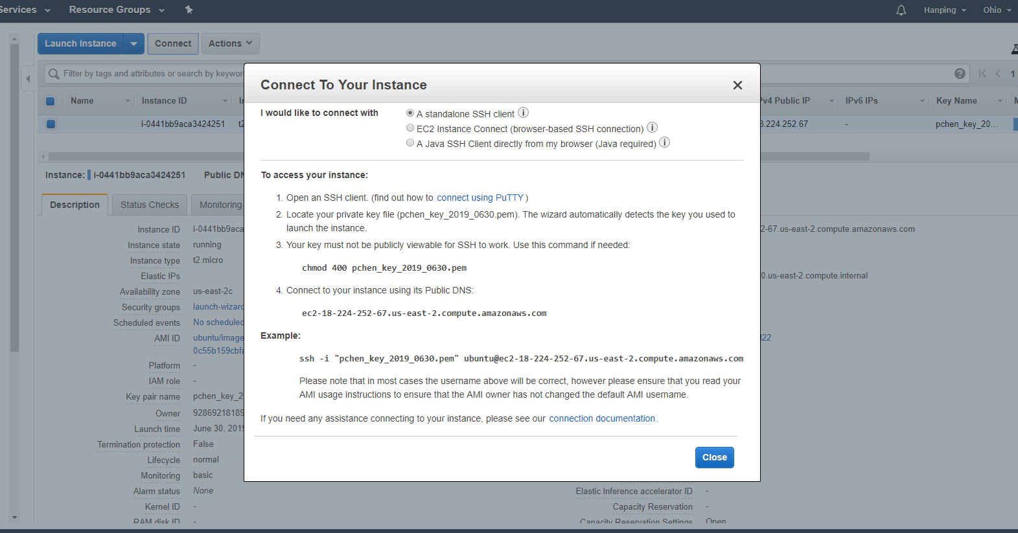
2.4 Host Name
https://www.youtube.com/watch?v=bi7ow5NGC-U
We can find the host name and user name from EC2 management console on AWS.
Just click on “Connect” button.

Slide 15
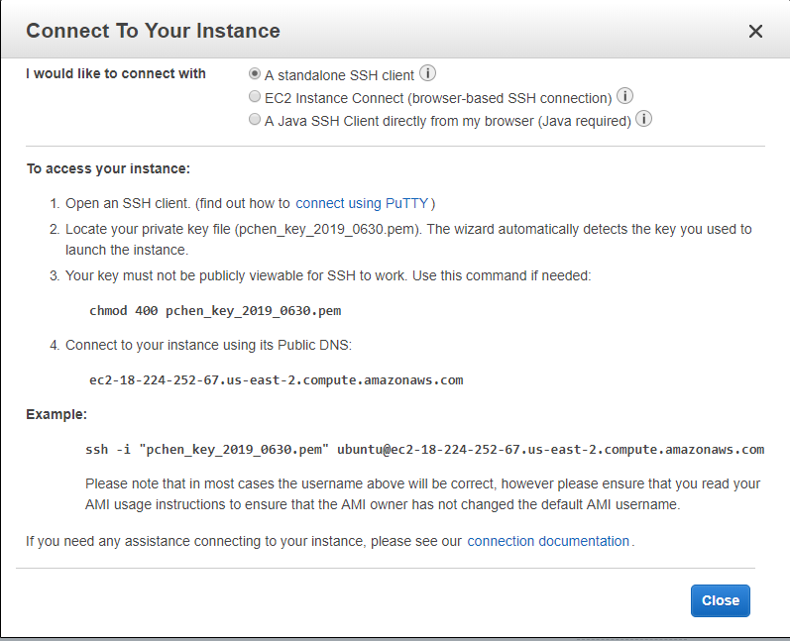
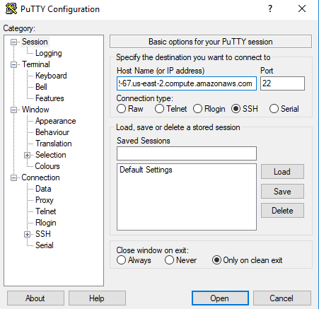
2.4 Host Name
https://www.youtube.com/watch?v=bi7ow5NGC-U
First, copy the host name “ec2-18-224-252-67.us-east-2.compute.amazonaws.com“ and paste to the “Host Name” section of Putty Tool.

Slide 16
2.5 User Name

Slide 17
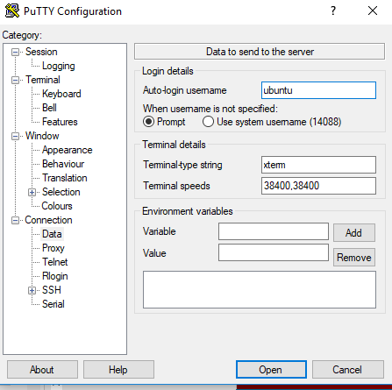
2.5 User Name
https://www.youtube.com/watch?v=bi7ow5NGC-U
Then, we copy the user name into the User name section of Connection > Data in Putty Tool.

Slide 18
2.6 PPK File

Slide 19
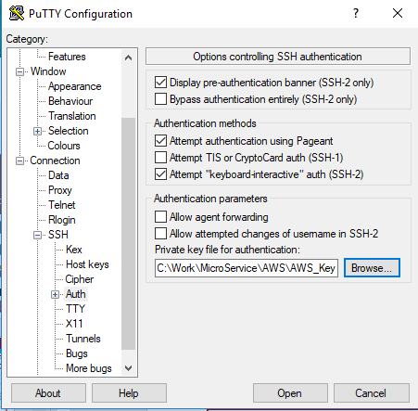
2.6 PPK File
https://www.youtube.com/watch?v=bi7ow5NGC-U
The “Converted_keypair_2019_0630.PPK” key file is put at the SSH > Auth >

Slide 20
2.7 Ubuntu

Slide 21
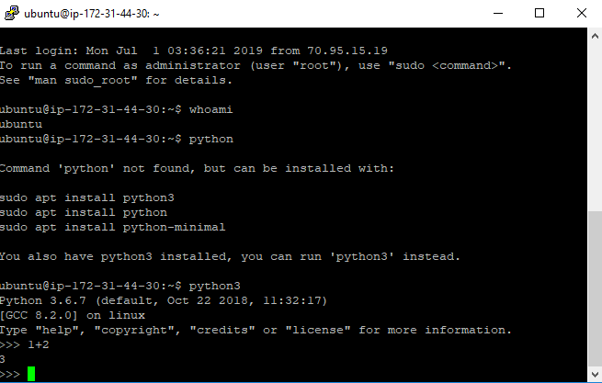
2.7 Ubuntu
https://www.youtube.com/watch?v=bi7ow5NGC-U
The user is “ubuntu” and automatically login.

Slide 22
2.8 Terminate EC2 Server

Slide 23
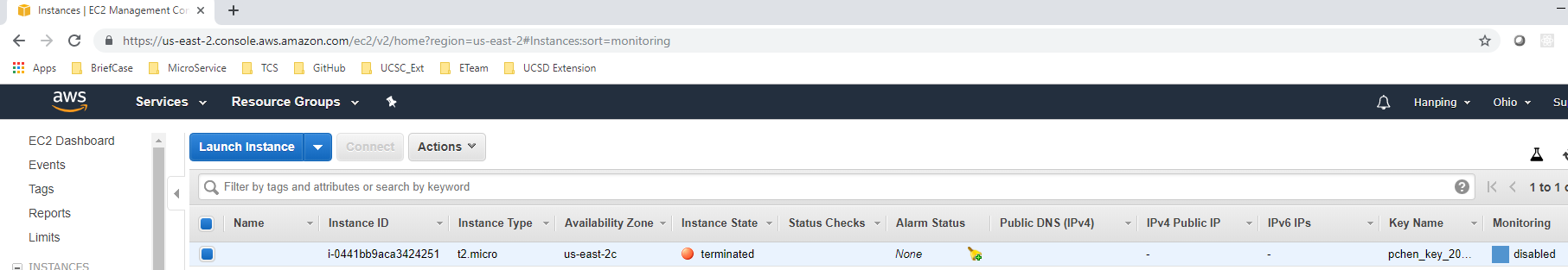
2.8 Terminate EC2 Server
https://www.youtube.com/watch?v=bi7ow5NGC-U
Actions > Instance State > Terminate.
Make the EC2 is terminate to avoid AWS charge,

Slide 24
End of Chapter

