Slide 1

5 Application Context
Peter H. Chen

Slide 2
5 Application Context
https://www.youtube.com/watch?v=ZxLaEovze3M&list=PLGibysfsUS7NAbefiaj1V4LbX0glTftDI&index=5
In this section, we use Application Context instead of using depreciated BeanFactory.
Application Context is similar to BeanFactory with additional functionality. Application Context has AOP and event notification.
The Application Context does all the BeanFactory does.

Slide 3
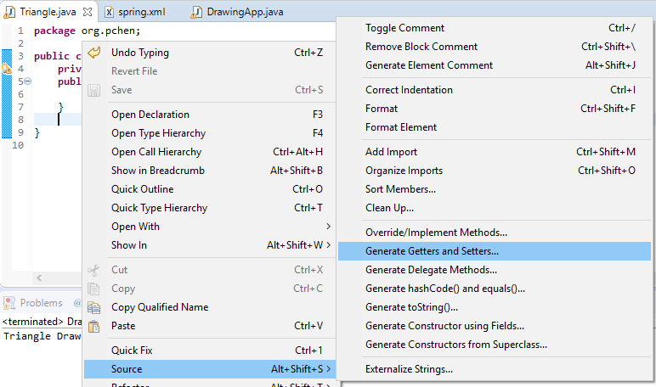
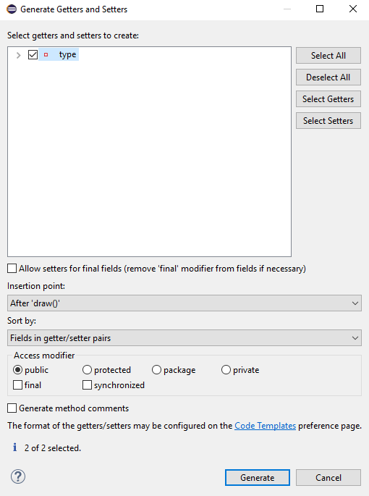
5 Application Context
https://www.youtube.com/watch?v=ZxLaEovze3M&list=PLGibysfsUS7NAbefiaj1V4LbX0glTftDI&index=5
In the class Triangle, add the Setter for private String type.
RMB: Source > Generate Getters and Setter …
Select Type and Click Generate

Slide 4
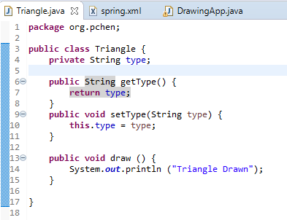
5 Application Context
https://www.youtube.com/watch?v=ZxLaEovze3M&list=PLGibysfsUS7NAbefiaj1V4LbX0glTftDI&index=5
The getType() and setType(String type) are generated0.
We have String type in class Triangle.
How can we specify the type in sping.xml?

Slide 5
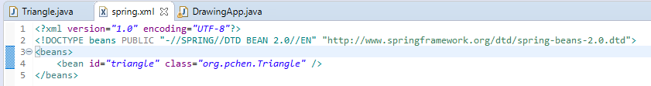
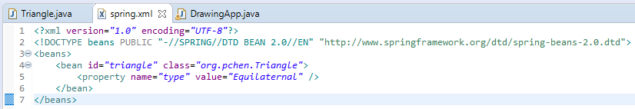
5 Application Context
https://www.youtube.com/watch?v=ZxLaEovze3M&list=PLGibysfsUS7NAbefiaj1V4LbX0glTftDI&index=5
In spring.xml, add property of triangle object.

Slide 6
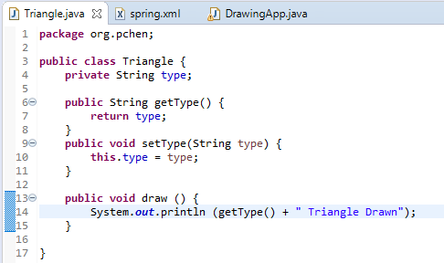
5 Application Context
https://www.youtube.com/watch?v=ZxLaEovze3M&list=PLGibysfsUS7NAbefiaj1V4LbX0glTftDI&index=5
Run again.

Slide 7
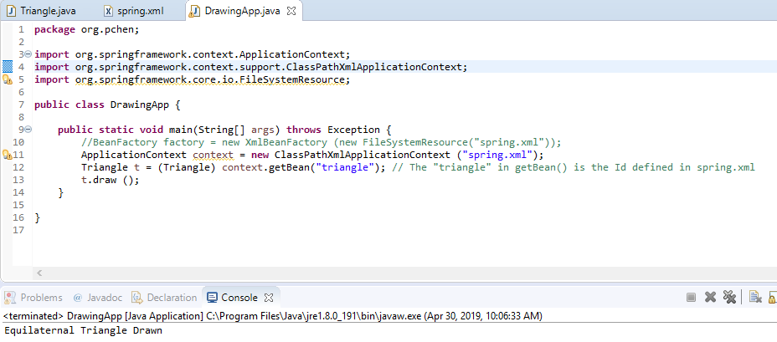
5 Application Context
https://www.youtube.com/watch?v=ZxLaEovze3M&list=PLGibysfsUS7NAbefiaj1V4LbX0glTftDI&index=5
Run again.

Slide 8
End of Chapter

