Slide 1

6 Constructor Injection
Peter H. Chen

Slide 2
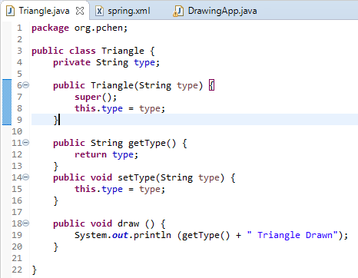
6 Constructor Injection
https://www.youtube.com/watch?v=IOZzxmJVus0&list=PLGibysfsUS7NAbefiaj1V4LbX0glTftDI&index=6
In this section, we use Constructor Injection to Add the property.
RMB: Source > Generate > Constructor

Slide 3
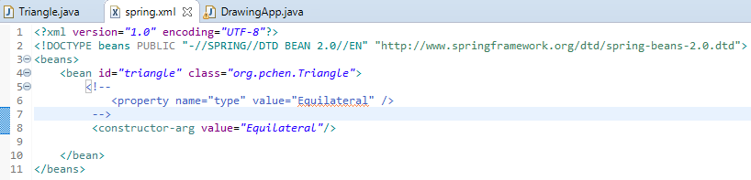
6 Constructor Injection
https://www.youtube.com/watch?v=IOZzxmJVus0&list=PLGibysfsUS7NAbefiaj1V4LbX0glTftDI&index=6
Control+shift+C to comment out the property.
Add <constructor-arg value=“Equilateral”/> to add the constructor value.

Slide 4
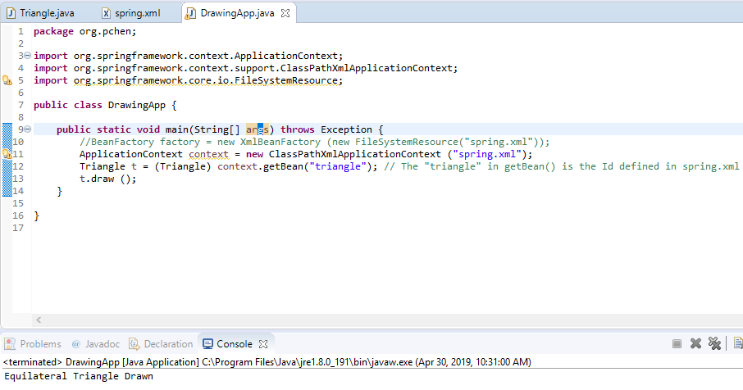
6 Constructor Injection
https://www.youtube.com/watch?v=IOZzxmJVus0&list=PLGibysfsUS7NAbefiaj1V4LbX0glTftDI&index=6
Run again with constructor injection.

Slide 5
6.1 Construct Height and Get Height
Peter H. Chen

Slide 6
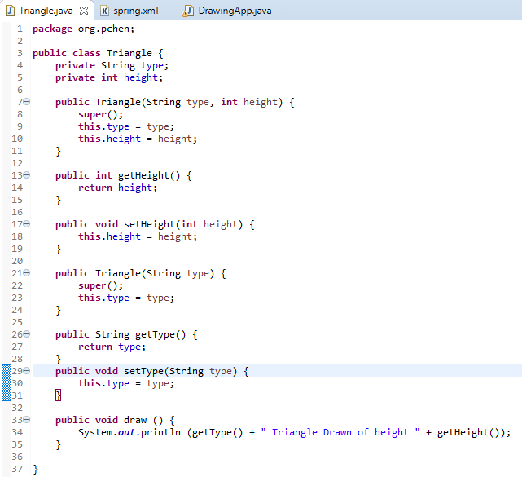
6.1 Construct Height and Get Height
https://www.youtube.com/watch?v=IOZzxmJVus0&list=PLGibysfsUS7NAbefiaj1V4LbX0glTftDI&index=6
Use Constructor to construct height and get height.
Add private int height;
RMB: source > generate > constructor
RMB: source > generate > getter and Setter.

Slide 7
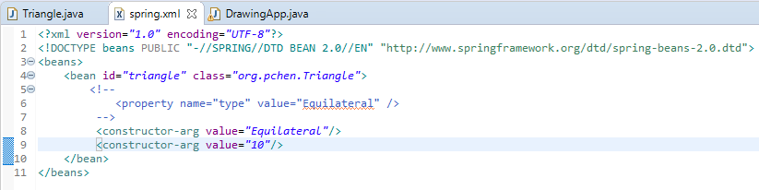
6.1 Construct Height and Get Height
https://www.youtube.com/watch?v=IOZzxmJVus0&list=PLGibysfsUS7NAbefiaj1V4LbX0glTftDI&index=6
Add <constructor-arg value=“10”/>
Both values in Spring are defined in double quote string (“”). Spring will converted the type into String or integer. String takes care of the type conversion depending on the data type in the constructor.

Slide 8
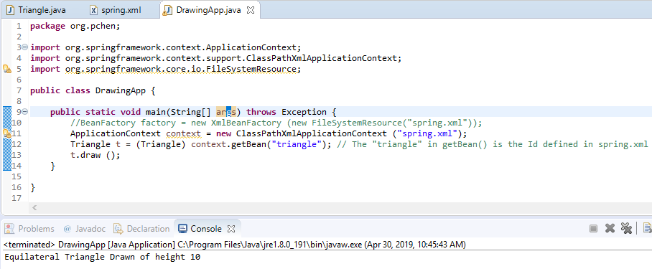
6.1 Construct Height and Get Height
https://www.youtube.com/watch?v=IOZzxmJVus0&list=PLGibysfsUS7NAbefiaj1V4LbX0glTftDI&index=6
Run Again.

Slide 9
6.2 Construct with Type and Index
Peter H. Chen

Slide 10
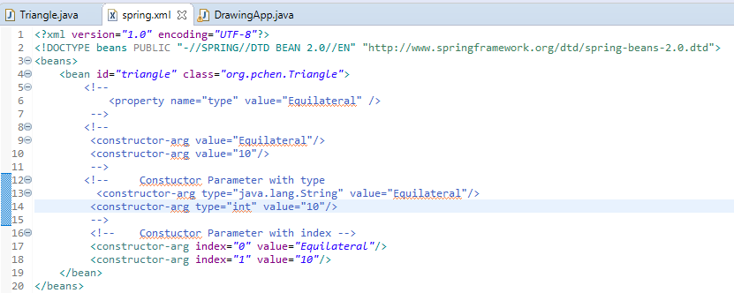
6.2 Construct with Type and Index
https://www.youtube.com/watch?v=IOZzxmJVus0&list=PLGibysfsUS7NAbefiaj1V4LbX0glTftDI&index=6
You can specify the type and index to prevent the errors for Spring.

Slide 11
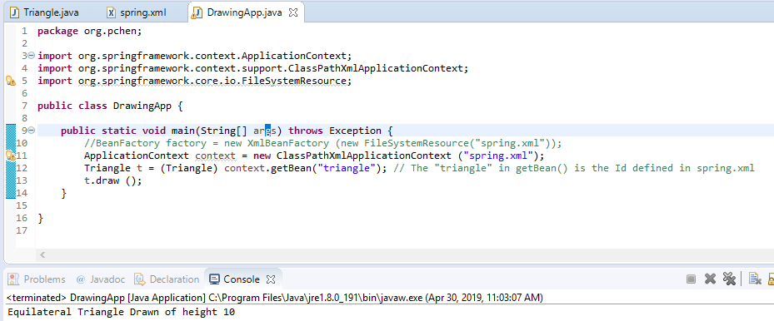
6.2 Construct with Type and Index
https://www.youtube.com/watch?v=IOZzxmJVus0&list=PLGibysfsUS7NAbefiaj1V4LbX0glTftDI&index=6
Run again.

Slide 12
6.3 Summary
Peter H. Chen

Slide 13
6.3 Summary
https://www.youtube.com/watch?v=IOZzxmJVus0&list=PLGibysfsUS7NAbefiaj1V4LbX0glTftDI&index=6
You can use property or constructor-arg to set the variables inside the Java.

Slide 14
End of Chapter

