Slide 1

4 Coding of Bean Factory
Peter H. Chen

Slide 2
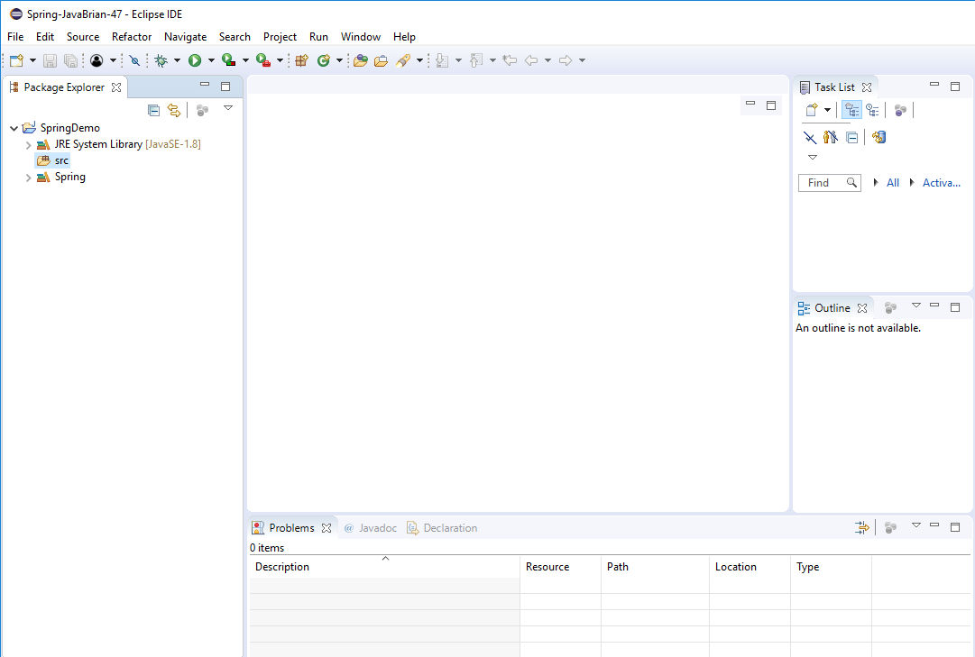
4 Coding of Bean Factory
https://www.youtube.com/watch?v=7c6ZTF6cF88&list=PLGibysfsUS7NAbefiaj1V4LbX0glTftDI&index=4
In this section, we discuss how to write code using Bean Factory.

Slide 3
4.1 Create Class Main
Peter H. Chen

Slide 4
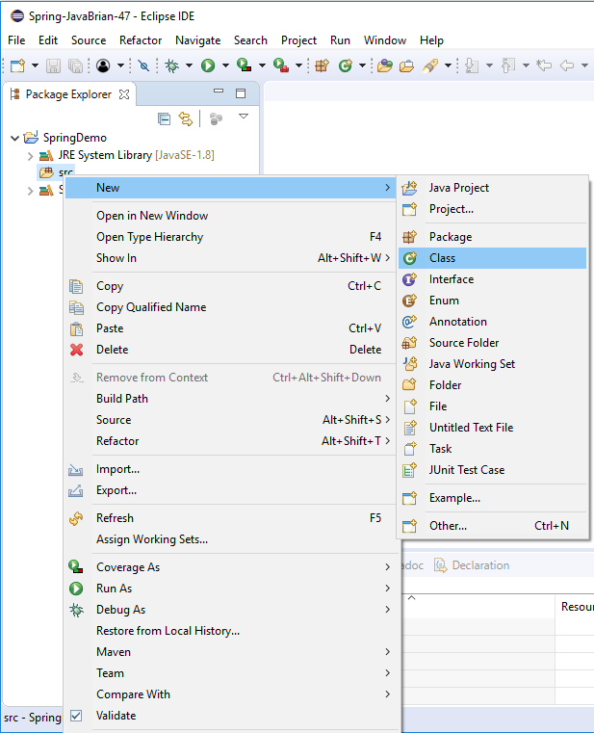
4.1 Create Class Main
https://www.youtube.com/watch?v=7c6ZTF6cF88&list=PLGibysfsUS7NAbefiaj1V4LbX0glTftDI&index=4
Select src. RMB: New > Class

Slide 5
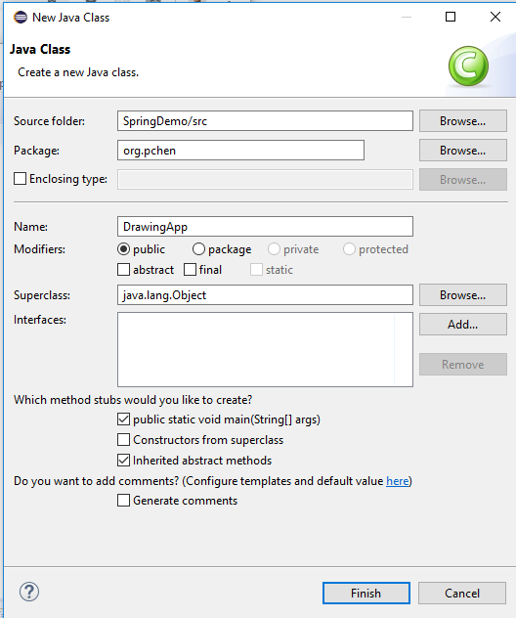
4.1 Create Class Main
https://www.youtube.com/watch?v=7c6ZTF6cF88&list=PLGibysfsUS7NAbefiaj1V4LbX0glTftDI&index=4
Create a class:
Package: org.pchen
Class Name: DrawingApp
Select “public static void main (String[] args)
Click “Finish”

Slide 6
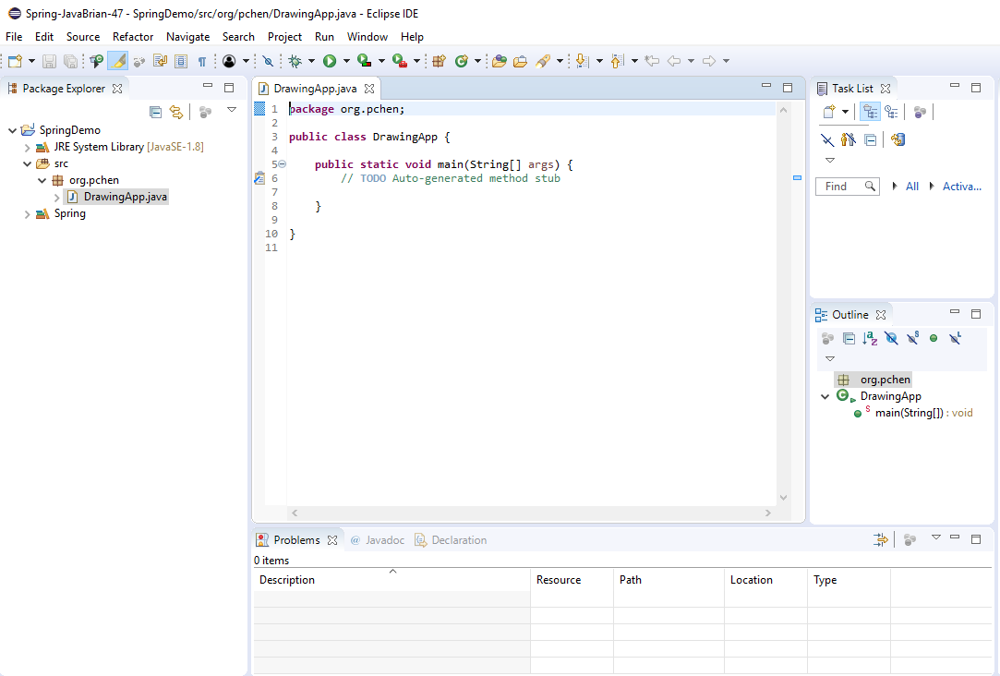
4.1 Create Class Main
https://www.youtube.com/watch?v=7c6ZTF6cF88&list=PLGibysfsUS7NAbefiaj1V4LbX0glTftDI&index=4
In this drawing application, we will be drawing some shapes.

Slide 7
4.2 Create Class Triangle
Peter H. Chen

Slide 8
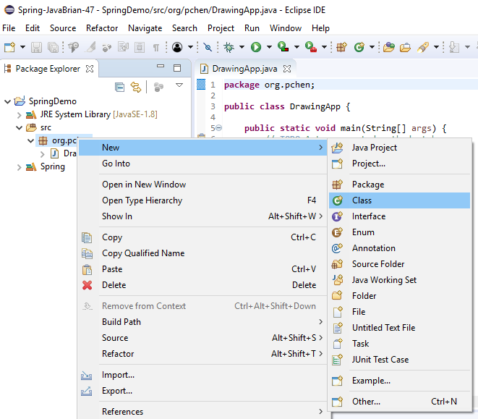
4.2 Create Class Triangle
https://www.youtube.com/watch?v=7c6ZTF6cF88&list=PLGibysfsUS7NAbefiaj1V4LbX0glTftDI&index=4
First, we will create Triangle class in the org.pchen package.
Select “prg.pchen” package. RMB: New >

Slide 9
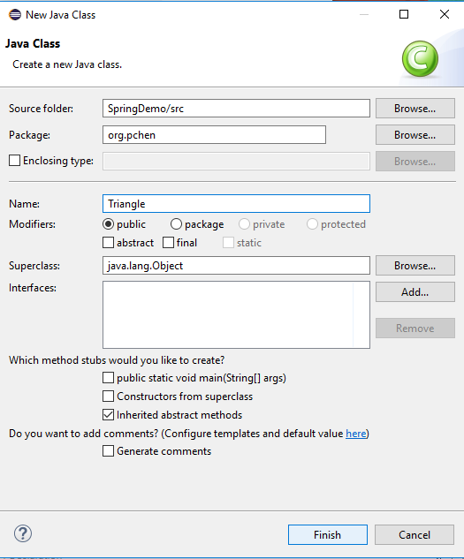
4.2 Create Class Triangle
https://www.youtube.com/watch?v=7c6ZTF6cF88&list=PLGibysfsUS7NAbefiaj1V4LbX0glTftDI&index=4
Enter Class Name: Triangle
We do not need to create the “public static main (String[] args)
Click “Finish”

Slide 10
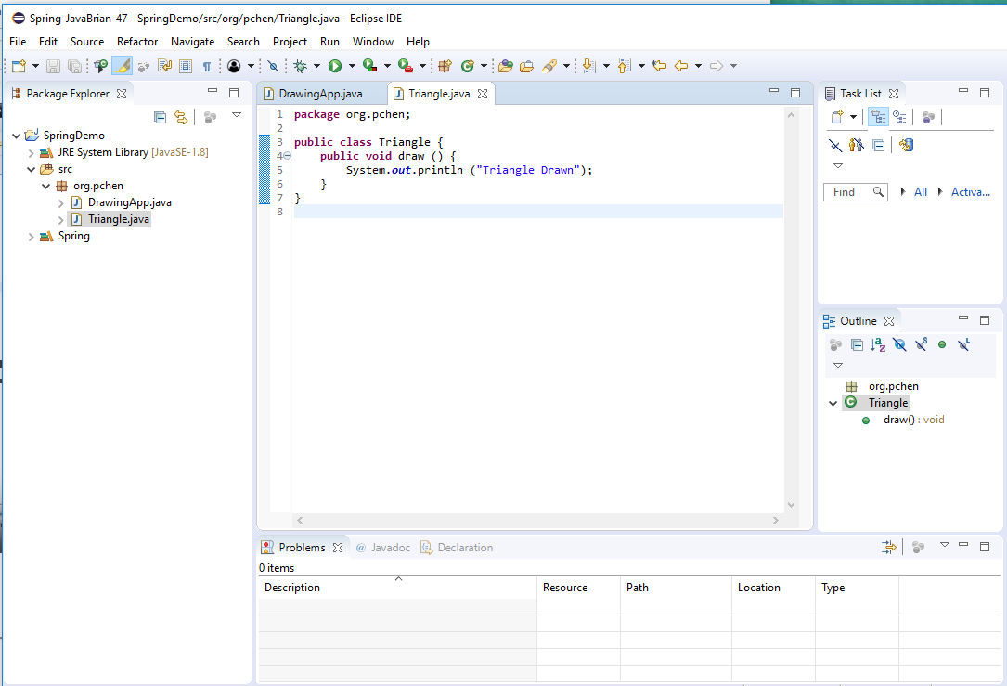
4.2 Create Class Triangle
https://www.youtube.com/watch?v=7c6ZTF6cF88&list=PLGibysfsUS7NAbefiaj1V4LbX0glTftDI&index=4
We have class “Triangle”.
Add the public void draw() { System.out.println (“…”); }

Slide 11
4.3 Use Bean Factory
Peter H. Chen

Slide 12
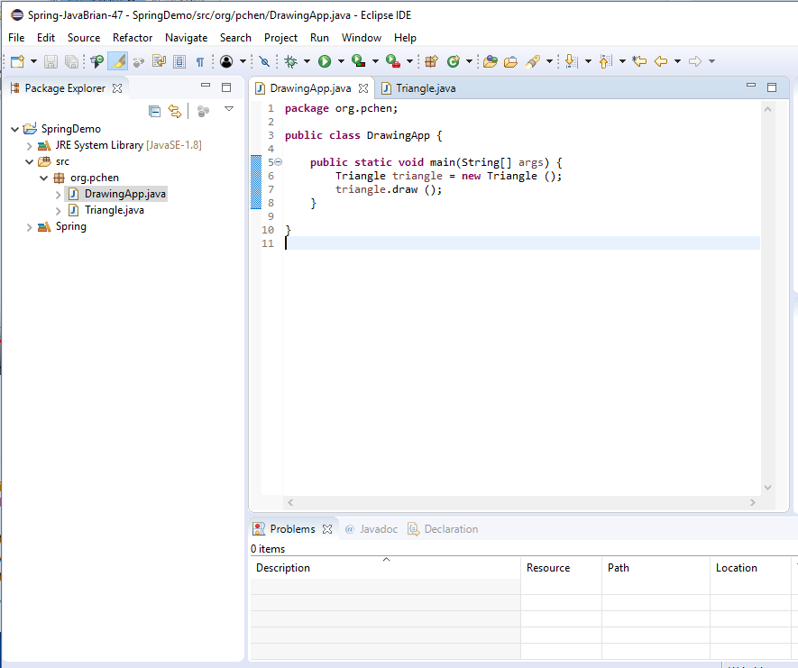
4.3 Bean Factory
https://www.youtube.com/watch?v=7c6ZTF6cF88&list=PLGibysfsUS7NAbefiaj1V4LbX0glTftDI&index=4
In Java Program:
In the main () {
Triangle triangle = new Triangle ();
triangle.draw();
}

Slide 13
4.3 Bean Factory
https://www.youtube.com/watch?v=7c6ZTF6cF88&list=PLGibysfsUS7NAbefiaj1V4LbX0glTftDI&index=4
If we use Spring, we are going to use Bean Factory.
Comment out the // Triangular triangular = new Triangular ();
We are going to use Bean Factory to do it.

Slide 14
4.3 Bean Factory
https://www.youtube.com/watch?v=7c6ZTF6cF88&list=PLGibysfsUS7NAbefiaj1V4LbX0glTftDI&index=4
BeanFactor factor = new XmlBeanFactor(…)
I need to provide the implementation of Bean Factor. There are different Bean Factory classes available. Bean Factor interface have different imeplementation classes.
We use XmlBeanFactory. The xml will configure the Bean Factory using XML file.
Bean Factory reads the blueprint of the Beans from a configuration file.
We use the XML file in this example to provide the configuration to Spring.
In order to read XML file, the Bean Factory interface has to be an XmlBeanFactory class. The XmlBeanFactory reads the XML file.
We create an instance of XmlBeanFactory(). The XmlBeanFactory() take argument which is the actual resource. We use new FileSystemResource (“spring.xml”);

Slide 15
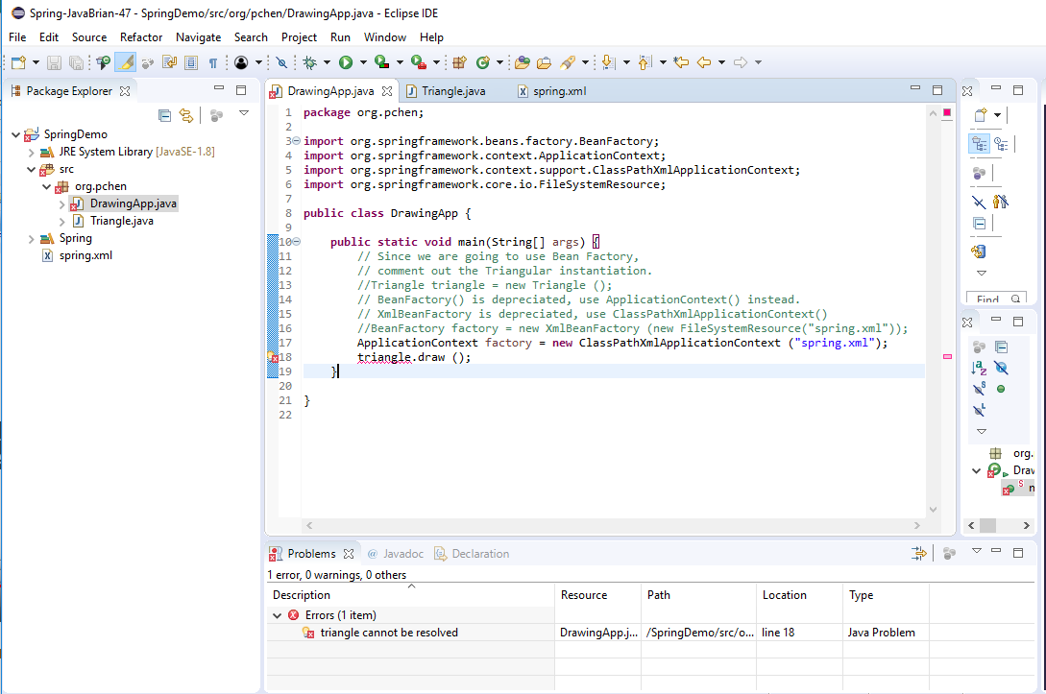
4.3 Bean Factory
https://www.youtube.com/watch?v=7c6ZTF6cF88&list=PLGibysfsUS7NAbefiaj1V4LbX0glTftDI&index=4
Since the BeanFactor and XmlBeanFactory are deprecated, we use ApplicaitonContenxt and ClassPathXmlApplicationContext instead, respectively.

Slide 16
4.4 Create *.xml File
Peter H. Chen

Slide 17
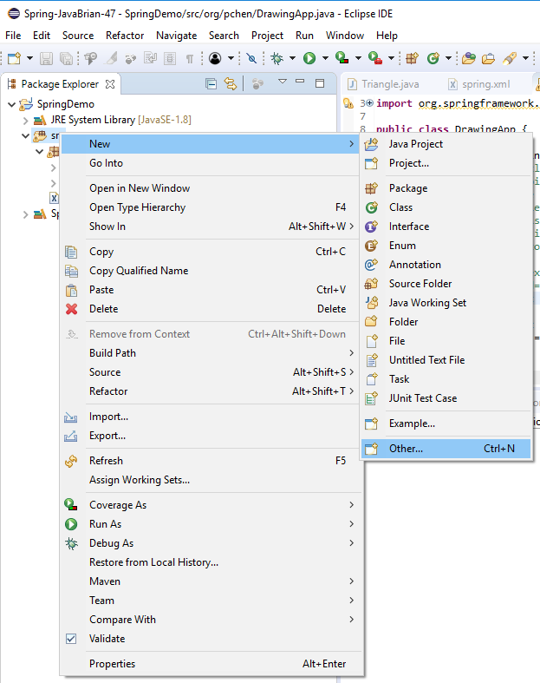
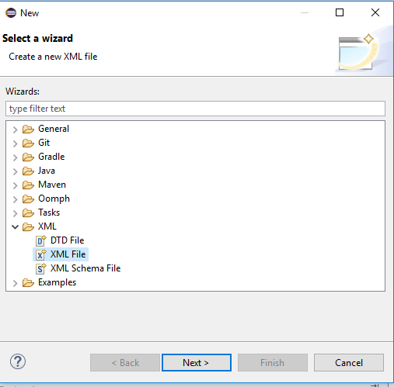
4.4 Create *.xml File
https://www.youtube.com/watch?v=7c6ZTF6cF88&list=PLGibysfsUS7NAbefiaj1V4LbX0glTftDI&index=4
Create XML file.
Select src, RMB: New > Other …
Note: The “spring.xml” has to be created under the default src folder.

Slide 18
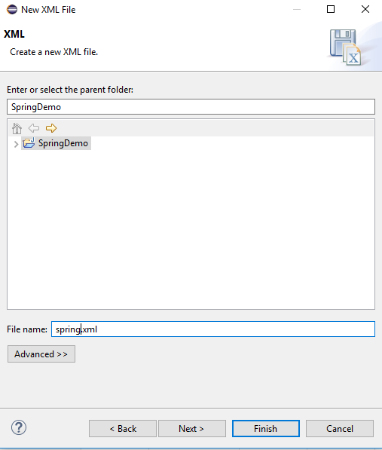
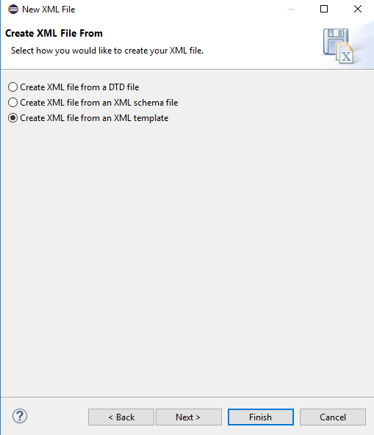
4.4 Create *.xml File
https://www.youtube.com/watch?v=7c6ZTF6cF88&list=PLGibysfsUS7NAbefiaj1V4LbX0glTftDI&index=4
Click Next, enter “spring.xml”
Select “Create XML file from an XML template” and click Finish.

Slide 19
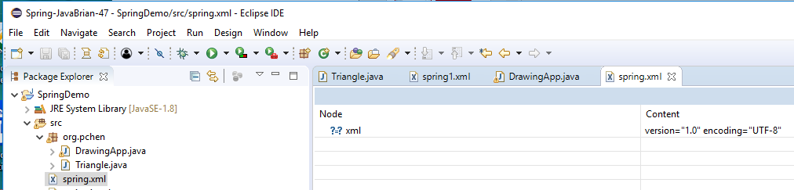
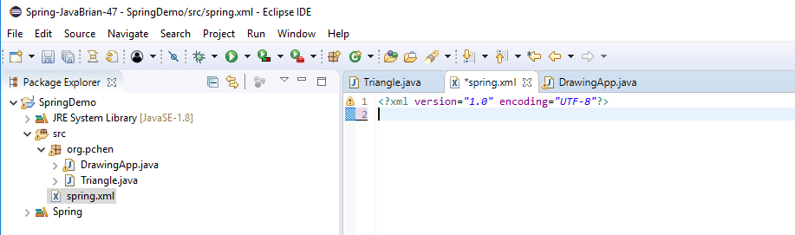
4.4 Create *.xml File
https://www.youtube.com/watch?v=7c6ZTF6cF88&list=PLGibysfsUS7NAbefiaj1V4LbX0glTftDI&index=4
You have blank spring.xml.
Click Source Tab. You have the blank source spring.xml.
Note: The spring.txt has to be under src folder.

Slide 20
4.4 Create *.xml File
https://www.youtube.com/watch?v=7c6ZTF6cF88&list=PLGibysfsUS7NAbefiaj1V4LbX0glTftDI&index=4
In spring.xml, we need to tell spring app. Hey,
We need a Triangle object and that object has to be instantiated.
We need to provide the blueprint for Bean Factory.
Find “ApplicaitonContext.xml” on web site:
New One:
https://howtodoinjava.com/spring5/core/applicationcontext-xml-config-example/
Old One with DOCTYPE:
https://alvinalexander.com/java/jwarehouse/spring-framework-2.5.3/test/org/springframework/jmx/applicationContext.xml.shtml
Copy the DOCTYPE
<!DOCTYPE beans PUBLIC "-//SPRING//DTD BEAN 2.0//EN" "http://www.springframework.org/dtd/spring-beans-2.0.dtd">

Slide 21
4.4 Create *.xml File
https://www.youtube.com/watch?v=7c6ZTF6cF88&list=PLGibysfsUS7NAbefiaj1V4LbX0glTftDI&index=4
The document is as follow:
<?xml version="1.0" encoding="UTF-8"?>
<!DOCTYPE beans PUBLIC "-//SPRING//DTD BEAN 2.0//EN" "http://www.springframework.org/dtd/spring-beans-2.0.dtd">
<beans>
<bean id = “triangle” class=“org.pchen.Triangle” />
</beans>

Slide 22
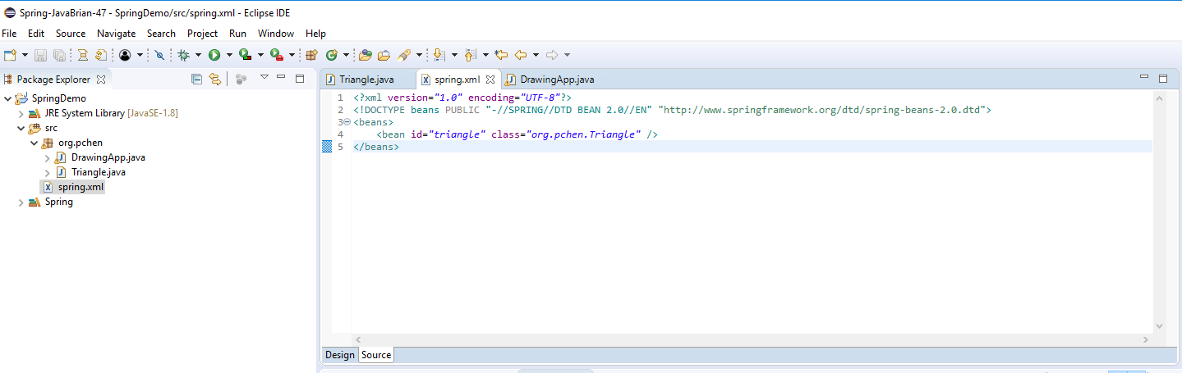
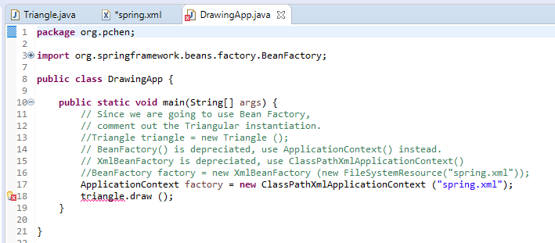
4.4 Create *.xml File
https://www.youtube.com/watch?v=7c6ZTF6cF88&list=PLGibysfsUS7NAbefiaj1V4LbX0glTftDI&index=4
Copy the DOCTYPE and
add
<beans>
<bean id = “triangle” class=“org.pchen.Triangle” />
</beans>
What is this mean?

Slide 23
4.4 Create *.xml File
https://www.youtube.com/watch?v=7c6ZTF6cF88&list=PLGibysfsUS7NAbefiaj1V4LbX0glTftDI&index=4
<!DOCTYPE beans PUBLIC "-//SPRING//DTD BEAN 2.0//EN" "http://www.springframework.org/dtd/spring-beans-2.0.dtd">
<beans>
<bean id = “triangle” class=“org.pchen.Triangle” />
</beans>
What is this mean?
Each bean has their id. This bean id is “triangle”.
I need “org.pchen.Triangle” class to create an Object for me.

Slide 24
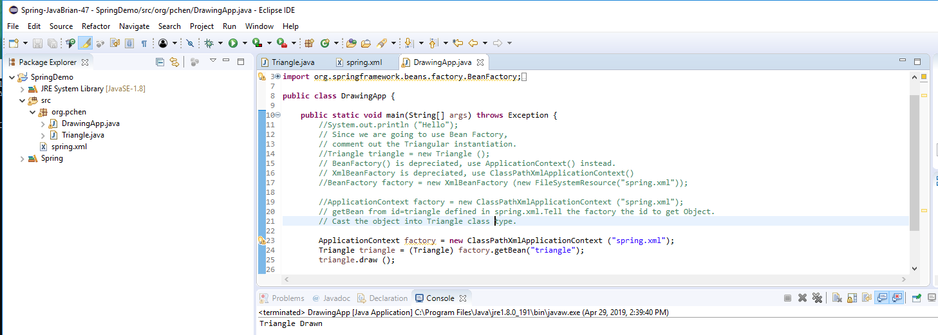
4.4 Create *.xml File
https://www.youtube.com/watch?v=7c6ZTF6cF88&list=PLGibysfsUS7NAbefiaj1V4LbX0glTftDI&index=4
In factory, what we need to do?

Slide 25
End of Chapter

