Slide 1

9 Inner Bean
Peter H. Chen

Slide 2
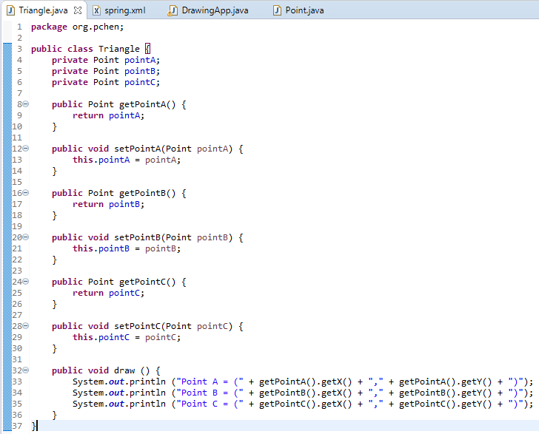
9 Inner Bean
https://www.youtube.com/watch?v=TW51XsixMqA&list=PLGibysfsUS7NAbefiaj1V4LbX0glTftDI&index=9
In this section, we discuss the Inner Beans.
We need bean “zeroPoint” all the time but we do not need bean “point2” and bean “point3” all the time.
We can move the bean “point2” and bean “point3” inside the Class Triangle property.

Slide 3
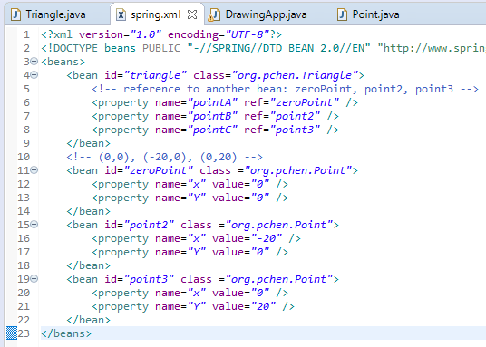
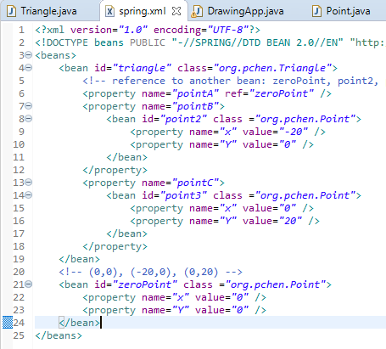
9 Inner Bean
https://www.youtube.com/watch?v=TW51XsixMqA&list=PLGibysfsUS7NAbefiaj1V4LbX0glTftDI&index=9
Move the bean “point2” and bean “point3” inside the Class Triangle property.
The benefit of the inner bean is that it is inside the property and it does not have the individual ID. The ID will not be reference from anywhere.

Slide 4
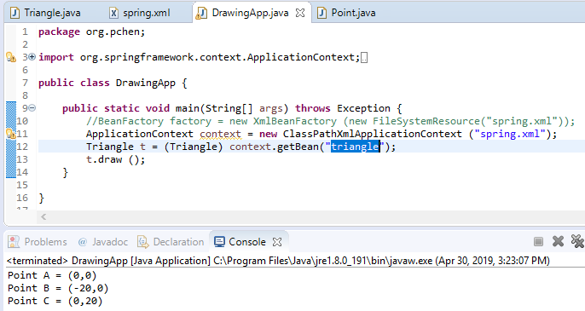
9 Inner Bean
https://www.youtube.com/watch?v=TW51XsixMqA&list=PLGibysfsUS7NAbefiaj1V4LbX0glTftDI&index=9
Run Inner Bean.

Slide 5
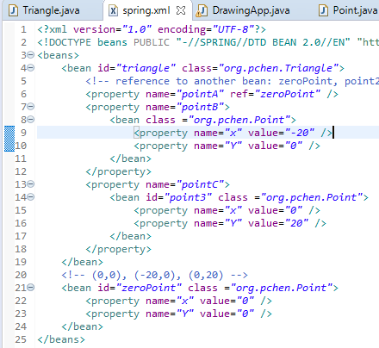
9 Inner Bean
https://www.youtube.com/watch?v=TW51XsixMqA&list=PLGibysfsUS7NAbefiaj1V4LbX0glTftDI&index=9
Since the bean is the inner bean, it does not have ID and will not be pointed to anywhere else.
You can have the ID for the inner bean but not required.

Slide 6
9.1 Alias
Peter H. Chen

Slide 7
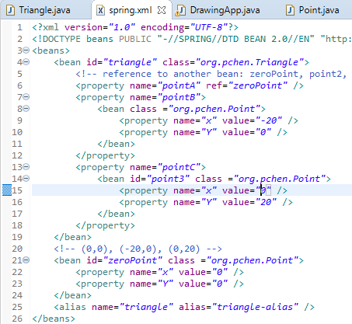
9.1 Alias
https://www.youtube.com/watch?v=TW51XsixMqA&list=PLGibysfsUS7NAbefiaj1V4LbX0glTftDI&index=9
We can give id=“triangle” with different alias as “triangle-alias” as below.
<alias name = “triangle” alias = “triangle-alias”>
You can do the other way:
<bean id=“triangle” class=“org.pchen.Triangle” name=“another-triangle-name”>

Slide 8
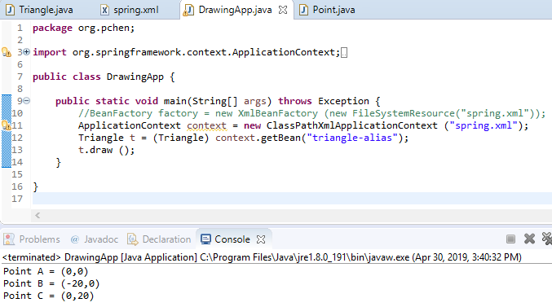
9.1 Alias
https://www.youtube.com/watch?v=TW51XsixMqA&list=PLGibysfsUS7NAbefiaj1V4LbX0glTftDI&index=9
In Java Code, we have use “triangle-alias” instead of “triangle”.
Rerun it.

Slide 9
9.2 idref
Peter H. Chen

Slide 10
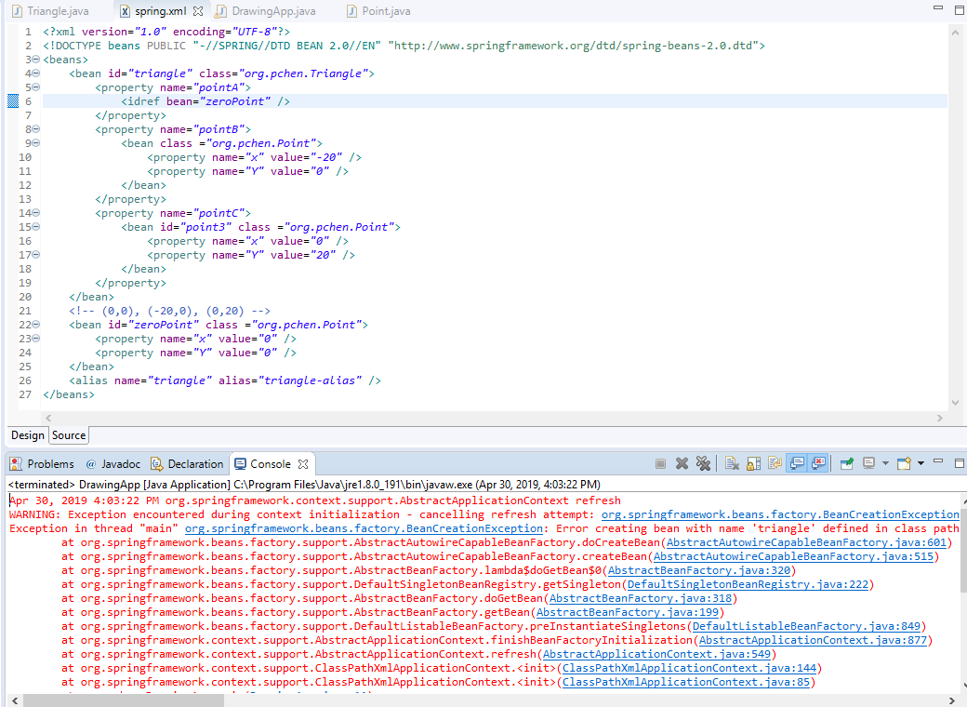
9.2 idref
https://www.youtube.com/watch?v=TW51XsixMqA&list=PLGibysfsUS7NAbefiaj1V4LbX0glTftDI&index=9
Your reference can be id, alias, and name.
If you want to reference the ID only, you need to use idref. The idref does not work well.

Slide 11
End of Chapter

