Slide 1

2 Setup
Peter H. Chen

Slide 2
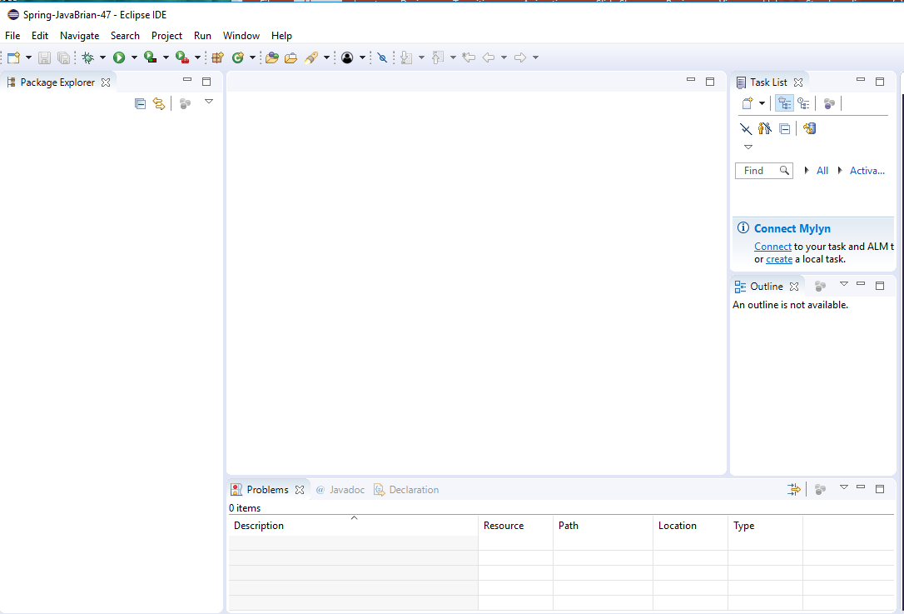

2 Setup
https://www.youtube.com/watch?v=Z5gubdHLJIc&list=PLGibysfsUS7NAbefiaj1V4LbX0glTftDI&index=2
Double click the Eclipse Java 2018-12

Slide 3
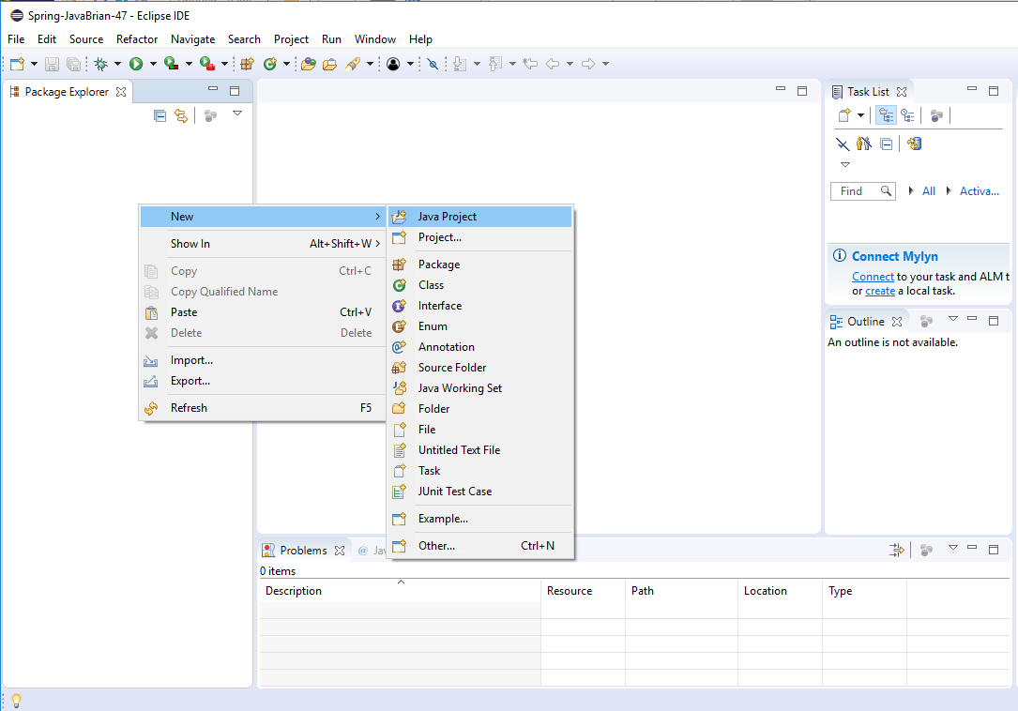
2 Setup
https://www.youtube.com/watch?v=Z5gubdHLJIc&list=PLGibysfsUS7NAbefiaj1V4LbX0glTftDI&index=2
RMB: New > Java Project> Create a new project.

Slide 4
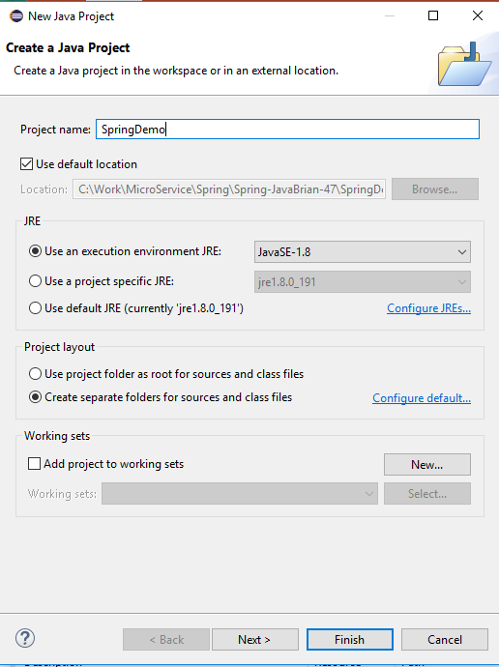
2 Setup
https://www.youtube.com/watch?v=Z5gubdHLJIc&list=PLGibysfsUS7NAbefiaj1V4LbX0glTftDI&index=2
Create Java Project:
Project Name: SpringDemo
Use JRE: JavaSE-1.8
Click Finish

Slide 5
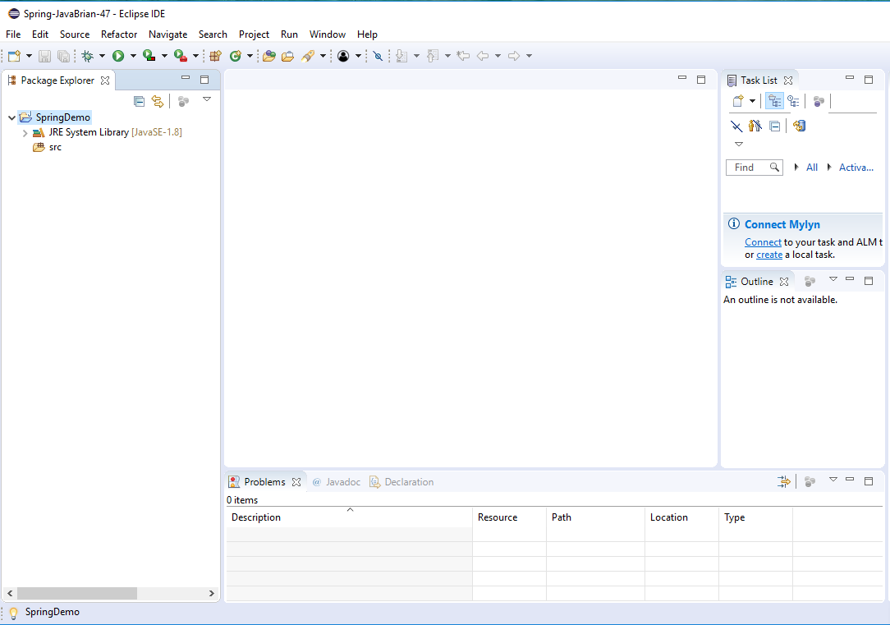
2 Setup
https://www.youtube.com/watch?v=Z5gubdHLJIc&list=PLGibysfsUS7NAbefiaj1V4LbX0glTftDI&index=2
This is the basic Java Project which uses the system library.

Slide 6
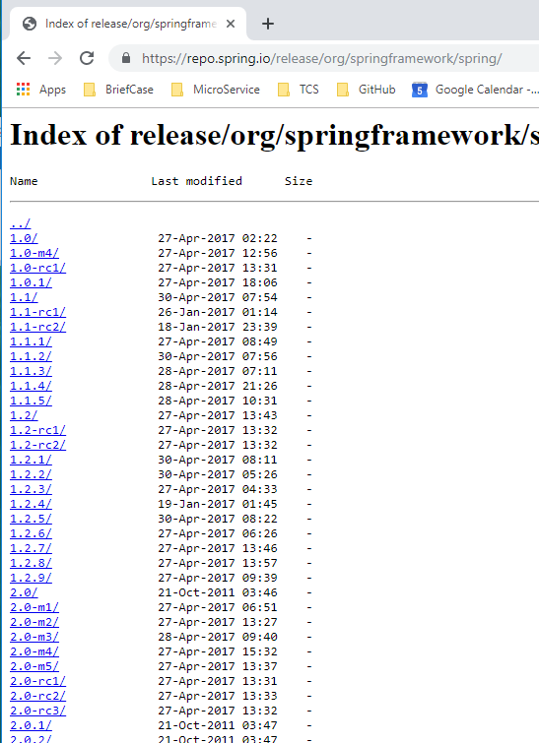
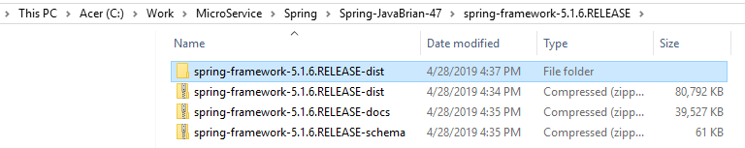
2 Setup
https://www.youtube.com/watch?v=Z5gubdHLJIc&list=PLGibysfsUS7NAbefiaj1V4LbX0glTftDI&index=2
Now, we will create a custom library which we will put all the Spring jars.
We can download the distributions from the Spring site.
The spring-framework-5.1.6.RELEASE-dist is the latest spring framework.

Slide 7
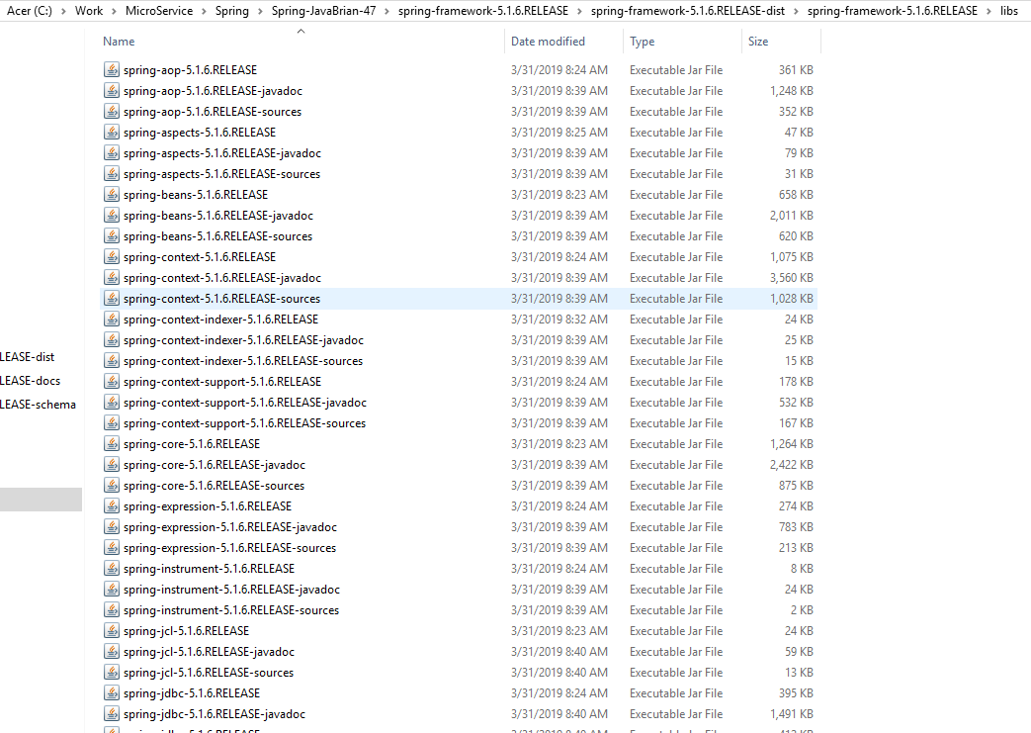
2 Setup
https://www.youtube.com/watch?v=Z5gubdHLJIc&list=PLGibysfsUS7NAbefiaj1V4LbX0glTftDI&index=2
The spring-framework-x.x.x.RELEASE-dist/spring-framework-x.x.x.RELEASE/libs folder contains all the jars files we need.

Slide 8
2.1 Add Library
Peter H. Chen

Slide 9
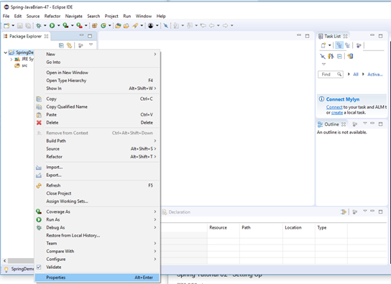
2.1 Add Library
https://www.youtube.com/watch?v=Z5gubdHLJIc&list=PLGibysfsUS7NAbefiaj1V4LbX0glTftDI&index=2
Click the Project “SpringDemo”
RMB: Properties

Slide 10
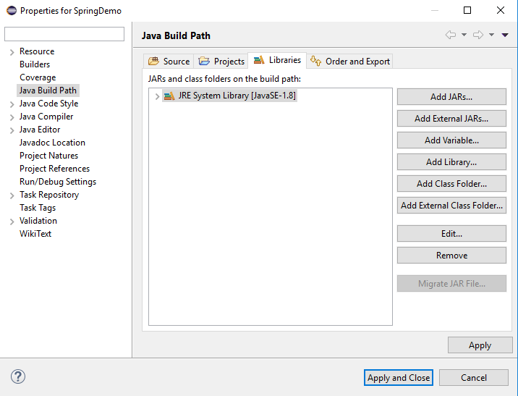
2.1 Add Library
https://www.youtube.com/watch?v=Z5gubdHLJIc&list=PLGibysfsUS7NAbefiaj1V4LbX0glTftDI&index=2
Click “Java Build Path” and Click Tab “Libraries”
Click “Add Library …”

Slide 11
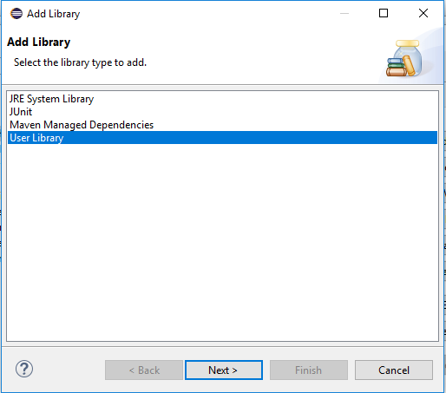
2.1 Add Library
https://www.youtube.com/watch?v=Z5gubdHLJIc&list=PLGibysfsUS7NAbefiaj1V4LbX0glTftDI&index=2
Select “User Library”
Click Next

Slide 12
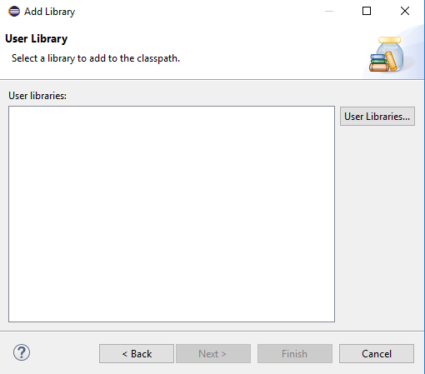
2.1 Add Library
https://www.youtube.com/watch?v=Z5gubdHLJIc&list=PLGibysfsUS7NAbefiaj1V4LbX0glTftDI&index=2
We do not have any libraries here.
Click “User Libraries …”

Slide 13
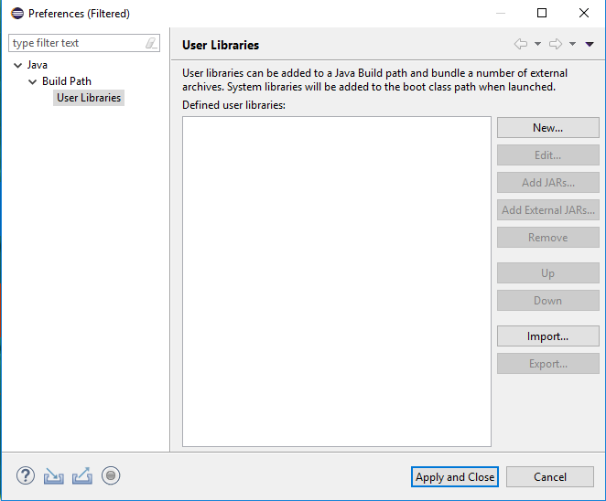
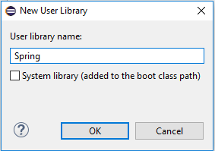
2.1 Add Library
https://www.youtube.com/watch?v=Z5gubdHLJIc&list=PLGibysfsUS7NAbefiaj1V4LbX0glTftDI&index=2
Click “New …”
Give the library name “Spring” and Click OK.

Slide 14
2.1 Add Library
https://www.youtube.com/watch?v=Z5gubdHLJIc&list=PLGibysfsUS7NAbefiaj1V4LbX0glTftDI&index=2
Click “New …”
Give the library name “Spring” and Click OK.

Slide 15
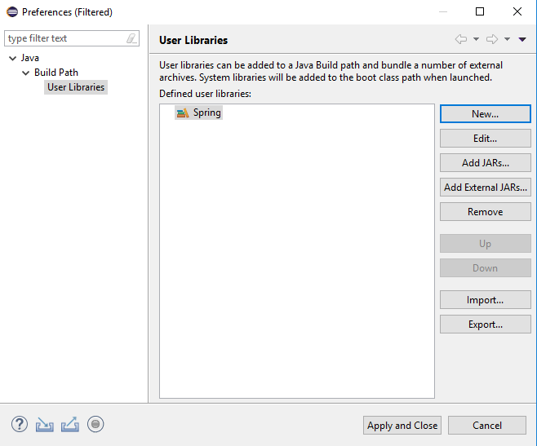
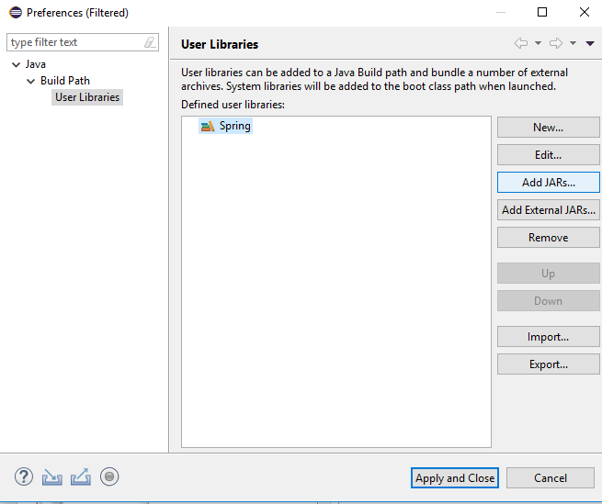
2.1 Add Library
https://www.youtube.com/watch?v=Z5gubdHLJIc&list=PLGibysfsUS7NAbefiaj1V4LbX0glTftDI&index=2
Now, we have blank “Spring” library here.
We need to add spring-framework-x.x.x.RELEASE/libs/*.jars here.
Click “Add External JARS…”

Slide 16
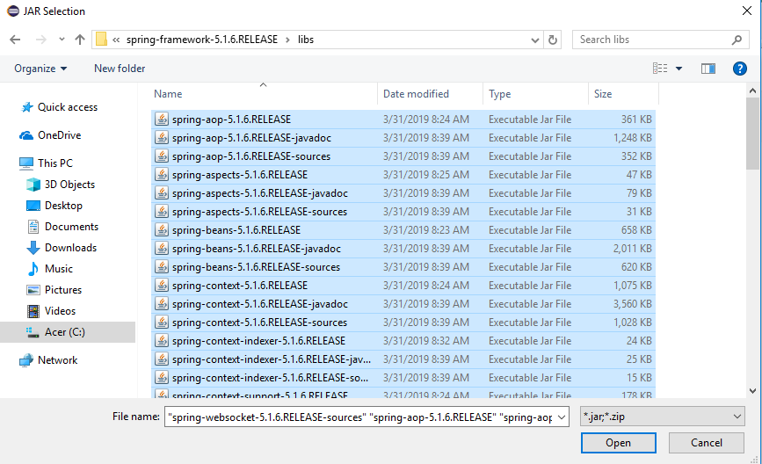
2.1 Add Library
https://www.youtube.com/watch?v=Z5gubdHLJIc&list=PLGibysfsUS7NAbefiaj1V4LbX0glTftDI&index=2
Select all the files (by select and then shift-select to select all).
Click Open

Slide 17
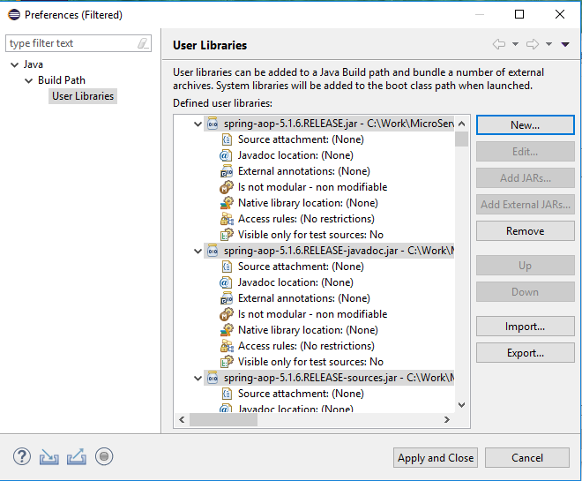
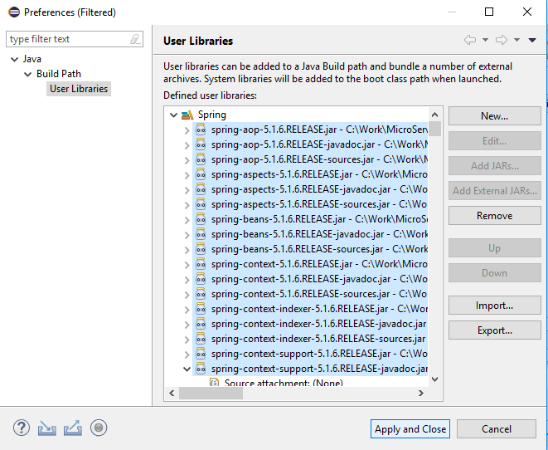
2.1 Add Library
https://www.youtube.com/watch?v=Z5gubdHLJIc&list=PLGibysfsUS7NAbefiaj1V4LbX0glTftDI&index=2
All the Spring Framework jars files are there.
Click “Apply and Close”

Slide 18
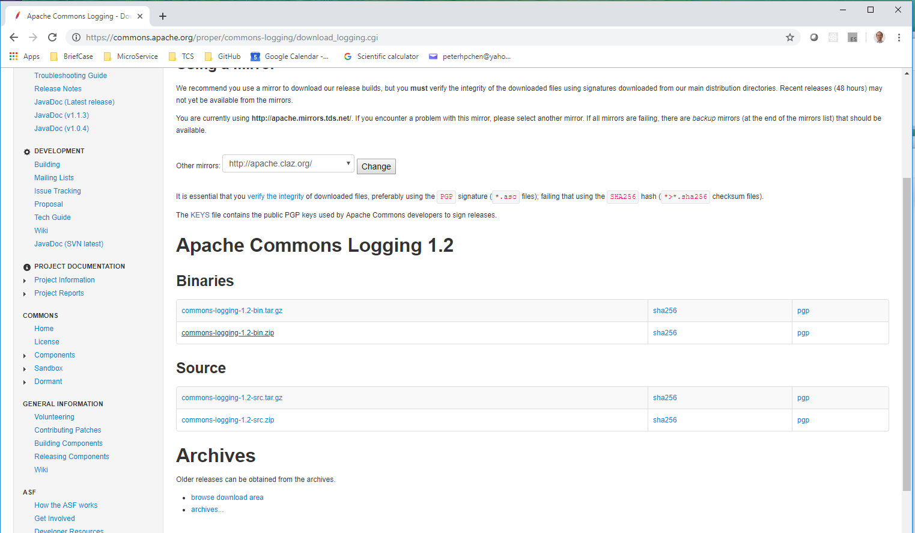
2.1 Add Library
https://www.youtube.com/watch?v=Z5gubdHLJIc&list=PLGibysfsUS7NAbefiaj1V4LbX0glTftDI&index=2
We also need the commons and logging (commons-logging.jars) from Apache for the project.

Slide 19
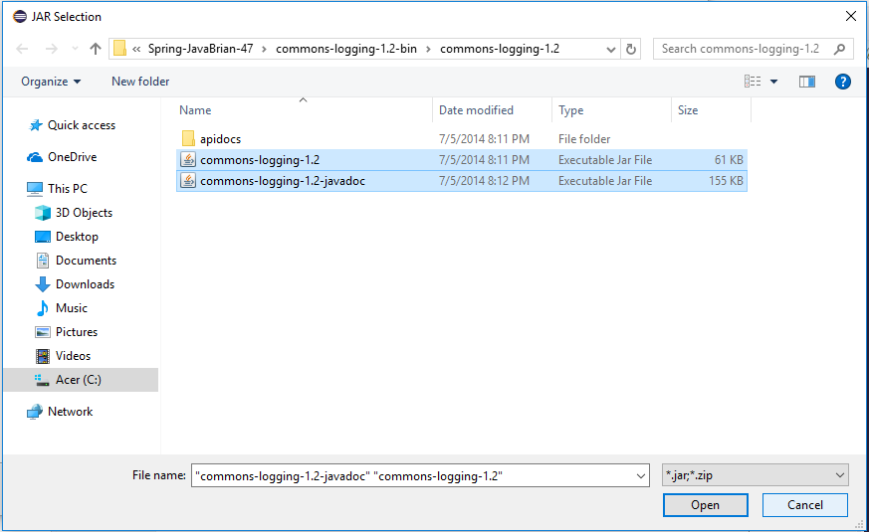
2.1 Add Library
https://www.youtube.com/watch?v=Z5gubdHLJIc&list=PLGibysfsUS7NAbefiaj1V4LbX0glTftDI&index=2
Repeat the Add User Library and select “commons-logging-x.x.jar”.

Slide 20
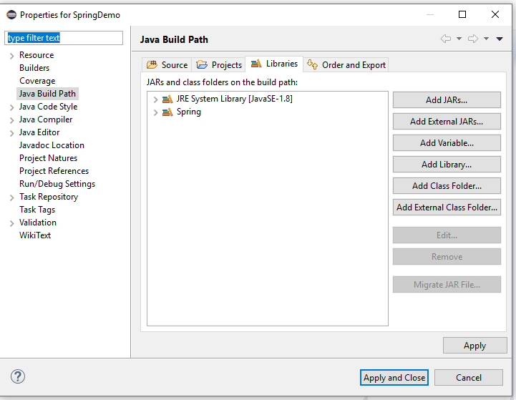
2.1 Add Library
https://www.youtube.com/watch?v=Z5gubdHLJIc&list=PLGibysfsUS7NAbefiaj1V4LbX0glTftDI&index=2
You should have library “Spring” and “JRE System Library [JavaSE-1.8]

Slide 21
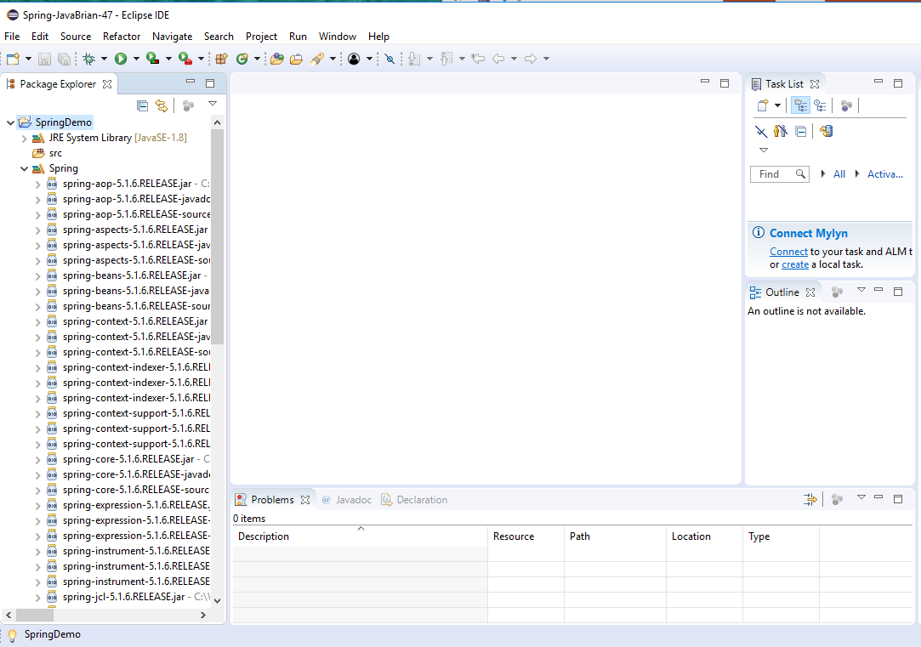
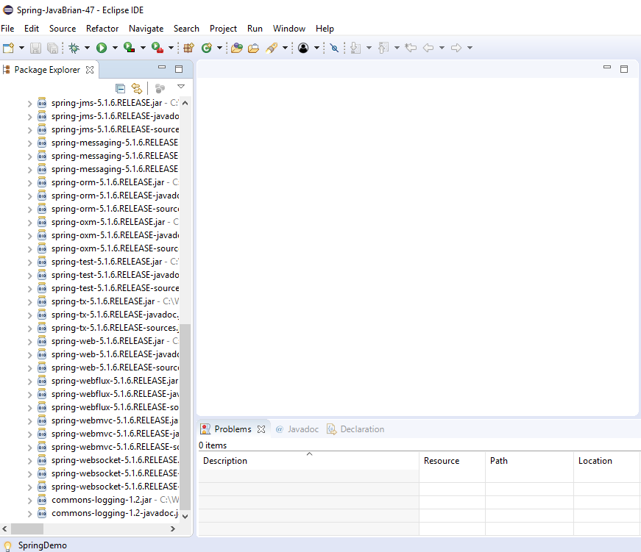
2.1 Add Library
https://www.youtube.com/watch?v=Z5gubdHLJIc&list=PLGibysfsUS7NAbefiaj1V4LbX0glTftDI&index=2
Verify the Project. Check all the Spring Library and Apache commons-logging are there.

Slide 22
End of Chapter

