Slide 1

8 Initialize Collection
Peter H. Chen

Slide 2
8 Initialize Collection
https://www.youtube.com/watch?v=MgYURkcYeDQ&list=PLGibysfsUS7NAbefiaj1V4LbX0glTftDI&index=8
In this section, we Initialize Collection.
Right now, we see how to setup the values for individual objects.
What if one of our member variable here was actually was a collection.
How to initialize the collection?
Spring initializes the collection three core interfaces that Java provide.
The core interfaces are: list, set, and map. All these three are supported by Spring.
We have the corresponding tags that we can use for XML.
We have list tag, set tag, and map tag.
In this section, we will discuss the list tag.
The set and map tags very straightforward. You can look at the syntax of Spring document.

Slide 3
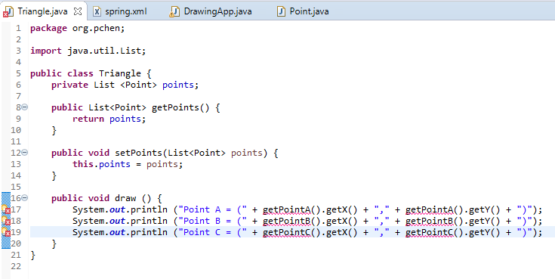
8 Initialize Collection
https://www.youtube.com/watch?v=MgYURkcYeDQ&list=PLGibysfsUS7NAbefiaj1V4LbX0glTftDI&index=8
In the Triangle class, it has three separated Point objects.
We are going to change into a list.
Import the java.util.List
Regenerate the setter and getter.

Slide 4
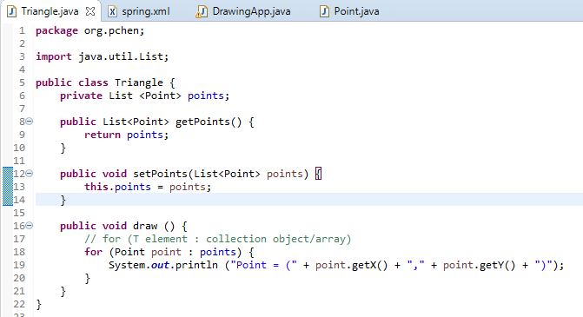
8 Initialize Collection
https://www.youtube.com/watch?v=MgYURkcYeDQ&list=PLGibysfsUS7NAbefiaj1V4LbX0glTftDI&index=8
In the draw(), loop through all the Collection object points.
The for syntax is “for (T element: collection object/array)”

Slide 5
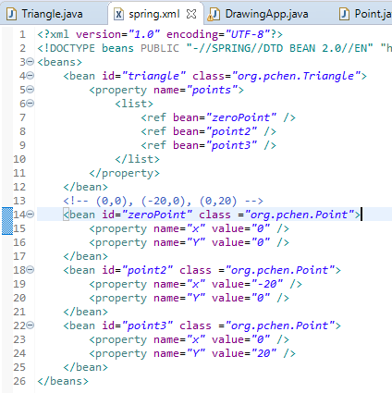
8 Initialize Collection
https://www.youtube.com/watch?v=MgYURkcYeDQ&list=PLGibysfsUS7NAbefiaj1V4LbX0glTftDI&index=8
Change the <property> to include <list> as follow.

Slide 6
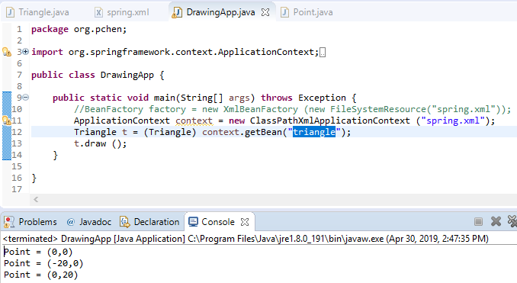
8 Initialize Collection
https://www.youtube.com/watch?v=MgYURkcYeDQ&list=PLGibysfsUS7NAbefiaj1V4LbX0glTftDI&index=8
Run Collection of List.

Slide 7
End of Chapter

