Slide 1

7 Inject Object
Peter H. Chen

Slide 2
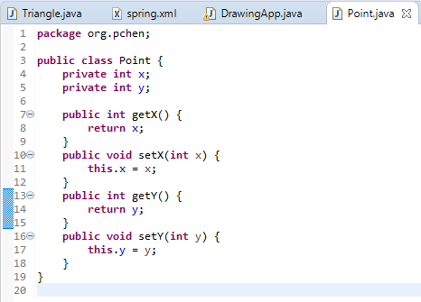
7 Inject Object
https://www.youtube.com/watch?v=g15RcFyEcrk&list=PLGibysfsUS7NAbefiaj1V4LbX0glTftDI&index=7
In this section, we inject objects by Spring.
Create class Point with (x, y).
RMB: Source > generate > getter and setter.

Slide 3
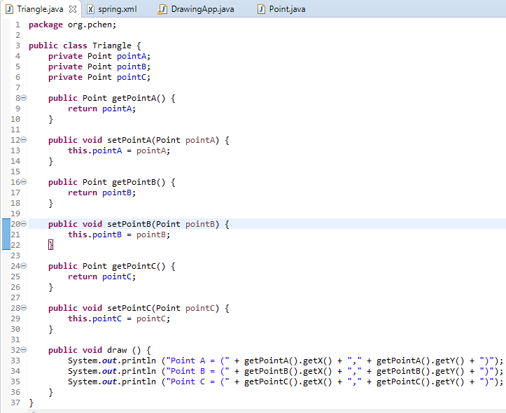
7 Inject Object
https://www.youtube.com/watch?v=g15RcFyEcrk&list=PLGibysfsUS7NAbefiaj1V4LbX0glTftDI&index=7
In class Triangle, we have PointA, PointB, and PointC.
The draw() print each point (x, y) by getPointA.getX(), getPointB.getY().

Slide 4
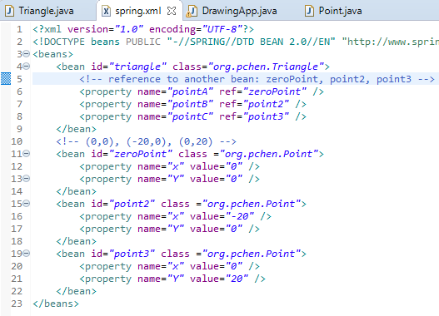
7 Inject Object
https://www.youtube.com/watch?v=g15RcFyEcrk&list=PLGibysfsUS7NAbefiaj1V4LbX0glTftDI&index=7
Define the <beans> which contains pointA, pointB, pointC, and ref for each id.

Slide 5
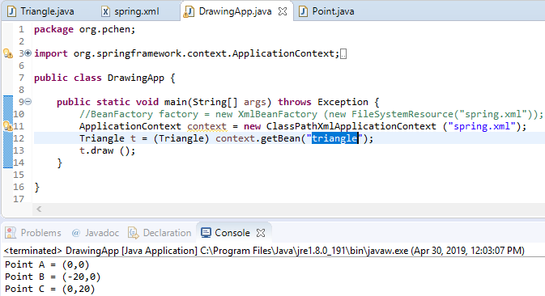
7 Inject Object
https://www.youtube.com/watch?v=g15RcFyEcrk&list=PLGibysfsUS7NAbefiaj1V4LbX0glTftDI&index=7
Run to print A, B, and C.

Slide 6
End of Chapter

