Slide 1

2 Load Data Set
Peter H. Chen

Slide 2
2 Load Data Set
https://www.youtube.com/watch?v=j-3vuBynnOE&index=2&list=PLQVvvaa0QuDfhTox0AjmQ6tvTgMBZBEXN
In this section, we will use the data set “Kaggle Cats and Dogs Dataset” from Microsoft.
They are initially from Kaggle challenge. They take pictures of cats and dogs and identified them by a neural network to tell they are cats or dogs.

Slide 3
2.1 Download Data Set

Slide 4
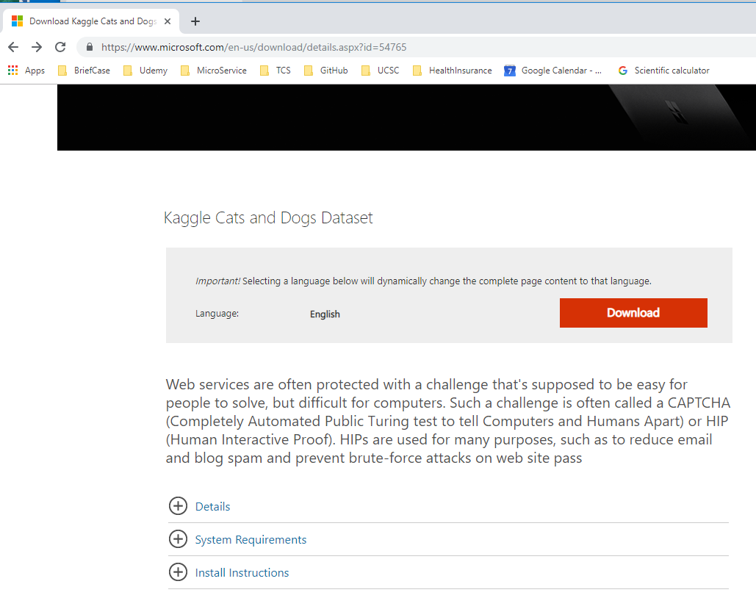
2.1 Download Data Set
https://www.youtube.com/watch?v=j-3vuBynnOE&index=2&list=PLQVvvaa0QuDfhTox0AjmQ6tvTgMBZBEXN
The Microsoft cat and dog web site has dataset 878MB. It takes about 30 minutes to download.
https://www.microsoft.com/en-us/download/details.aspx?id=54765

Slide 5
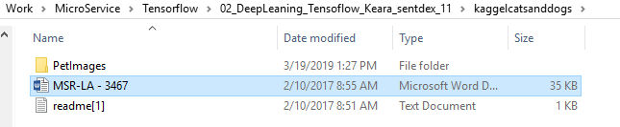
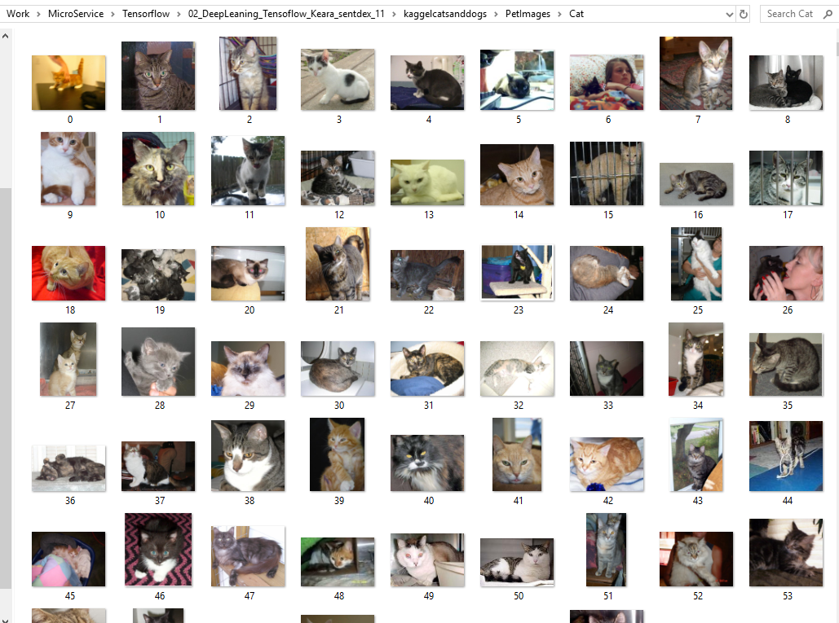
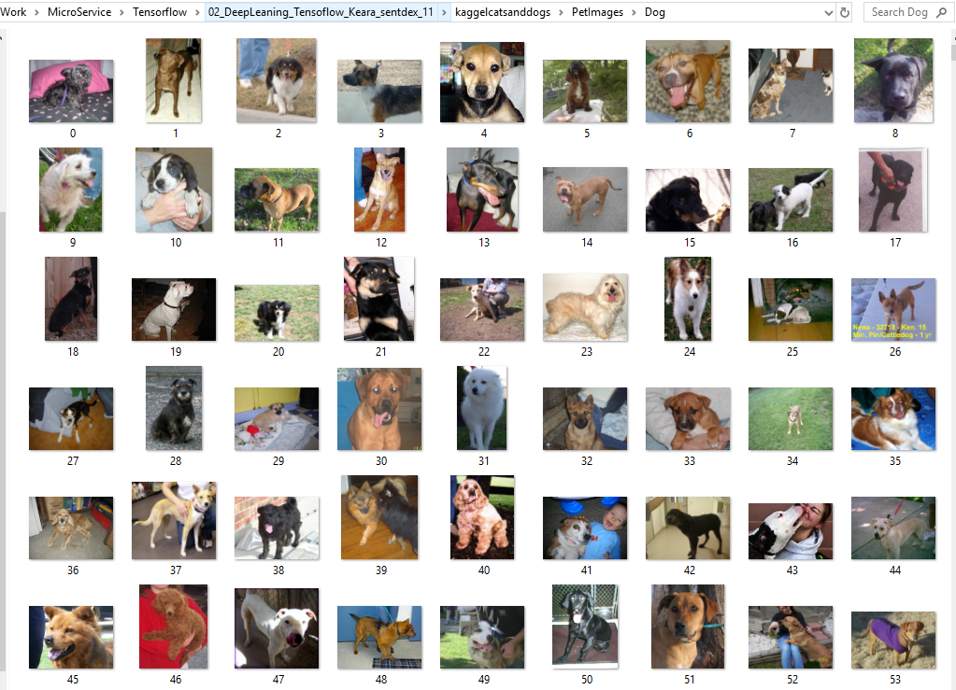
2.1 Download Data Set
https://www.youtube.com/watch?v=j-3vuBynnOE&index=2&list=PLQVvvaa0QuDfhTox0AjmQ6tvTgMBZBEXN
Unzip the download files.
Cat data set:
Dog data set:

Slide 6
2.2 Import Package

Slide 7
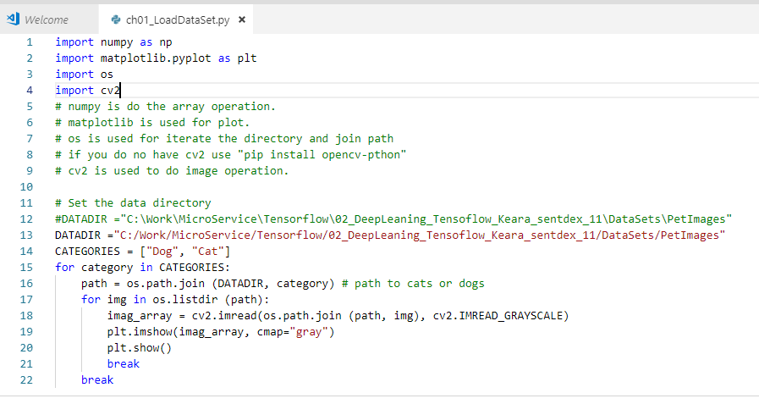
2.2 Import Package
https://www.youtube.com/watch?v=j-3vuBynnOE&index=2&list=PLQVvvaa0QuDfhTox0AjmQ6tvTgMBZBEXN
Use the VS Code to write the code:
The numpy is used for the array operation.
The matplotlib is a library used for plot.
The os is used for iterate the directory and join path
If you do not have cv2 use "pip install opencv-pthon"
The cv2 is used to do image operation.

Slide 8
2.3 Setup Directory

Slide 9
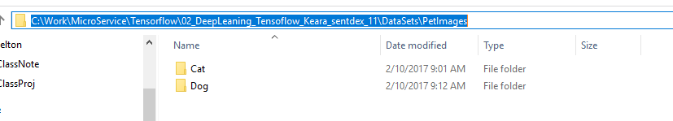
2.3 Setup Directory
https://www.youtube.com/watch?v=j-3vuBynnOE&index=2&list=PLQVvvaa0QuDfhTox0AjmQ6tvTgMBZBEXN
Set the data directory
DATADIR ="C:\Work\MicroService\Tensorflow\02_DeepLeaning_Tensoflow_Keara_sentdex_11\DataSets\PetImages“
CATEGORIES = ["Dog", "Cat"]

Slide 10
2.4 Read Grayscale Image

Slide 11
2.4 Read Grayscale Image
https://www.youtube.com/watch?v=j-3vuBynnOE&index=2&list=PLQVvvaa0QuDfhTox0AjmQ6tvTgMBZBEXN
Use the VS Code to write the code:
Now, we want to iterate all the sample of cats and dogs data.
path = os.path.join (DATADIR, category) # look through the paths of cat and the dog.
for img in os.lisdir(path) # look through all image files.
Img_array = cv2.imread() # we read the image and put into the image array.
cv2,.IMREAD_GRAYSCALE, is to convert the RGB data into grayscale. The RGB data size is three times than grayscale.
Color is not essential in this specific task of identifying the cats and dogs.

Slide 12
2.5 Display Grayscale Image

Slide 13
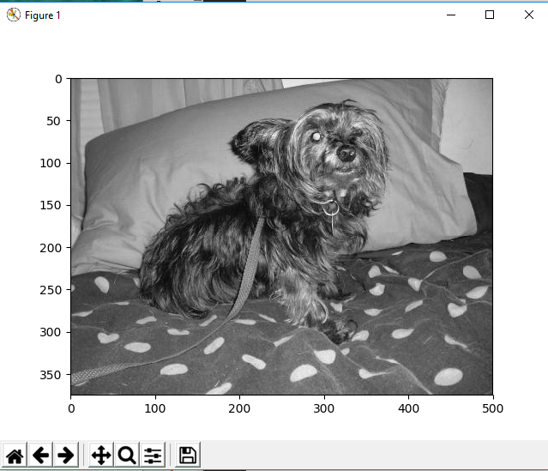
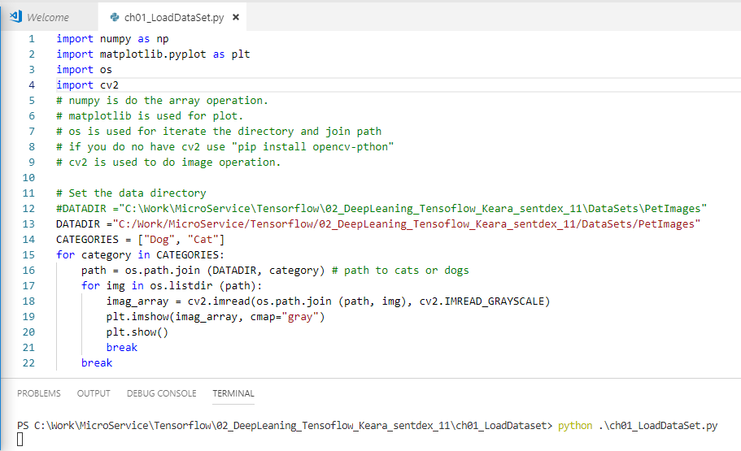
2.5 Display Grayscale Image
https://www.youtube.com/watch?v=j-3vuBynnOE&index=2&list=PLQVvvaa0QuDfhTox0AjmQ6tvTgMBZBEXN
Then, we want to print the read in data.
Use plt.imshow() an plot.show() to display the image.
We just want to display one image. Put two breaks to exit the display loop.

Slide 14
2.6 Print Grayscale Image

Slide 15
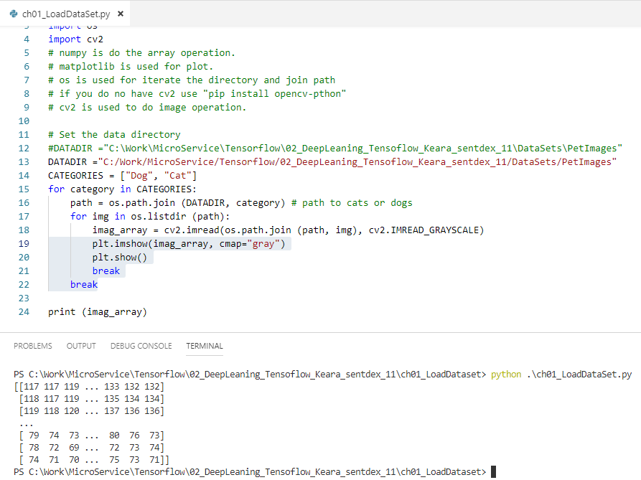
2.6 Print Grayscale Image
https://www.youtube.com/watch?v=j-3vuBynnOE&index=2&list=PLQVvvaa0QuDfhTox0AjmQ6tvTgMBZBEXN
Then, we want to print the one image data after display one image data. You can see a bunch of number. They are grayscale pixel values here. It is 2D array.

Slide 16
2.7 Read and Print RGB Image

Slide 17
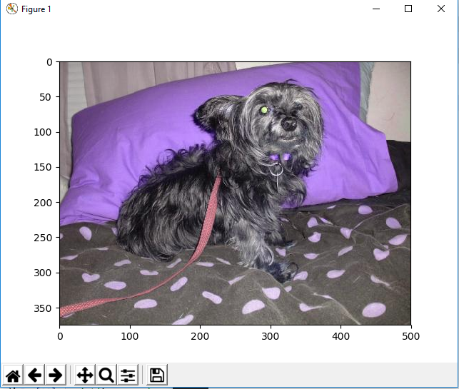
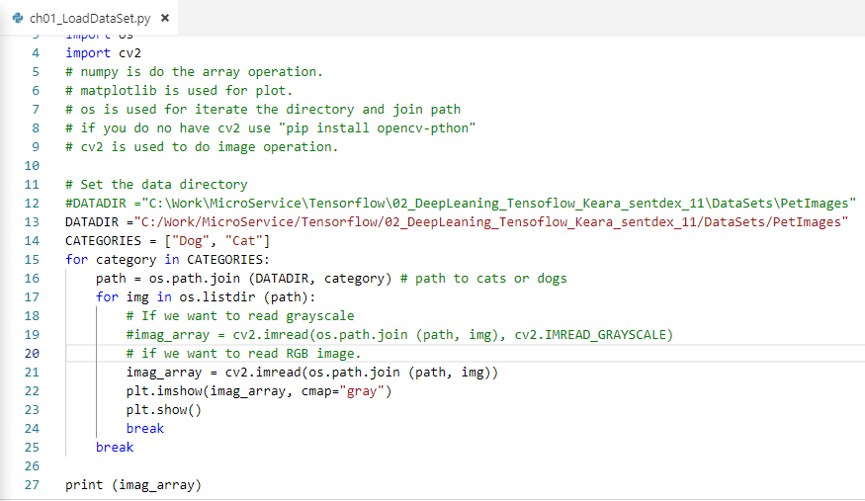
2.7 Read RGB Image
https://www.youtube.com/watch?v=j-3vuBynnOE&index=2&list=PLQVvvaa0QuDfhTox0AjmQ6tvTgMBZBEXN
Then, we want to print the RGB data. You can remove (cv2..IMREAD_GRAYSCALE) as below.
The display is color.

Slide 18
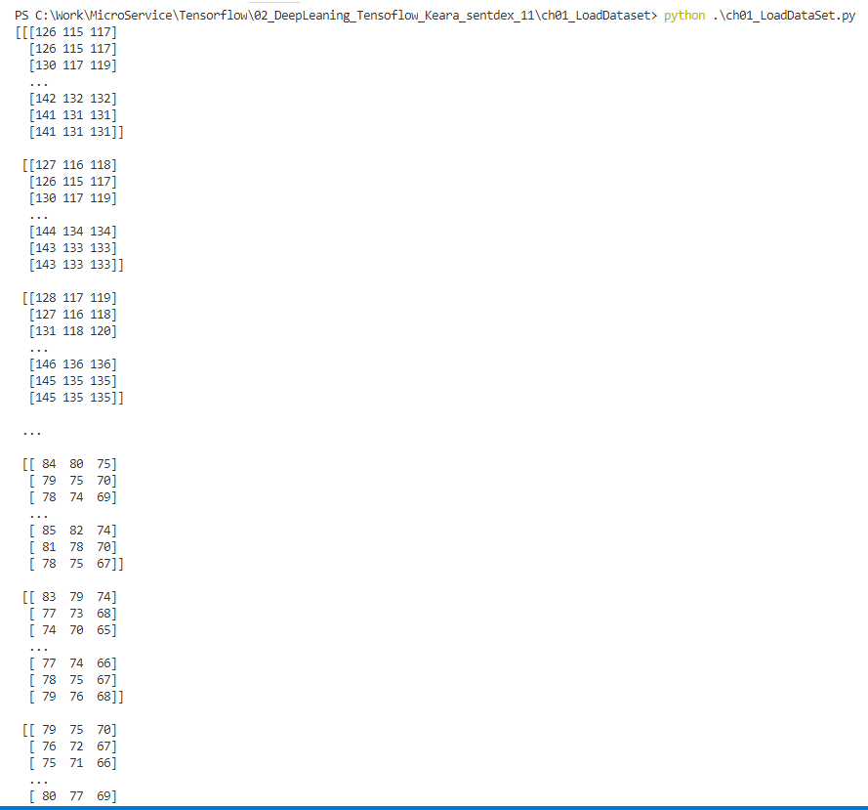
2 Load Data Set
https://www.youtube.com/watch?v=j-3vuBynnOE&index=2&list=PLQVvvaa0QuDfhTox0AjmQ6tvTgMBZBEXN
The print data is RBG array.

Slide 19
2.7 Print shape

Slide 20
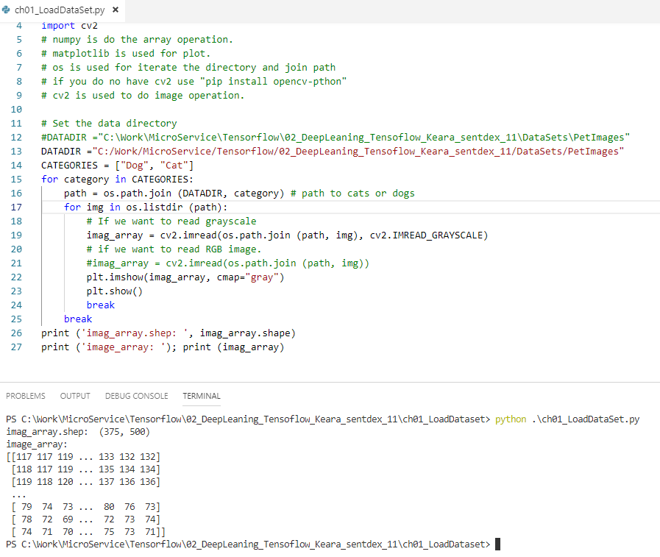
2.7 Print shape
https://www.youtube.com/watch?v=j-3vuBynnOE&index=2&list=PLQVvvaa0QuDfhTox0AjmQ6tvTgMBZBEXN
We only use grayscale in these series.
Print (imge_array.shape), we have (375, 500).
This bring next problem, all the dogs are in different image size. Some are landscape, some are portrait, some are square, and we really need everything to be normalized at all.
They are always to have variable sized image to make classification.
We want to make every image the same shape and keep as simple as possible.
We need to decide the size of image we are going to use.

Slide 21
2.8 Decide Image Size

Slide 22
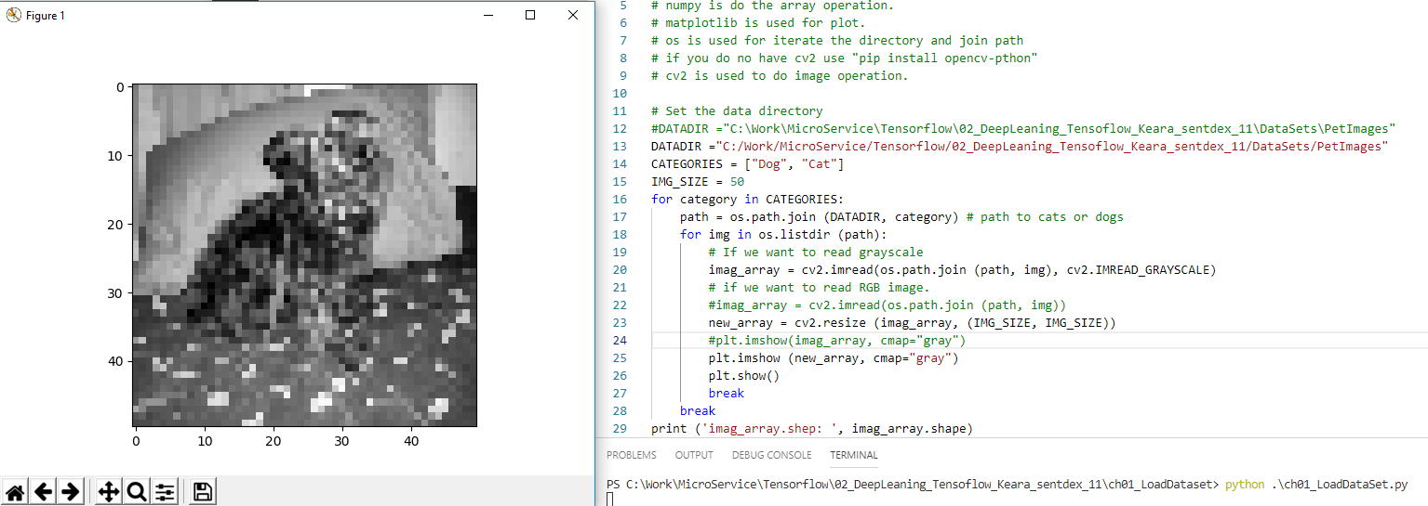
2.8 Decide Image Size
https://www.youtube.com/watch?v=j-3vuBynnOE&index=2&list=PLQVvvaa0QuDfhTox0AjmQ6tvTgMBZBEXN
IMG_SIZE = 50
new_array = cv2.resize (img_array, (IMG_SIZE, IMG_SIZE))
Plt.imshow(new_array,cmp=‘gray’)
Plt.show()
We will use image size 50

Slide 23
2.9 Training Data

Slide 24
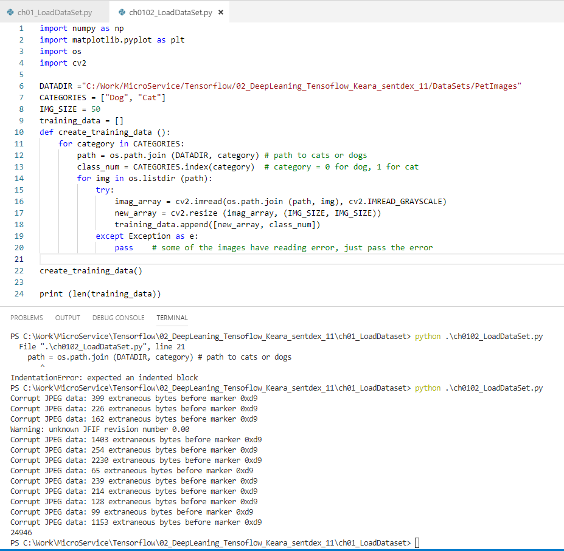
2.9 Training Data
https://www.youtube.com/watch?v=j-3vuBynnOE&index=2&list=PLQVvvaa0QuDfhTox0AjmQ6tvTgMBZBEXN
Initialized the training_data = []
Get the class_num (image index) for each dog (category=0) and cat (category=1).
Read each image, some image data is corrupt, just pass it.
Print the length (taining_data). The training_data size is around 25K (24,946).
Before Shuffle:
Training_data [*, 0]
Training_data [*, 1]
50 x 50
Category = 0
50 x 50
Category = 0
50 x 50
Category = 0
50 x 50
Category = 0
50 x 50
Category = 1
50 x 50
Category = 1
50 x 50
Category = 1
50 x 50
Category = 1

Slide 25
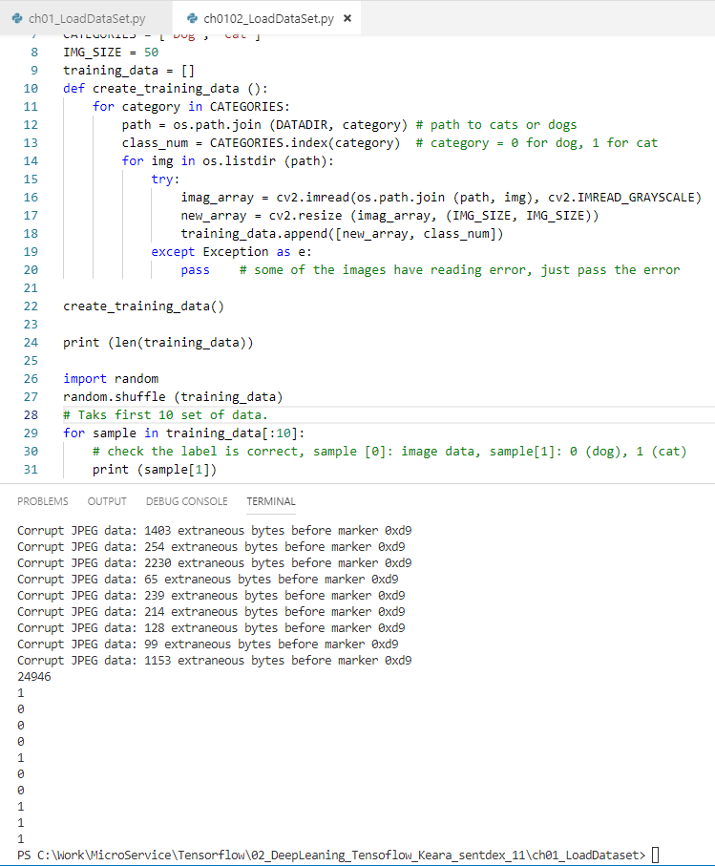
2.9 Training Data
https://www.youtube.com/watch?v=j-3vuBynnOE&index=2&list=PLQVvvaa0QuDfhTox0AjmQ6tvTgMBZBEXN
Random shuffle the training_data.
Pick up the first 10 data by [:10]
Print the dimension 0 is the image data, dimension 1 which is category 0 or 2.
After shuffle, the cat and dog are in random order.
Training_data [*, 0]
Training_data [*, 1]
50 x 50
50 x 50
Category = 0
50 x 50
Category = 0
50 x 50
Category = 0
50 x 50
Category = 1
50 x 50
Category = 0
50 x 50
Category = 0
50 x 50
Category = 0
Category = 1

Slide 26
2.10 Feature and Label

Slide 27
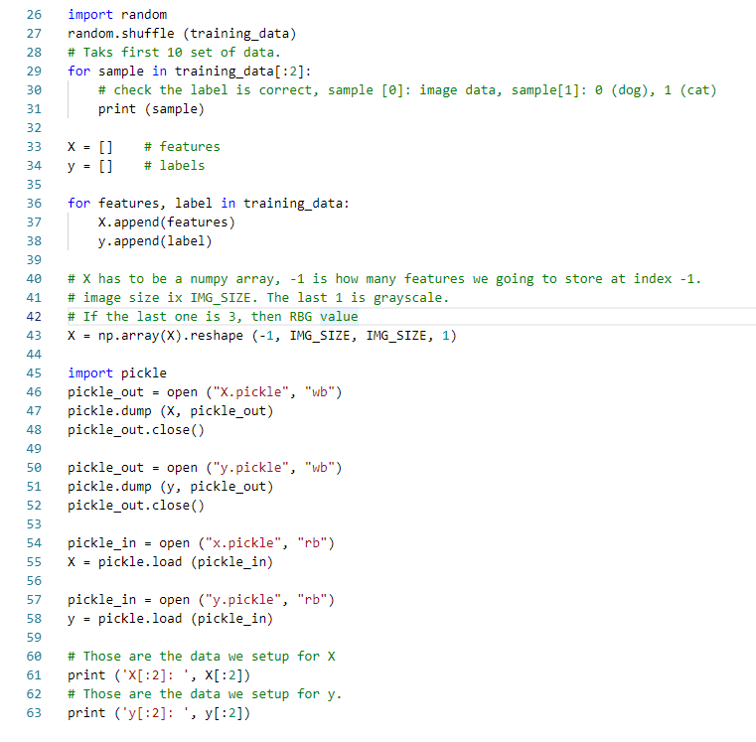
2.10 Feature and Label
https://www.youtube.com/watch?v=j-3vuBynnOE&index=2&list=PLQVvvaa0QuDfhTox0AjmQ6tvTgMBZBEXN
Now, Capital X is for features set and lowercase y is for label.
Extract the features and label from training_data.
X has to reshape. The keras should do this for us. Right now reshape to (-1, IMG_SIZE, IMG_SIZE, 1)
Then, we store the data by pickle.
Then, we print out the data.
We only print 2 features and 2 labels.

Slide 28
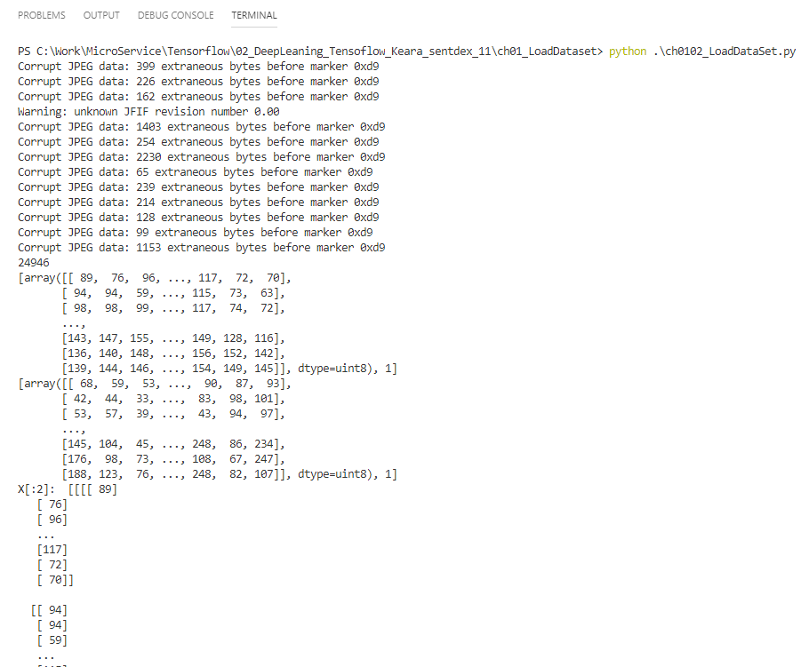
2.10 Feature and Label
https://www.youtube.com/watch?v=j-3vuBynnOE&index=2&list=PLQVvvaa0QuDfhTox0AjmQ6tvTgMBZBEXN
Print the features.

Slide 29
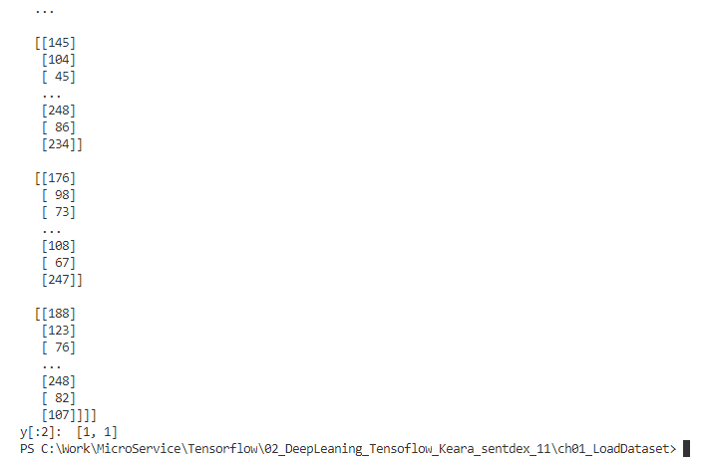
2.10 Feature and Label
https://www.youtube.com/watch?v=j-3vuBynnOE&index=2&list=PLQVvvaa0QuDfhTox0AjmQ6tvTgMBZBEXN
Print the label.

Slide 30
End of Chapter

