Slide 1

1 Introduction
Peter H. Chen

Slide 2
1 Introduction
https://www.youtube.com/watch?v=wQ8BIBpya2k&t=158s&index=2&list=PLQVvvaa0QuDfhTox0AjmQ6tvTgMBZBEXN
This section introduce deep learning, python, tensorflow, and keras.
Keras is a high level API for tensorflow now.
Keras is top of tensorflow and make tensorflow become super simple.
We discuss the neural network of deep learning and Python 3.6 in the series.

Slide 3
1.1 Machine Learning Concept

Slide 4
1.1 Machine Learning Concept
https://www.youtube.com/watch?v=wQ8BIBpya2k&t=158s&index=2&list=PLQVvvaa0QuDfhTox0AjmQ6tvTgMBZBEXN
Machine Learning (1)
What is goal of machine learning? We have input X1, X2, and X3. We want to map those to some sort of output. Let say the output is some sort of Dog or Cat. So the output is going to be two neurons in this case.
Now, we are going to figure out how to map from the inputs to the outputs.
We can use a single hidden layer. Let’s say we are going to do some neuron here.
X1
Dog
X2
Cat
X3
Hidden Layer

Slide 5
1.1 Machine Learning Concept
https://www.youtube.com/watch?v=wQ8BIBpya2k&t=158s&index=2&list=PLQVvvaa0QuDfhTox0AjmQ6tvTgMBZBEXN
Machine Learning (2)
Each input X1, X2, X3 going to map to the hidden layer. Each input of data gets connected to the neuron in the first layer hidden layer and each those connections has its own unique weight.
W
X1
Dog
X2
Cat
X3
Hidden Layer

Slide 6
1.1 Machine Learning Concept
https://www.youtube.com/watch?v=wQ8BIBpya2k&t=158s&index=2&list=PLQVvvaa0QuDfhTox0AjmQ6tvTgMBZBEXN
Machine Learning (3)
Now, from here that first hidden layer could then map and connect to that output layer.
The problem is if you did this relationship between X1 and Dog or Cat and all the other ones.
Those relationships would only be linear relationship.
So it we are looking to map for nonlinear relationships which is the more complex question.
One hidden layer means you just have one neural network.
W
X1
Dog
X2
Cat
X3
Hidden Layer

Slide 7
1.1 Machine Learning Concept
https://www.youtube.com/watch?v=wQ8BIBpya2k&t=158s&index=2&list=PLQVvvaa0QuDfhTox0AjmQ6tvTgMBZBEXN
Machine Learning (4)
Two or more hidden layers means you have a core deep neural network.
Then, once that is fully connected again all unique weights. Each of those blue lines has a unique weight associated with it.
W
W
X1
Dog
X2
Cat
X3
Hidden Layer

Slide 8
1.1 Machine Learning Concept
https://www.youtube.com/watch?v=wQ8BIBpya2k&t=158s&index=2&list=PLQVvvaa0QuDfhTox0AjmQ6tvTgMBZBEXN
Machine Learning (5)
And then the second hidden layer gets mapped the output.
The output again each blue line has a unique weight associated with it.
W
W
X1
W
Dog
X2
X3
Cat
Hidden Layer

Slide 9
1.1 Machine Learning Concept
https://www.youtube.com/watch?v=wQ8BIBpya2k&t=158s&index=2&list=PLQVvvaa0QuDfhTox0AjmQ6tvTgMBZBEXN
Machine Learning (6)
Now, what we are going to do is to talk what is going on an individual neuron level.
So again, that neuron has certain inputs coming to it.
It might be the input layer X values or it could be the inputs coming out of other neurons.
W
W
X1
W
Dog
X2
X3
Cat
Hidden Layer

Slide 10

1.1 Machine Learning Concept
https://www.youtube.com/watch?v=wQ8BIBpya2k&t=158s&index=2&list=PLQVvvaa0QuDfhTox0AjmQ6tvTgMBZBEXN
Machine Learning (7)
So we are going to call the inputs X1, X2, and X3. But keep in mind, these data might be not your input data. These data might be come from another neuron. But regardless where is the data come from, we are just going get the sum of that data.
But remember, We also have the weights of each of the inputs. These weights have a unique weight against the input data and then we sum them together.
X1
W
W
X2
X3
W

Slide 11
1.1 Machine Learning Concept
https://www.youtube.com/watch?v=wQ8BIBpya2k&t=158s&index=2&list=PLQVvvaa0QuDfhTox0AjmQ6tvTgMBZBEXN
Machine Learning (8)
Finally, and this is kind of where the artificial neural network comes into play.
We have an activation function and this activation function is kind of meant to simulate a neuron actually firing or not.
So you can think of the activation function like on a graph.
You get your X and your y and then a really basic activation function would be like a step function.
So if X is a certain value, then we step up and have a value 1 or 0.
If X value is greater than 3, then the activation return 1. But today, we use the sigmoid function.
X1
W
W
1
X2
0
X3
W
1
2
3

Slide 12
1.1 Machine Learning Concept
https://www.youtube.com/watch?v=wQ8BIBpya2k&t=158s&index=2&list=PLQVvvaa0QuDfhTox0AjmQ6tvTgMBZBEXN
Machine Learning (9)
So it is not going to be a 01 or 1. It is going to be some sort of value between 0 and 1.
It can be return 0.79, or something like that.
X1
W
1
W
0.79
X2
W
0
X3
1
2
3

Slide 13
1.1 Machine Learning Concept
https://www.youtube.com/watch?v=wQ8BIBpya2k&t=158s&index=2&list=PLQVvvaa0QuDfhTox0AjmQ6tvTgMBZBEXN
Machine Learning (10)
So, back to the neuron network.
Let’s say the final output layer. You have got do and cat.
The output layer is almost certain to have just a sigmoid activation function and what is going say is maybe dog is 0.79 and cat is 0.21. These two values are going and up to perfect 1.0. But we are going to go to whatever is largest value is.
W
W
X1
W
Dog
0.79
X2
X3
Cat
0.21
Hidden Layer

Slide 14
1.2 Tensorflow Version
Peter H. Chen

Slide 15
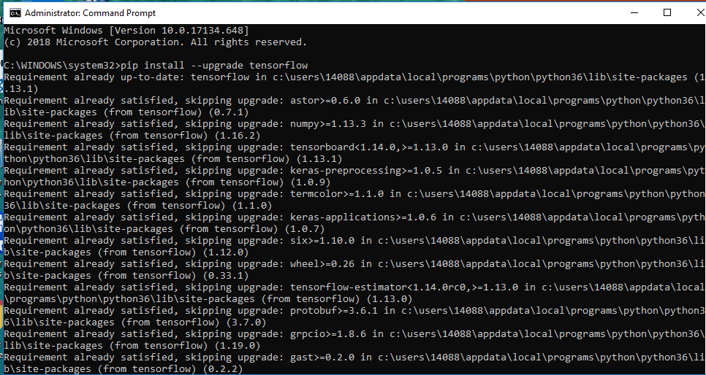
1.2 Tensorflow Version
https://www.youtube.com/watch?v=wQ8BIBpya2k&t=158s&index=2&list=PLQVvvaa0QuDfhTox0AjmQ6tvTgMBZBEXN
Tensorflow
Now, we all have the concepts of the neural networks. Let’s go ahead and build one.
We are going to need tensorflow.
> pip install --upgrade tensorflow

Slide 16
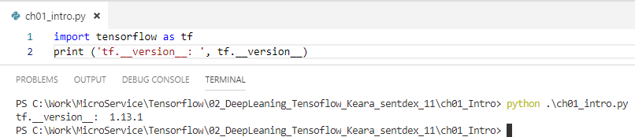
1.2 Tensorflow Version
https://www.youtube.com/watch?v=wQ8BIBpya2k&t=158s&index=2&list=PLQVvvaa0QuDfhTox0AjmQ6tvTgMBZBEXN
Machine Learning (12)
Import tensorflow as tf
Print (‘tf.__version__: ‘, tf.__version__)

Slide 17
1.3 Display Image

Slide 18
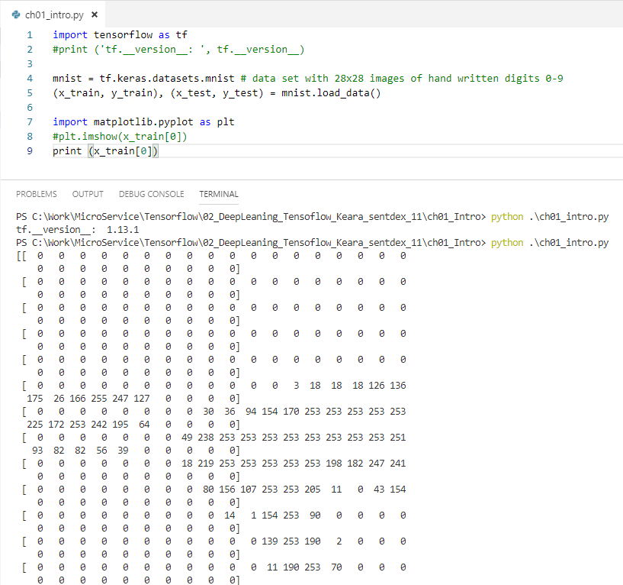
1.3 Display Image
https://www.youtube.com/watch?v=wQ8BIBpya2k&t=158s&index=2&list=PLQVvvaa0QuDfhTox0AjmQ6tvTgMBZBEXN
Now, let’s go ahead and get started. The first thing we are going to do is import a data set.
We are going to use mnist example data sets with machine learning.
It is a dataset that consists of 28 x 28 images size of hand written digits 0 through 9.
Then, we will unpack the data set to training and testing variables.
This is very complicated operation when it is actually a data that you bring in or that you build.
We unpack by (x_train, y_train), (x_test, y_test) = mnist.load_data()
print (x_train[0])

Slide 19
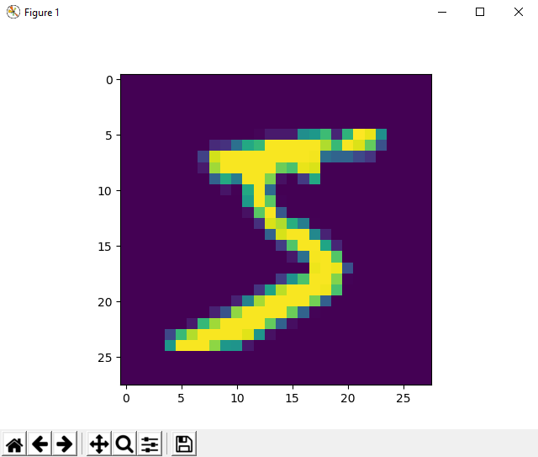
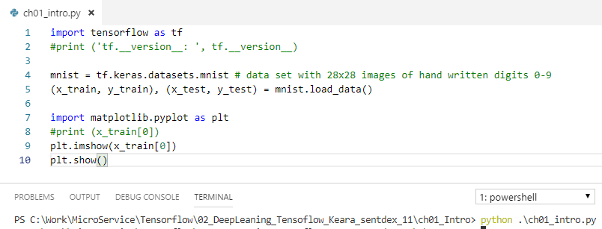
1.3 Display Image
https://www.youtube.com/watch?v=wQ8BIBpya2k&t=158s&index=2&list=PLQVvvaa0QuDfhTox0AjmQ6tvTgMBZBEXN
plt.imshow (x_train[0])
plt.show()

Slide 20
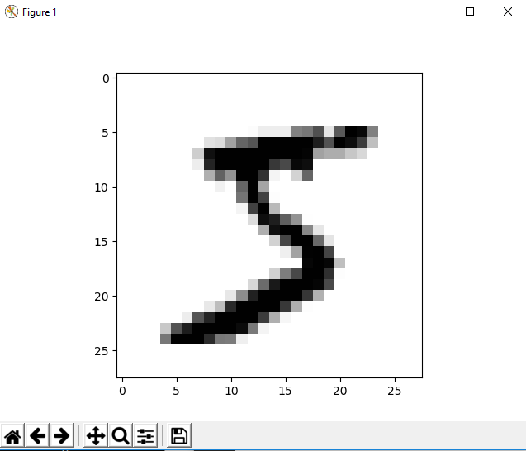
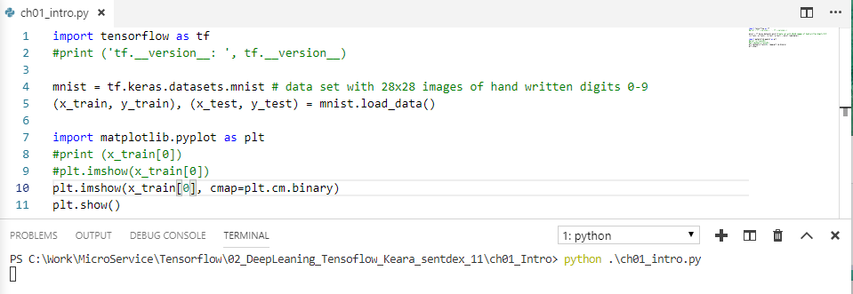
1.3 Tensorflow Version
https://www.youtube.com/watch?v=wQ8BIBpya2k&t=158s&index=2&list=PLQVvvaa0QuDfhTox0AjmQ6tvTgMBZBEXN
plt.imshow (x_train[0], cmap=plt.cm.binary) # set cmap (color map) into binary.
plt.show()

Slide 21
1.4 Setup Model

Slide 22
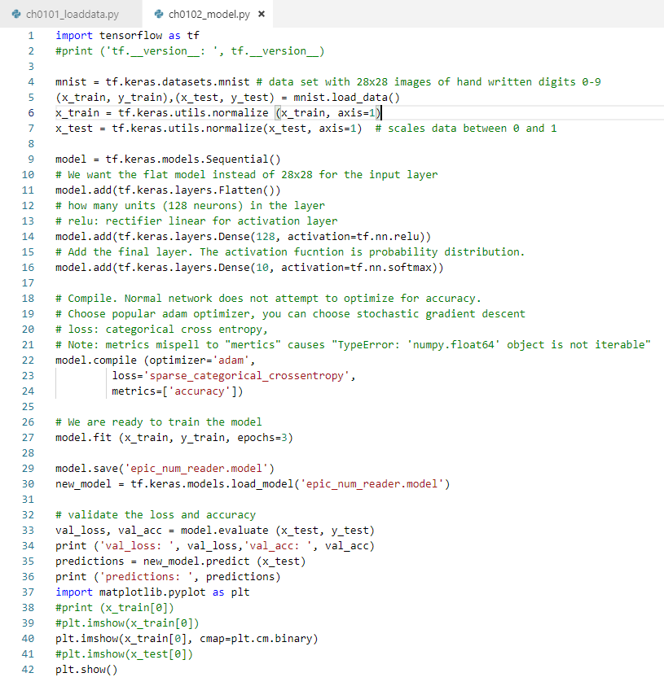
1.4 Setup Model
https://www.youtube.com/watch?v=wQ8BIBpya2k&t=158s&index=2&list=PLQVvvaa0QuDfhTox0AjmQ6tvTgMBZBEXN
Setup Model: Input Layer, Hidden layer: 128 neurons, Output Layer: 10 Labels

Slide 23
1.5 Compile Optimizer

Slide 24
1.5 Compile Optimizer
https://www.youtube.com/watch?v=wQ8BIBpya2k&t=158s&index=2&list=PLQVvvaa0QuDfhTox0AjmQ6tvTgMBZBEXN
Setup Compile optimizer, loss function, and metrics.

Slide 25
1.6 Train Model

Slide 26
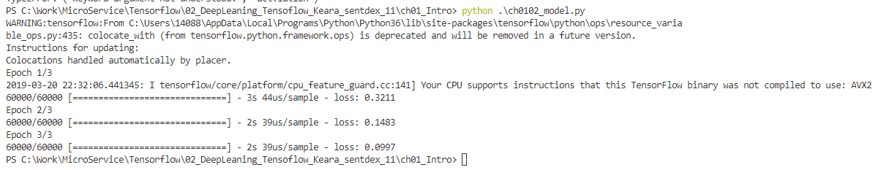
1.6 Train Model
https://www.youtube.com/watch?v=wQ8BIBpya2k&t=158s&index=2&list=PLQVvvaa0QuDfhTox0AjmQ6tvTgMBZBEXN
Train model by x_train and y_train: loss: 0.0997 is pretty good. But problem is might be overfit.

Slide 27
1.7 Save/Read Model Data

Slide 28
1.7 Save/Read Model Data
https://www.youtube.com/watch?v=wQ8BIBpya2k&t=158s&index=2&list=PLQVvvaa0QuDfhTox0AjmQ6tvTgMBZBEXN
Save and Read Model Data.

Slide 29
1.8 Test Model

Slide 30
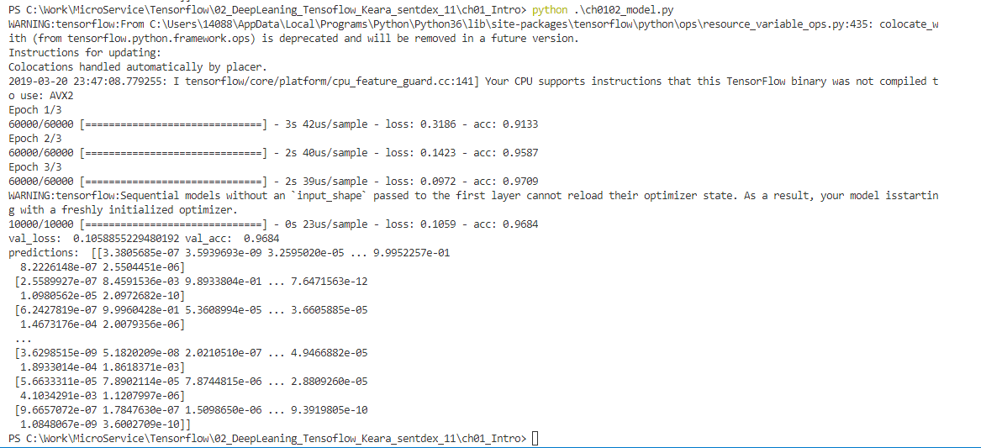
1.8 Test Model
https://www.youtube.com/watch?v=wQ8BIBpya2k&t=158s&index=2&list=PLQVvvaa0QuDfhTox0AjmQ6tvTgMBZBEXN
Save and Read Model Data.

Slide 31
End of Chapter

