Slide 1
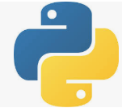
0302 NumPy Get Started
Peter H. Chen

Slide 2
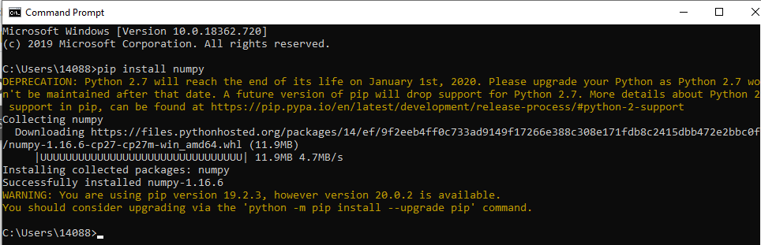
0302 NumPy Get Started
https://www.w3schools.com/python/numpy_getting_started.asp
Installation of NumPy
If you have Python and PIP already installed on a system, then installation of NumPy is very easy.
Install it using this command:
> pip install numpy

Slide 3
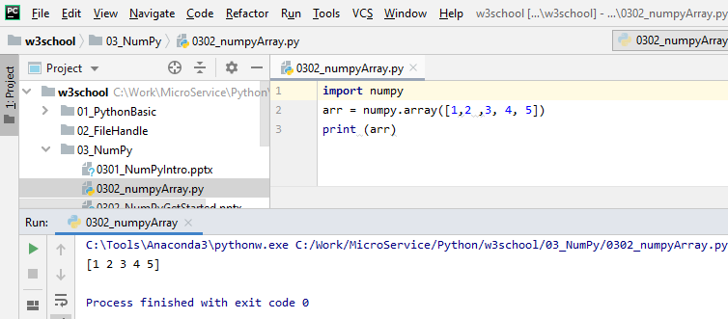
0302 NumPy Get Started
https://www.w3schools.com/python/numpy_getting_started.asp
Import numpy

Slide 4
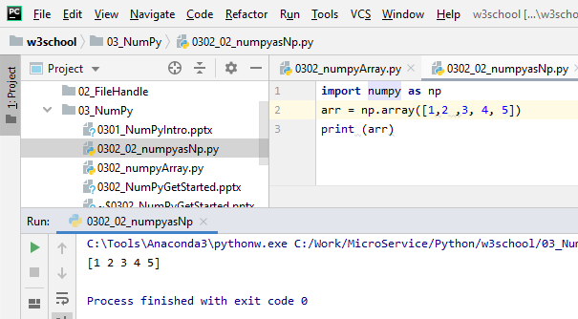
0302 NumPy Get Started
https://www.w3schools.com/python/numpy_getting_started.asp
Import numpy as np

Slide 5
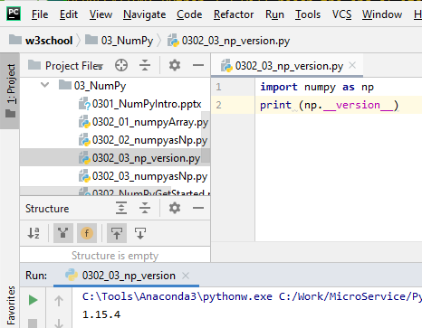
0302 NumPy Get Started
https://www.w3schools.com/python/numpy_getting_started.asp
print numpy version

Slide 6
End of Chapter

