Slide 1
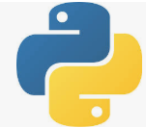
0303 NumPy Create Array
Peter H. Chen

Slide 2
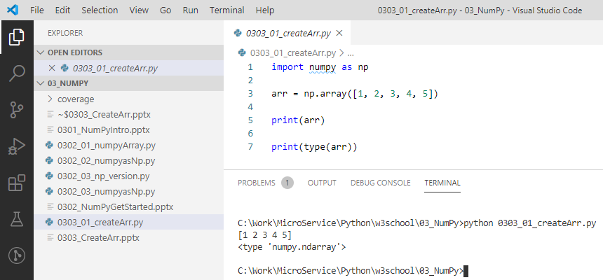
0303 NumPy Create Array
https://www.w3schools.com/python/numpy_creating_arrays.asp
Create a NumPy ndarray Object
NumPy is used to work with arrays. The array object in NumPy is called ndarray.
We can create a NumPy ndarray object by using the array() function.

Slide 3
End of Chapter

