Slide 1

82 Socket
Peter H. Chen

Slide 2
82 Socket
https://www.youtube.com/watch?v=u4kr7EFxAKk&list=PLsyeobzWxl7poL9JTVyndKe62ieoN-MZ3&index=82
Socket
We discuss Socket.
In the internet, we have the machines and nodes.
These nodes can be a server and can be a client. These are the peer-to-peer network.
Below is one server listing to three clients. Server is waiting for the client to send a request and the server will send you a response
Client-1
Client-2
Server
Client-3

Slide 3
82 Socket
https://www.youtube.com/watch?v=u4kr7EFxAKk&list=PLsyeobzWxl7poL9JTVyndKe62ieoN-MZ3&index=82
Socket
For example, google.com, the google server is up and running.
It is waiting for the client to connect.
For the moment, you send a request to the Google server.
The Google server will send you some response.
Client-1
request
Client-2
Server
response
Client-3

Slide 4
82 Socket
https://www.youtube.com/watch?v=u4kr7EFxAKk&list=PLsyeobzWxl7poL9JTVyndKe62ieoN-MZ3&index=82
Socket
The response may be a page, page not found, or etc.
We are going to do in this discussion is to understand the base of the internet or base of the network by using the socket.
In this discussion, we do the socket programming in Python.
We use the python socket to implement on the network.
Client-1
request
Client-2
Server
response
Client-3

Slide 5
82 Socket
https://www.youtube.com/watch?v=u4kr7EFxAKk&list=PLsyeobzWxl7poL9JTVyndKe62ieoN-MZ3&index=82
Socket
We need two files: Socket.py and client.py
We need two concepts:
one is the port number and
other one is the type of connection we are going to build.
When we have a server and we have an IP address. We can interact the internet with the IP address. The IP address have a name, e.g., Google.com, the domain name. Behind the domain name is the IP address. We call this IP address as the public address.
If you are working in the LAN (Local Area Network) environment, we have multiple machines connected to our Wi-Fi or the LAN network. We are in the Private Network. We have our private IP address as well.
We have a machine that provides the multiple services. Every service will have a different port number, for example, you are running a HTTP server here, it will be having a different port number. If you are using a mail service, you will be having a different port number.
Port Number

Slide 6
82 Socket
https://www.youtube.com/watch?v=u4kr7EFxAKk&list=PLsyeobzWxl7poL9JTVyndKe62ieoN-MZ3&index=82
Socket
First point: When we create a server, it should have a port number as well.
We have to use a free port number. We cannot use a port number which already booked for something else, for example, if you have a Tomcat installed, it will use a port number by default which is 8080. So we cannot use that port number.
We will use the port number 9999 for our case. We do not have any global service running on this port number.
Second point: the type of connection. If you have seen the concept of networking, We the concept of TCP and UDP.
We can have TCP which is connection-oriented or we can have connection-less network.
TCP
UDP
Connection
Oriented
Connectionless
Oriented

Slide 7
82 Socket
https://www.youtube.com/watch?v=u4kr7EFxAKk&list=PLsyeobzWxl7poL9JTVyndKe62ieoN-MZ3&index=82
Socket
The TCP stand for the Transmission control protocol. TCP uses a connection-oriented protocol which means you have to first create a connection and then you can communicate.
On the other hand, we have UDP, in which you do not have to create the connection. You just send the packet. Based on the network or based on the address, it will simply reach to the particular destination.
The only drawback UDO is. You are not sure that your packet will be reaching there destination or not. That is the only issue.
We will use TCP protocol in our example. We first create the socket and then we send the packets.
TCP
UDP
Connection
Oriented
Connectionless
Oriented

Slide 8
82.1 Socket Example 1
Peter H. Chen

Slide 9
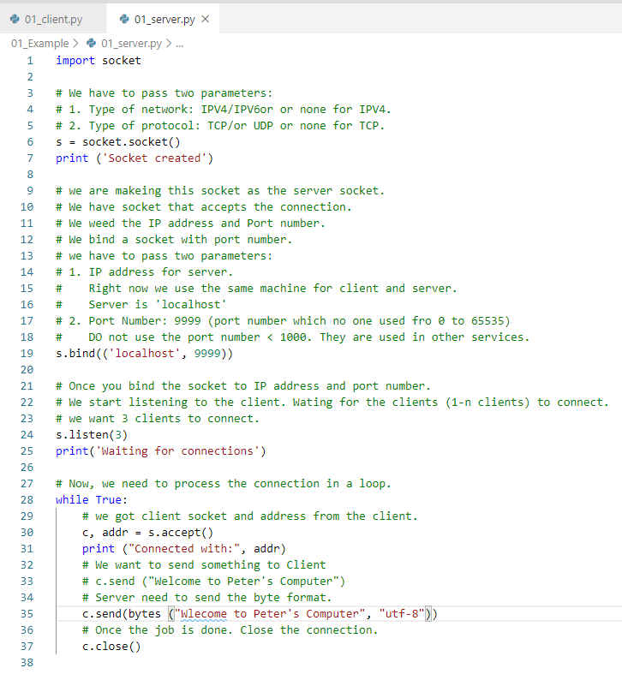
82.1 Socket Example 1
https://www.youtube.com/watch?v=u4kr7EFxAKk&list=PLsyeobzWxl7poL9JTVyndKe62ieoN-MZ3&index=82
Socket Server:
s = socket (ipv4, tcp)
s.bind((IP-addr, port-num))
s.listen(1-n)
While True:
c, addr = s.accept()
c.send (message)
c.close()

Slide 10
82.1 Socket Example 1
https://www.youtube.com/watch?v=u4kr7EFxAKk&list=PLsyeobzWxl7poL9JTVyndKe62ieoN-MZ3&index=82
Socket Server:
Start the server.
> python 01_server.py
Socket Server:
Now, server is waiting for connection
But, server is not printing anything. Why? Because we do not have client yet.

Slide 11
82.1 Socket Example 1
https://www.youtube.com/watch?v=u4kr7EFxAKk&list=PLsyeobzWxl7poL9JTVyndKe62ieoN-MZ3&index=82
Socket Server:
Start the server.
Now, server is waiting for connection
But, server is not printing anything. Why? Because we do not have client yet.
To stop the server:
> netstat -a -n -o | grep 9999
> taskkill [PID]
Note:
You also can use Control+Alt+Del to close the command window and associated process.

Slide 12
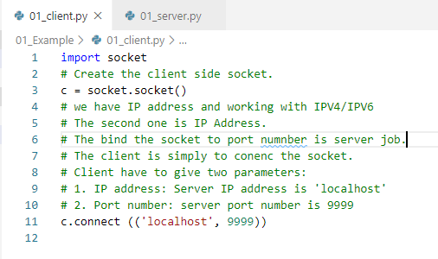
82.1 Socket Example 1
https://www.youtube.com/watch?v=u4kr7EFxAKk&list=PLsyeobzWxl7poL9JTVyndKe62ieoN-MZ3&index=82
Socket Client:
01_client.py

Slide 13

82.1 Socket Example 1
https://www.youtube.com/watch?v=u4kr7EFxAKk&list=PLsyeobzWxl7poL9JTVyndKe62ieoN-MZ3&index=82
Socket Server:
Start the Server
Open first command prompt
> python 01_Server.py
Socket Client:
Start the client
Open second command prompt
> python 01_client.py
This time, the server get:
The client IP address (127.0.0.1) which is same as server for this case)
client port number (51214) which is different from server port number 9999).

Slide 14
82.2 Socket Example 2
Peter H. Chen

Slide 15
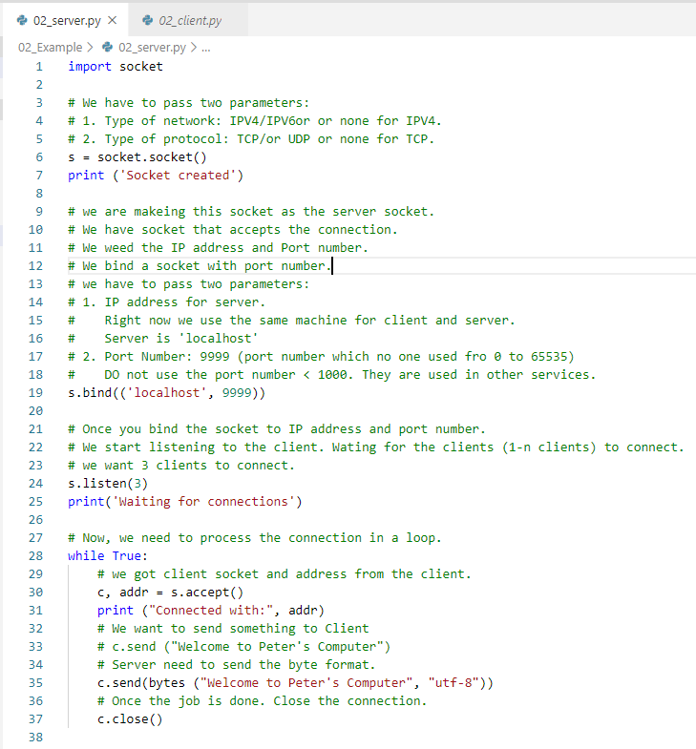
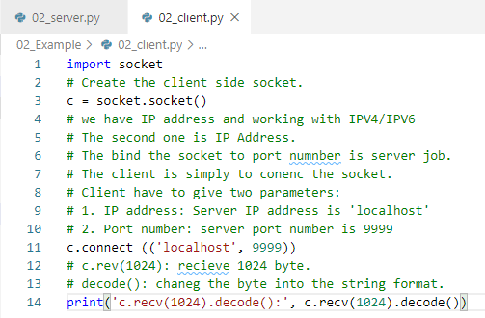
82.2 Socket Example 2
https://www.youtube.com/watch?v=u4kr7EFxAKk&list=PLsyeobzWxl7poL9JTVyndKe62ieoN-MZ3&index=82
Socket Server:
Right now, server is sending something to client.
It is the client responsibility to respond what he accepted.
Socket Client:
Right now, server is sending something to client.
It is the client responsibility to respond what he accepted.

Slide 16


82.2 Socket Example 2
https://www.youtube.com/watch?v=u4kr7EFxAKk&list=PLsyeobzWxl7poL9JTVyndKe62ieoN-MZ3&index=82
Socket Server:
Start Server
> python 02_server.py
Socket Server:
Start Client
> python 02_client.py

Slide 17
82.3 Send User Name Example 3
Peter H. Chen

Slide 18
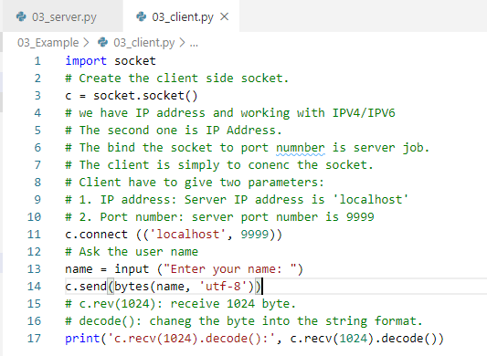
82.3 Send User Name Example 3
https://www.youtube.com/watch?v=u4kr7EFxAKk&list=PLsyeobzWxl7poL9JTVyndKe62ieoN-MZ3&index=82
In this example, we will ask user name in the client side and send the user name to the server.
In the client side, add the input name and then send to the server.

Slide 19
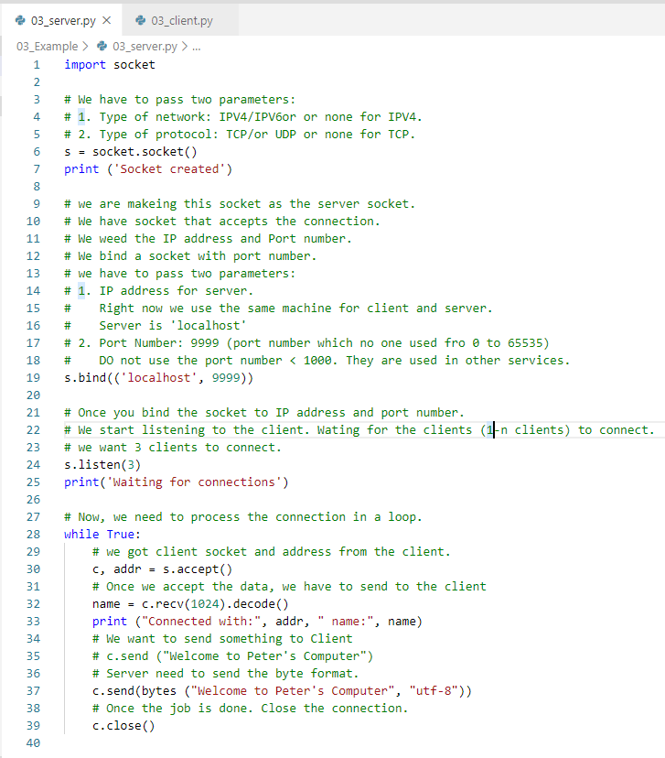
82.3 Send User Name Example 3
https://www.youtube.com/watch?v=u4kr7EFxAKk&list=PLsyeobzWxl7poL9JTVyndKe62ieoN-MZ3&index=82
The server respond the name and IP address.

Slide 20


82.3 Send User Name Example 3
https://www.youtube.com/watch?v=u4kr7EFxAKk&list=PLsyeobzWxl7poL9JTVyndKe62ieoN-MZ3&index=82
Socket Server:
Start Server
> python 03_server.py
Socket Server:
Start Client
> python 03_client.py
Enter the name: Peter

Slide 21
End of Chapter

