Slide 1

2 Deploy Web App
Peter H. Chen

Slide 2
2 Deploy Web App
https://www.youtube.com/watch?v=jtyk_2_f3d0&list=PLsyeobzWxl7rM-MltvxjUa-2LSgAhA11v&index=2
In this section, we deploy the Java Spring WebApp on AWS.
We will use AWS EC2, AWS Beanstalk, and AWS CodeStar.
You can used AWS and Beanstalk to deploy. Using AWS CodeStar make your job easy.
You need to sign up an AWS account

Slide 3
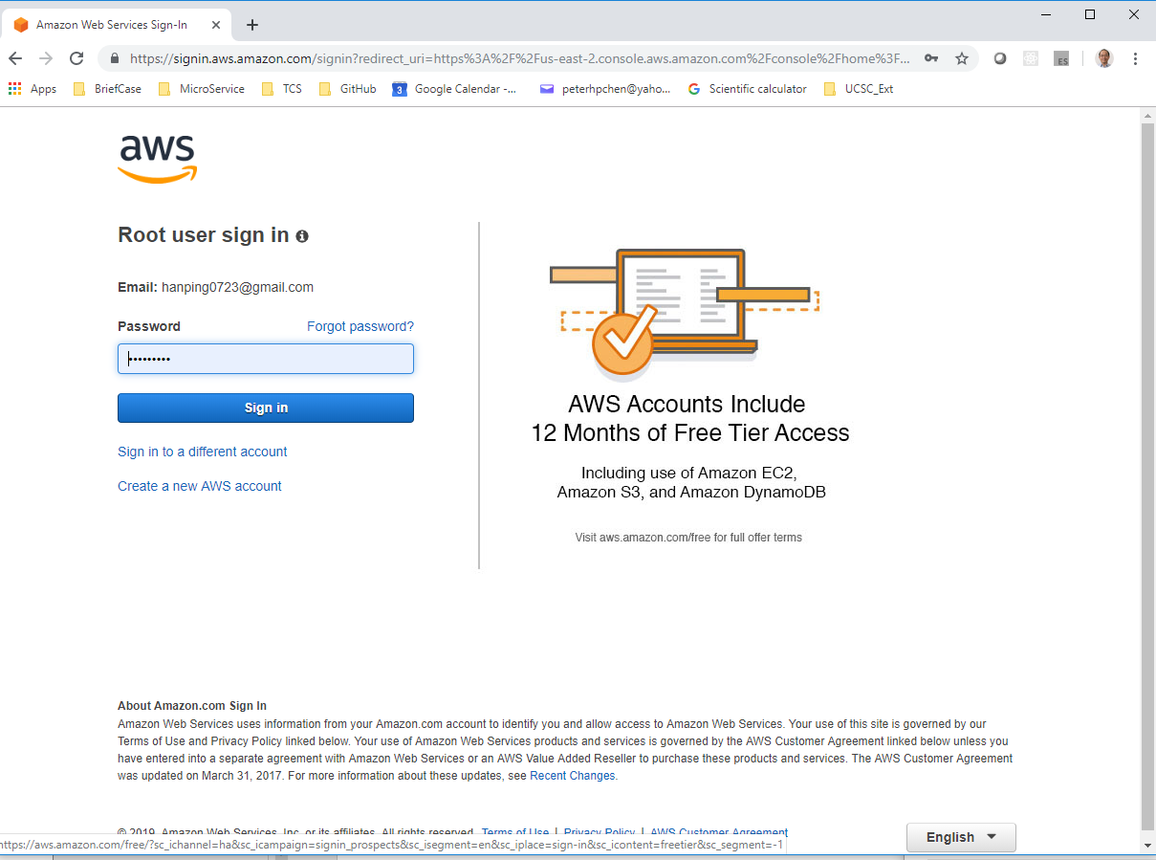
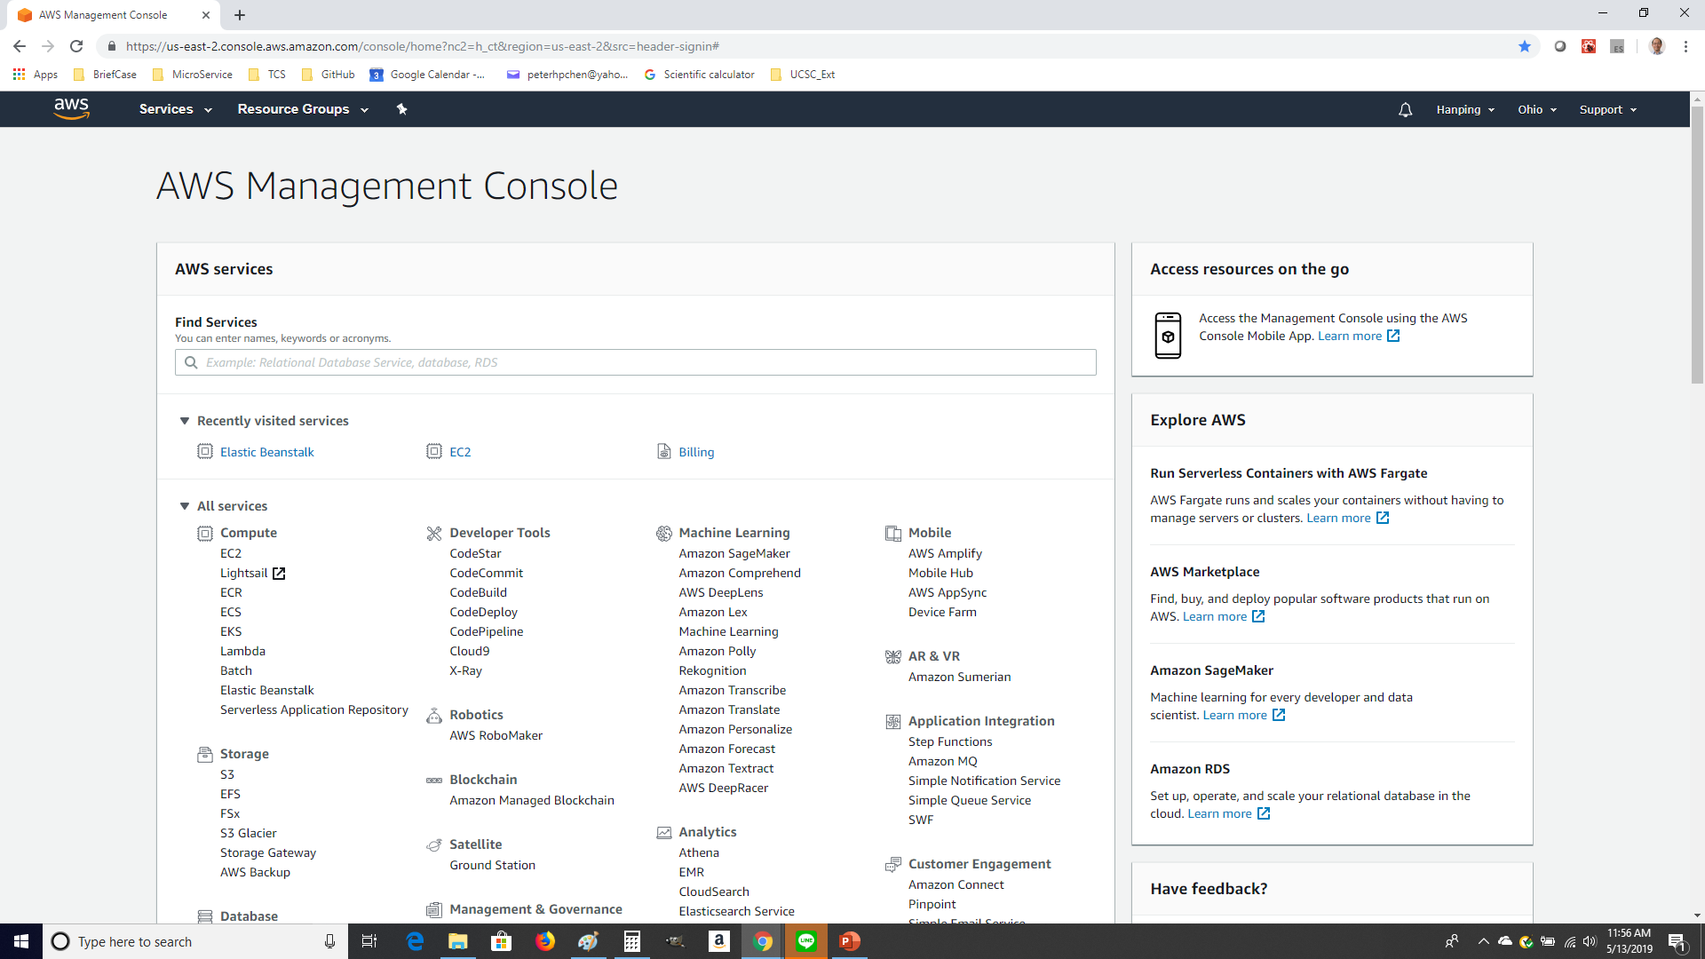
2 Deploy Web App
https://www.youtube.com/watch?v=jtyk_2_f3d0&list=PLsyeobzWxl7rM-MltvxjUa-2LSgAhA11v&index=2
Sign in the AWS account.
You can see some recently used information.

Slide 4
2 Deploy Web App
https://www.youtube.com/watch?v=jtyk_2_f3d0&list=PLsyeobzWxl7rM-MltvxjUa-2LSgAhA11v&index=2
You might get several services for one application, such as, EC2, IoT Services, and etc.
You might not use all services in one application.
You need to deploy your application on Virtual Server. That is the reason we use EC2. You may need to install Tomcat and etc.
When you deploy your application, you just need to use Elastic Beanstalk. The Beanstalk will help you in deploying the application. Beanstalk will take care these servers you need.
When we use development and deploy together, we can use CodeStar instead of Beanstalk. Since we use CodeStar, the EC2 and Beanstalk will be automatically used in the background.
The CodeStar is the best for ASW developer. The CodeStar combines the development and deployment together. The CodeStar is based on Atlassian which includes the Jira and DevOps functionalities as well.

Slide 5
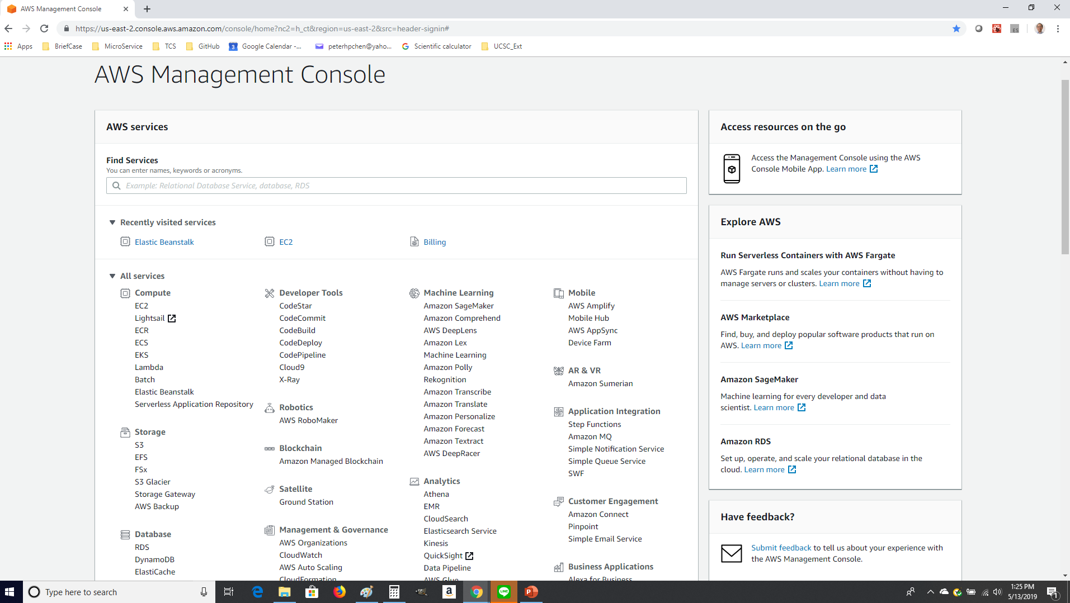
2 Deploy Web App
https://www.youtube.com/watch?v=jtyk_2_f3d0&list=PLsyeobzWxl7rM-MltvxjUa-2LSgAhA11v&index=2
In the Developer Tools, you can click on CodeStar.

Slide 6
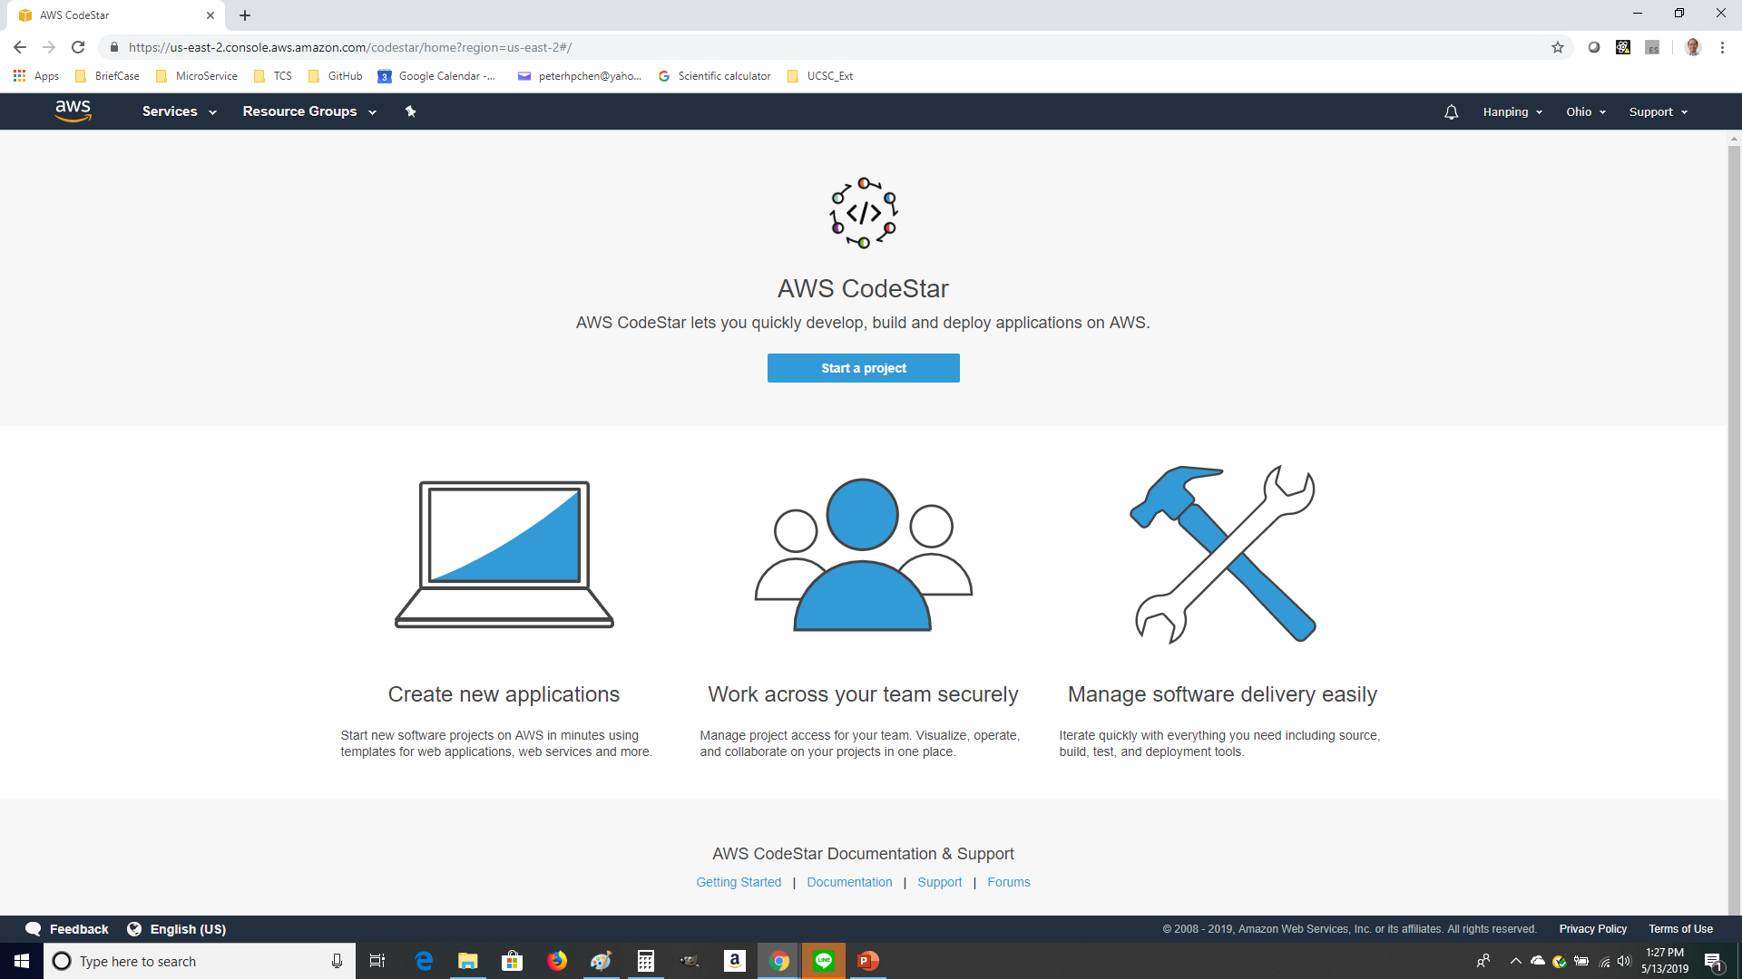
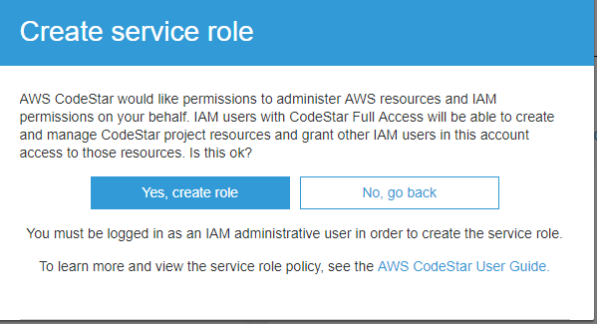
2 Deploy Web App
https://www.youtube.com/watch?v=jtyk_2_f3d0&list=PLsyeobzWxl7rM-MltvxjUa-2LSgAhA11v&index=2
AWS CodeStar: Click on “Start a project”

Slide 7
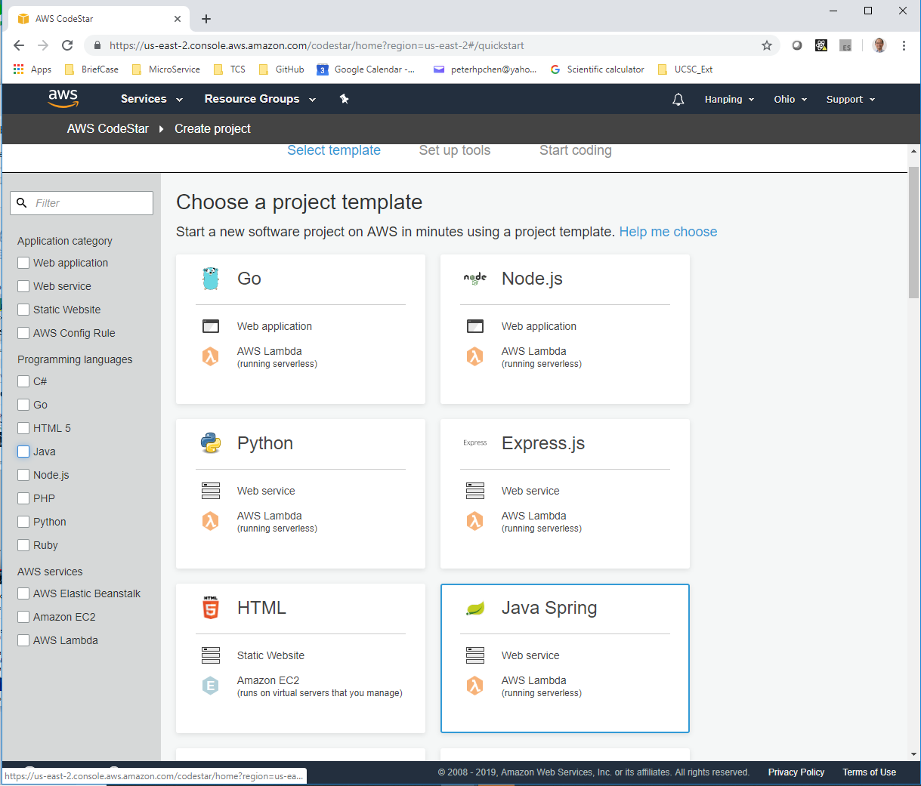
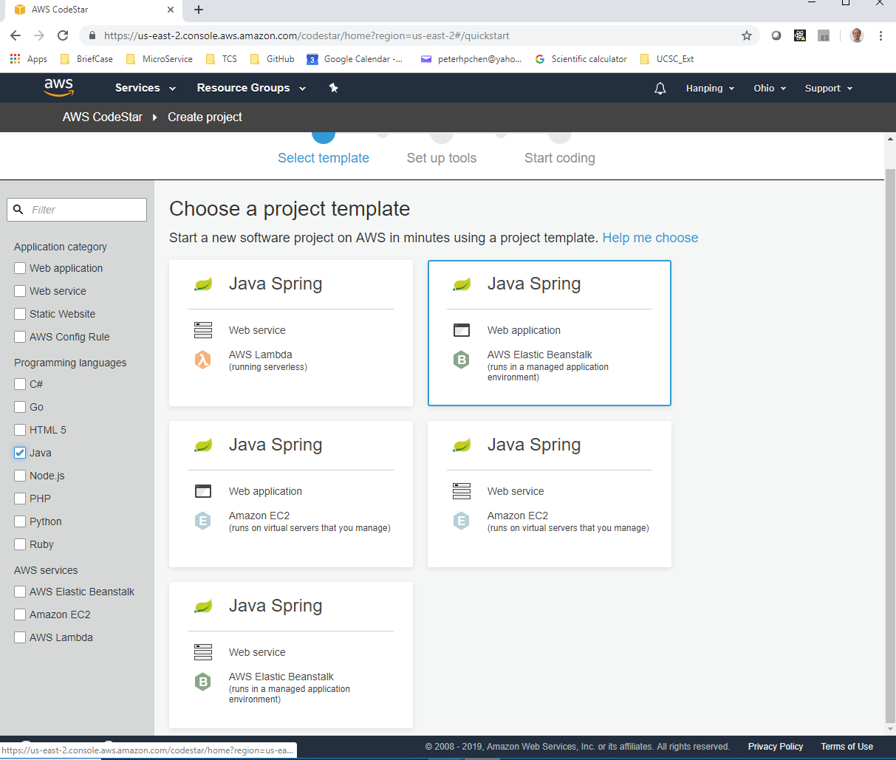
2 Deploy Web App
https://www.youtube.com/watch?v=jtyk_2_f3d0&list=PLsyeobzWxl7rM-MltvxjUa-2LSgAhA11v&index=2
The default gives you a lot of options.
Click Java, it gives you 5 options.

Slide 8
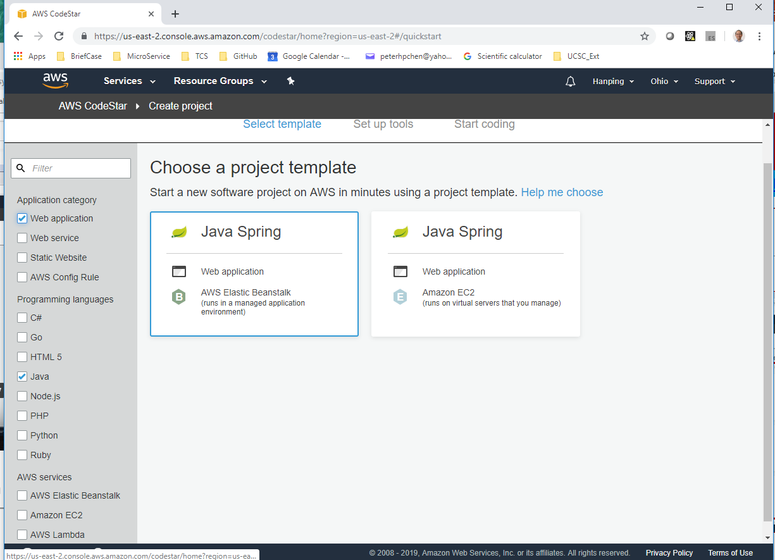
2 Deploy Web App
https://www.youtube.com/watch?v=jtyk_2_f3d0&list=PLsyeobzWxl7rM-MltvxjUa-2LSgAhA11v&index=2
Then, we click Java and Web Application, we have 2 options “Beanstalk and JavaSprint”.
In this section, we use “Beanstak”. Just click Beanstalk.

Slide 9
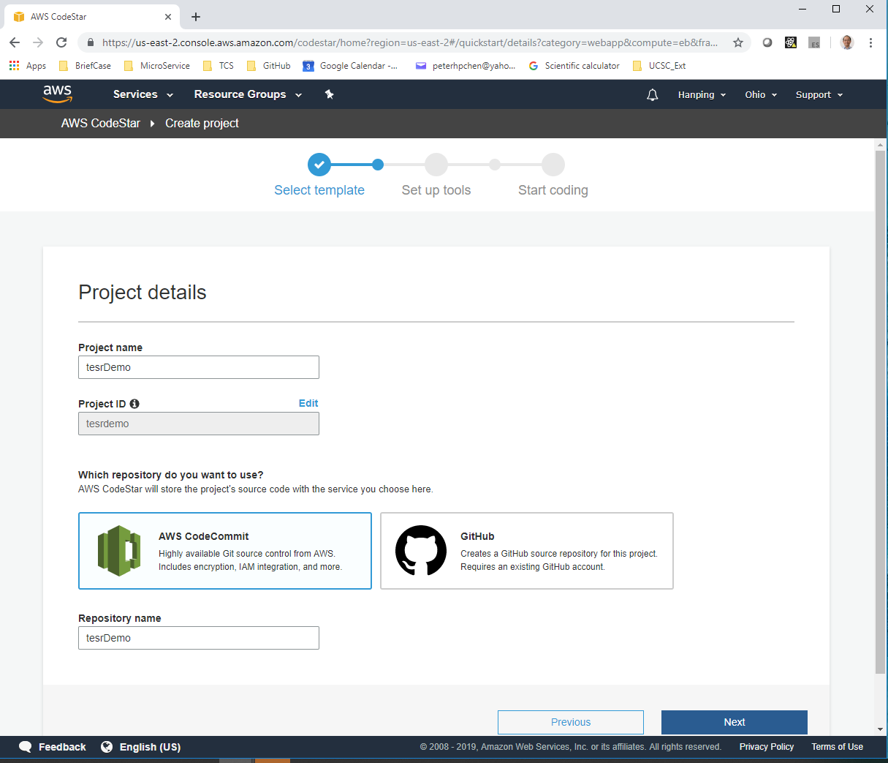
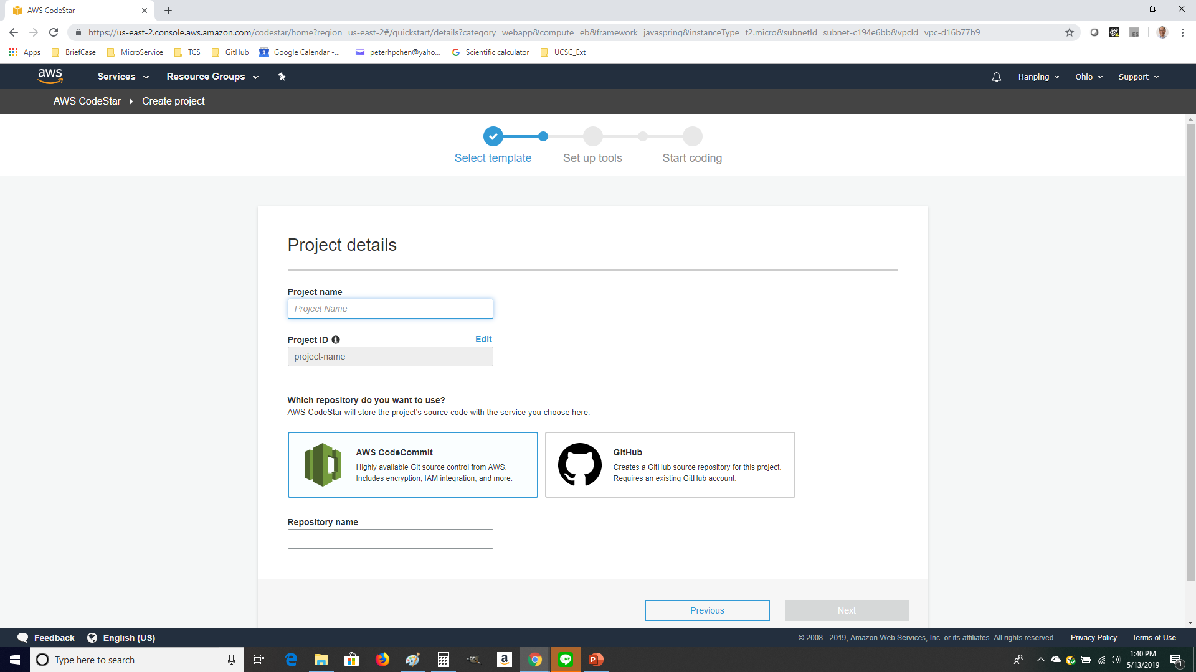
2 Deploy Web App
https://www.youtube.com/watch?v=jtyk_2_f3d0&list=PLsyeobzWxl7rM-MltvxjUa-2LSgAhA11v&index=2
Then, give the project name “testDemo”.
We have two choice on AWS CodeCommit and GitHub. Since we use AWS, we pick up the AWS CodeCommit.

Slide 10
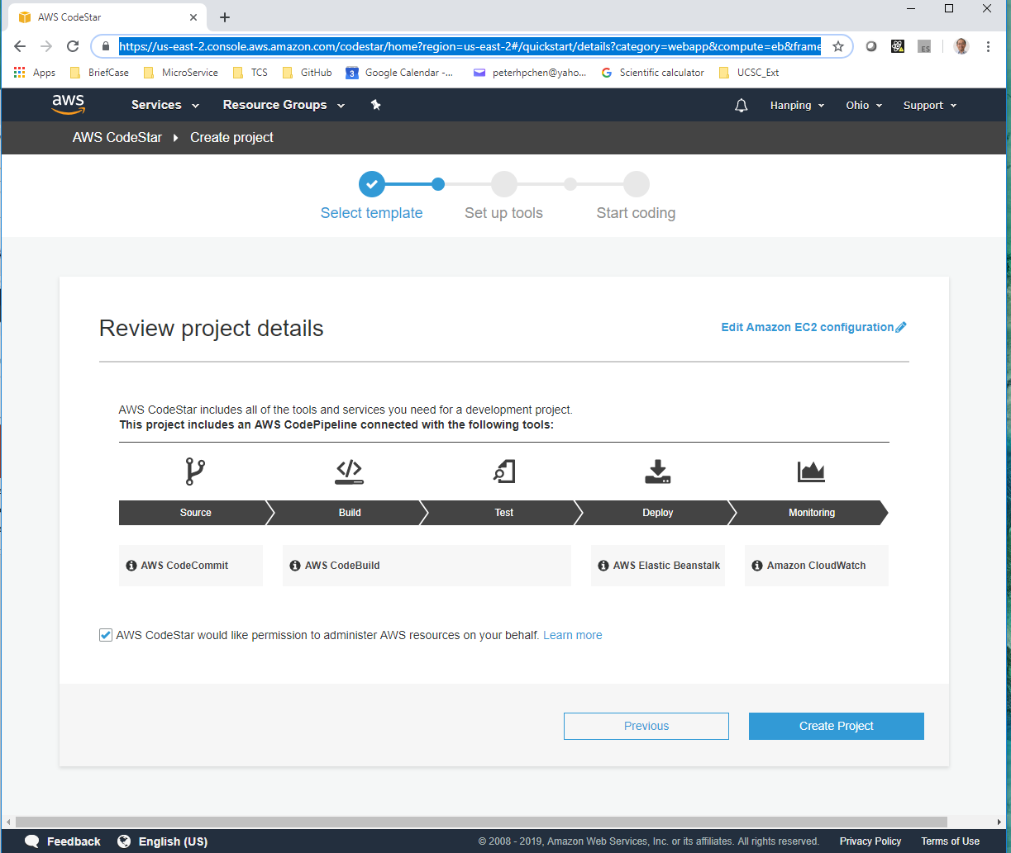
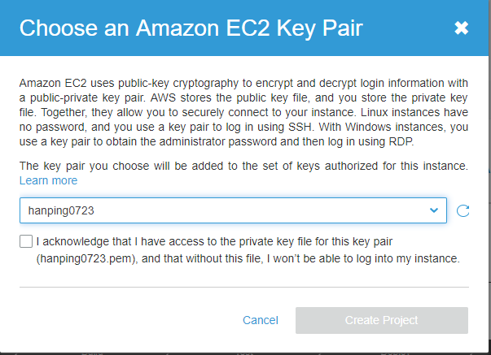
2 Deploy Web App
https://www.youtube.com/watch?v=jtyk_2_f3d0&list=PLsyeobzWxl7rM-MltvxjUa-2LSgAhA11v&index=2
Create Project.

Slide 11
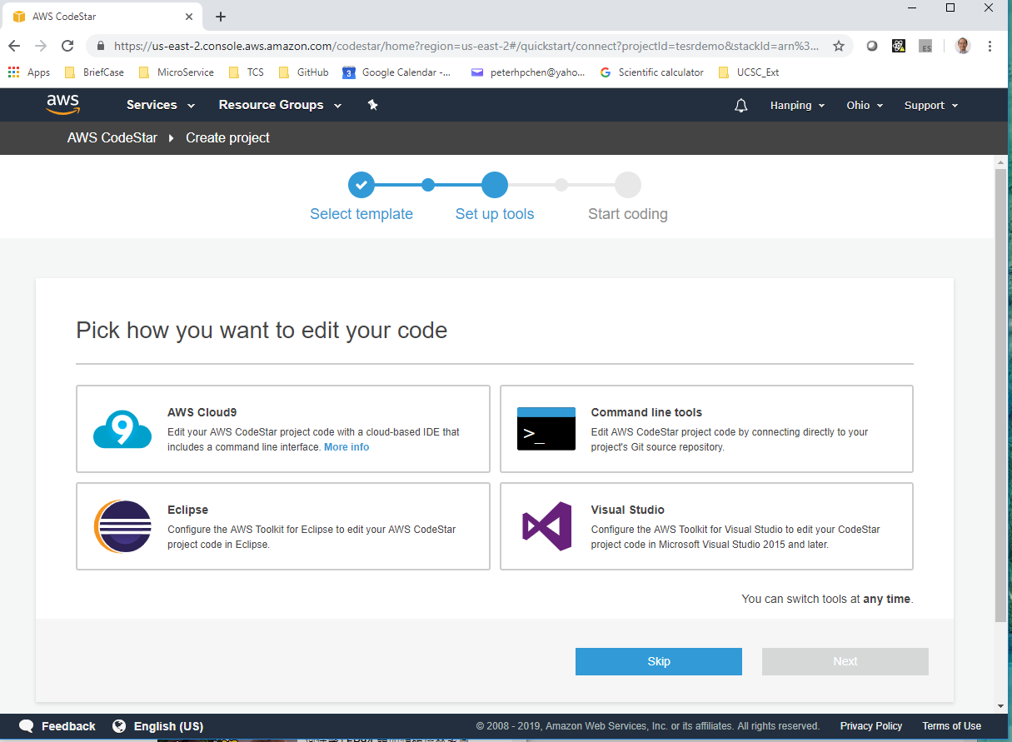
2 Deploy Web App
https://www.youtube.com/watch?v=jtyk_2_f3d0&list=PLsyeobzWxl7rM-MltvxjUa-2LSgAhA11v&index=2
Skip the selections.

Slide 12
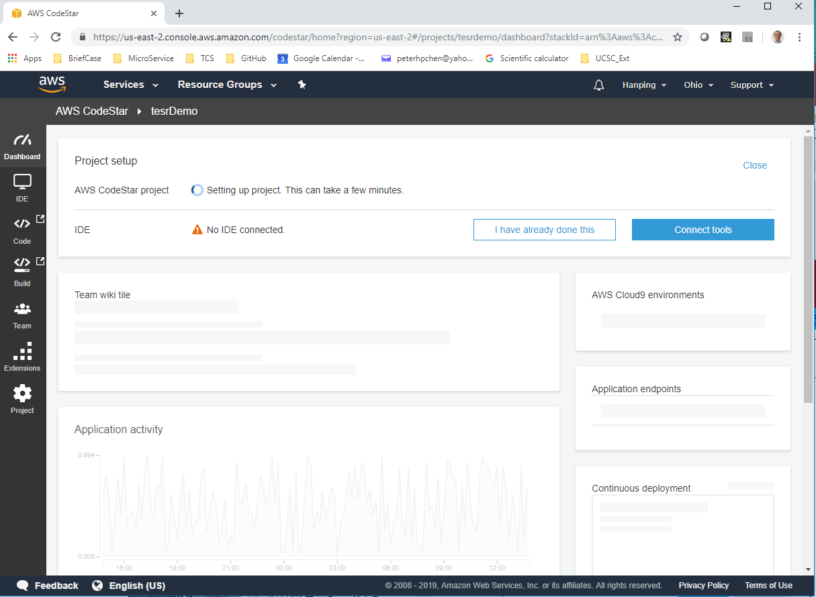
2 Deploy Web App
https://www.youtube.com/watch?v=jtyk_2_f3d0&list=PLsyeobzWxl7rM-MltvxjUa-2LSgAhA11v&index=2
Skip the selections.

Slide 13
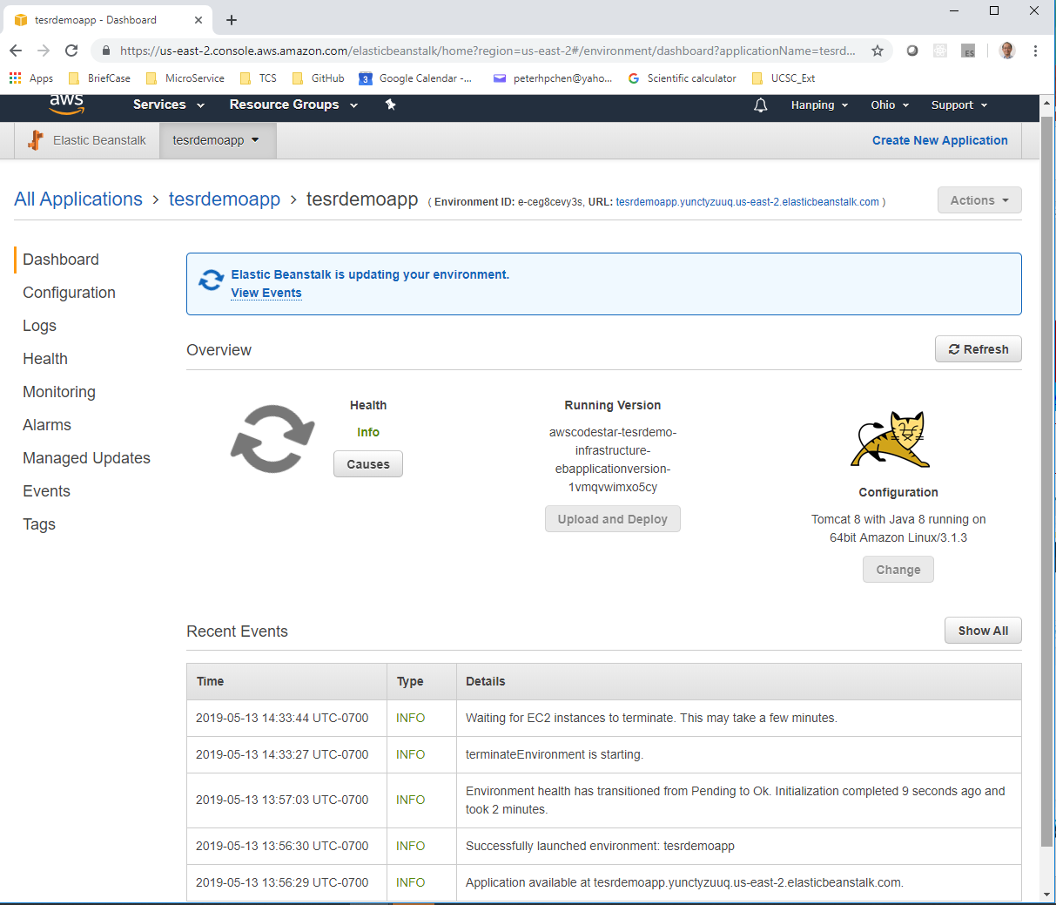
2 Deploy Web App
https://www.youtube.com/watch?v=jtyk_2_f3d0&list=PLsyeobzWxl7rM-MltvxjUa-2LSgAhA11v&index=2
Terminate the application after done.

Slide 14
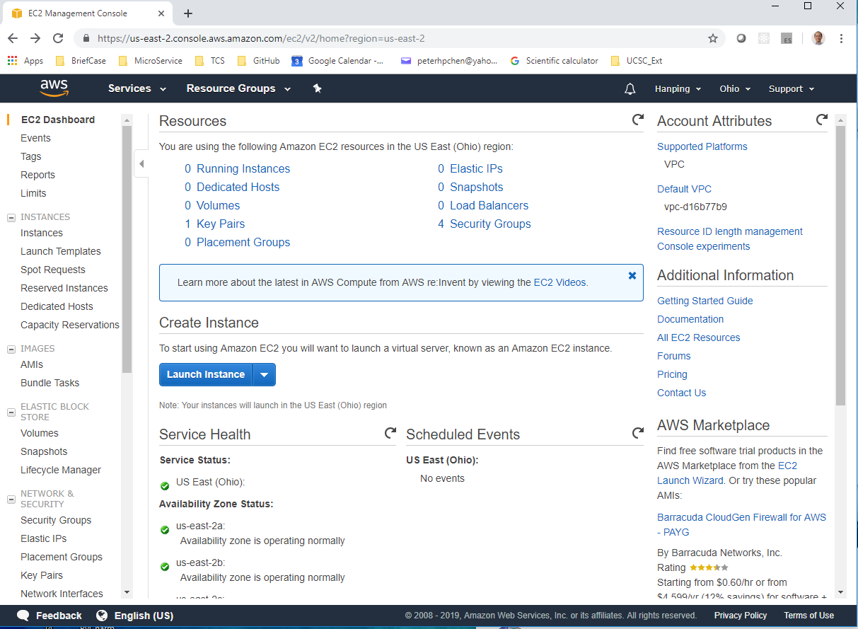
2 Deploy Web App
https://www.youtube.com/watch?v=jtyk_2_f3d0&list=PLsyeobzWxl7rM-MltvxjUa-2LSgAhA11v&index=2
Go to EC2. Make sure the all the instances are terminated.

Slide 15
End of Chapter

