Slide 1
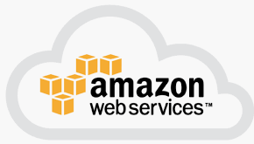
1 AWS
Peter H. Chen

Slide 2
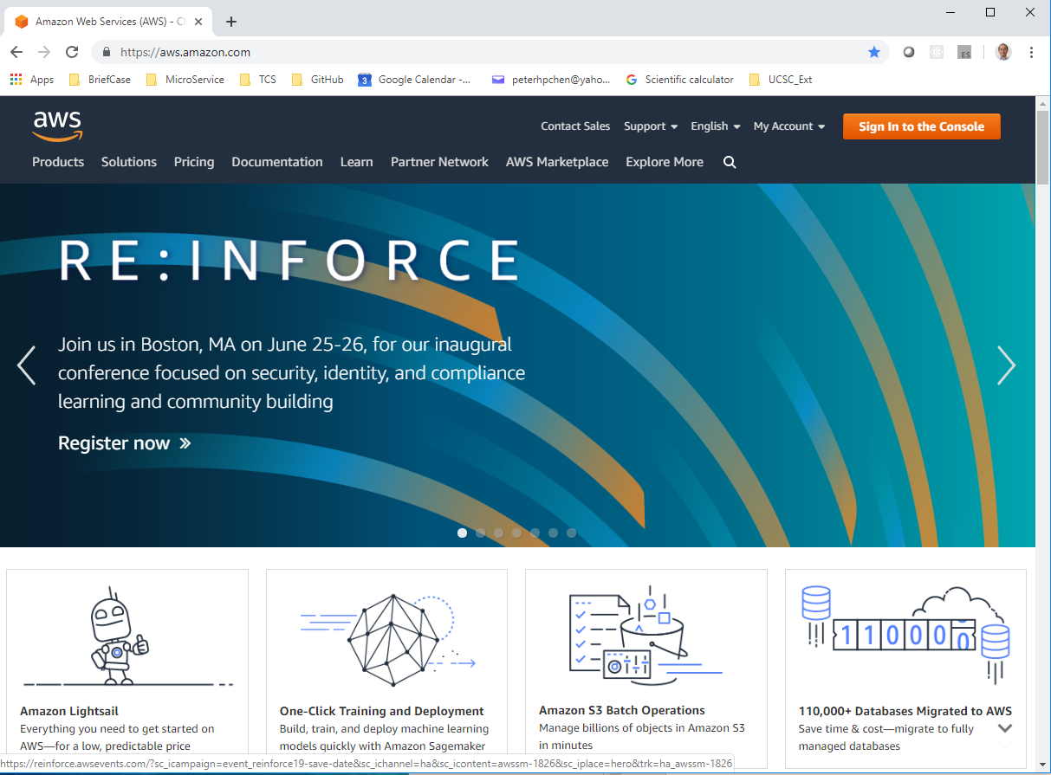
1.1 AWS
https://www.youtube.com/watch?v=LvcNFmtks5k&list=PLsyeobzWxl7rM-MltvxjUa-2LSgAhA11v&index=1
How to get a free account on AWS (Amazon Web Service)?
Go to: aws.amazon.com

Slide 3
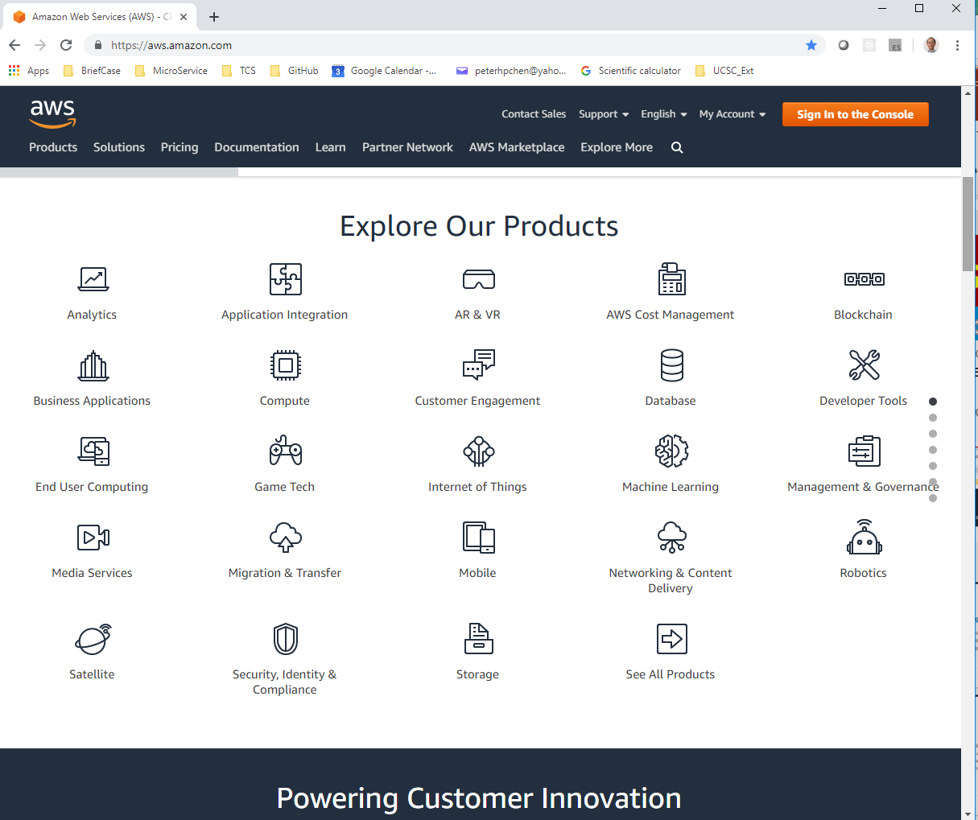
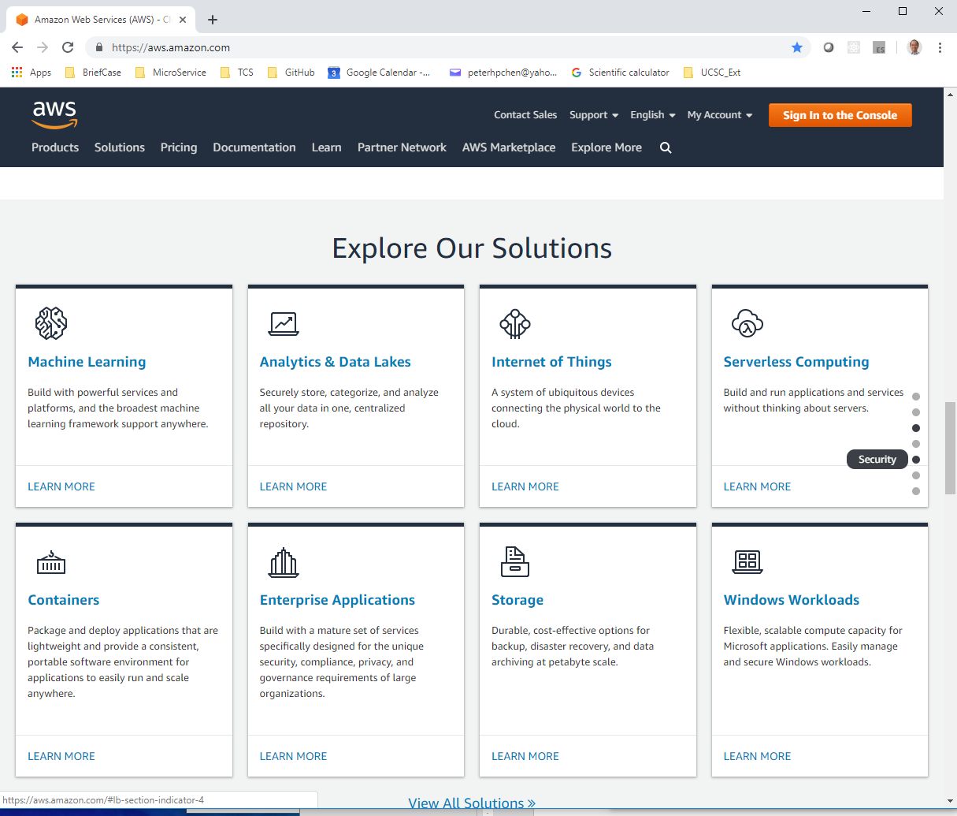
1.1 AWS
https://www.youtube.com/watch?v=LvcNFmtks5k&list=PLsyeobzWxl7rM-MltvxjUa-2LSgAhA11v&index=1
Scroll the aws.amazon.com page. You can see so many services and product here.
It will Take more than 10 years to learn all of them.
We do not need all of them. We just need one of them to deploy our project.

Slide 4
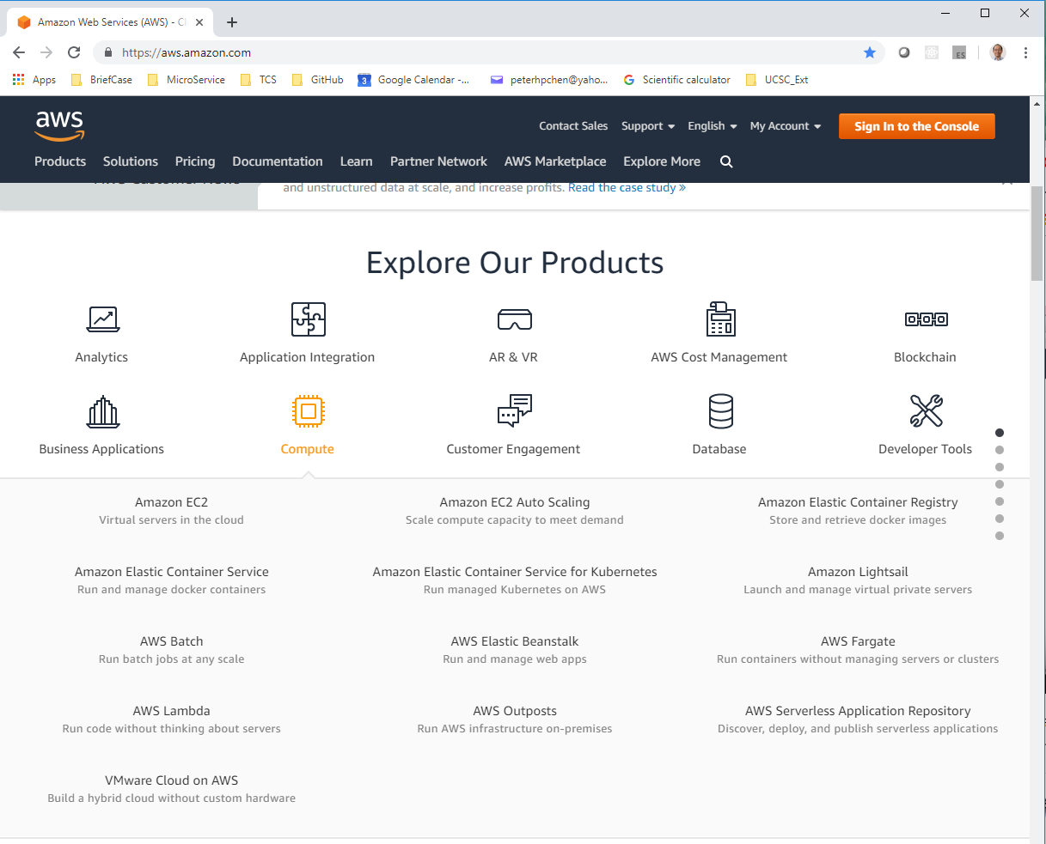
1.1 AWS
https://www.youtube.com/watch?v=LvcNFmtks5k&list=PLsyeobzWxl7rM-MltvxjUa-2LSgAhA11v&index=1
Amazon provides services for Mobile, AI, IOT, Database, Web Application.
The first group is Compute. Inside Compute, the firs one is EC2. EC2 stands for Elastic Cloud Computing.

Slide 5
1.1 AWS
https://www.youtube.com/watch?v=LvcNFmtks5k&list=PLsyeobzWxl7rM-MltvxjUa-2LSgAhA11v&index=1
AWS provides you the virtual services instead of having your own server. You can buy a server and you can install the OS on server. Instead of doing that, you can use a virtual server.
If you want to run some services to deploy your web application, you can use AWS Elastic Beanstalk.
On AWS Elastic Beanstalk, you can deploy your web application.

Slide 6
1.1 AWS
https://www.youtube.com/watch?v=LvcNFmtks5k&list=PLsyeobzWxl7rM-MltvxjUa-2LSgAhA11v&index=1
AWS EC2 is basically the server.
AWS Beanstalk is used to deploy the web application.
You can image AWS Beanstalk actually work on EC2.
Because AWS EC2 is a service provider. There are so many services that you don’t need all of the services.
In this discussion, we only use AWS EC2 and AWS Elastic Beanstalk.

Slide 7
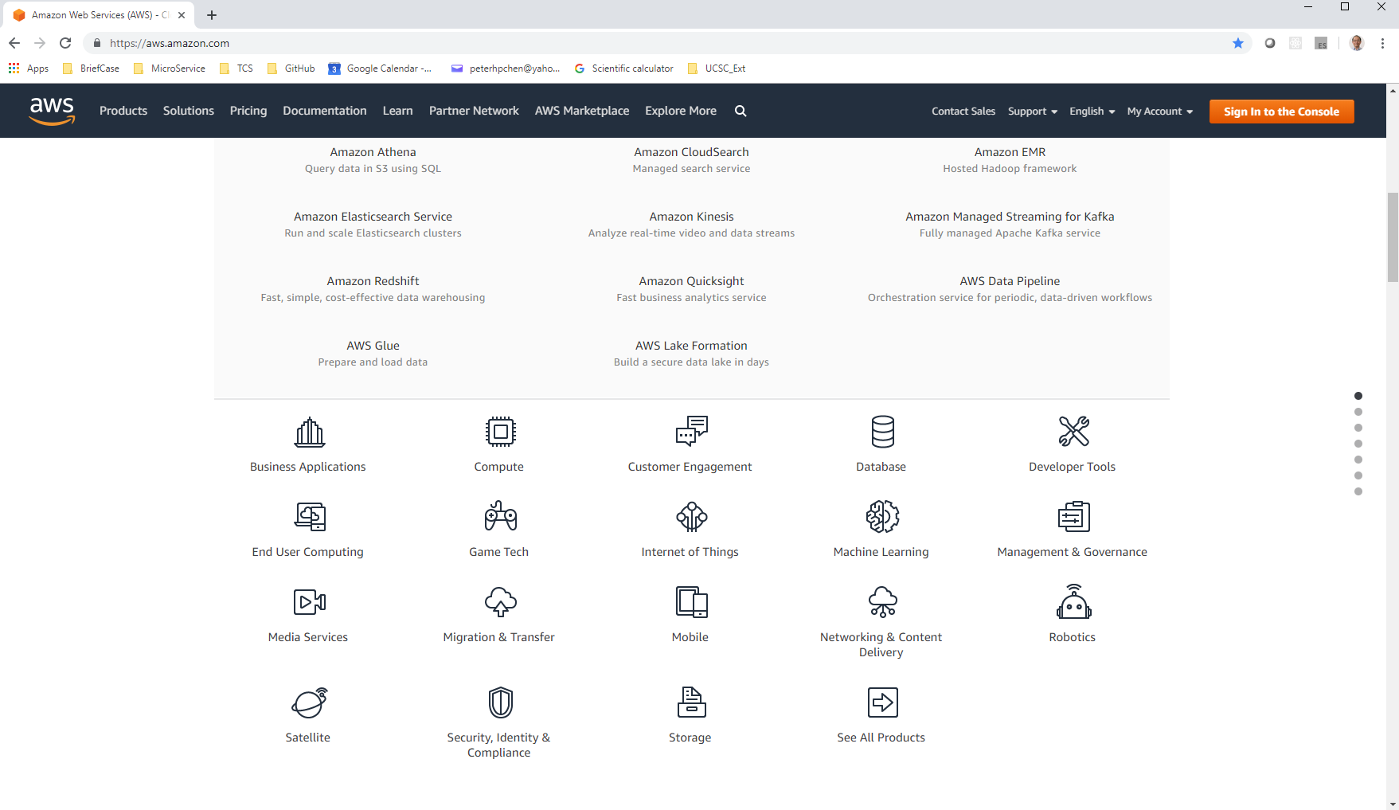
1.1 AWS
https://www.youtube.com/watch?v=LvcNFmtks5k&list=PLsyeobzWxl7rM-MltvxjUa-2LSgAhA11v&index=1
If you are the developer and you want a specific service.
You can click the Developer Tools Service.

Slide 8
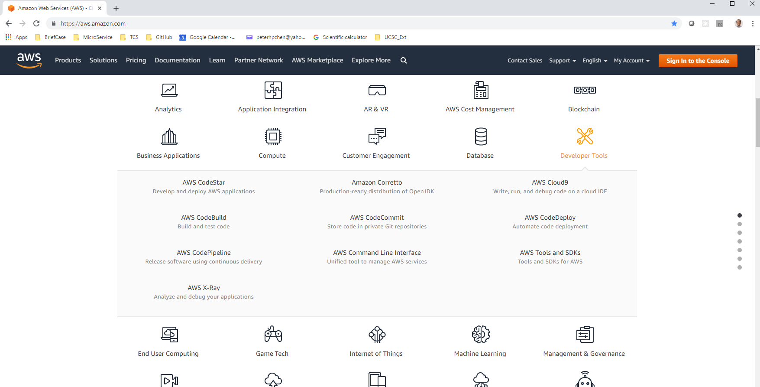
1.1 AWS
https://www.youtube.com/watch?v=LvcNFmtks5k&list=PLsyeobzWxl7rM-MltvxjUa-2LSgAhA11v&index=1
Inside the Developer Tools, we have AWS CodeStar that we are going to use.
AWS also have their own Git repository. GitHub have their own repository.
We will use AWS CodeStar, AWS CodeBuild, AWS CodeCommit, and AWS CodeDeploy for development.

Slide 9
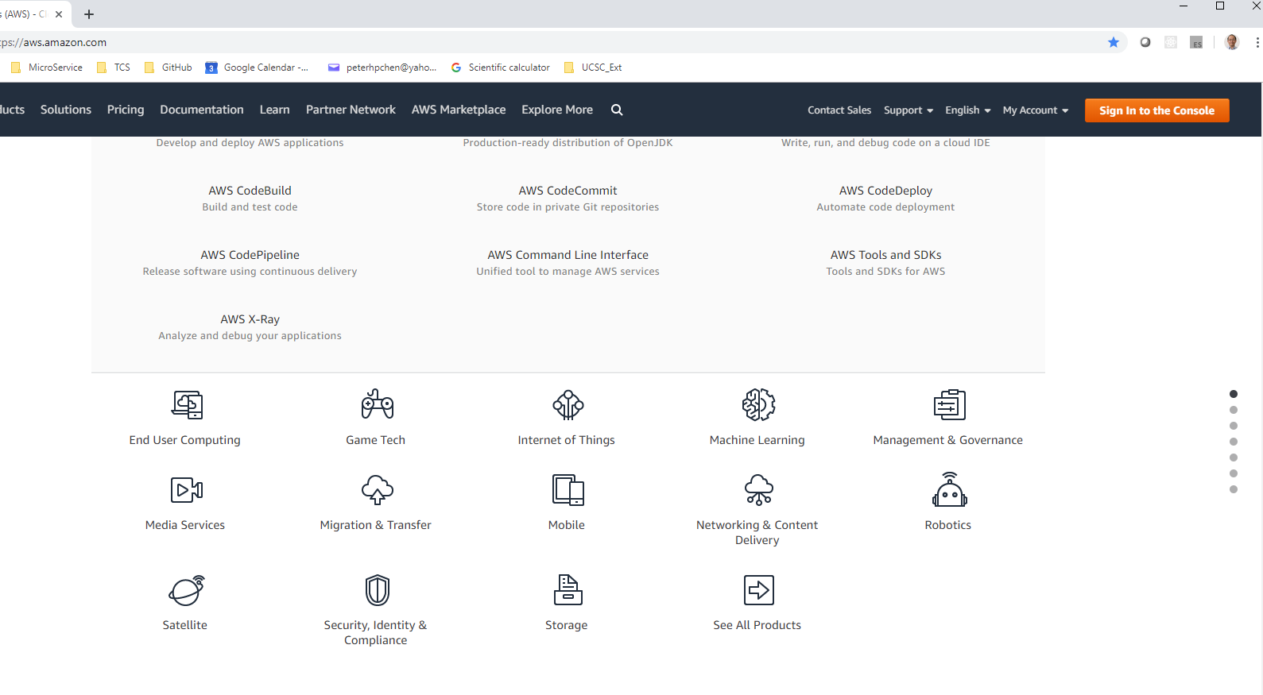
1.1 AWS
https://www.youtube.com/watch?v=LvcNFmtks5k&list=PLsyeobzWxl7rM-MltvxjUa-2LSgAhA11v&index=1
We will not discuss the IoT and Mobile in this document but these are important and worth to look at as well.
AWS provides you the free service for one year. You can explore them for one year.
You can explore, implement, and get certificate for them in one year.

Slide 10
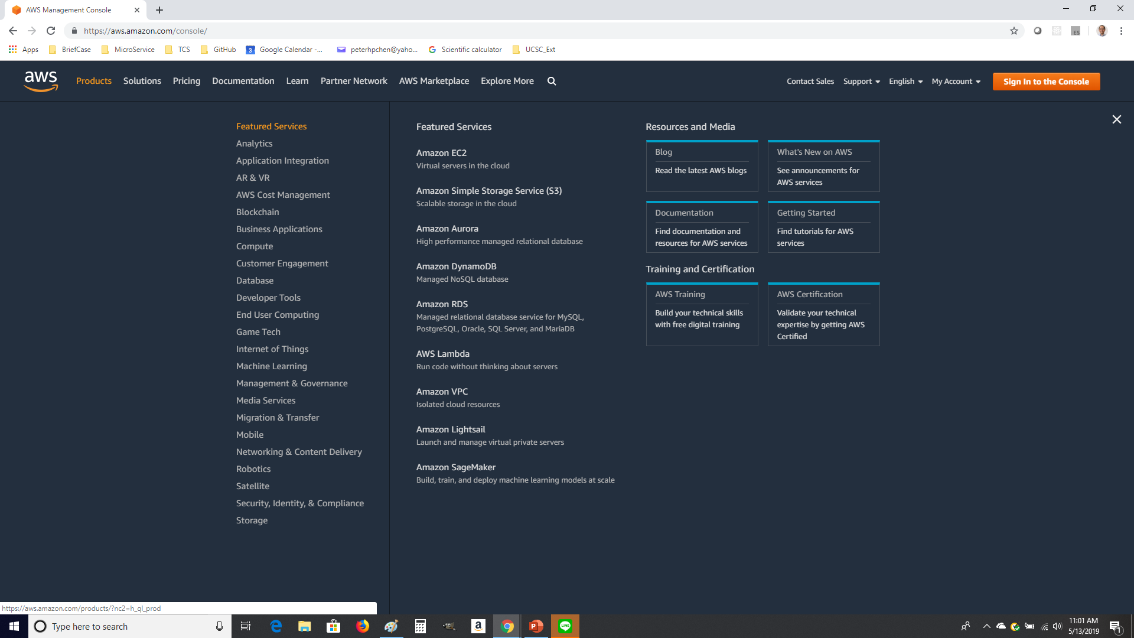
1.1 AWS
https://www.youtube.com/watch?v=LvcNFmtks5k&list=PLsyeobzWxl7rM-MltvxjUa-2LSgAhA11v&index=1
These are the AWS Products.

Slide 11
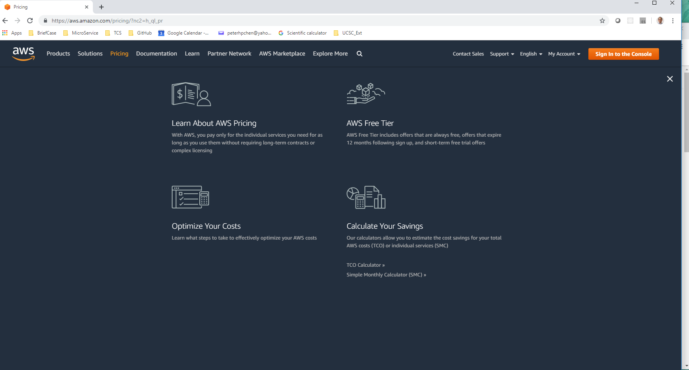
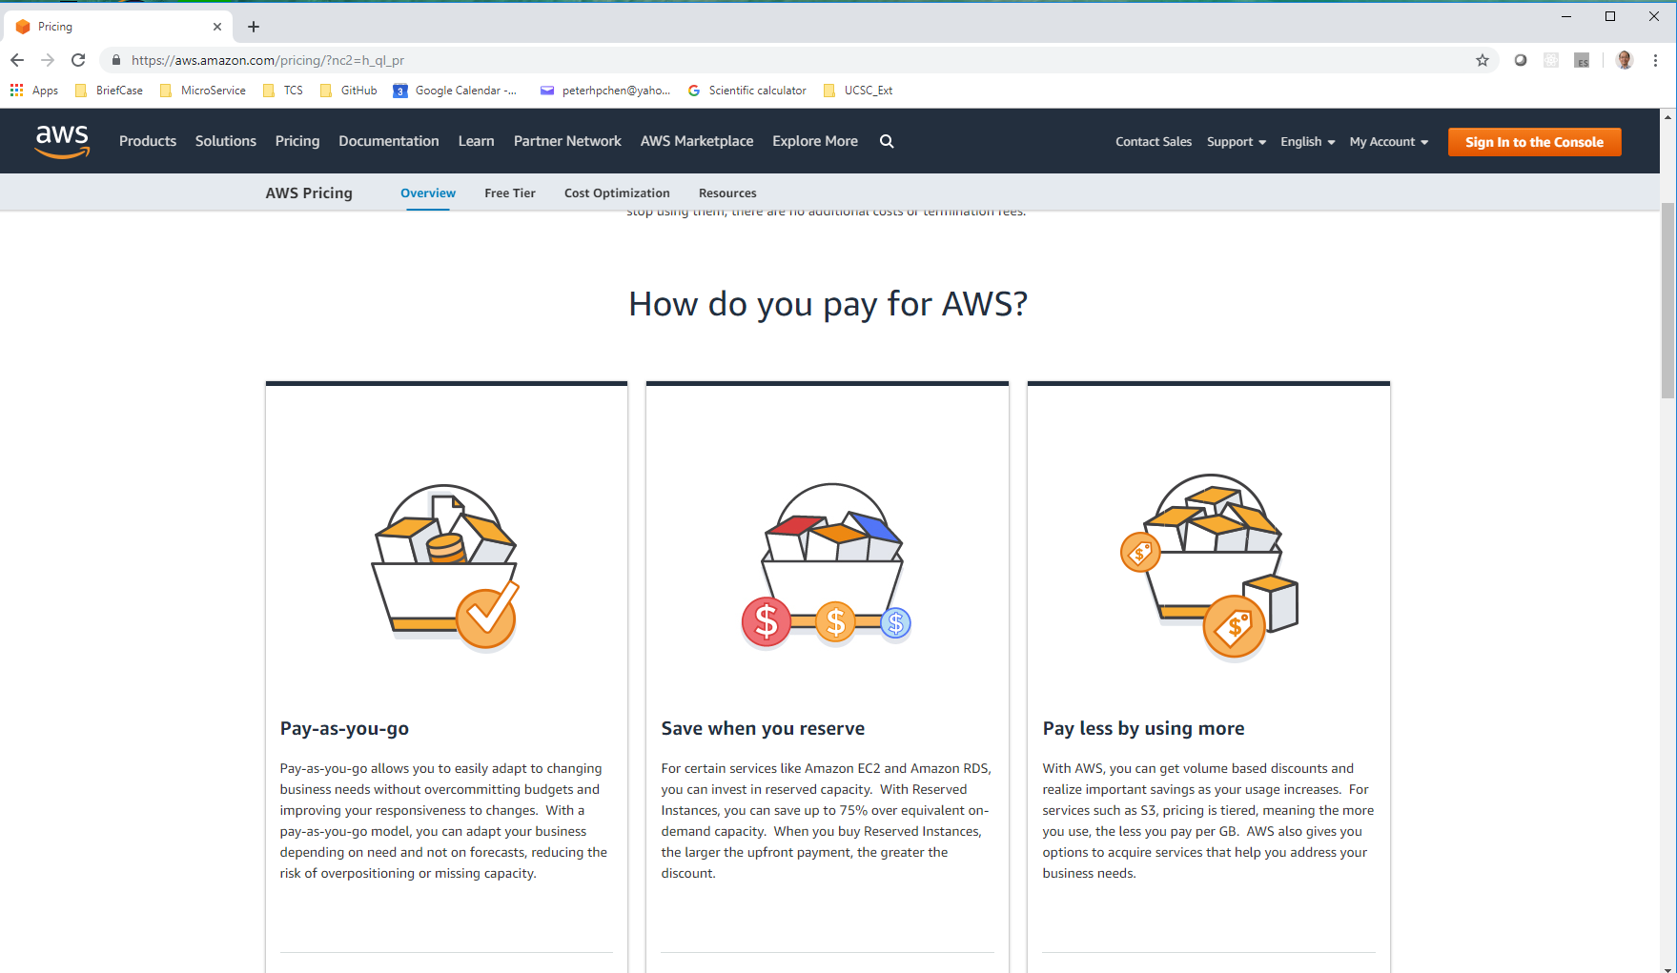
1.1 AWS
https://www.youtube.com/watch?v=LvcNFmtks5k&list=PLsyeobzWxl7rM-MltvxjUa-2LSgAhA11v&index=1
Click Pricing tab.
Click “Learn About AWS Pricing”

Slide 12
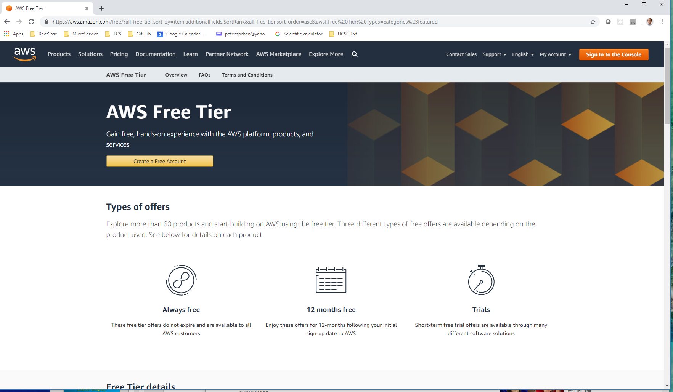
1.1 AWS
https://www.youtube.com/watch?v=LvcNFmtks5k&list=PLsyeobzWxl7rM-MltvxjUa-2LSgAhA11v&index=1
Click “Free Tier”

Slide 13
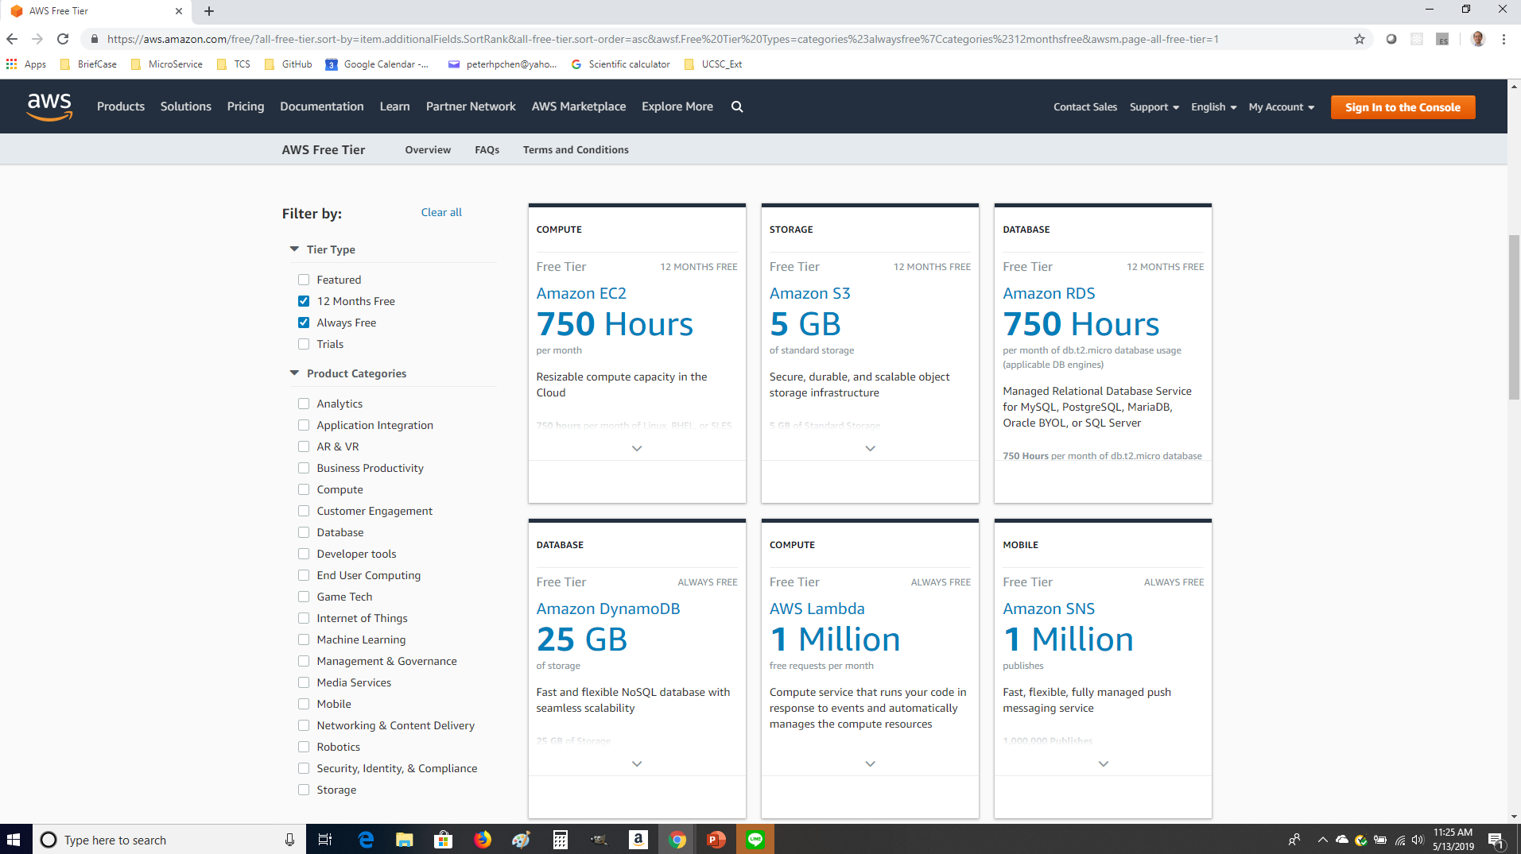
1.1 AWS
https://www.youtube.com/watch?v=LvcNFmtks5k&list=PLsyeobzWxl7rM-MltvxjUa-2LSgAhA11v&index=1
Check with Tier Type: 12 Months Free and Always Free.
We concern the EC2, Amazon RDS, Beanstalk, and Developer Tools. EC2 is 12 months free and 750 hours free for one CPU running. For two CPU, it become 750/2 = 375 hours.

Slide 14
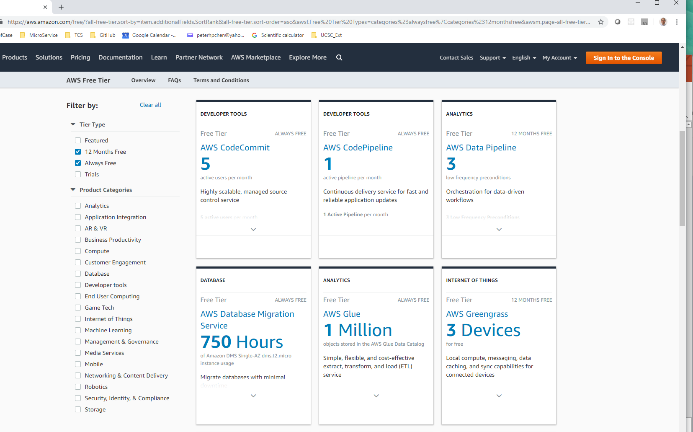
1.1 AWS
https://www.youtube.com/watch?v=LvcNFmtks5k&list=PLsyeobzWxl7rM-MltvxjUa-2LSgAhA11v&index=1
We need AWS CodeCommit, Code .

Slide 15
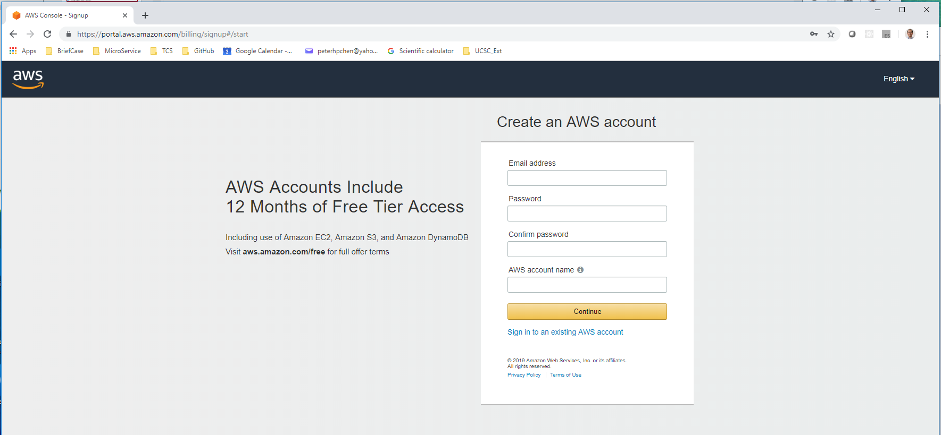
1.1 AWS
https://www.youtube.com/watch?v=LvcNFmtks5k&list=PLsyeobzWxl7rM-MltvxjUa-2LSgAhA11v&index=1
We can create an account for 12 months Free Tier Service.
You need the user name, email id, and credit card number.
Remember do not cross 750 hours limit to avoid the charge.

Slide 16
End of Chapter

