Slide 1

3 Practical
Peter H. Chen

Slide 2
3 Practical
https://www.youtube.com/watch?v=uEYjXpMDJiU&list=PLsyeobzWxl7rFkYFysfTwBu1JBPaNNDrk&index=3
This section discusses the practical implementation of Maven.
Quick review: What is Maven?
Maven is a build tool. If you want to create a project and you want some project structure, compile your application, test your application, and etc. Maven gives you all the required libraries.
If you use Spring or Hibernate, you need some dependencies which is libraries.

Slide 3
3.1 Spring.io Web Site

Slide 4
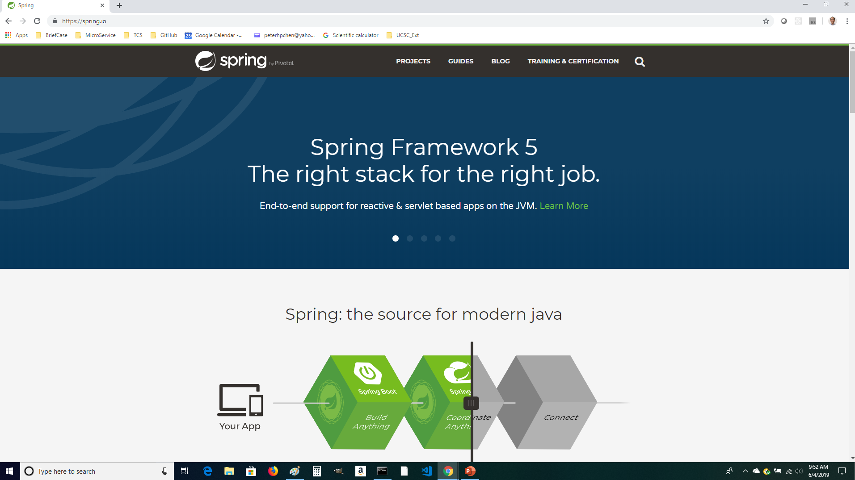
3.1 Spring.io Web Site
https://www.youtube.com/watch?v=uEYjXpMDJiU&list=PLsyeobzWxl7rFkYFysfTwBu1JBPaNNDrk&index=3
To use these libraries, you have to go to a website “spring.io”.

Slide 5
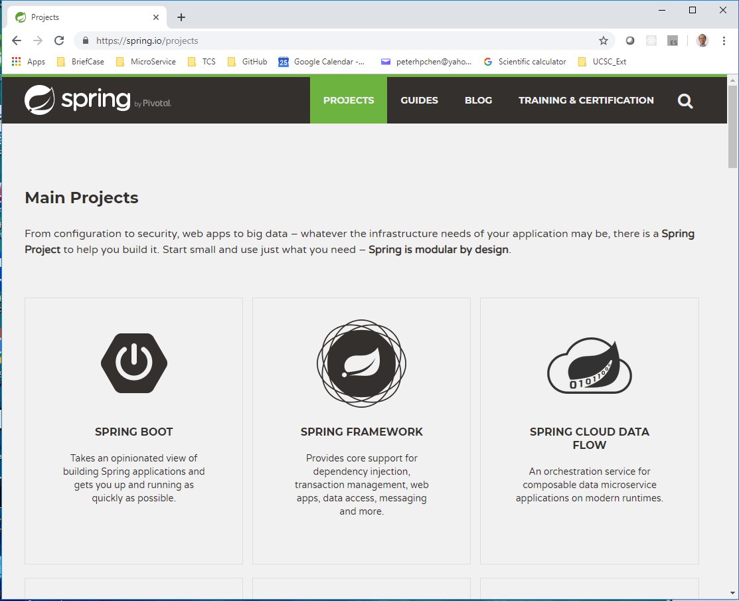
3.1 Spring.io Web Site
https://www.youtube.com/watch?v=uEYjXpMDJiU&list=PLsyeobzWxl7rFkYFysfTwBu1JBPaNNDrk&index=3
Click the Projects. You can see Spring provides a lot of frameworks.
Click “Spring Framework”. There is Quick Start which is “Spring Boot”

Slide 6
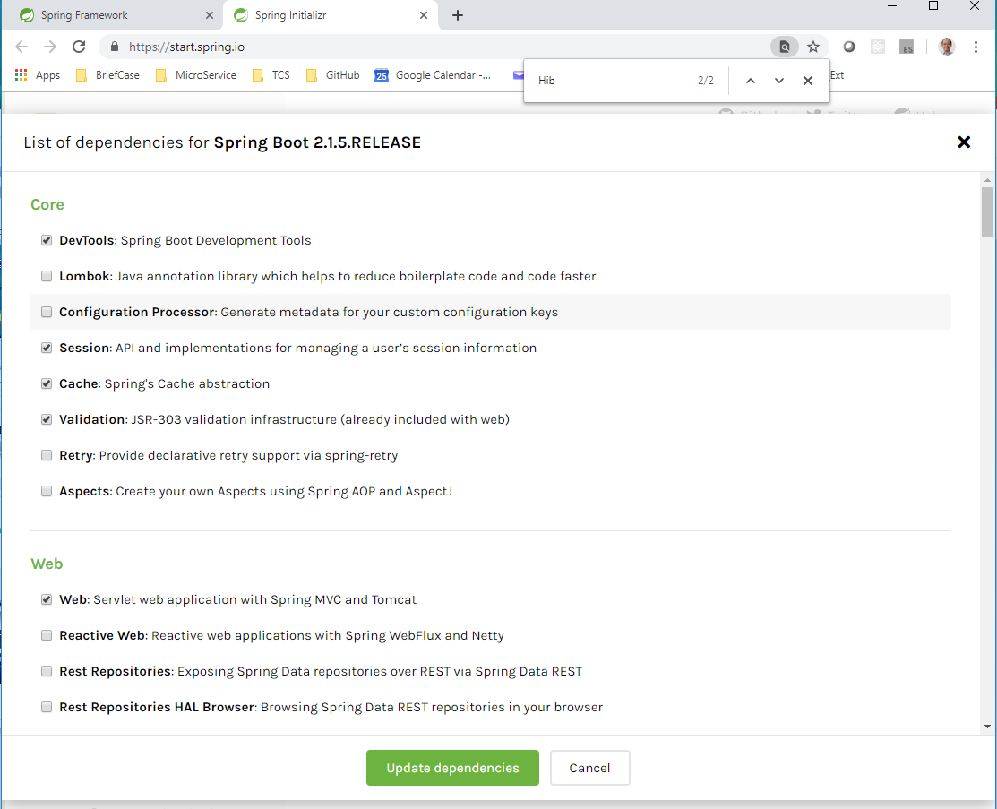
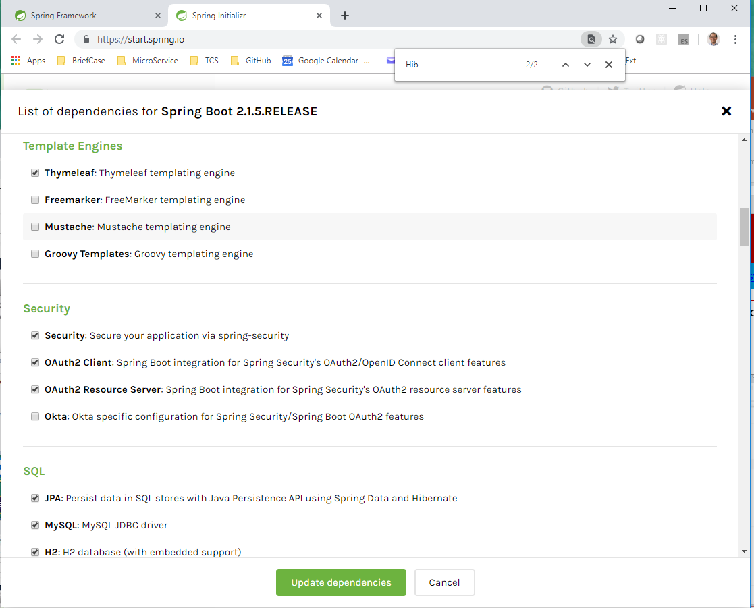
3.1 Spring.io Web Site
https://www.youtube.com/watch?v=uEYjXpMDJiU&list=PLsyeobzWxl7rFkYFysfTwBu1JBPaNNDrk&index=3
Select the required dependencies and download them.

Slide 7
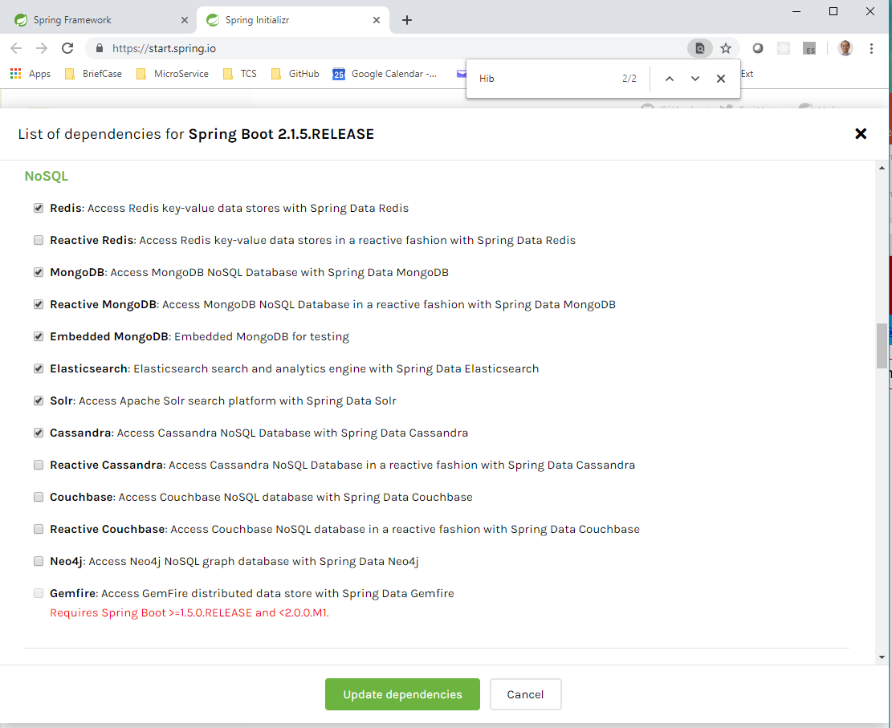
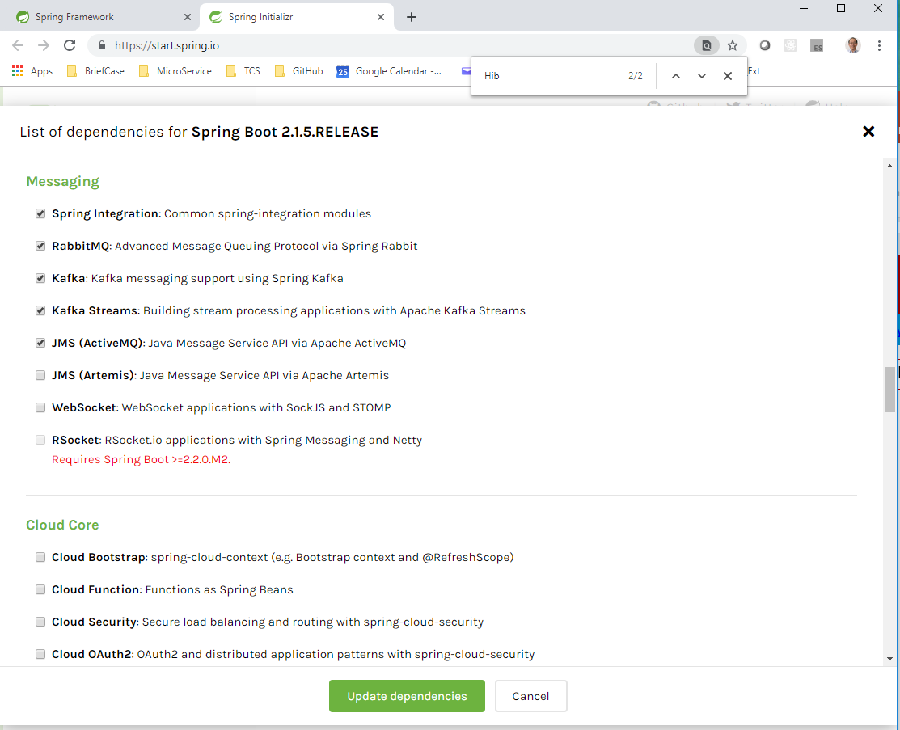
3.1 Spring.io Web Site
https://www.youtube.com/watch?v=uEYjXpMDJiU&list=PLsyeobzWxl7rFkYFysfTwBu1JBPaNNDrk&index=3
Select the required dependencies and download them.

Slide 8
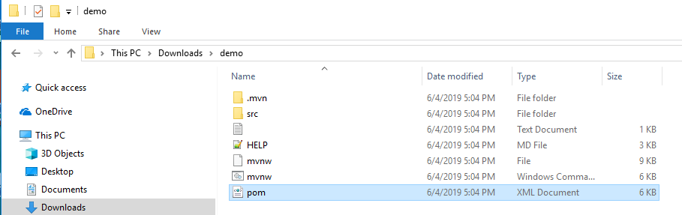
3.1 Spring.io Web Site
https://www.youtube.com/watch?v=uEYjXpMDJiU&list=PLsyeobzWxl7rFkYFysfTwBu1JBPaNNDrk&index=3
The dem.zip contains the Spring dependency libraries.

Slide 9
3.2 Create Maven Project

Slide 10
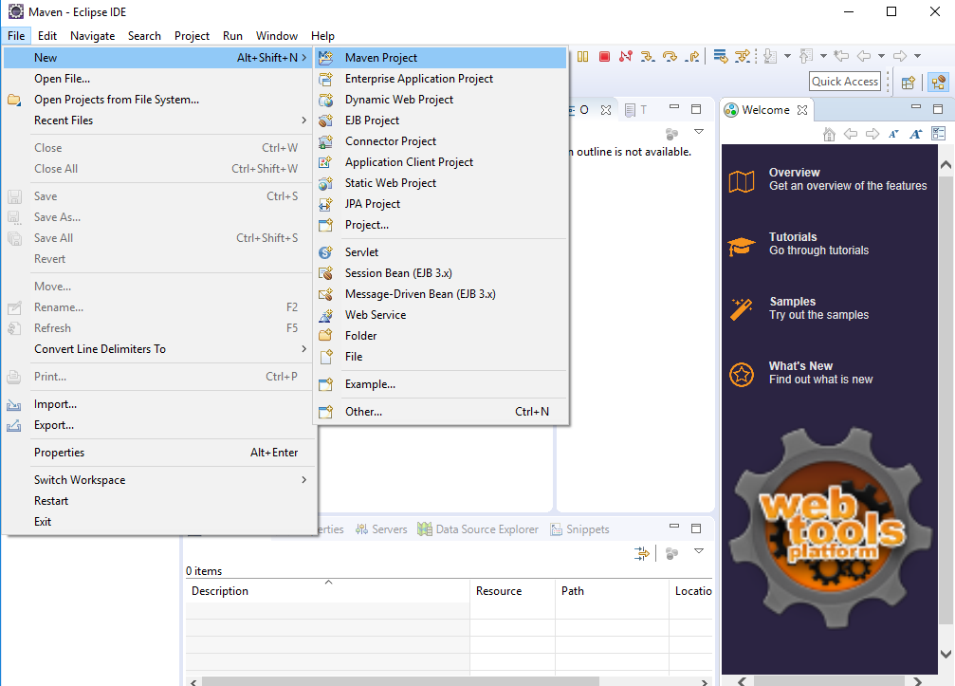
3.2 Create Maven Project
https://www.youtube.com/watch?v=uEYjXpMDJiU&list=PLsyeobzWxl7rFkYFysfTwBu1JBPaNNDrk&index=3
Start Eclipse/JEE, File > New > Maven Project.

Slide 11
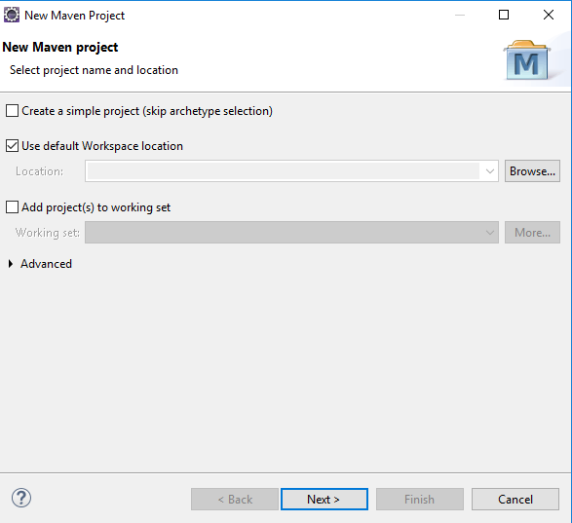
3.2 Create Maven Project
https://www.youtube.com/watch?v=uEYjXpMDJiU&list=PLsyeobzWxl7rFkYFysfTwBu1JBPaNNDrk&index=3
Click Next.

Slide 12
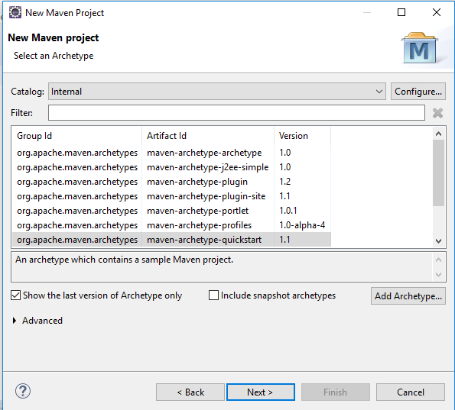
3.2 Create Maven Project
https://www.youtube.com/watch?v=uEYjXpMDJiU&list=PLsyeobzWxl7rFkYFysfTwBu1JBPaNNDrk&index=3
There are lots of selection for Maven Archetype:
We select “Internal” for Catalog.
The “All Catalog” can show all the Maven dependencies in case your network have to firewall to block.
Archetype: Create template of sample project.
J2EE simple: Create template of J2EE.
Quickstart: Core Java Application.
Webapp: Create Web application.
We select Quickstart for Core Java Application.

Slide 13
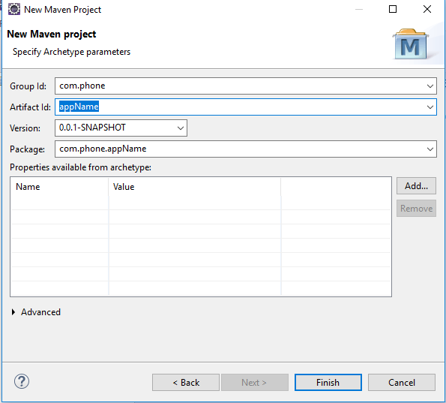
3.2 Create Maven Project
https://www.youtube.com/watch?v=uEYjXpMDJiU&list=PLsyeobzWxl7rFkYFysfTwBu1JBPaNNDrk&index=3
Group Id: com.phone (Package Name)
Artifact Id: appName (Application Name)
Group Id: com.phone (Package Name)
Artifact Id: appName (Project Name)
Package: Package is the combination of Group Id and Artifact Id.

Slide 14
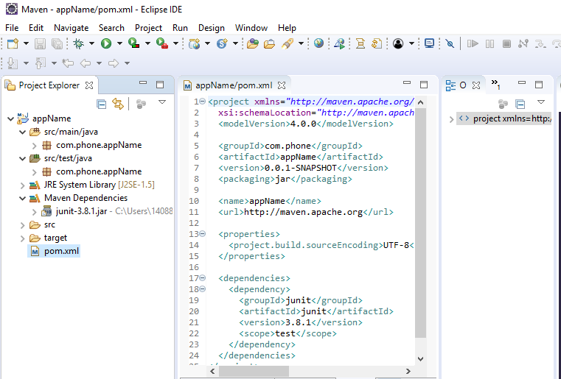
3.2 Create Maven Project
https://www.youtube.com/watch?v=uEYjXpMDJiU&list=PLsyeobzWxl7rFkYFysfTwBu1JBPaNNDrk&index=3
Java Project: appName
We have junit-3.8.1.jar from remote server.

Slide 15
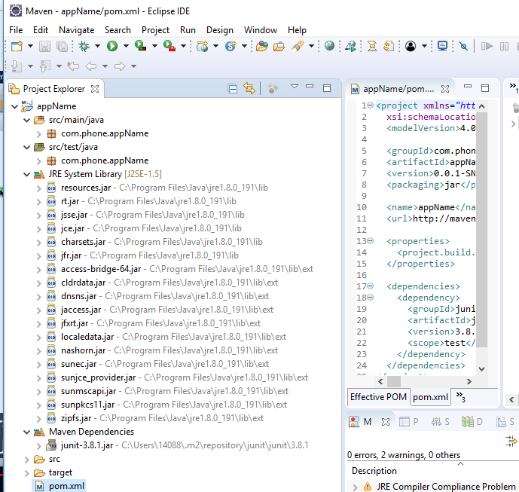
3.2 Create Maven Project
https://www.youtube.com/watch?v=uEYjXpMDJiU&list=PLsyeobzWxl7rFkYFysfTwBu1JBPaNNDrk&index=3
Maven creates two repositories: one is remote repository and the other one is local repository.
Remote repository is on remote server and local repository is one your machine.
The remote repository is automatically download and put in the “C:\users\14088\.m2” folder.

Slide 16
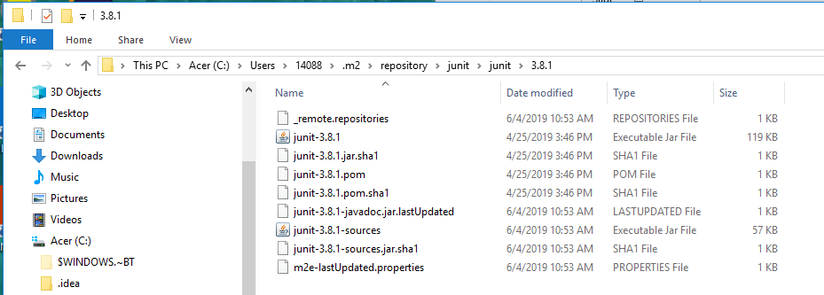
3.2 Create Maven Project
https://www.youtube.com/watch?v=uEYjXpMDJiU&list=PLsyeobzWxl7rFkYFysfTwBu1JBPaNNDrk&index=3
Open the file browser
Go to C:\Users\14088\.m2\repository\junit\junit\3.8.1
These are all from remote repository.
Those are the jar files loaded from remote repository and needed for junit.

Slide 17
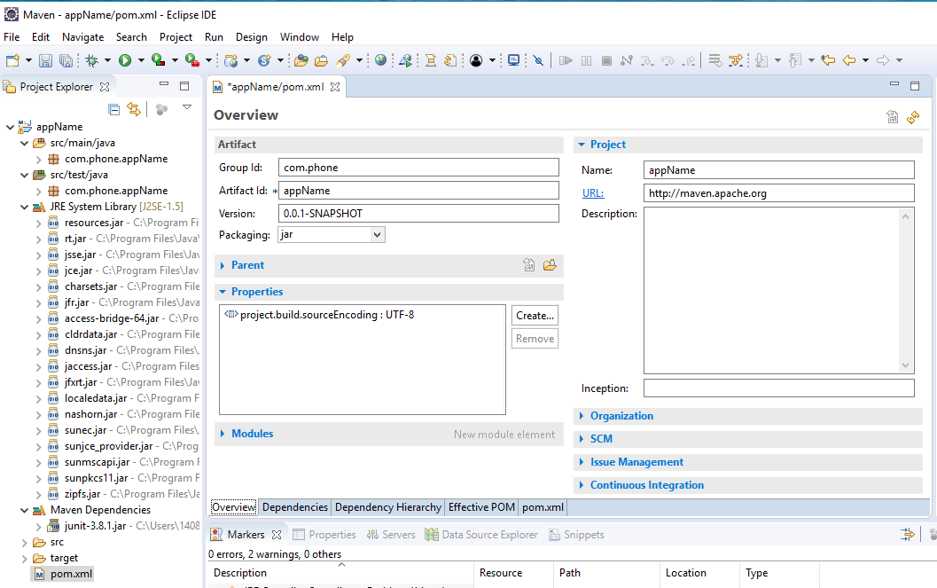
3.2 Create Maven Project
https://www.youtube.com/watch?v=uEYjXpMDJiU&list=PLsyeobzWxl7rFkYFysfTwBu1JBPaNNDrk&index=3
Click Tab Overview to see all the configuration.

Slide 18
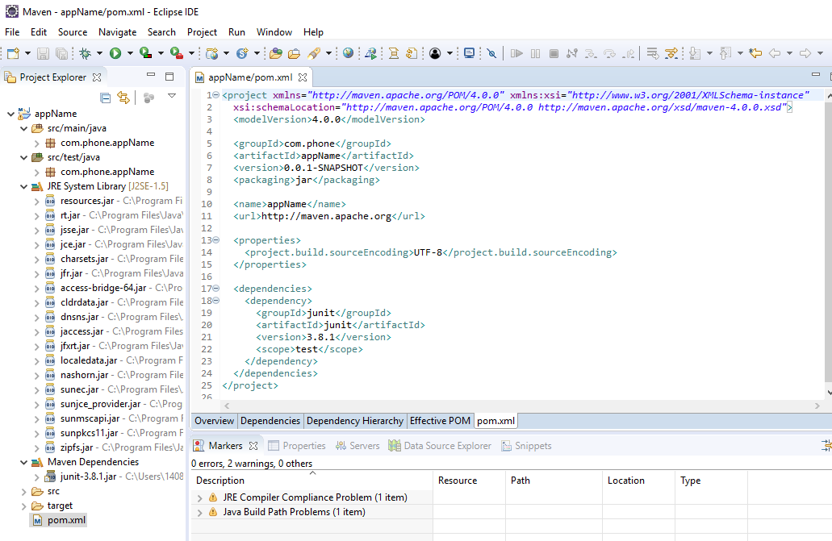
3.2 Create Maven Project
https://www.youtube.com/watch?v=uEYjXpMDJiU&list=PLsyeobzWxl7rFkYFysfTwBu1JBPaNNDrk&index=3
In appName Project, the pom.xml for Maven project is pom.xml
We can see project Id, artifact Id
The packaging is jar file. If you create the web app, it is war.
The junit version is 3.8.1.

Slide 19
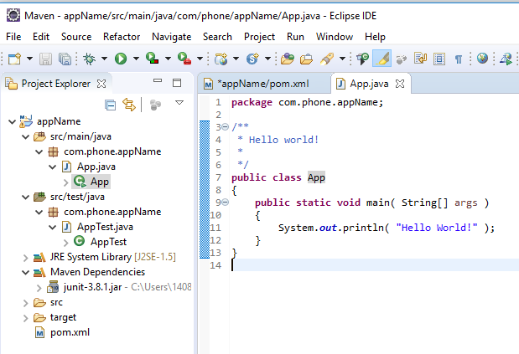
3.2 Create Maven Project
https://www.youtube.com/watch?v=uEYjXpMDJiU&list=PLsyeobzWxl7rFkYFysfTwBu1JBPaNNDrk&index=3
Click In src/…, find app.java

Slide 20
3.3 Update pom.xml

Slide 21
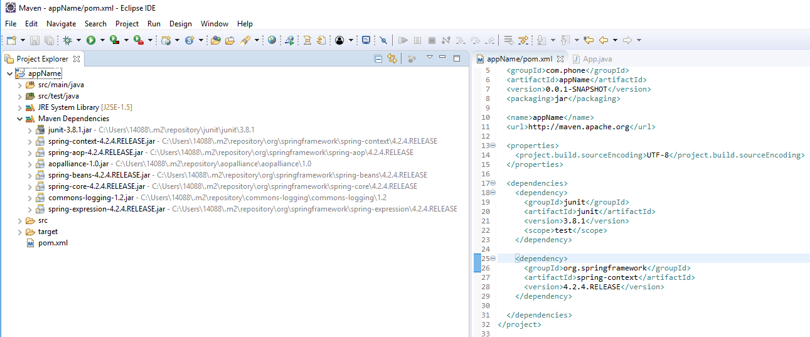
3.3 Update pom.xml
https://www.youtube.com/watch?v=uEYjXpMDJiU&list=PLsyeobzWxl7rFkYFysfTwBu1JBPaNNDrk&index=3
How to add more dependencies?
Add <dependency>
<artifactId>org.springframework<artifactId>
…
Save pom.xml and springframework will be automatically downloaded.

Slide 22
End of Chapter

